Slide 1


Electronic Hub
Presented By-
Prachi Santosh Shejwal (233062)
Shruti Fulchand Patil(233091)
Guided by-
Mrs. Gauri mam
http://www.free-powerpoint-templates-design.com

Slide 2
Points to be discussed
Screenshots
Specification
Conclusion
Introduction
Motivation
Future Enhancement
References
Advantages
S/W and H/W
Requirement
Objectives
UML Diagrams

Slide 3
Introduction:
Online Electronic shopping is the process whereby consumers directly buy goods, services etc. from a seller interactively in real-time without an intermediary service over the internet.
Online shopping is the process of buying goods and services from merchants who sell on the Internet. Since the emergence of the World Wide Web, merchants have sought to sell their products to people who surf the Internet.
Shoppers can visit web stores from the comfort of their homes and shop as they sit in front of the computer. Consumers buy a variety of items from online stores.

Slide 4
Motivation:
User-Centric Experience: The primary motivation for designing an electronic store is to provide users with a seamless, intuitive, and enjoyable experience.
Visual Appeal: Design plays a crucial role in attracting and retaining customers. A well-designed electronic store with visually appealing elements, consistent branding, and high-quality images
Trust and Credibility: A professional and polished design instills trust in users.
Navigation and Search: A well-designed navigation system and search functionality help users quickly find what they're looking for.
Scalability and Adaptability: As your store grows and evolves, the design should be scalable and adaptable. This motivation involves designing a system that can accommodate an expanding product range, changing user needs, and future design trends.

Slide 5
Objective :
The Electronic Hub Software Application is poised to revolutionize the way individuals and businesses manage and interact with their electronic devices.
By providing seamless connectivity, advanced automation, and robust security features, this application will serve as the ultimate electronic device management solution in the modern digital era.
An online electronic store is a software application that allows customers to purchase electronic products through a website or mobile application. The system typically includes features such as product catalogs, shopping carts, payment and order management .
The main advantage of an online electronic store is its convenience. Customers can easily browse and purchase products from anywhere at any time, without the need to physically visit a store. This can save time and effort and can help to increase sales for electronic retailers .

Slide 6
UML DIAGRAMS :

Slide 7
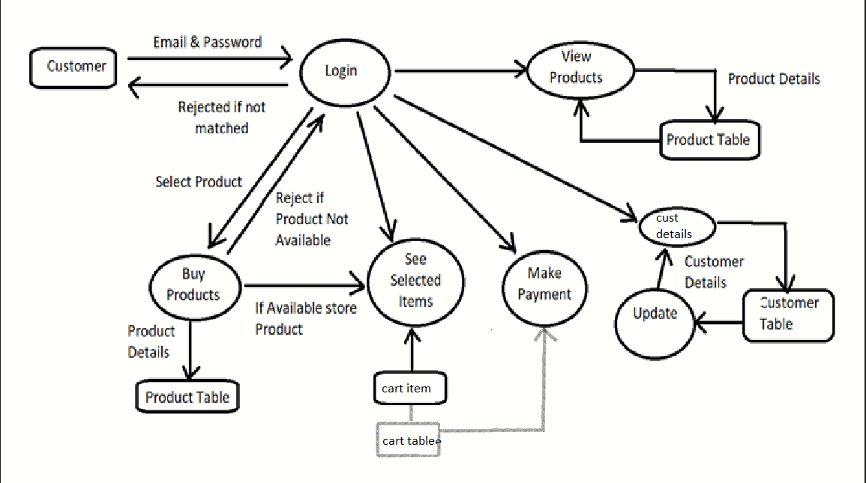
Data Flow Diagram :

Slide 8
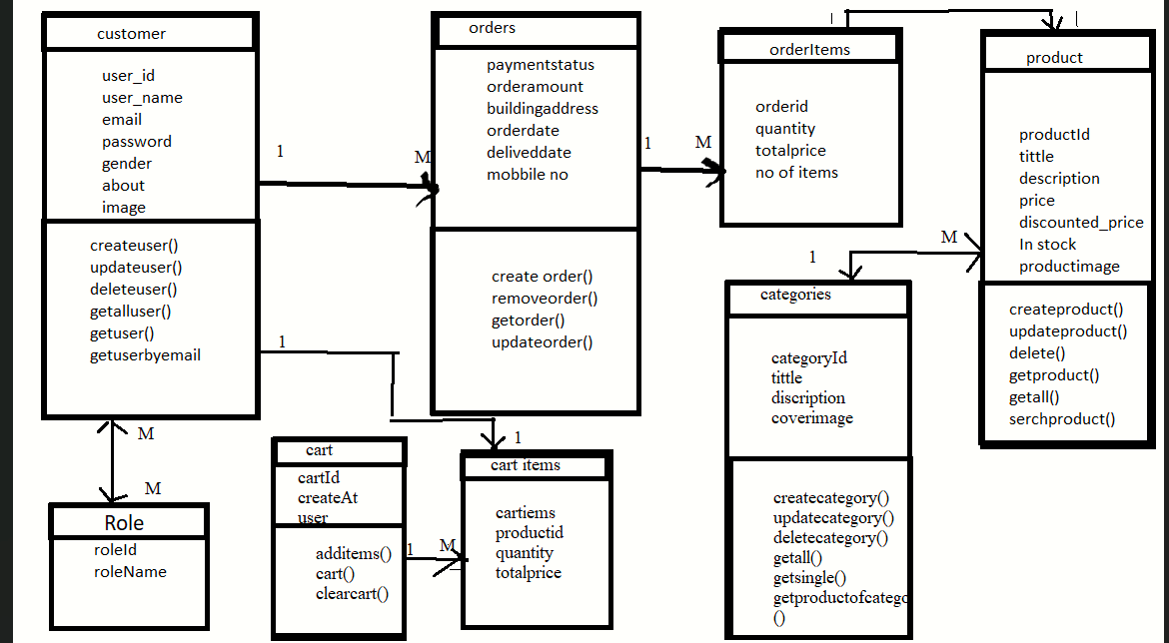
Class Diagram:

Slide 9
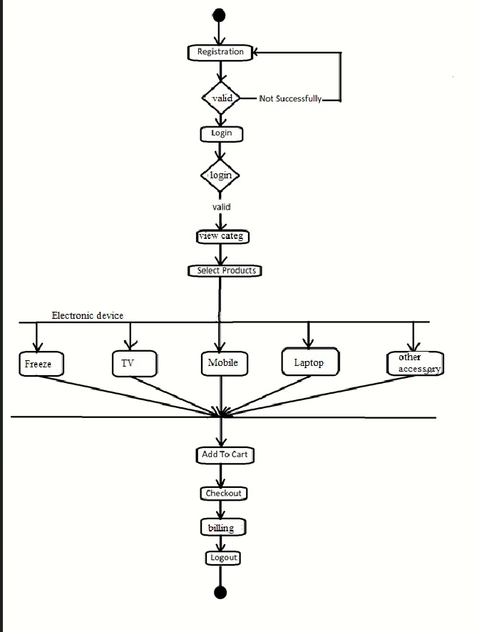
Customer
Activity
Diagram:

Slide 10
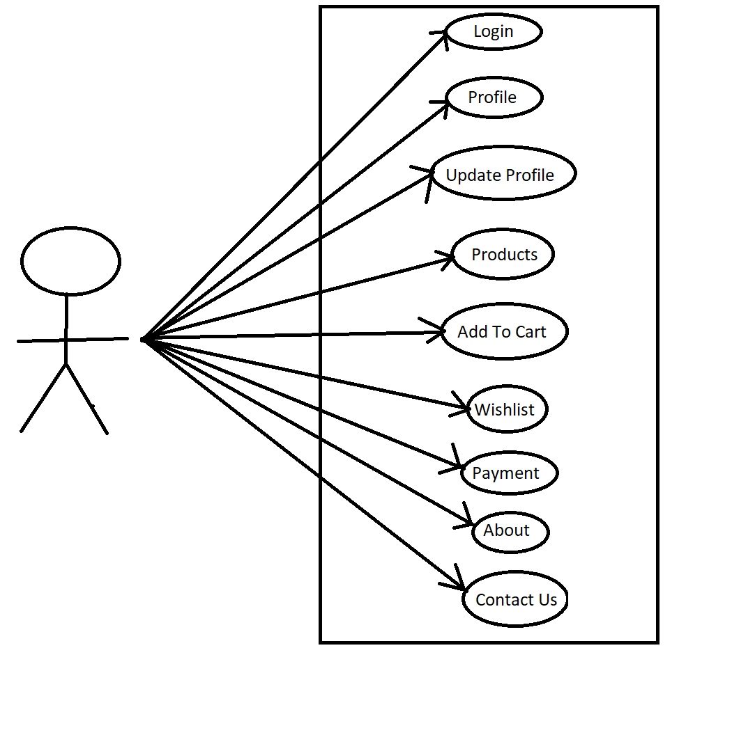
Use Case Diagram For Customer User:

Slide 11
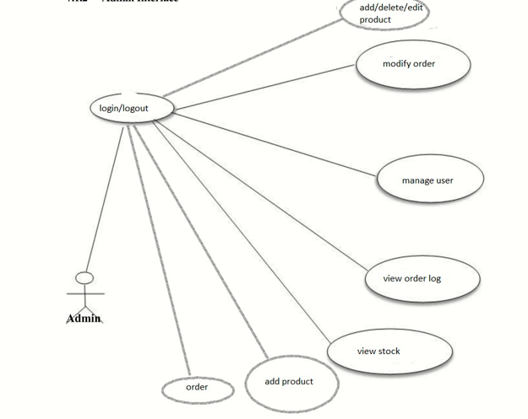
Use Case Diagram For Admin User:

Slide 12
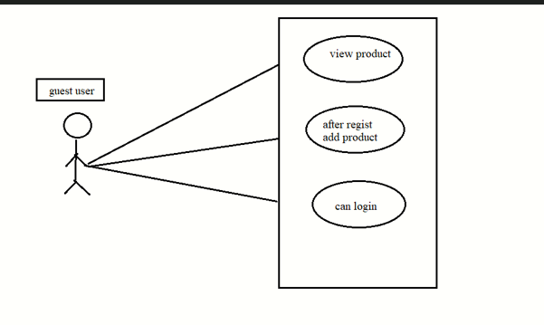
Use Case Diagram For Guest User:

Slide 13
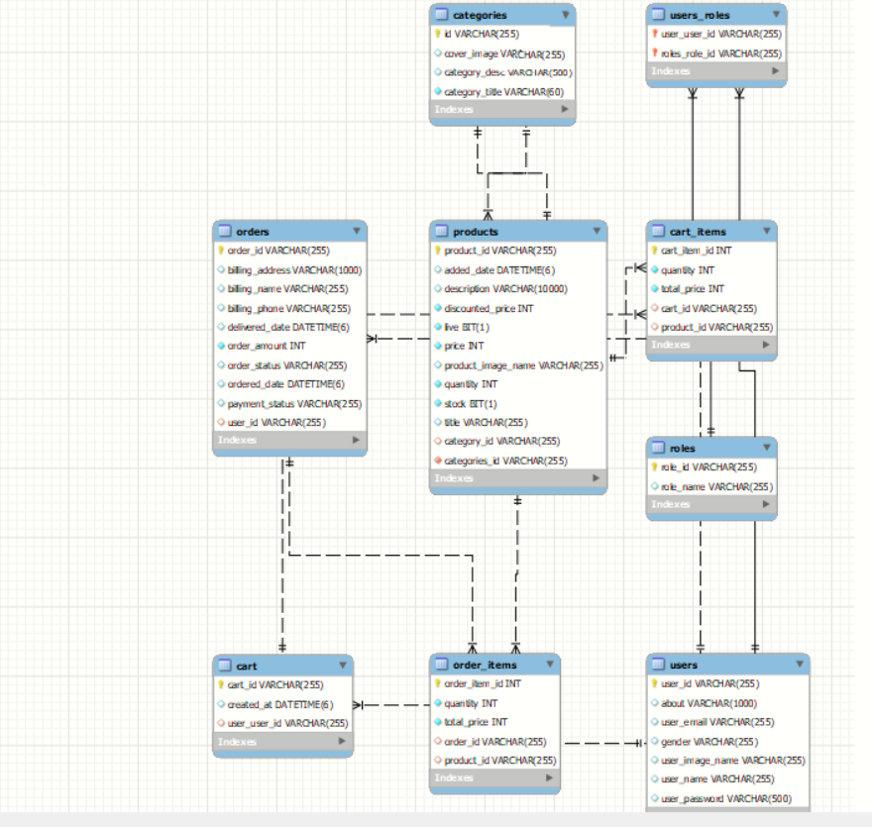
ER
Diagram :

Slide 14
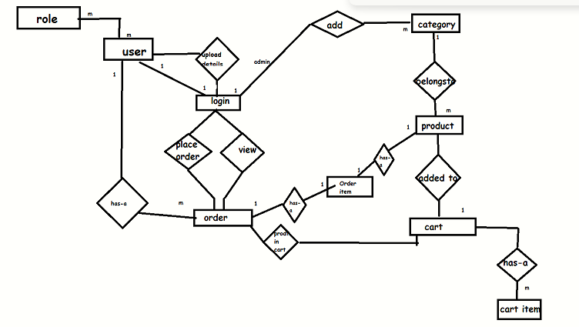
ER
Diagram :

Slide 15
Specifications:
The application will use JavaScript, jQuery and CSS as main web technologies.
HTTP and FTP protocols are used as communication protocols. FTP is used to upload the web application in live domain and the client can access it via HTTP protocol.
SMTP protocol is used for Email communication.
Since Electronic Hub application is a web-based application, internet connection must be established.
The Electronic Hub application will be used on PCs and will function via internet in any web browser.

Slide 16
S/W and H/W Requirements:
Server Side:
Processor: Intel(R) Core(TM) i3-10110U CPU @ 2.10GHz 2.59 GHz
HDD: Minimum 500GB Disk Space
RAM: Minimum 4GB
OS: Windows 10, Linux 6
Database: MySQL
Client Side (minimum requirement):
Processor: Intel Dual Core
HDD: Minimum 80GB Disk Space
RAM: Minimum 2GB
OS: Windows 7, Linux

Slide 17
Advantages:
Global Reach: An electronic online store has the potential to reach a global audience.
24/7 Availability: Your online store is accessible to customers around the clock. This provides convenience for shoppers who may have different schedules and time zones, increasing the potential for sales at any time.
Lower Overhead Costs: Operating an electronic online store often involves lower overhead costs compared to maintaining a physical store.
Wider Product Range: An electronic online store can offer a wider variety of products compared to a physical store.
Streamlined Inventory Management: Digital inventory management systems can help businesses keep track of stock levels, automate reordering processes, and reduce the risk of overselling or underselling products.
Ease of Expansion and Scaling: Online stores can easily expand their product offerings, target new markets, and scale their operations without the constraints of physical infrastructure.
Overall, electronic online stores offer convenience, a wide range of choices, and cost-effective solutions for both businesses and consumers, making them an integral part of modern commerce.

Slide 18
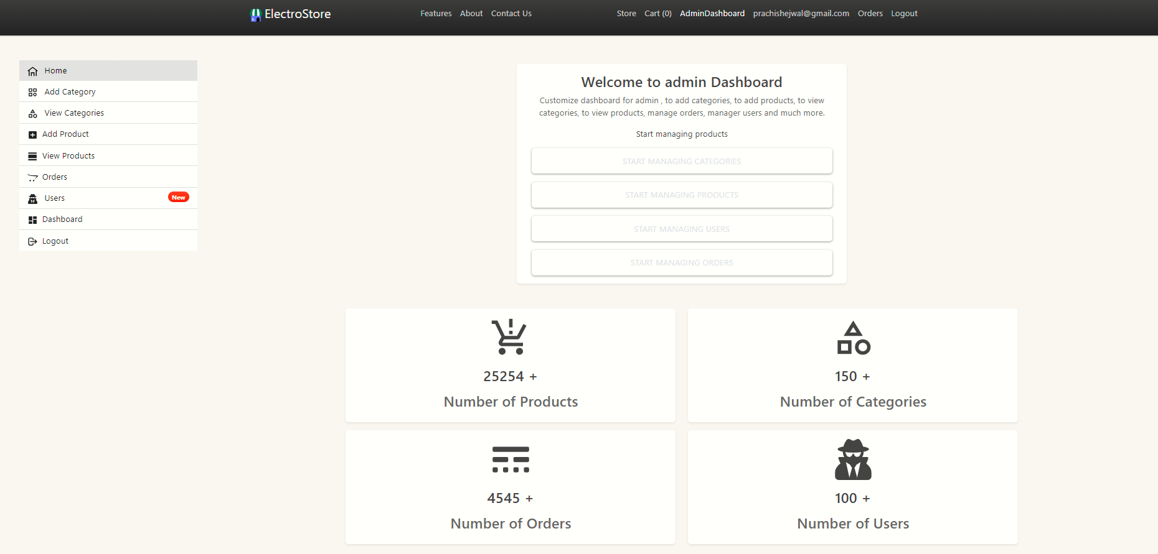
Project SnapShots:
1.Admin Dashboard

Slide 19
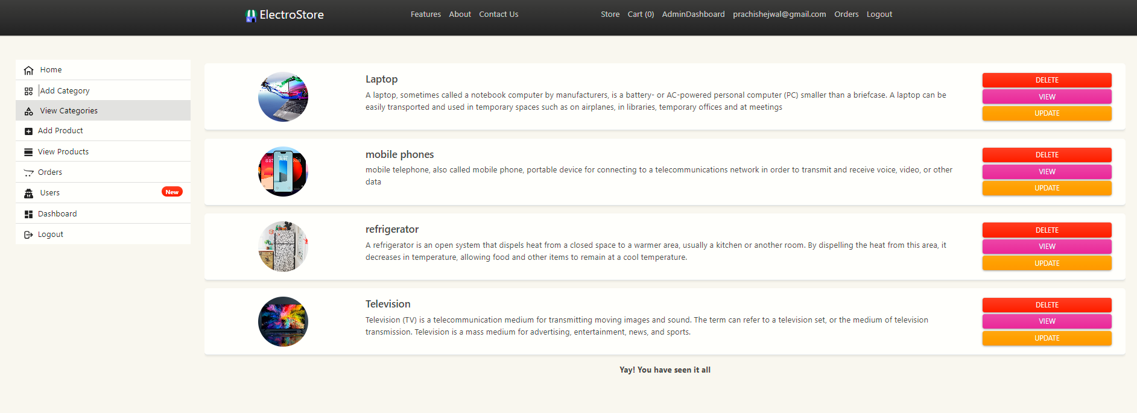
2.As admin want to see view Category

Slide 20
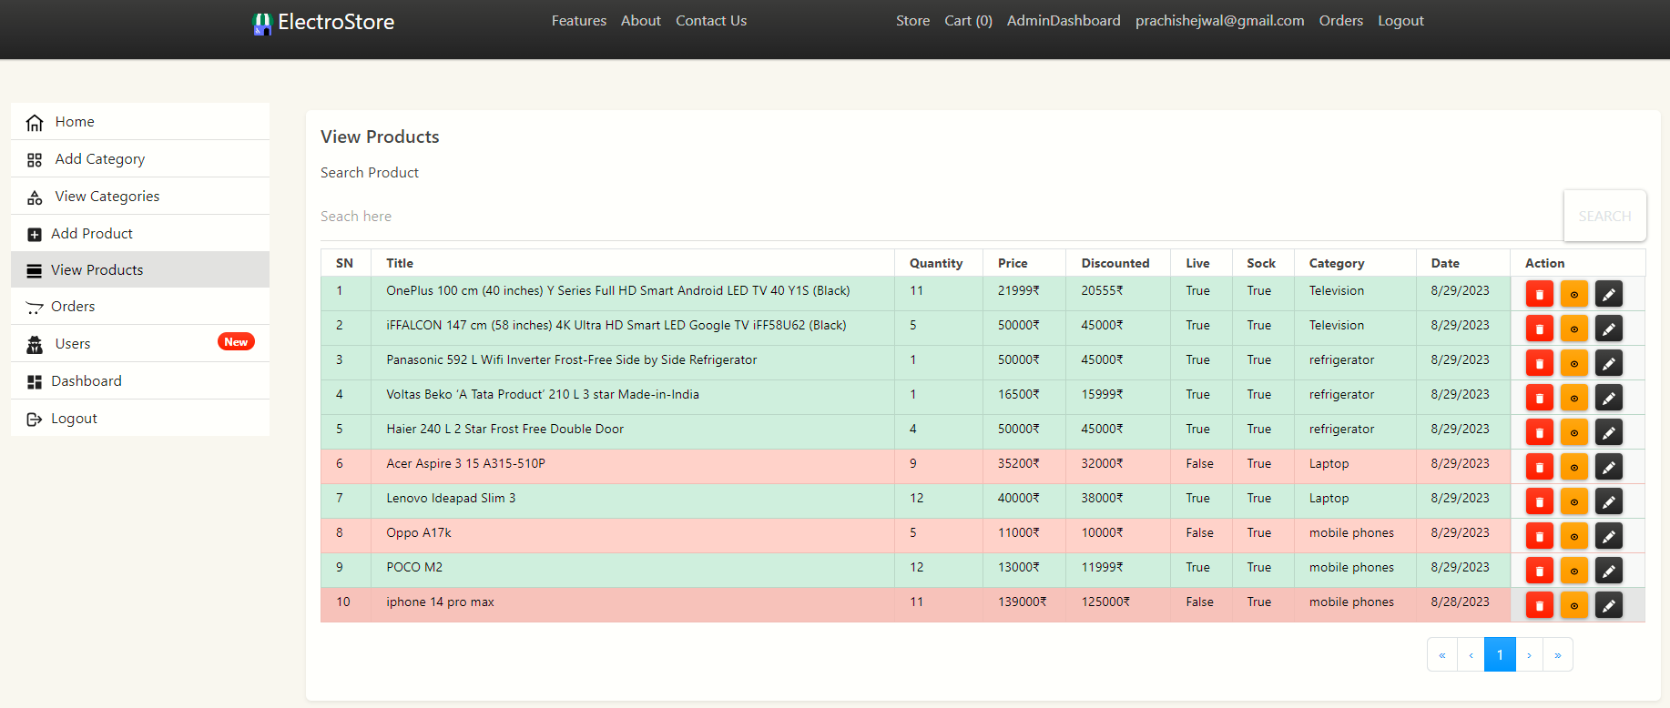
3.As Admin wants to view,Update,Delete Product

Slide 21
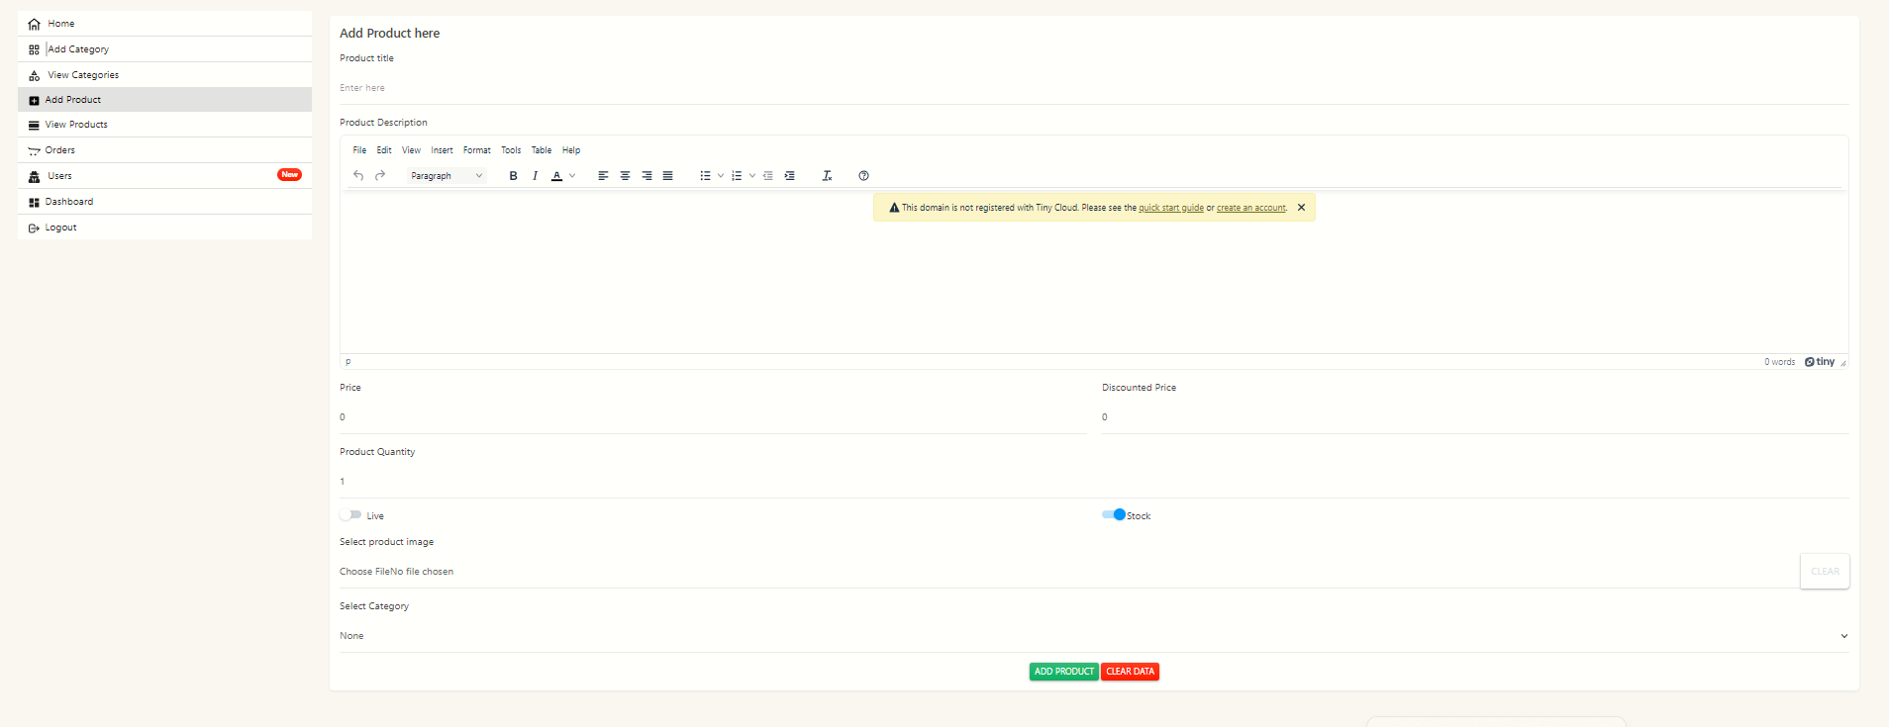
4.As admin wants to add product

Slide 22
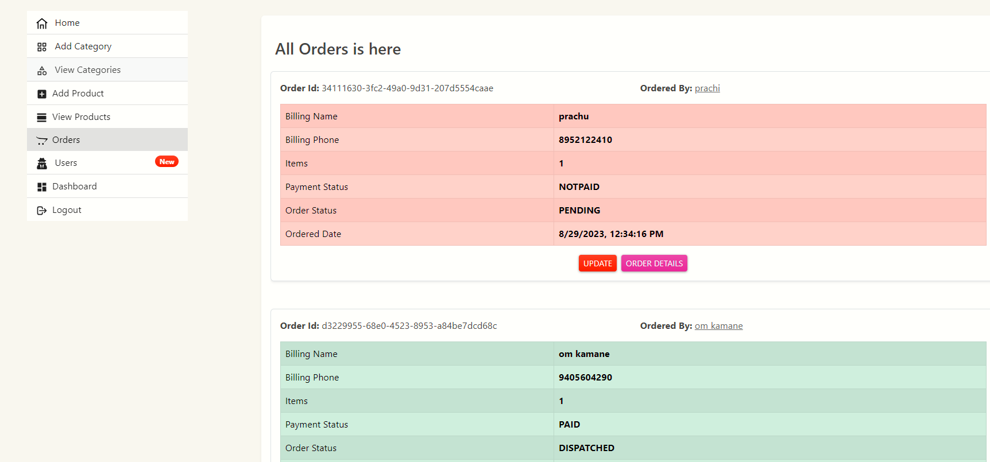
5.As admin wants to view Order

Slide 23
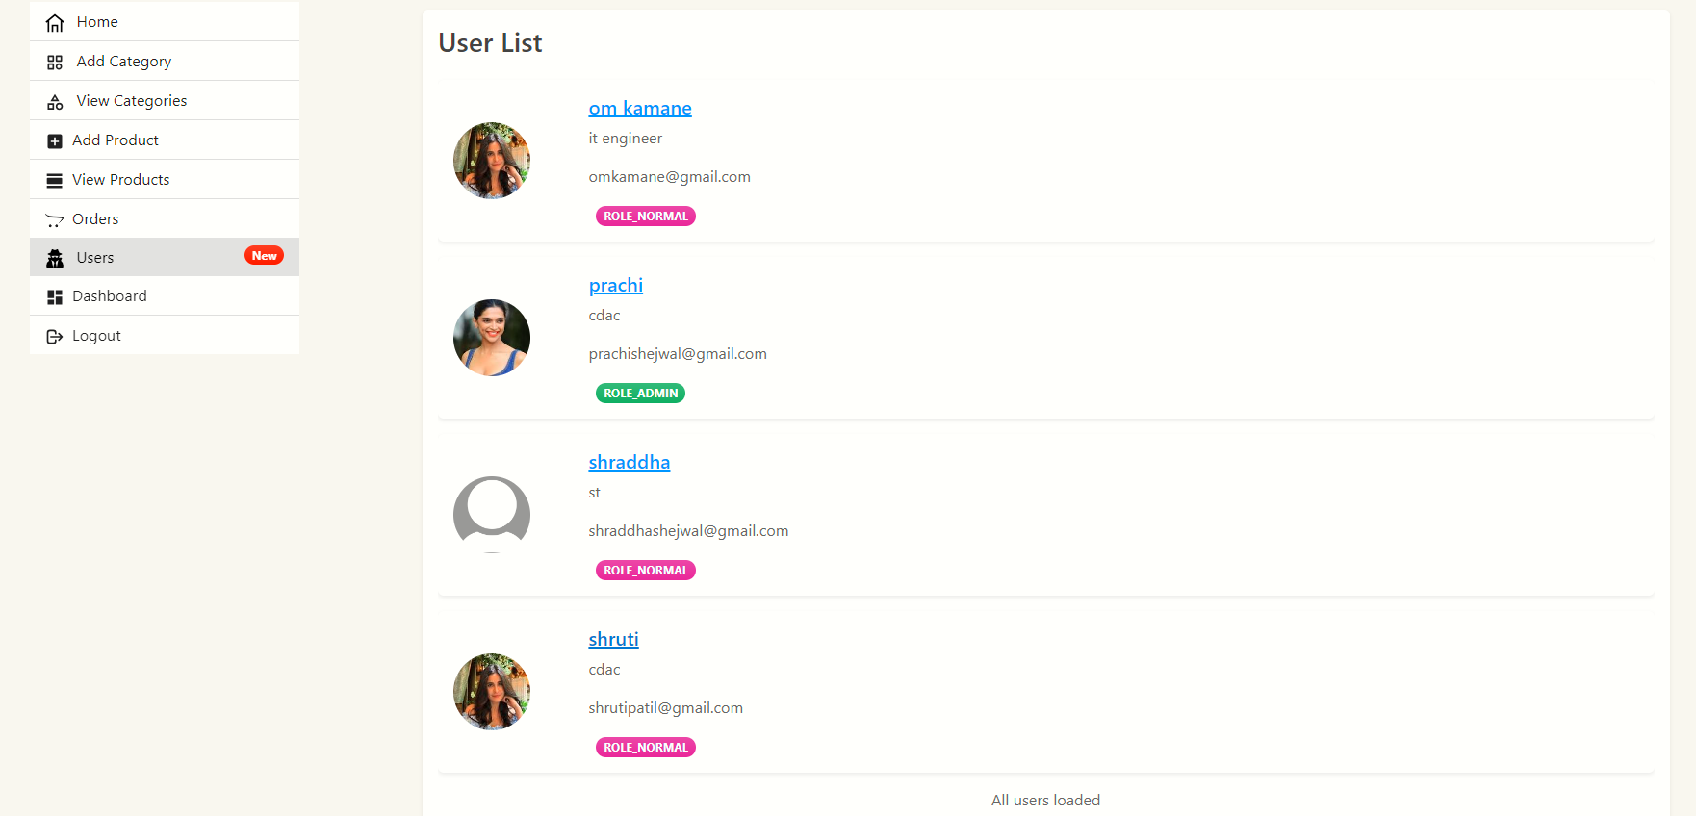
6.As admin wants to See all Users and Update, Delete Users.

Slide 24
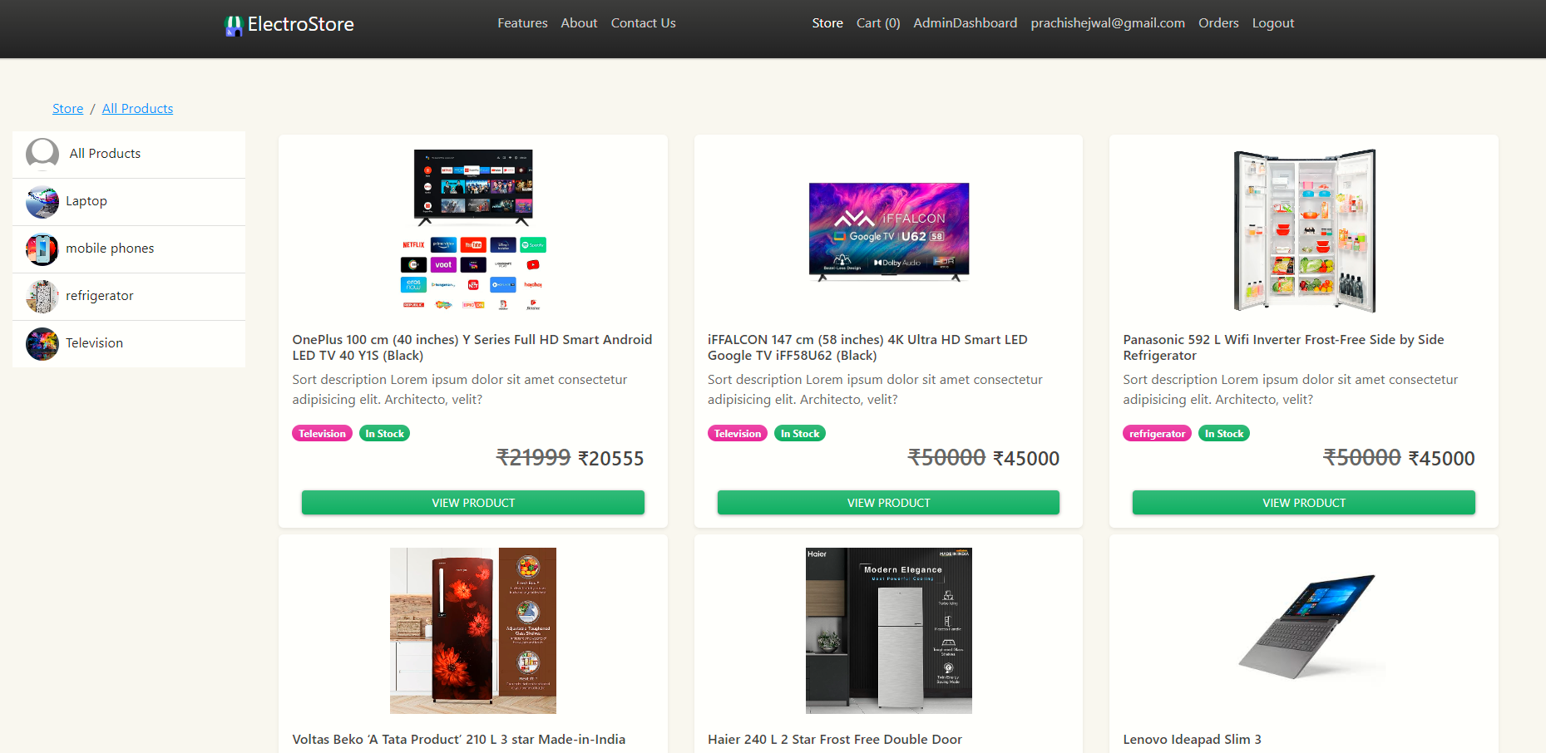
7.All live Products are Seen by Admin,Normal User and Guest User

Slide 25
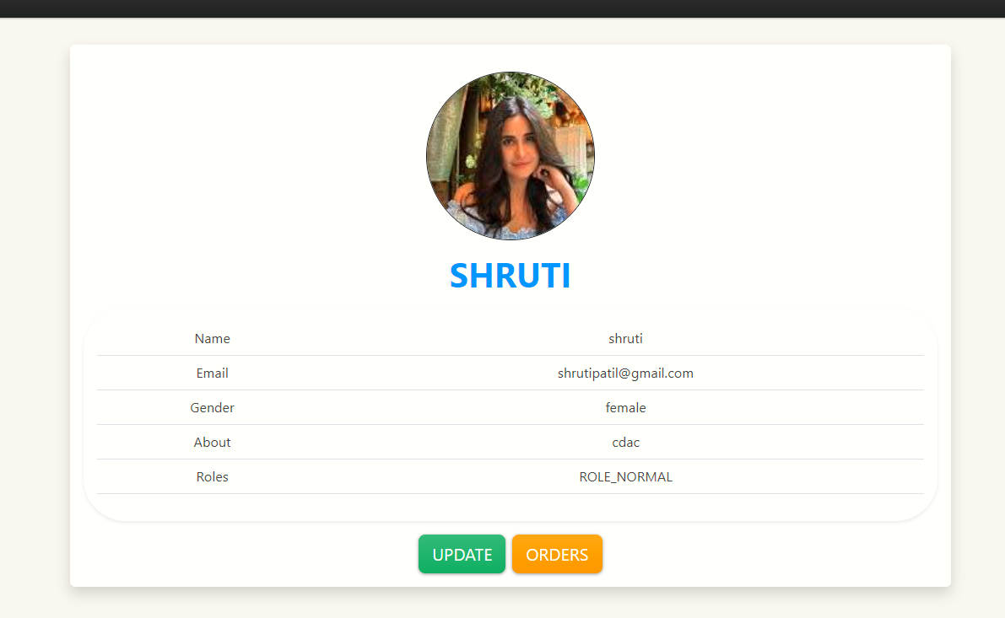
2.Customer
As Customer we are logged in,Customer can see following Website pages:
1.Customer can see his profile and can update it

Slide 26
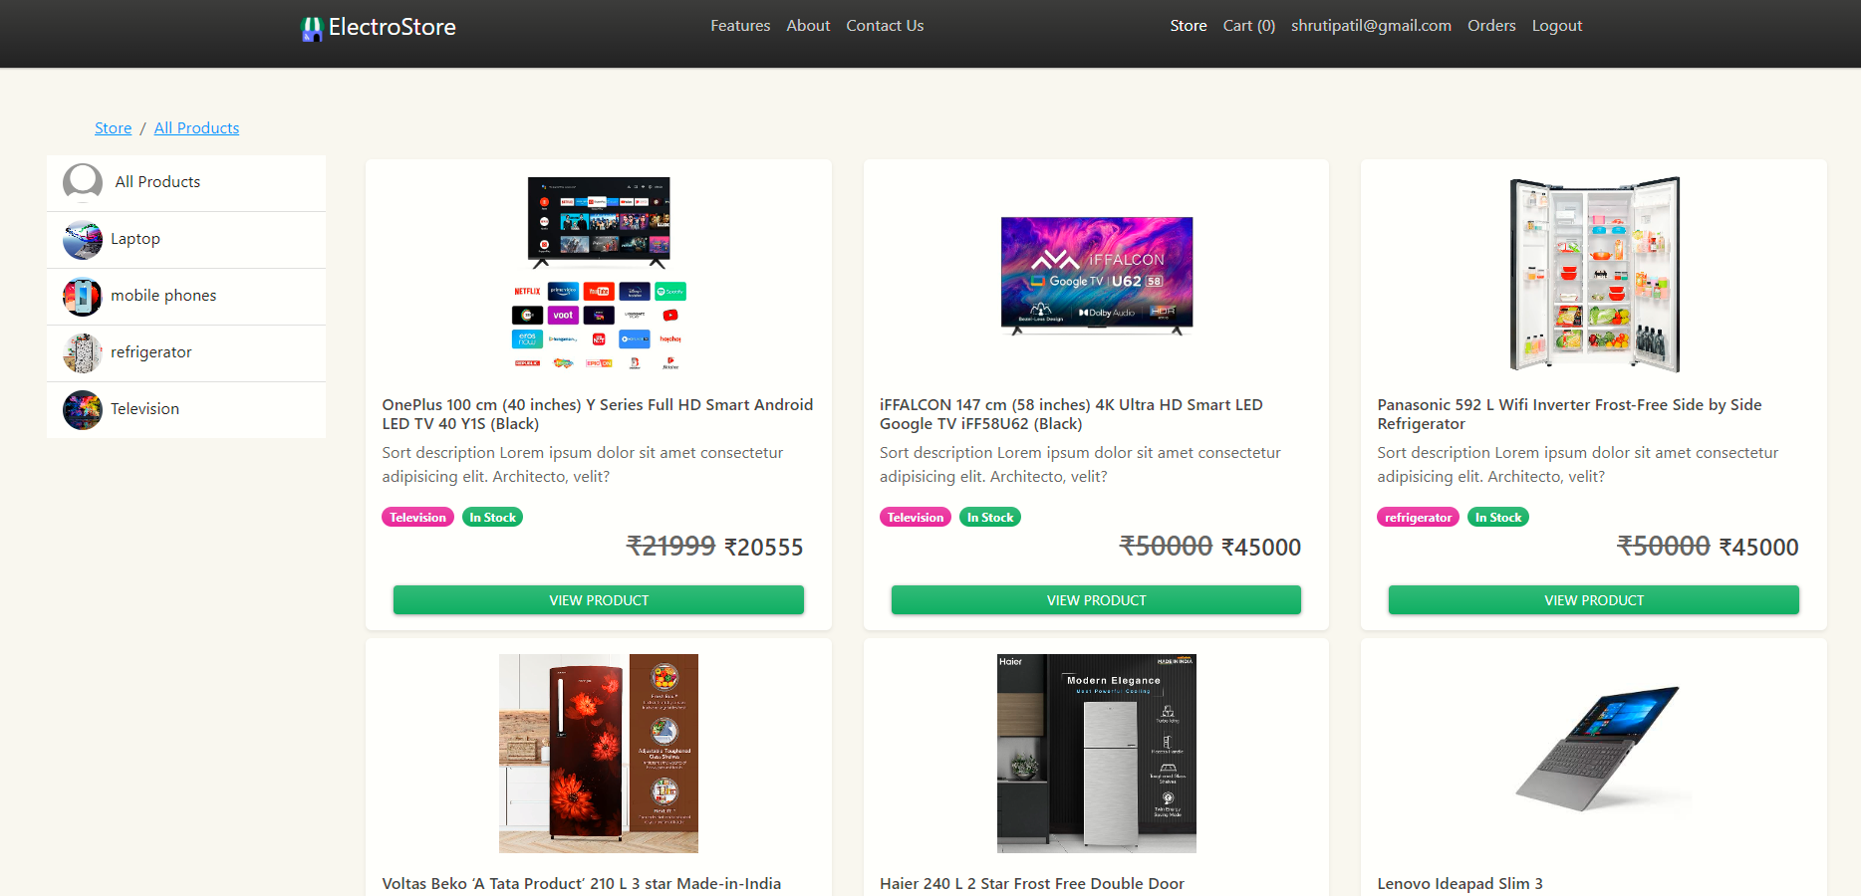
2.Customer can see all Categories

Slide 27
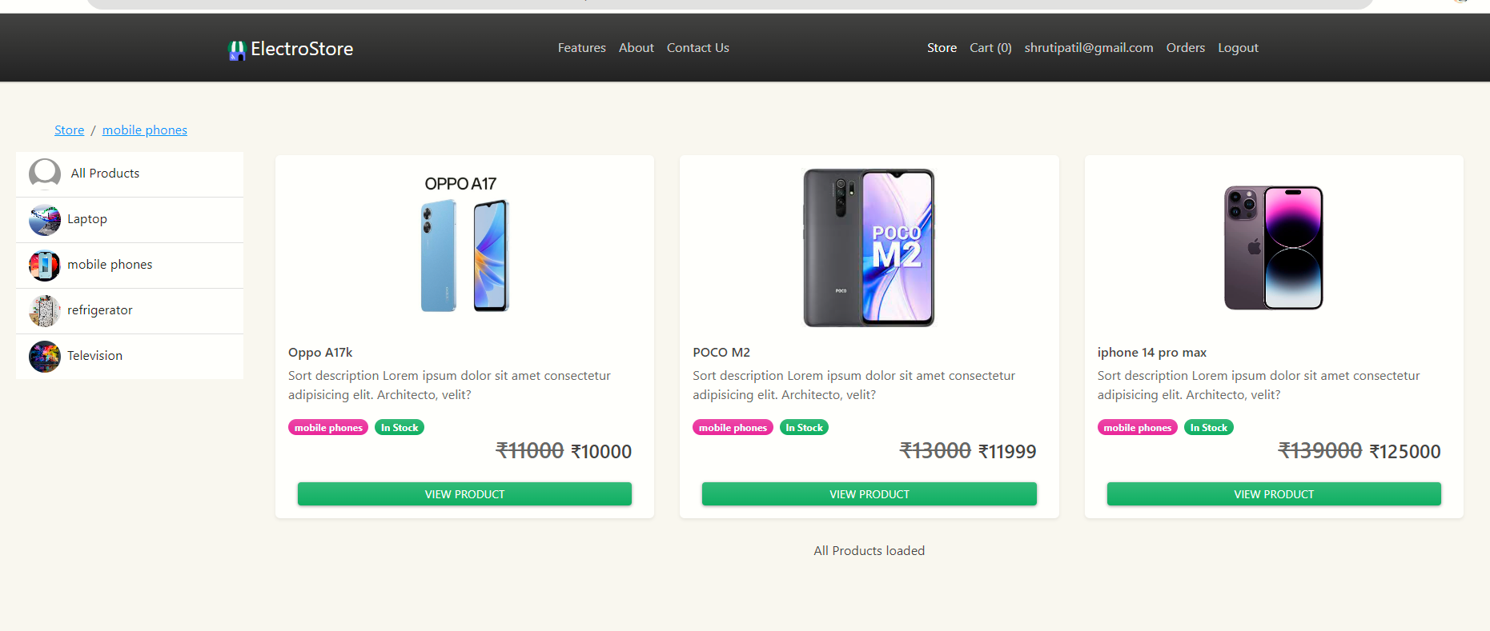
3. Customer can view all Products.

Slide 28
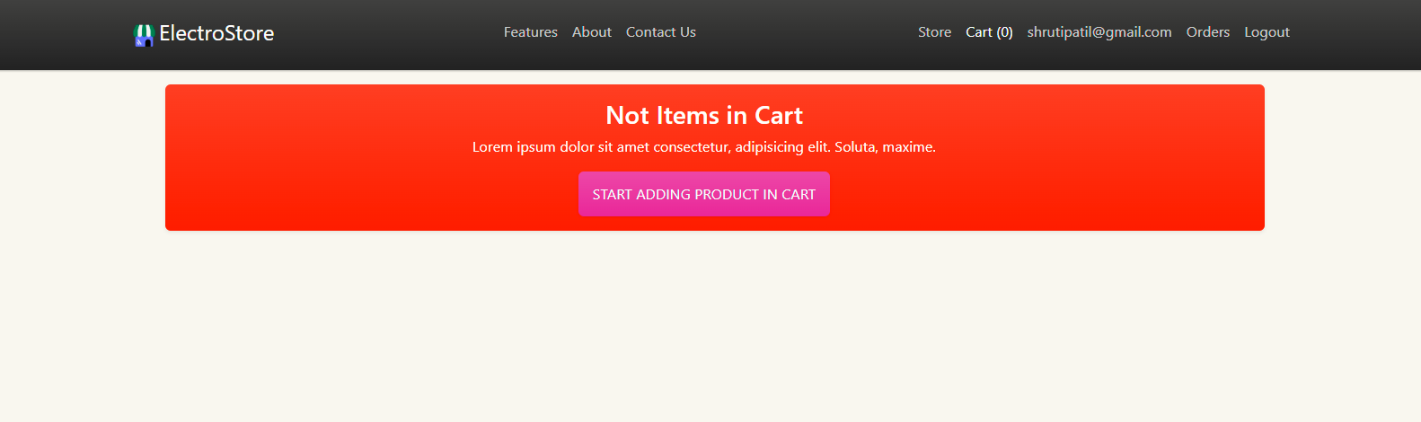
4. Customer can add Product to cart by clicking on “Start adding in cart”

Slide 29
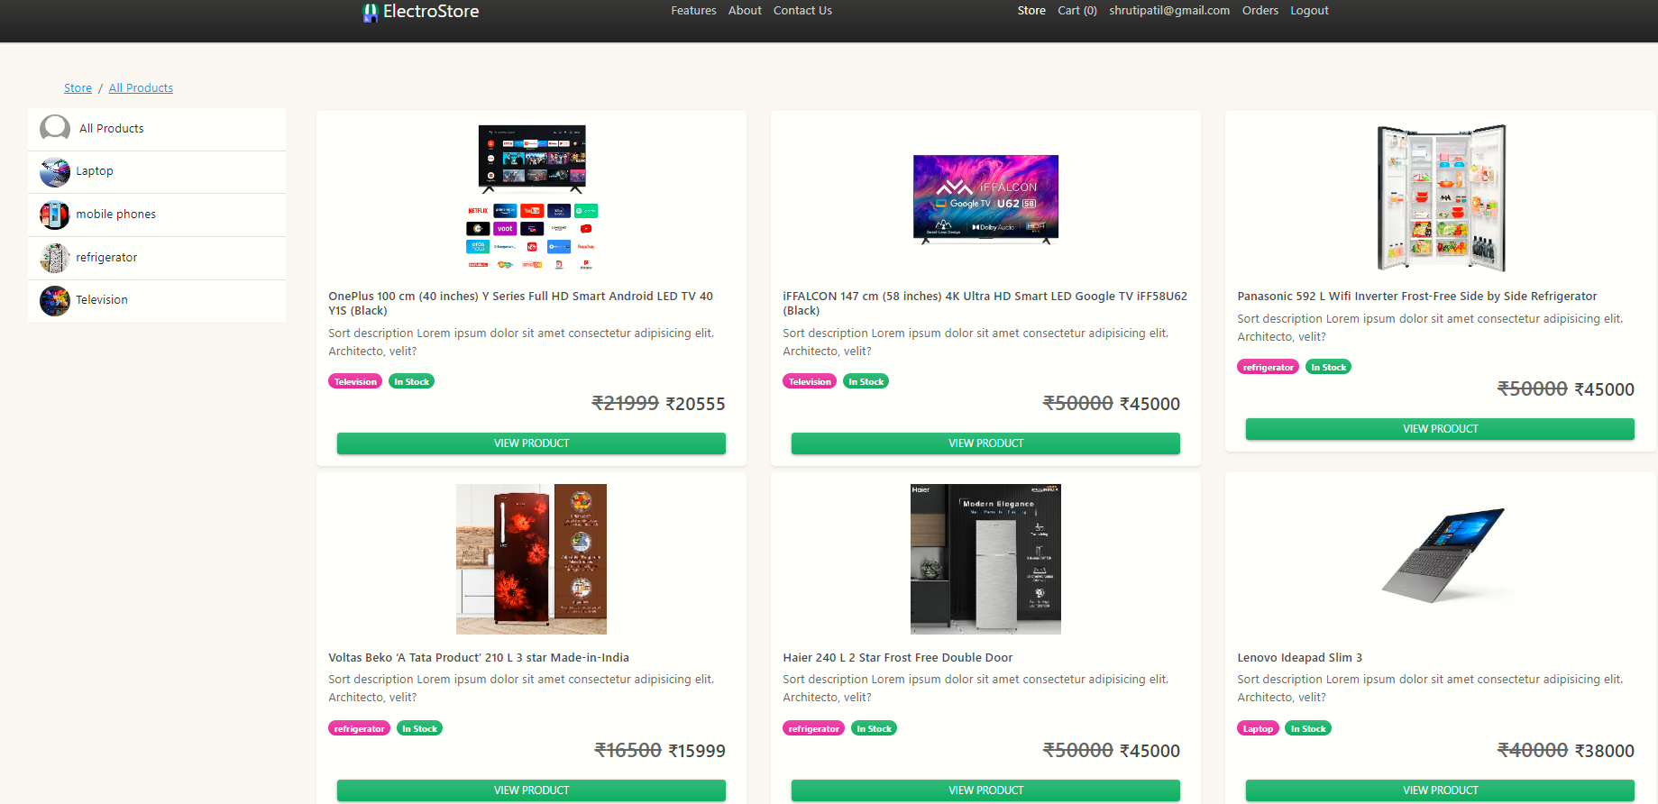
5.All Products seen by Customer.

Slide 30
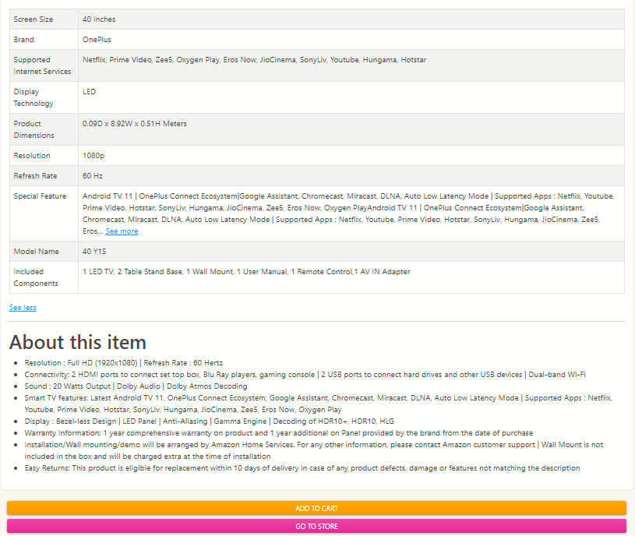
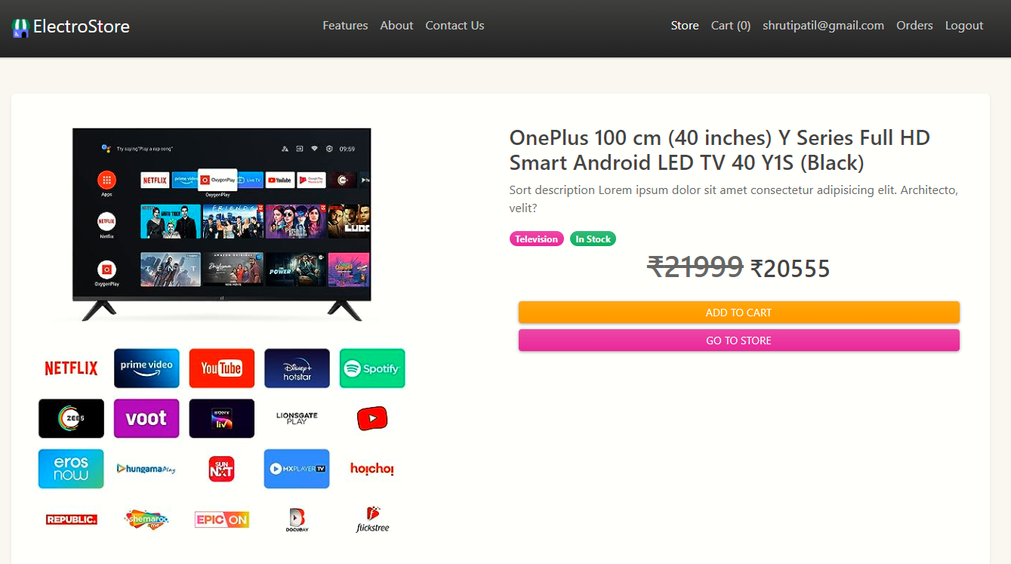
6.Customer can add Product to cart and also back to store

Slide 31
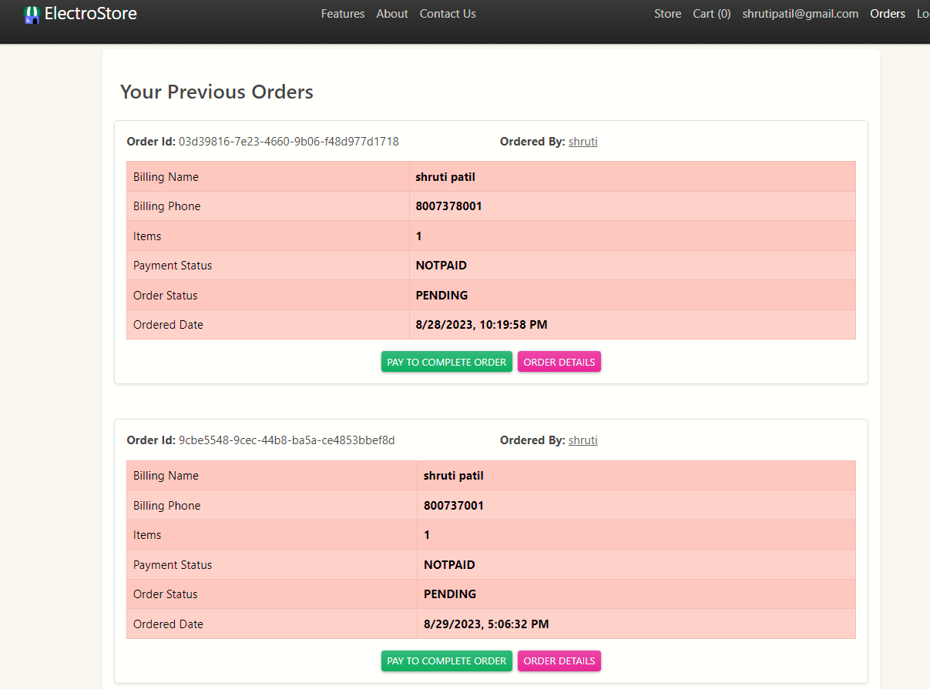
7.Customer can see all her orders in one page

Slide 32
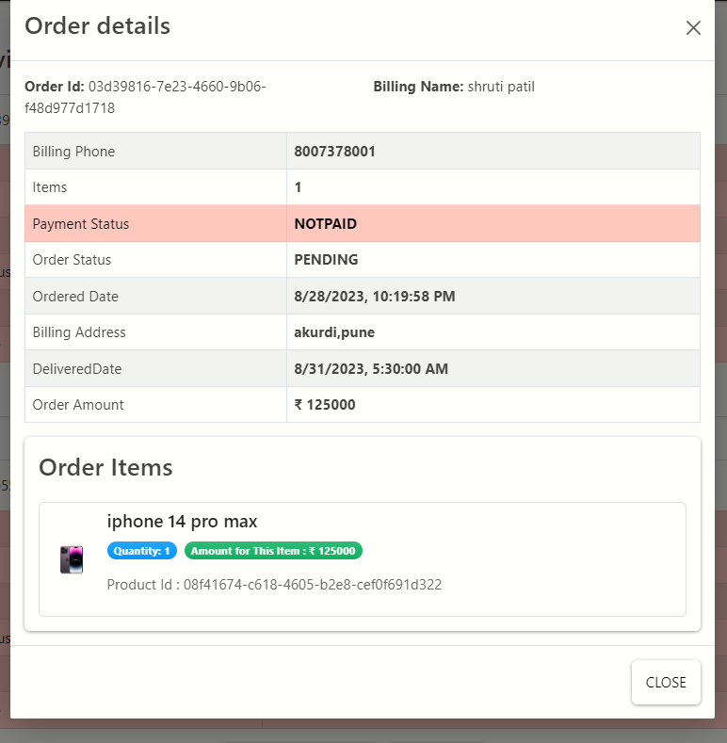
8.Customer also see his order details by clicking on “Order Details”.

Slide 33
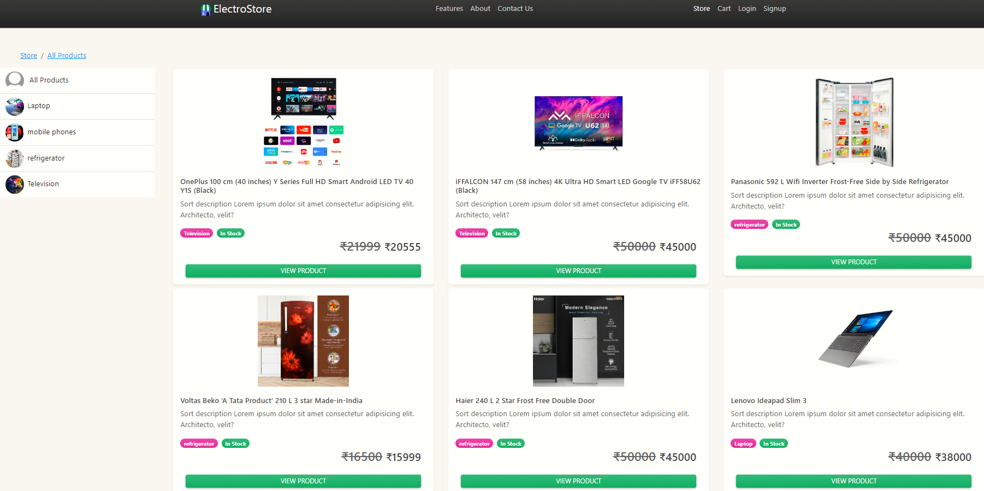
Guest User:
1.As a guest users,we can see all product
2.For adding product to product,guest user should be registered.

Slide 34
Conclusion:
our online electronic store project represents a convergence of technology, design, and user-centricity, redefining the way people engage with electronic products in the digital landscape
Through planning, tireless development, and a commitment to excellence, we have brought to life a platform that transcends physical boundaries, offering customers an immersive and seamless shopping experience from the comfort of their screens.
The system has been developed with much care and free of errors and at the same time it is efficient and less time consuming. The purpose of this project was to develop a web application for purchasing items from a shop
This project helped us in gaining valuable information and practical knowledge on several topics like designing web pages using React.js, usage of responsive templates and management of database using MySQL. The entire system is secured. Also, the project helped us understanding about the development phases of a project and software development life cycle. We learned how to test different features of a project.

Slide 35
Future Enhancement:
Voice Search and Shopping: Integrating voice search capabilities would make it effortless for users to search for products and complete purchases using voice commands, enhancing accessibility and convenience.
Enhanced Mobile App: Developing a feature-rich mobile app for our store would cater to the increasing number of mobile shoppers, offering a seamless and optimized experience across devices.
Smart Product Filters: Implementing advanced filters that allow users to refine product searches based on specific technical specifications, features, and price ranges.

Slide 36
References :
https://www.slideshare.net/AmitKumarVerma61/online-electronic-shopping-project
https://bootstrapmade.com/mentor-free-education-bootstrap-theme/
https://www.w3schools.com/
https://javaee.github.io/javaee-spec/javadocs/

Slide 37
THANK YOU…

