Slide 1
Document Scanner
& Image Enhancement
From a tilted phone photo to a flat, readable scan and extracted text, using classical computer vision
OpenCV · Tesseract · Streamlit
Notes:
Introduce the project: we take a phone photo of a paper page, find the page, flatten it, clean it up and read the text. No machine learning model is trained; it is classical computer vision plus the pretrained Tesseract OCR engine.

Slide 2
The problem we solve
Phone photos of paper are tilted, shadowed and cluttered
Perspective makes a rectangular page look like a trapezoid
OCR on the raw photo gives poor text
Goal: one pipeline that outputs the page outline, a flat scan, cleaned images and text
4
4
pipeline stages
team members
0
116
ML models trained
automated tests
Notes:
Explain why raw photos fail at OCR: tilt, perspective, uneven light. The four stages are detect, geometry, enhance, OCR. The tests count is 116 test functions in the pytest suite.

Slide 3
How the pipeline works
Input
Detect
Warp
Enhance
OCR
App
validate, EXIF fix, working copy
›
find page, 4 corners
›
homography to flat page
›
shadows, denoise, B&W
›
Tesseract text
›
Streamlit, PNG/PDF/TXT
Box colour = owner (teal M1, indigo M2, amber M3, pink M4)
Shared contract: images are BGR uint8; corners are float32 (4,2) ordered TL, TR, BR, BL in original-image pixels; expected failures are a structured ScannerError, so the pipeline never crashes silently.
Notes:
Walk left to right. Detection runs on a down-scaled copy (about 800 px) for speed; the warp runs on the original full-resolution image. All modules agree on one contract in backend/contracts.py.

Slide 4
Team and work division
1
Detection
2
Geometry & Pipeline
Where is the page?
Flatten it, never crash
detection.py, text_region.py
Eval: detection_metrics, annotate_corners
input_handler, geometry, pipeline, deskew, orientation_search
Eval: synthetic, reliability, debug_run
3
Enhancement
4
OCR & Application
Make it readable
Read it, deliver it
enhancement.py
Eval: enhancement_metrics
ocr, export, ui_support, app.py
Eval: ocr_metrics
Notes:
Each member owns specific modules, their tests and one evaluation tool (the member_split folders mirror this). The shared contract file backend/contracts.py and the test helpers are owned jointly. Replace 'Member N' with names.

Slide 5
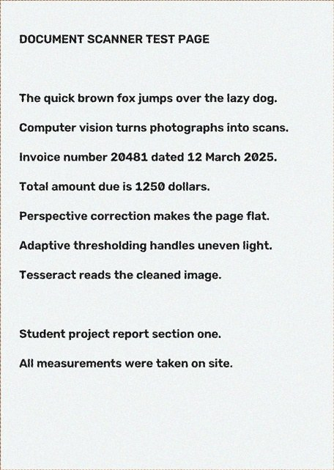
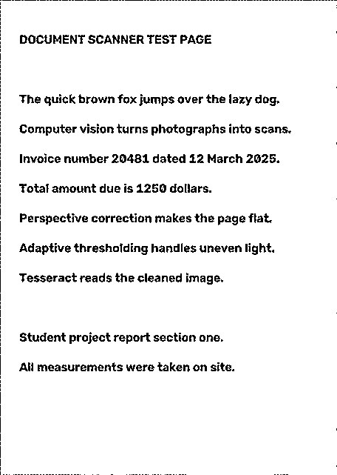
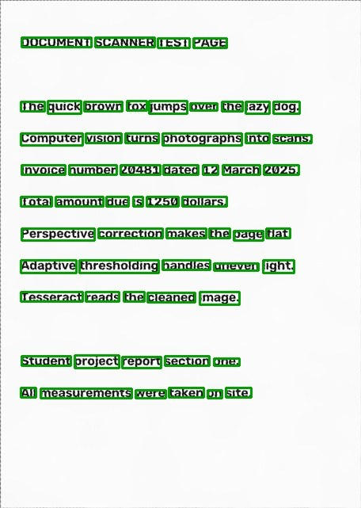
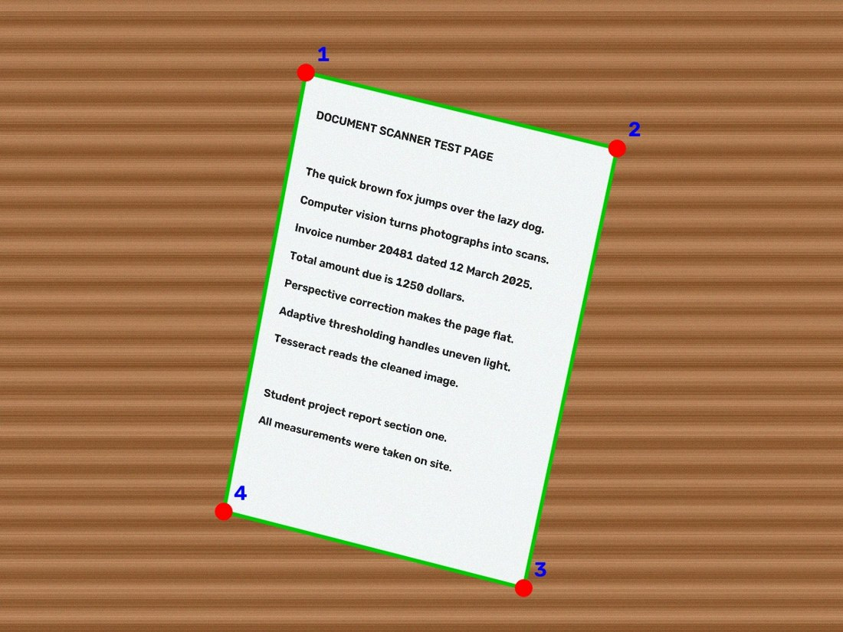
One photo, end to end
1
Detect
2
Warp
3
Enhance
4
OCR
4 corners found
flat, upright page
black & white output
words + confidence
Synthetic test photo from evaluation/synthetic.py · OCR read every line, mean word confidence 94.5
Notes:
One real run of our pipeline on a synthetic photo (wood background, page tilted about 14 degrees). Each panel is produced by a different member's module, so this slide is the hand-off between speakers. Images are generated by running backend code directly; the warp uses the detected corners.

Slide 6
1
Detection
“Given any reasonable photo, where is the page?”
Four strategies: Canny, sensitive Canny, Otsu threshold, HSV paper mask
Each outline reduced to a 4-point polygon, then scored on fill, angles, size and edge support
Rejects frame-like regions; reports weak or ambiguous results
Text-aware step stops the crop from cutting text off
30/30
pages found on the synthetic set (IoU ≥ 0.90)
0.995
mean IoU against exact ground truth
Notes:
Quality score = 0.30 fill + 0.20 angle + 0.20 size + 0.30 edge support. It is a heuristic, not a probability. Known limit: white paper on a white desk. Numbers are from the synthetic set, which is easier than real photos.

Slide 7
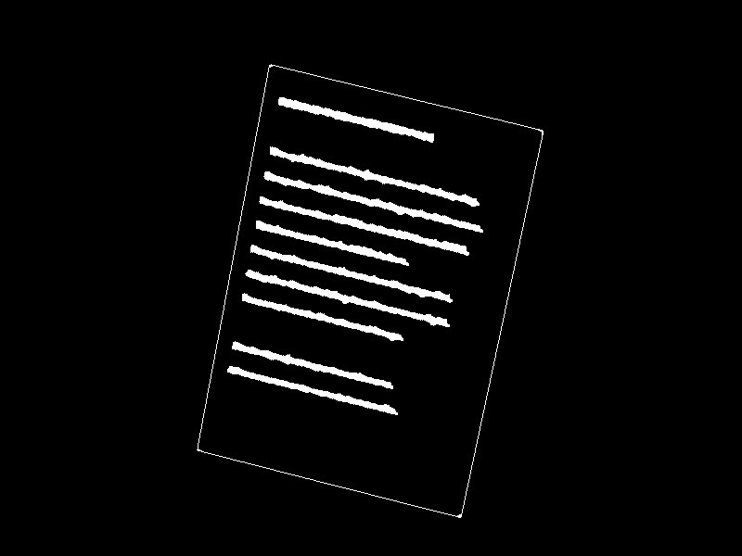
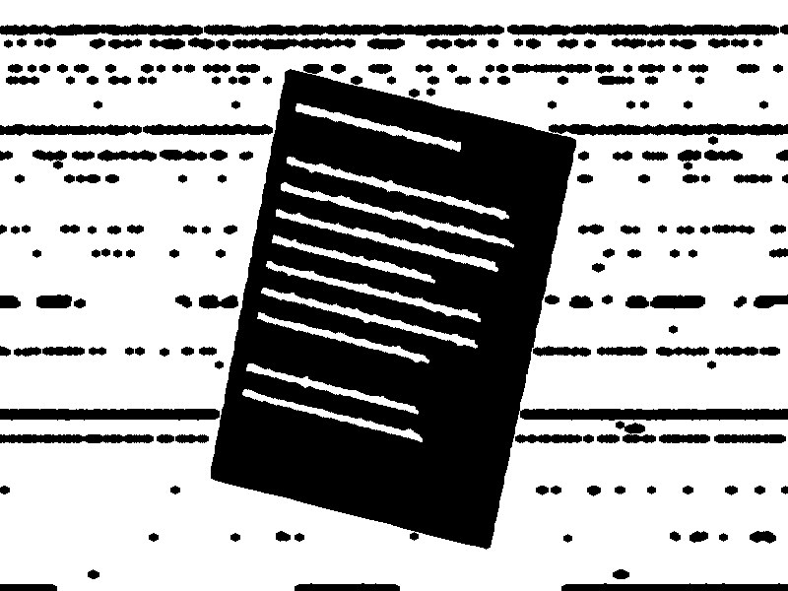


1
Detection: four strategies, one winner
Each strategy makes a mask; every 4-sided candidate is scored
Quality score (heuristic)
0.30 fill + 0.20 angles
+ 0.20 size + 0.30 edge support
Canny
Sensitive Canny
Winning strategy, 30 photos
Sensitive Canny
11
Canny
9
HSV paper mask
6
Otsu threshold
HSV paper mask
Otsu threshold
4
Notes:
All four strategies run on every photo; each produces a mask, contours become 4-point candidates, and the scoring formula picks the winner. Every strategy wins on some photos, which justifies running all four. Counts are from detection_metrics on the 30 synthetic photos.

Slide 8
Text-aware crop protection
1
Keep important text inside the final scan
HOW THE MODULE WORKS
1
Find text-like marks
WHY THIS MATTERS
Use local background contrast to separate dark ink-like pixels from the paper.
A boundary that is slightly too tight can cut off words near the edge of a page. Text-aware protection reduces that risk.
Group nearby marks
2
Connect close components into text blocks instead of treating every letter fragment separately.
IMPORTANT LIMITS
Check the page edges
3
Measure whether nearby text extends beyond the detected quadrilateral.
• This is text-region detection, not OCR: it locates text-like marks but does not read the words.
• Distant text is ignored using a proximity check.
• Known issue: a downstream axis-aligned bounding-box step can keep extra background on tilted pages; this is listed for future improvement.
Expand only when needed
4
Move the relevant sides outward with a small safety margin to reduce text clipping.
Main file: backend/text_region.py | Key functions: find_text_blocks(), expand_quad_to_text(), text_region_quad()
8

Slide 9
Text-aware crop: validation & safeguards
1
Automated checks and corner-ground-truth evaluation
WHAT IS TESTED
DETECTION RESULTS · SYNTHETIC SET
• Detection tests: corner ordering, successful detection, failure handling and coordinate scaling
• Text-region tests: text-block detection, safe boundary expansion and fallback behaviour
• Ground-truth tool: manually mark the four page corners for objective comparison
30/30
images met IoU ≥ 0.90
0.995
mean IoU vs. ground truth
0.075%
mean corner error / image diagonal
IoU measures overlap with the true page; normalised corner error measures corner-position accuracy. Synthetic results validate this test set, not every real-world photo.
9

Slide 10
2
Geometry & Pipeline Core
Flatten the page and never crash silently
Input validation: size, decodability, EXIF orientation, scaled working copy
Homography from 4 corners; output size from the longer opposite sides
Text-line deskew and orientation search for rotated pages
Pipeline controller with structured errors; synthetic ground-truth generator
30/30
files processed without a crash or failure
1.6 s
mean time per file (no OCR)
Notes:
A homography is a 3x3 matrix fixed by four point pairs. The corner order TL,TR,BR,BL matters; a wrong order mirrors the page. The reliability script ran 30 synthetic photos with 30 successes; this does not include real or corrupt files.

Slide 11
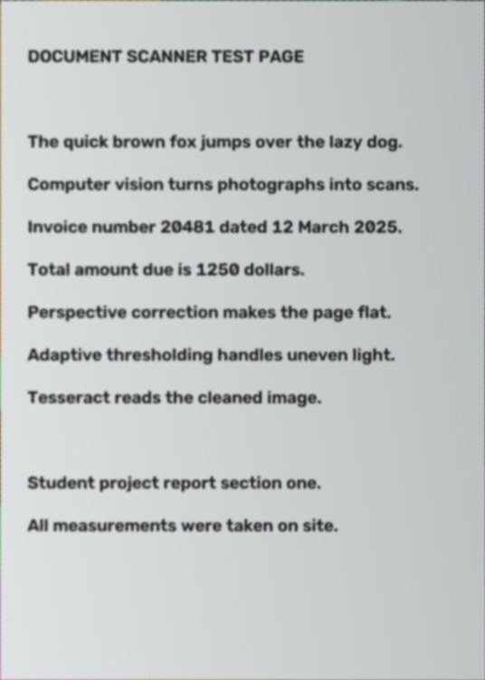
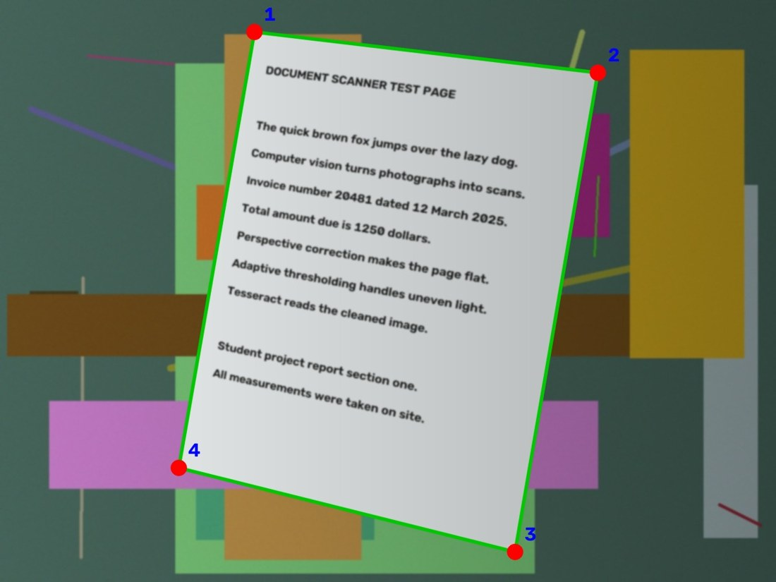
2
Geometry: from trapezoid to rectangle
Four point pairs fix the 3×3 homography; warp runs at full resolution
Never crash silently
Bad file, wrong format or too small → clear message
Expected failures → ScannerError (stage, code, message, hint)
Detection fails → manual corner sliders
OCR failure keeps the scan
Rotated pages: text-line deskew, then Tesseract OSD for 90/180/270°
Corners ordered TL → TR → BR → BL; output size uses the longer of each pair of opposite sides
Notes:
Left: cluttered synthetic photo with the four ordered corners. Right: result of cv2.getPerspectiveTransform + warpPerspective on the full-resolution original. The error policy means the UI always gets a result object, never a traceback.

Slide 12
3
Enhancement
Readability under bad lighting
Illumination normalisation: estimate paper background, divide it out
Denoising, then CLAHE only when text/paper contrast is weak
Three outputs: colour, grayscale (best for OCR), black & white
Adaptive threshold; blur, low-contrast and low-resolution warnings
3
named output variants
12
enhancement unit tests
Notes:
Main risk: removing shadows can fade big headings or leave halos. Thresholding throws information away, which is why colour and grey are always kept. The ablation table of each step on/off against OCR error is still to be produced with real photos.

Slide 13
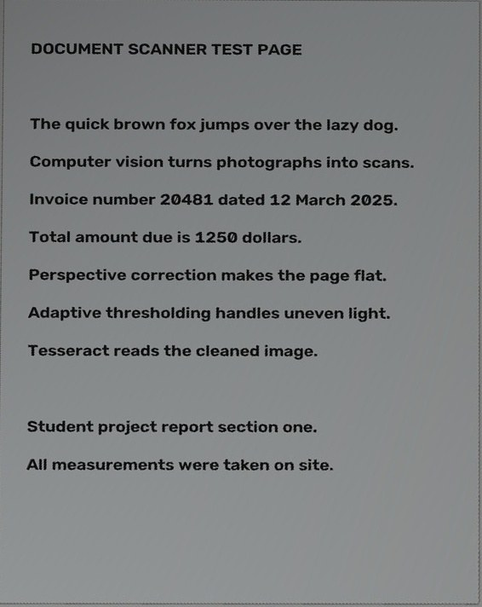
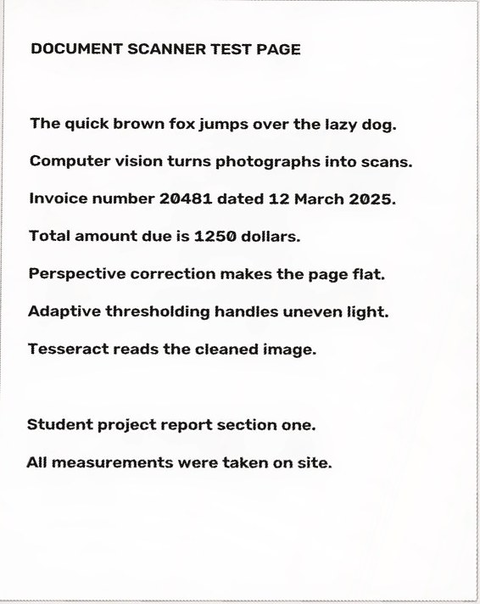
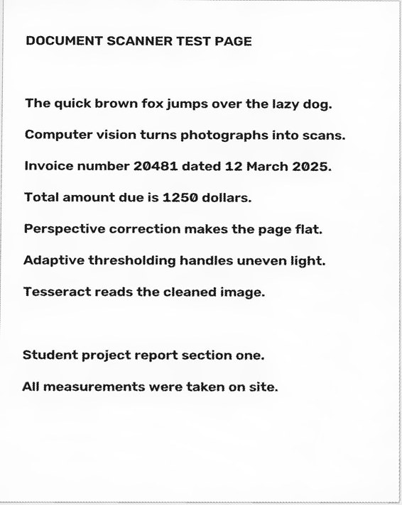
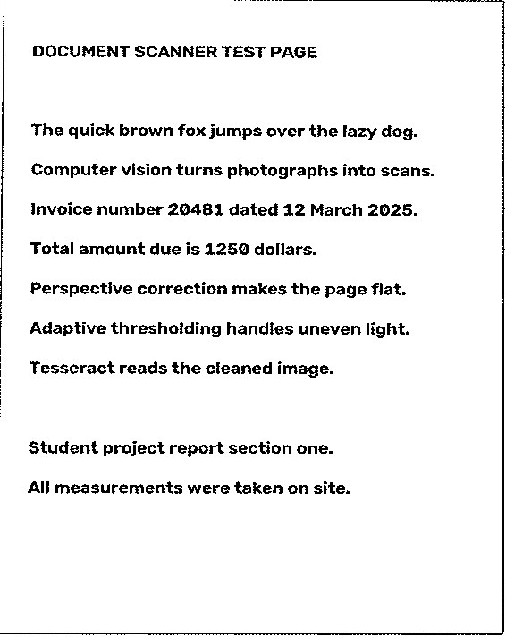
3
Enhancement: removing a shadow
Synthetic photo with a dark gradient added across the page
38.9 → 10.8
background unevenness, raw → grayscale
125 → 140
Flattened input
Colour
Grayscale
Black & white
ink/paper contrast (mean of 30 photos)
Notes:
We darkened one side of a synthetic photo to simulate a shadow. Illumination normalisation estimates the paper background and divides it out. Background unevenness is the standard deviation of paper pixels, averaged over the 30 synthetic photos by enhancement_metrics. Lower is flatter.

Slide 14
4
OCR & Application
Trustworthy text, delivered in a usable app
Tesseract via pytesseract; text rescaled to ~24 px letters before reading
Per-word confidences; doubtful words shown in red
Streamlit UI: upload, settings, manual corner sliders, diagnostics tab
Export to PNG, TXT and multi-page PDF (up to 10 pages)
15
OCR unit tests (fake engine, no Tesseract needed)
3
export formats: PNG, PDF, TXT
Notes:
OCR is injectable, so tests run with a fake engine. CER = edit distance / reference length on characters. We choose the OCR input variant by measuring, not guessing.

Slide 15
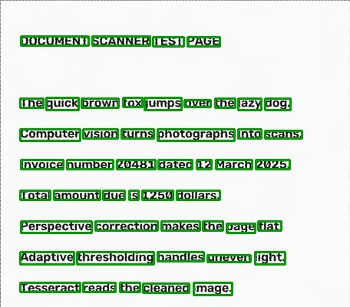
4
OCR: what each stage buys us
Median character error rate (CER) by image given to Tesseract
Green = confident word, red = doubtful
Notes:
CER = character edit distance divided by reference length; 0 is perfect. Median over the synthetic images where OCR returned text (14 for the raw photo, 22-24 for the others, out of 30). Medians are used because a few rotated reads give CER near 1 and skew the mean. Correcting geometry is the biggest gain; enhancement roughly halves the remaining error.

Slide 16
Testing and evaluation
Evaluation tools
Detection: IoU and corner error
OCR: CER and WER
Enhancement: contrast, sharpness, uniformity
Reliability: crashes per stage
Notes:
Tests prove the code behaves as designed; evaluation measures how well it works on images. 116 test functions in total.

Slide 17
Results so far
100%
0.075%
113/116
30/30
detection success, 30 synthetic photos
mean corner error / image diagonal
tests passing
pipeline runs without failure
Honest caveats
Results use clean synthetic images, so they validate the code, not real-world accuracy. Three tests fail. Root cause of two: the text-aware safety step replaces the tilted page outline with an upright bounding box, so background is kept; disabling it makes 115/116 pass. The third is an OCR word-box mapping test.
Notes:
Be upfront: synthetic images are easy. In pipeline.py, after expand_quad_to_text, the code unions the quad with the axis-aligned text box and uses that rectangle whenever it is 2% larger, which is true for almost any tilted page. Detection itself is correct (IoU 0.995); the crop is what goes wrong. Fix before submission.

Slide 18
Limitations and future work
Limitations
Future work
White paper on a light desk can defeat detection
Page filling the whole frame is rejected
Curled or folded pages are not four-sided
Ablation of each enhancement step against OCR error
Fix the bounding-box crop in the text-aware step
Batch processing; better handling of hard-edged shadows
Notes:
These limitations are documented in the module docstrings.

Slide 19
Thank you
Questions?
Detection · Geometry & Pipeline · Enhancement · OCR & App

