Slide 1
PM Accelerator
Our mission is to break down financial barriers and achieve educational fairness.
With the goal of establishing 200 schools worldwide over the next 20 years, we aim to
empower more kids for a better future in their life and career, simultaneously
fostering a diverse landscape in the tech industry.
Building the Future of Product Management through Data & AI

Slide 2
Weather Trend Forecasting Project Report
1. Project Overview
This project aims to analyze global weather data and forecast temperature trends using classical time series models. It involves both basic and advanced data science techniques such as EDA, anomaly detection, multi-model forecasting, and environmental impact analysis. The final goal is to derive insights and build models that could serve practical forecasting needs.
Dataset Source: Global Weather Repository

Slide 3
2. Data Preprocessing
Missing Values: Handled missing coordinates, temperature, and air quality data using .dropna() and imputation.
Outliers: Detected via rolling statistics and boxplots.
Datetime Parsing: Converted last_updated_epoch into datetime format for time series analysis.
Feature Engineering:
Created temp_diff = max - min temperature.
Rolling mean and standard deviation for anomaly detection.
3. Basic EDA
Temperature & Precipitation Trends:
Line plots per city.
Distribution plots to visualize overall trends.
Correlation Heatmap:
Found correlations between temperature, pressure, humidity, and air quality features.

Slide 4
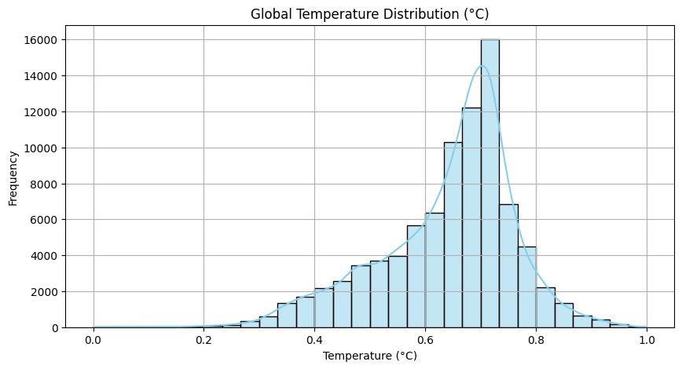
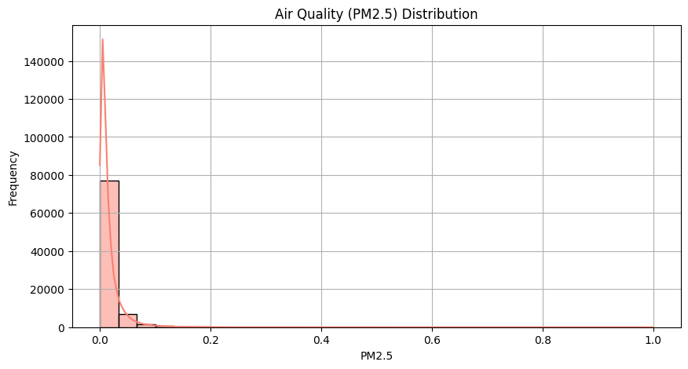
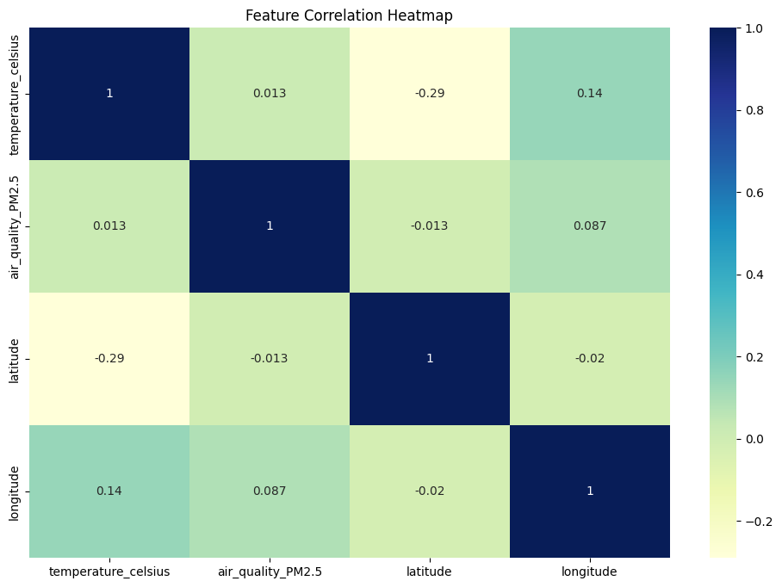
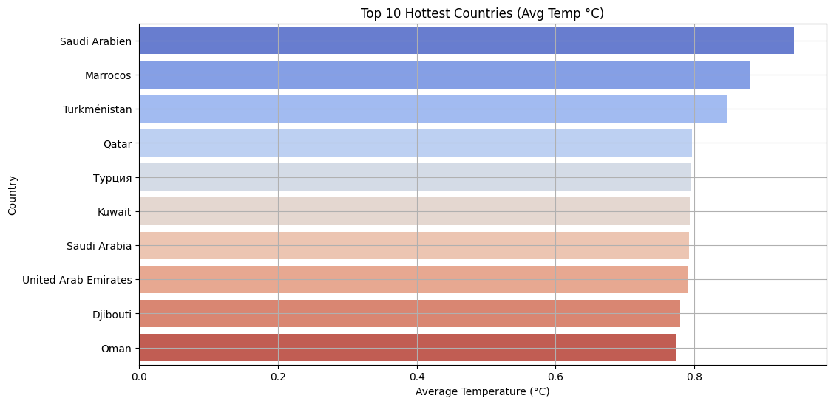

Slide 5
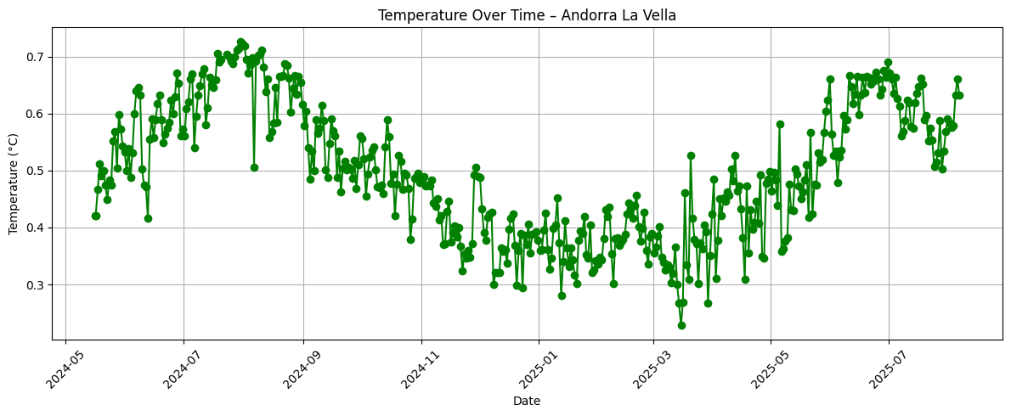

Slide 6
4. Forecasting Models
ARIMA (Tirana)
Preprocessing: Differencing applied after ADF test (non-stationary series).
Forecast: 30-day temperature forecast.
Evaluation:
MAE: 0.0487
RMSE: 0.0555
ETS (Kabul)
Preprocessing: No differencing required.
Evaluation:
MAE: 0.0474
RMSE: 0.0503
Prophet (Yerevan)
Preprocessing: Converted epoch to ds, temperature to y.
Evaluation:
MAE: 6.0674
RMSE: 6.7243
Ensemble
Combined predictions from ARIMA, ETS, and Prophet.
Used averaging for final forecast.

Slide 7
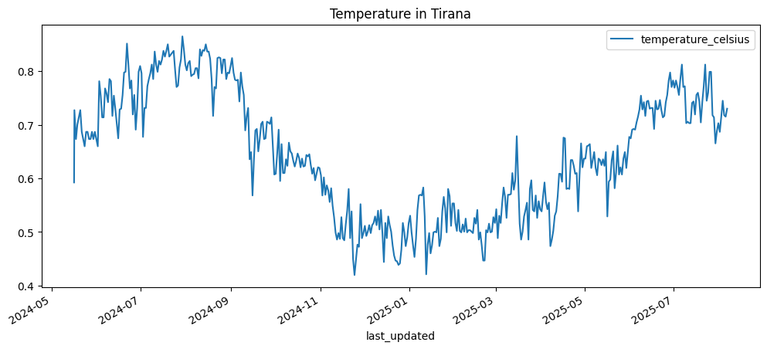
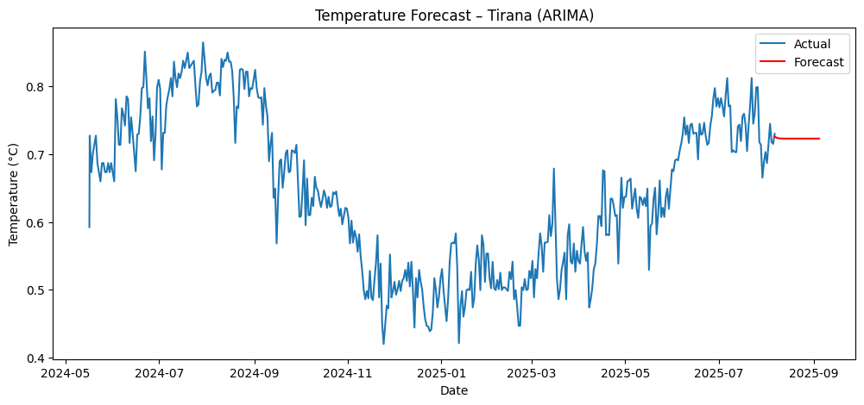

Slide 8
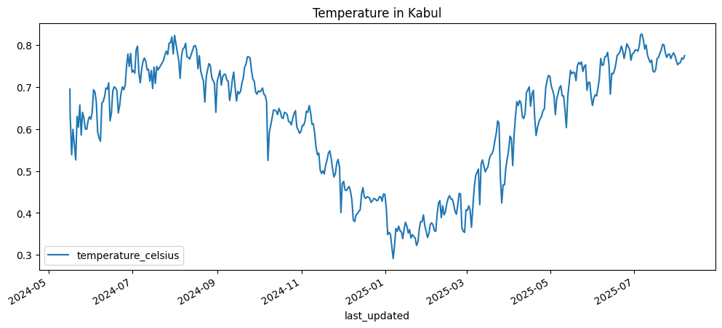
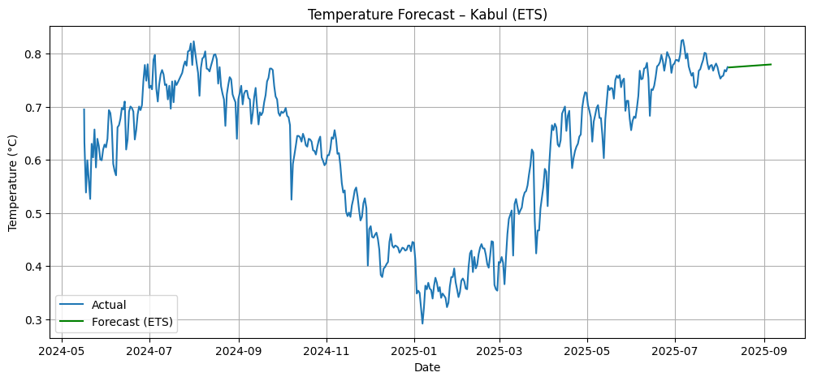

Slide 9
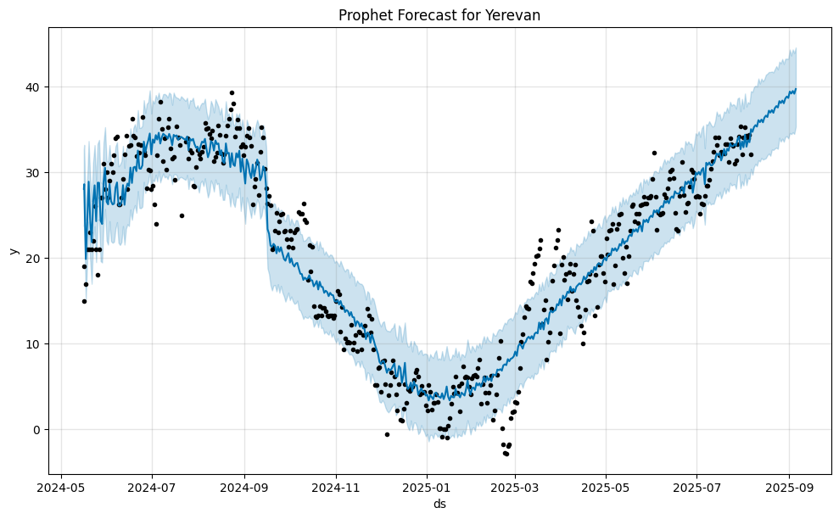

Slide 10
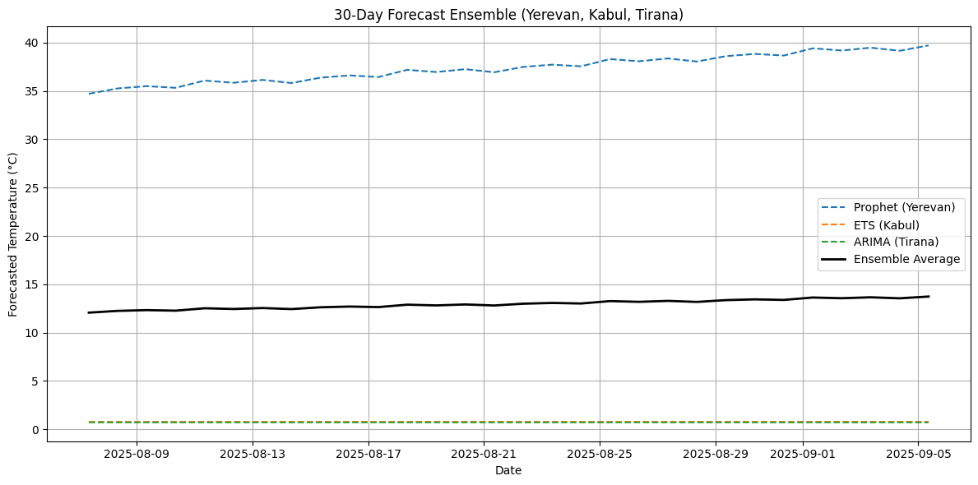

Slide 11
5. Advanced EDA: Anomaly Detection
Applied rolling statistics to identify temperature outliers.
Cities like Yerevan and Tirana showed occasional spikes/deviations in daily trends.
6. Unique Analyses
Climate Analysis
Visualized long-term changes in temperature for cities like New York, Delhi, Tokyo, etc.
Identified upward trends indicating global warming in some regions.
Environmental Impact
Studied air quality variables like PM2.5, CO, NO2, and their correlation with temperature.
Found moderate correlation between higher temperature and elevated PM2.5 levels.
Feature Importance
Used Random Forest Regression for feature importance ranking.
humidity, air_quality_PM2.5, and pressure_mb emerged as strong predictors of temperature.
Spatial Analysis & Geographical Patterns
Used Plotly to generate geo-scatter plots for temperature and air quality.
Highlighted global temperature distribution and regional anomalies.

Slide 12
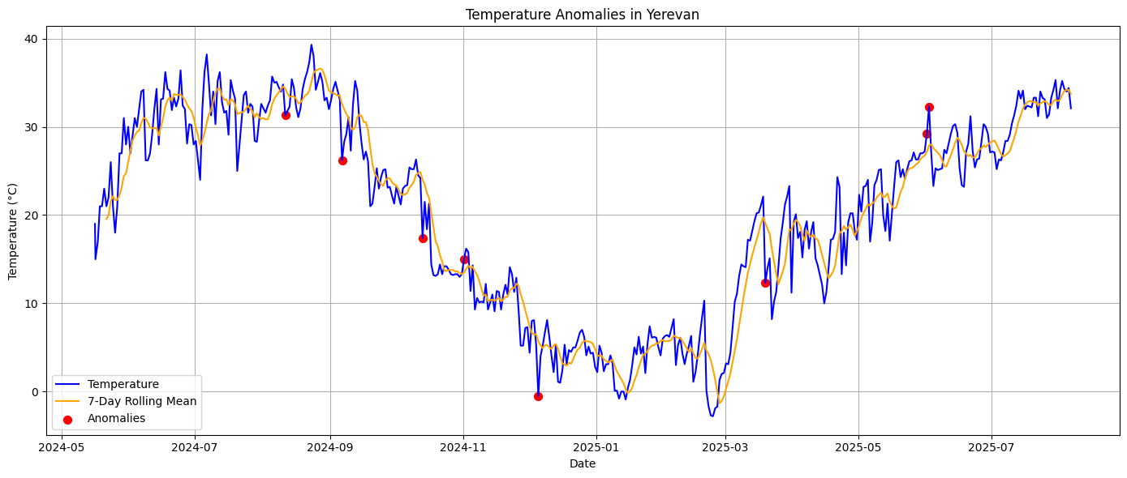
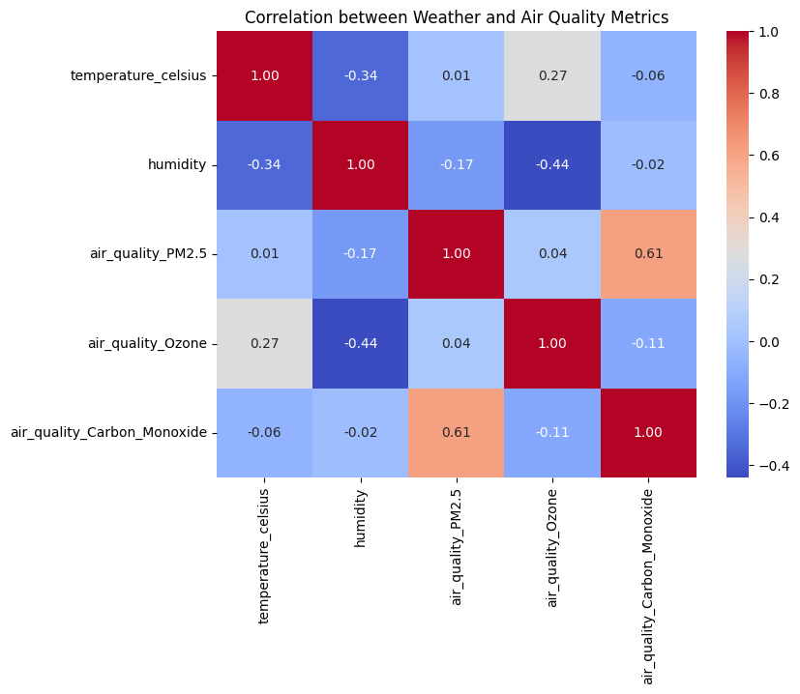

Slide 13
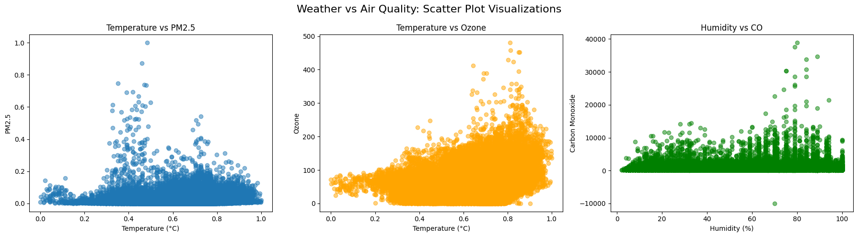
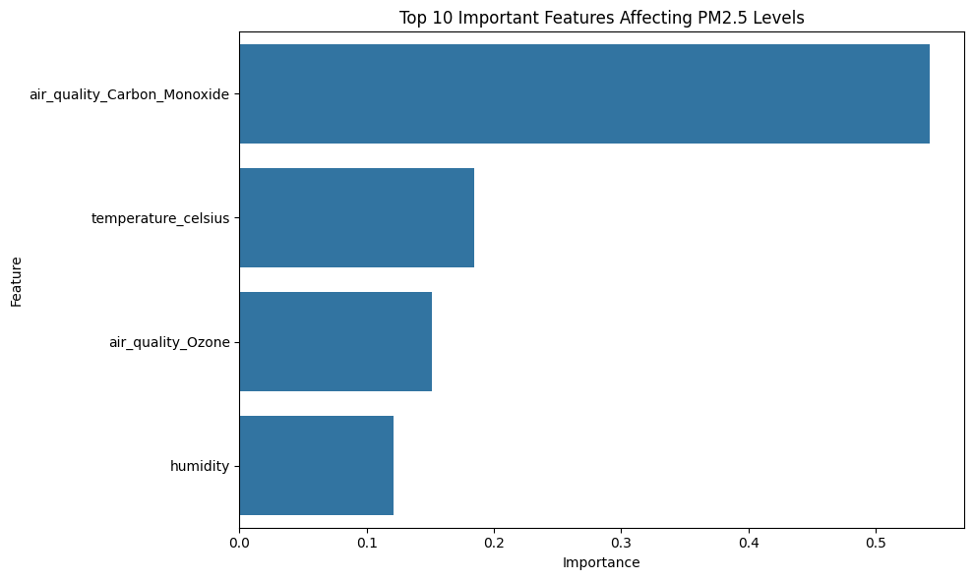

Slide 14
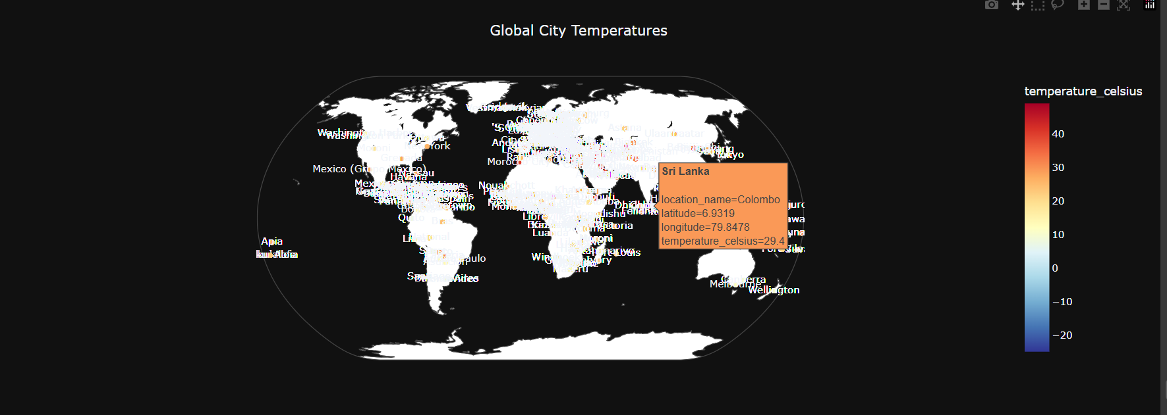

Slide 15
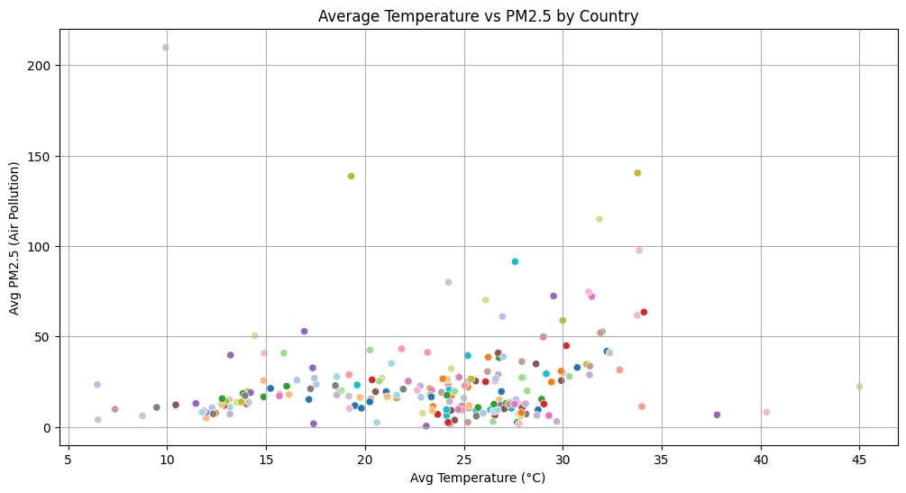
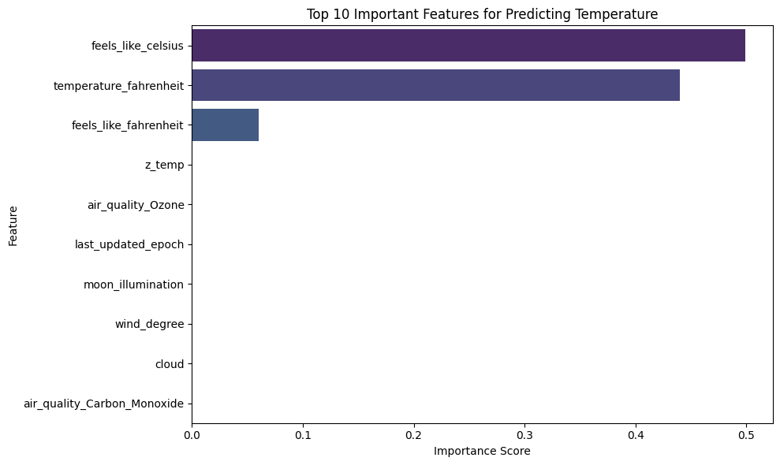
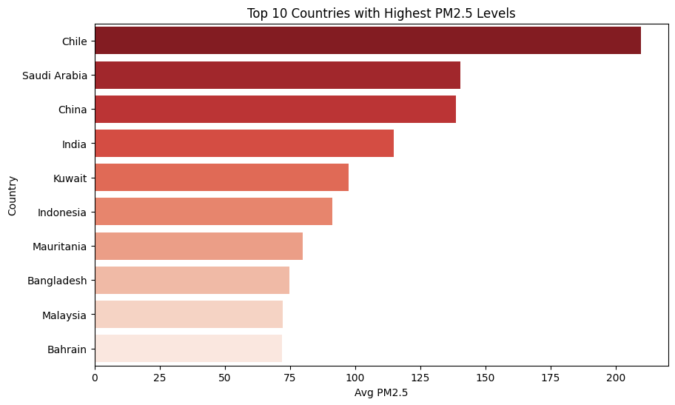

Slide 16
Conclusion & Insights
ETS model was the most accurate among individual models.
Yerevan showed the highest error due to high variance in temperature.
Air quality and temperature patterns align with environmental observations globally.
Ensemble forecasting and spatial analysis add practical value for climate tech applications.

