Slide 1
Safe Haven: Confidential Support System for Victims of Domestic Violence

Slide 2
Contents
Introduction
Literature Survey
ER Diagram
Requirements
Tables

Slide 3
Introduction
Problem Statement :Victims of domestic violence require discreet, accessible, and immediate support options,but existing systems may be fragmented or difficult to access. A confidential app thatprovides safety planning, emergency contacts, and direct communication with supportservices could empower victims to seek help safely.
Domestic violence victims face barriers in seeking help.
Existing systems are fragmented and hard to access.
Need for a confidential, accessible, and immediate support app.

Slide 4
Literature Survey
Existing apps/services provide some features but:
- Lack integration of safety planning, contacts, and services.
- Many are not discreet or user-friendly.
Research shows victims need:
-Quick emergency response.
-Anonymous and safe communication.
-Reliable database of services.

Slide 5
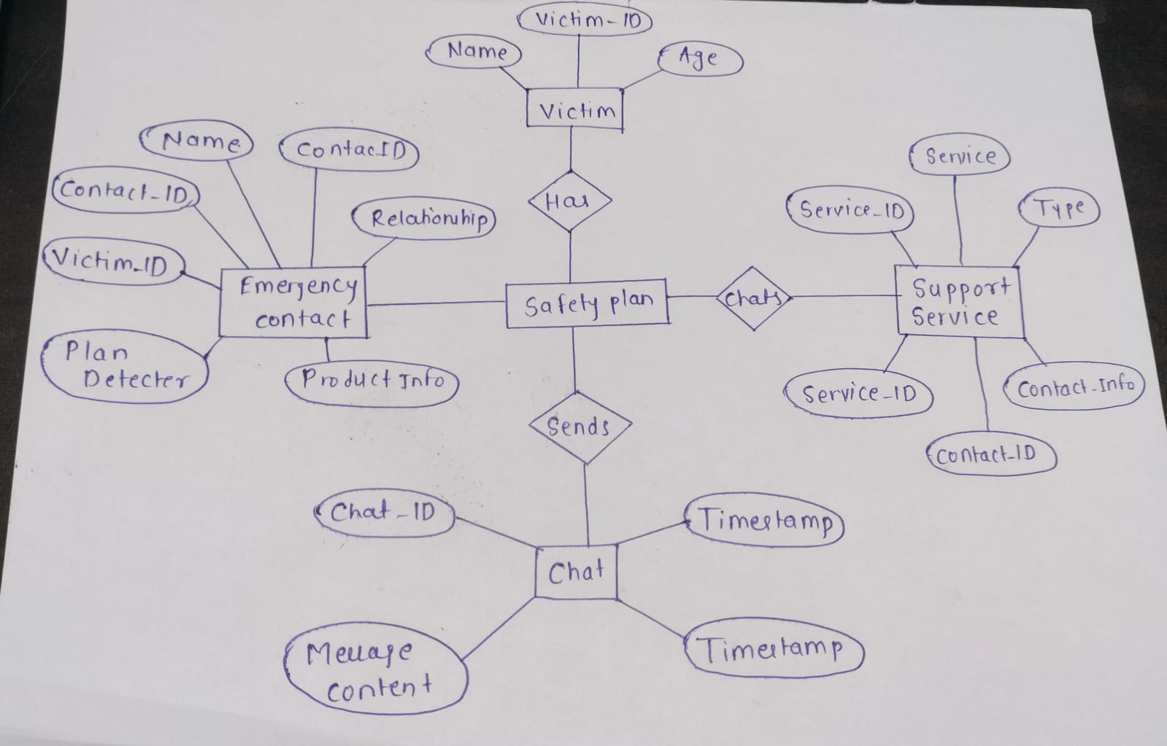
ER Diagram
Entity Relationship Diagram of the Confidential Support App

Slide 6
Requirements
Functional Requirements:
User registration/login (optional for safety).
Emergency SOS button.
Contact directory of support services.
Chat/Call with NGOs or police.
Hidden/disguise mode.
Non-Functional Requirements:
Data confidentiality and encryption.
High availability and quick response.
Mobile-friendly UI.

Slide 7
Database Tables
Users Table – user_id, name, contact info (optional).
Emergency_Contacts Table – contact_id, type, phone/email.
Support_Services Table – service_id, org _name, location, helpline.
Incident_Reports Table – report_id, user_id, description, timestamp.

Slide 8
Tech Stack
Frontend: React Native / Flutter
Backend: Node.js (Express) / Django
Database : MySQL
Security: JWT, Data Encryption (SSL/AES)
APIs/Services: Firebase (Auth, Notifications), Twilio (SMS/Calls)

Slide 9
Thank You

