Slide 1


CE Verse
Prepared by: Shruti Sangani(21CE118)
Khushi Shah(21CE127)
Moxshang Shah(21CE129)
Guided by: Asif Iqbal Thakor
Department:U & P U Patel Department of Computer Engineering

Slide 2
Definition
This a website is made reader friendly and with relevant information to get information about CE branch in CHARUSAT which helps student to find each and every detail in a simplified way.

Slide 3
Why we had chose this project
Our main purpose behind choosing this project was to reduce the difficulties faced by the students on our main website.
As we also have faced this similar situation so this will able to guide them easily.

Slide 4
Key Features
Website made with salient features of useful things.
Used of different languages for making this website.
Website is designed by keeping point of view of 1st year student.

Slide 5
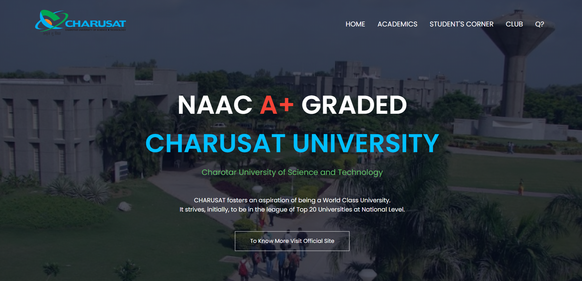

Slide 6
Detailed Explanation
As we can see in the picture this website includes options like home page, academics, timetable, query section, classroom.
If any one who has join after some time then this website will be helpful to them as well as others also.
In this we have also kept some images so they can easily get the idea of their department.
The main benefit of this website is that we can clear their doubt if they have query.

Slide 7
Languages used
HTML
Java script
CSS
GitHub - shruti3977/charusat_website
Website - https://ceverse.netlify.app/

Slide 8
Advantages
User Friendly.
Time Convenient.
Anyone can easily access.
Can be used at any time.
Simply Planned.

Slide 9
References
Reference has been taken from the official website of Charusat.
References has also been taken from web designing and development tutorials.
From Google also.

Slide 10


