Slide 1
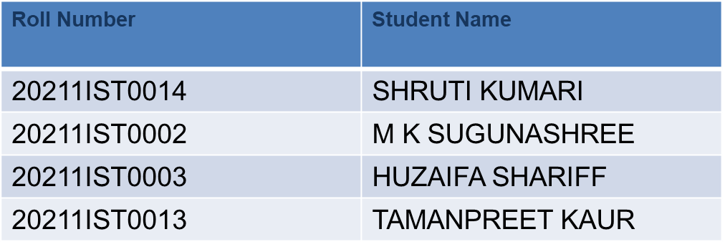
PSCS64: MediMate -Making HealthCare Support Easy , One Chat AT A Time
PIP104 University Project-II
Review-1
Batch Number:PSCS64
Under the Supervision of,
Ms. MONISHA GUPTA
Professor
School of Computer Science & Engineering
Presidency University
Name of the Program: Bachelor Of Technology
Name of the HoD: Dr Pallavi R
Name of the Program Project Coordinator: Ms. Monisha Gupta
Name of the School Project Coordinators: Dr. Sampath A K / Dr. Abdul Khadar A / Mr. Md Ziaur Rahman

Slide 2
Introduction
A customer support chatbot using machine learning (ML) is designed to automate customer service processes by interpreting user queries, searching relevant databases for solutions, and providing timely responses. By leveraging natural language processing (NLP) and ML algorithms, the chatbot can understand and resolve customer complaints efficiently. It can also learn from interactions, improving over time by updating the database with new solutions based on conversations between customers and support staff. This continuous learning process enhances future interactions, making the chatbot more responsive and effective in addressing diverse customer needs.
When a query is unfamiliar, it escalates the issue to a support staff member. Through conversations between customers and staff, the chatbot updates the database, learning from new solutions. Over time, this improves its ability to handle similar future queries autonomously. This approach reduces response times, minimizes human intervention, and ensures continuous improvement of customer service interactions.

Slide 3
Literature Review
Chatbots and AI-driven conversational agents highlights their evolution from simple rule-based systems to sophisticated, NLP-enhanced models capable of handling complex customer queries. Modern chatbots, such as those utilizing models like BERT and GPT, leverage advanced NLP and machine learning to interpret user intent, generate context-aware responses, and continuously improve through user interaction. Key applications in customer support demonstrate how chatbots streamline processes, reduce costs, and escalate unresolved issues to human agents, while updating their knowledge base for future use. However, challenges such as intent recognition and handling out-of-domain queries persist.
Sl. No. | Author | Challenges/Research Problems | Objectives | Methodology | Major Findings
1. | Bhawiyuga et al. (2017) | The research work on designing chatbots aimed at e-commerce is still very limited. | Propose the design and implementation of an e-commerce chatbot system that provides automatic responses to customers’ questions. | System development, experiment | In the usability and performance testing, the proposed system can automatically deliver the answer in less than 5 s with relatively good matching accuracy
2. | Cui et al. (2017) | There are significant issues in terms of data scale and privacy. | Present a customer service chatbot that leverages large-scale and publicly available commerce data. | System development | Improved the end-to-end user experience in terms of online shopping as it is more convenient for customer’s information acquisition.

Slide 4
Literature Review
3. | Doherty and Curran (2019) | There is a lack of technology in place to enhance the customer online banking experience. | Implement a web-based chatbot to assist with online banking. | System development, experiment | Enhance accessibility.
4. | Herrera et al. (2019) | Help people interact more easily | Present a live customer service using a chatbot along with several services. | System development | Customer support and experience are improved.
5. | Kurachi et al. (2018) | Improve efficiency of contact centers by utilizing AI. | Outline the contact point solution and describe the AI chatbot technology behind the solution | Concept presentation only | It proposes the CHORDSHIP Digital Agent, which is equipped with an AI technology ideal for contact centers; it is a “conversation-machine learning hybrid AI”
6. | Suhel et al. (2020) | Limited number of tests considered in the study. | Ontology-based dialog handling in the area of banking and finance. | Case studies | Implementation of chatbots can enhance the quality of user services and reduce human workload.

Slide 5
Literature Review
7. | IllescasManzano et al. (2021) | Chatbot application deployment platform privacy restriction. | Leads generated approach | Survey | Chatbot implementation leads to immediate response customer query
8. | Nuruzzaman and Hussain (2020) | Existing chatbots have several shortcomings, e.g. failing to provide a meaningful response to the user, offering semantically incorrect information etc. | Proposes a domain-specific chatbot, that uses multiple strategies to generate a response. | System development, experiment | The comparison results between it and 3 other chatbot demonstrate its superiority in providing the user with a complete answer and engaging the user in a dialogue.
9. | Chakrabarti and Luger (2014) | Contemporary chatter bots do not perform well at tasks where a specific context has to be maintained across a several utterance exchanges pairs. | Demonstrate a modular, robust, and scalable architecture for chatter bots. | System development, experiment | The proposed system had a success rate of 87.5%.
10. | Putri et al. (2019) | There is only little research in developing chatbot-hotel in Indonesia. | Develop an interactive intelligent personalized chatbot-hotel by using AIML and Google Flutter. | System development | The proposed prototype chatbot-hotel Berscha in Indonesia was developed; however, no performance evaluation was reported.

Slide 6
Objectives
The objectives of the customer support chatbot project focus on automating query resolution, enhancing personalization, and improving customer service efficiency through machine learning, while continuously learning from interactions for future improvements. The key points include:
Automate Customer Query Resolution : Create a chatbot that can accurately interpret customer inquiries and provide timely, relevant responses using machine learning-based NLP techniques.
Enhance Efficiency through Knowledge Base Integration :The chatbot should be equipped with a current knowledge base to effectively address common customer issues and learn from past interactions.
Personalized Customer Support :Utilize customer profile data to enhance the relevance and quality of support by tailoring responses to the customer's previous interactions or purchase history.
Continuous Learning and Adaptation :Implement a system for updating the chatbot's knowledge base and training models after each interaction, enhancing its ability to handle similar issues with greater accuracy.
Improve User Experience and Satisfaction :The chatbot should provide a seamless and efficient customer experience by promptly addressing their concerns, minimizing wait times, and enhancing overall satisfaction.

Slide 7
Existing Methods-Drawbacks
Some drawbacks of customer support chatbots include:
Limited understanding: Chatbots may struggle with complex or unusual queries, leading to incorrect or incomplete answers.
Lack of personalization: Bots may not offer personalized support like human agents can, making responses feel generic.
Inability to handle emotions: Bots can't understand or respond to emotions effectively, which can frustrate upset customers.
Dependency on pre-programmed knowledge: Chatbots rely on the data they're trained on, so they may lack the latest information.
Escalation delays: If a chatbot can't solve an issue, it may take longer to escalate it to a human agent, causing delays.

Slide 8
Proposed Method
To build a customer support chatbot using machine learning, the proposed methodology includes the following key points:
Data Collection and Preprocessing :Gather customer queries and complaint data and preprocess this data in a format suitable for ML models using Natural Language Processing (NLP) techniques
Model Selection :Choose appropriate ML models for tasks such as
- Natural Language Processing (NLP) for understanding customer queries.
- Sentiment Analysis to gauge customer satisfaction.
- Intent Recognition to determine the purpose of customer inquiries.
- Recommendation Systems to suggest solutions based on previous similar issues.
Training the Model :Utilizing the prepared dataset, train the chosen models. Update the training data frequently to increase accuracy.
Chatbot Architecture : Utilizing transformer or sequence-to-sequence models, which enable context-aware answers, construct the chatbot. Build the chatbot's machine learning models using frameworks like TensorFlow or PyTorch, and use Flask or Django for deployment.
Database Management and Query Handling : Implement a backend database to store customer queries and retrieve relevant information quickly, ensuring optimal performance for customer interactions.
Evaluation : Conduct regular evaluation of the chatbot's accuracy using metrics such as response time, accuracy, and customer satisfaction.
Learning from Customer-Agent Interactions : Design the system to monitor the interactions between customers and support agents, extract new information and update the database, improving future chatbot performance.

Slide 9
Methodology/Modules
Here are a few key points on the proposed methodology for the customer support chatbot project:
Natural Language Processing (NLP) Implementation :The chatbot will use Natural Language Processing (NLP) techniques like tokenization, stemming, and lemmatization to accurately understand and classify customer queries.
Machine Learning Algorithms :Supervised learning models like Decision Trees, Random Forests, or Neural Networks are utilized to predict and suggest optimal solutions based on historical data.
Query Classification and DB Search :Create a database containing various customer issues and solutions, with a chatbot classifying queries, matching them to existing data, and retrieving potential resolutions.
Continuous Learning :Use reinforcement learning or other learning methods to ensure that the chatbot improves over time.
User Interface and Experience (UI/UX) :Develop a user-friendly interface for both customers and support agents to interact with the chatbot and facilitate efficient issue resolution.
Performance Monitoring :Implement logging and tracking of chatbot responses to monitor performance, success rates, and areas for improvement, ensuring the chatbot becomes more efficient over time.
This methodology focuses on building an intelligent chatbot system capable of both handling routine customer queries and learning from interactions to improve future performance.

Slide 10
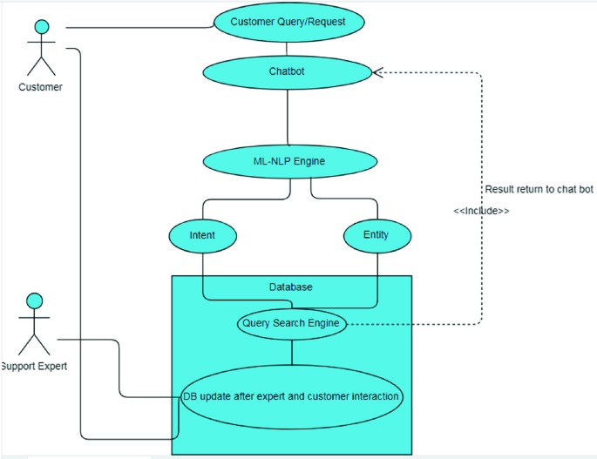
Architecture Diagram

Slide 11
Hardware/Software compoments
Hardware Components:
Servers: To host the chatbot, process requests, and store data.
Networking equipment: Routers, switches, and internet connections to ensure smooth communication between users and the chatbot.
Storage devices: For storing chatbot logs, user interactions, and data analytics.
Software Components:
Natural Language Processing (NLP) engine: For understanding and processing human language.
Machine Learning models: To improve the bot's understanding and responses based on user interactions.
Chatbot framework: The software platform that builds and manages the bot (e.g., Microsoft Bot Framework).
User Interface (UI): For interaction, whether it's through text, voice, or other input forms.
Analytics tools: To track performance and improve the chatbot's effectiveness by analyzing user interactions.

Slide 12
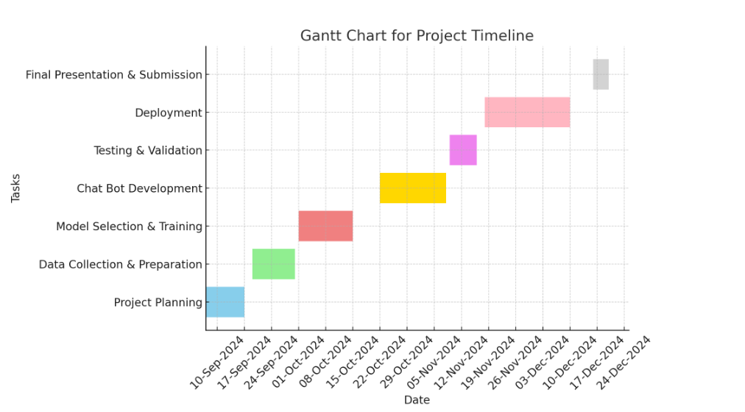
Timeline of Project/Gantt Chart

Slide 13
Expected Outcomes
This project aims to showcase the benefits of automation and AI in customer support, focusing on efficient query handling, streamlined resolution processes, and continuous learning for future interactions. Here are a few points on the expected outcomes :
Automated Query Resolution :The chatbot will automatically resolve customer queries by searching the database for previously recorded solutions, reducing manual effort for customer support teams.
Improved Response Times :The chatbot is expected to significantly enhance response times by providing immediate solutions, thereby boosting customer satisfaction and reducing waiting times.
Adaptive Learning :The system will continuously improve its effectiveness in handling diverse queries by learning from customer interactions and incorporating new solutions over time.
Enhanced Support Staff Efficiency :The chatbot will enhance productivity by assisting human agents in handling common queries and allowing them to concentrate on more complex issues.
Accurate Query Classification :The chatbot, using NLP and machine learning algorithms, will accurately classify queries and match them to relevant solutions in the database for precise issue resolution.
Continuous Database Enrichment :The chatbot will enhance the organization's knowledge base by regularly adding new issues and resolutions, thereby improving future query handling.
These outcomes aim to streamline customer support processes, reduce operational costs, and improve the overall customer experience.

Slide 14
Conclusion
In conclusion, the customer support chatbot project leverages AI and automation to enhance efficiency in addressing customer queries. The system not only resolves common issues by searching a database for relevant solutions but also escalates unresolved problems to human staff, allowing for continuous learning by updating the database based on these interactions. This ensures the chatbot becomes progressively better at handling similar queries in the future, ultimately improving customer satisfaction and reducing response time.
A customer support chatbot powered by machine learning (ML) improves efficiency by quickly understanding and responding to customer queries. It uses Natural Language Processing (NLP) to recognize intent and provide relevant solutions. Over time, ML helps the bot learn and improve from past interactions. This automation reduces response times, handles repetitive questions, and frees human agents for more complex issue.
ML-driven chatbots streamline customer service by providing instant, accurate support, but may still require human assistance for complex cases.

Slide 15
Github Link
https://github.com/shruti7877/Capstone-Project

Slide 16
References
Prof.K. Bala, Mukesh Kumar, Sayali Hulawale and SahiI Pandita, "Chat-Bot For College Management System Using A.I", International Research Journal of Engineering and Technology (IRJET), vol. 04, no. 11, pp. 2030-2033, Nov 2017.
Guruswami Hiremath, Aishwarya Hajare, Priyanka Bhosale, Rasika Nanaware and K. S. Wagh, "Chatbot for education system", International Journal of Advance Research Ideas and Innovations in Technology (IJARIIT), vol. 4, no. 3, pp. 37-43, 2018.
K. Jwala, G.N.V.G Sirisha and G.V. Padma Raju, "Developing a Chatbot using Machine Learning", International Journal of Recent Technology and Engineering (IJRTE), vol. 8, no. 1S3, pp. 89-92, June 2019.
Naeun Lee, Kirak Kim and Taeseon Yoon, "Implementation of Robot Journalism by Programming Custombot using Tokenization and Custom Tagging", International Conference on Advanced Communications Technology (ICACT), pp. 566-570, Feb 2017.
Setiaji Bayu and Wibowo Ferry, "Chatbot Using a Knowledge in Database: Human-to-Machine Conversation Modeling", 7th International Conference on Intelligent Systems Modelling and Simulation (ISMS), pp. 72-77, Jan 2016.
M. Nuruzzaman and O. K. Hussain, "A survey on chatbot implementation in customer service industry through deep neural networks", 2018 IEEE 15th International Conference on e-Business Engineering (ICEBE)., pp. 54-61, 2018.
A. Rahman, A. Al Mamun and A. Islam, "Programming challenges of chatbot: Current and future prospective", 2017 IEEE Region 10 Humanitarian Technology Conference (R10-HTC)., pp. 75-78, 2017.
J. Hill, W. Ford and I. Farreras, Real conversations with artificial intelligence: A comparison between human-human online conversations and human-chatbot conversations, vol. 49, 2015.

Slide 17
References
I. Sutskever, Oriol Vinyals and Quoc V. Le, "Sequence to sequence learning with neural networks", Advances in Neural Information Processing Systems 27:Annual Conference on Neural Information Processing Systems 2014, pp. 3104-3112, December 8-13 2014.
M. Adam, M. Wessel, A. Benlian, Ai-based chatbots in customer service and their effects on user compliance, Electron. Mark. (2020), pp. 1-19

Slide 18
Project Work Mapping With SDG
SDG 4: Quality Education
SDG 8: Decent Work and Economic Growth
SDG 9: Industry, Innovation, and Infrastructure
SDG 10: Reduced Inequalities

Slide 19
Thank You

