Slide 1
Lung Cancer Prediction using MAchine Learning and cnn ( convolutional neural network )
Project i [ P.22.6.631 ]
Team Members :
Shruti Verma (25325)
Abhishek (25230)
LAkshay (25278)
Mentors :
prof. parveen kumari
prof. suman chopra

Slide 2
Introduction
Lung cancer is one of the most common and fatal types of cancer globally.
It causes uncontrolled growth of cells in lung tissues, interfering with breathing and spreading rapidly.
Early detection increases survival rates significantly.
Traditional diagnosis through CT scan interpretation is slow and prone to error.
This project introduces an AI-based solution for early, automated detection.
Problem statement
The current manual process for analyzing CT scans is time-consuming and subjective.
Radiologists face limitations in terms of availability and consistency.
There’s a lack of intelligent, automated systems for real-time diagnosis.
Need for a system that combines medical imaging and artificial intelligence to provide fast and accurate diagnosis.

Slide 3
Objectives
To develop a deep learning model using Convolutional Neural Networks (CNN) to classify lung CT scan images.
To preprocess and enhance image quality for better model performance.
To build a web-based application for uploading scans and receiving predictions.
To provide diagnostic confidence scores and downloadable reports.
To explore integration of blood parameter input for multimodal prediction.
Methodology
Data Collection:
Public CT scan image dataset from Kaggle.
2 real-life lung images captured.
Image Preprocessing:
Resizing images to 224×224.
Converting to grayscale.
Gaussian blur for noise removal.
Canny edge detection.
Normalization and data augmentation.
3. Model Development:
CNN built using TensorFlow and Keras.
Binary classification (Normal vs Cancer).
Train-test split with performance evaluation.
4. Web App Interface:
Built using HTML, CSS, JavaScript.
Simulated analysis result with modal display.
Downloadable .txt report generation.

Slide 4
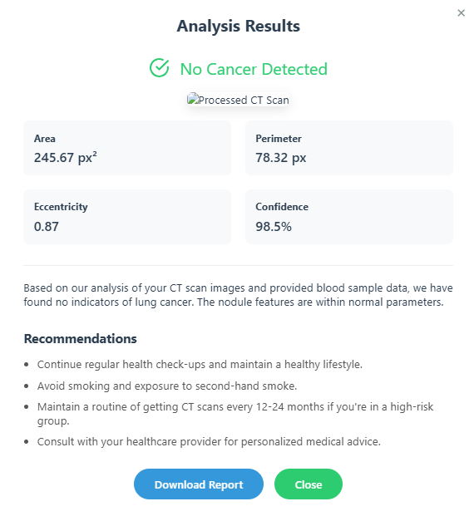
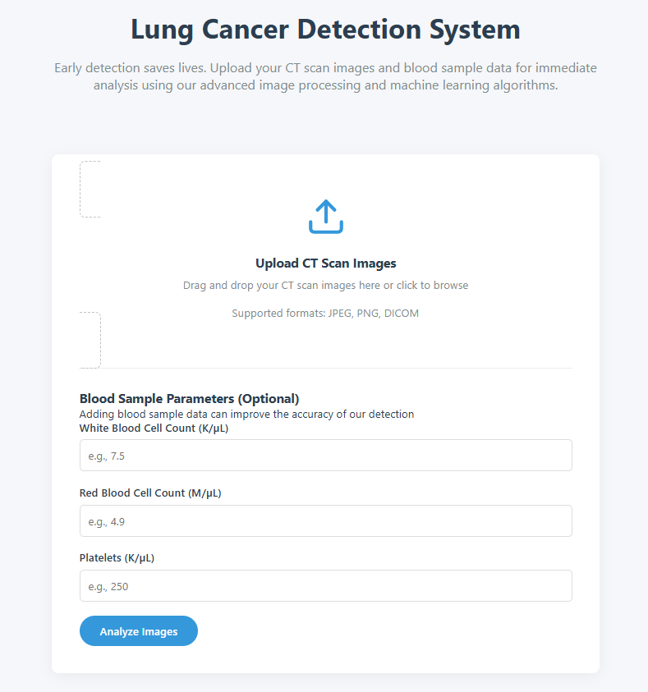

Slide 5
tools and libraries
Programming Language: Python
Libraries and Frameworks:
TensorFlow, Keras – for deep learning model
OpenCV – for image processing
NumPy, Pandas – for data handling
Matplotlib, Seaborn – for visualization
Frontend: HTML, CSS, JavaScript
4. Algorithms Implemented:
Traditional Machine Learning:
Logistic Regression, K-Nearest Neighbors (KNN).
Decision Tree, Bagging Classifier, Gaussian Naive Bayes, Random Forest.
Deep Learning (for Image Analysis):
Convolutional Neural Networks (CNN).

Slide 6
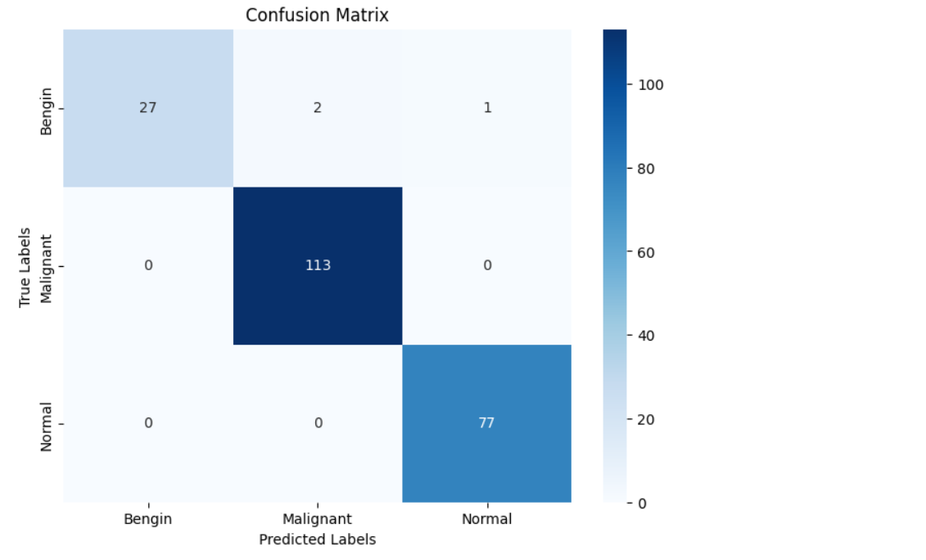
expected Results
The model demonstrated strong performance, especially in early detection.
Training Accuracy: Achieved 98.3% (training) and 97.8% (validation), indicating good generalization.
Multi-class Classification (Benign, Malignant, Normal):
Overall Accuracy: 88.3%
Recall for Malignant cases: 100% (crucial for medical diagnosis).

Slide 7
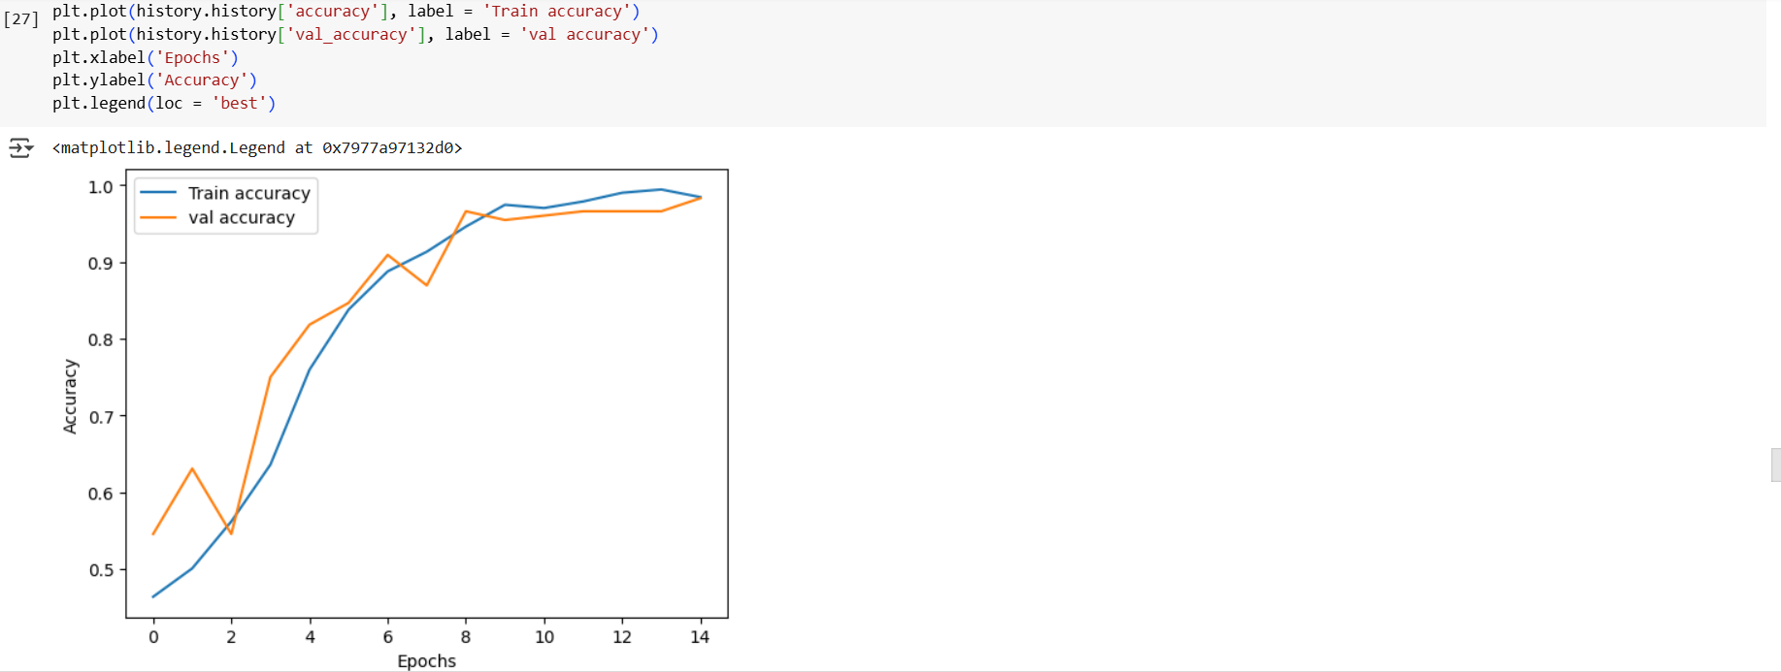

expected Results
Binary Classification (Best Performance):
Overall Accuracy: 89.3%
F1-score: 93.9%
Clinical Significance: Consistently high recall (93.1% to 100%) minimizes missed diagnoses.

Slide 8
scope and limitations
Scope:
Can serve as a supportive tool for radiologists.
Useful in rural/remote areas where diagnostic infrastructure is limited.
Helps in awareness and early-stage diagnosis campaigns.
Limitations:
Dataset size is small, may not generalize perfectly to unseen data.
Currently, the web frontend simulates the prediction; no live model integration yet.
Accuracy may vary depending on input image quality and orientation.
Not intended to replace medical professionals or final diagnosis.

Slide 9
references
[1] S. Nageswaran et al., “[Retracted] Lung Cancer Classification and Prediction Using Machine Learning and Image Processing,” BioMed Research International, vol. 2022, no. 1, p. 1755460, 2022.
[2] S. U. Krishna, A. Lakshman, T. Archana, K. Raja, and M. Ayyadurai, “Lung cancer prediction and classification using decision tree and VGG16 convolutional neural networks,” The Open Biomedical Engineering Journal, vol. 18, no. 1, 2024.
[3] I. Nazir, I. ul Haq, S. A. AlQahtani, M. M. Jadoon, and M. Dahshan, “Machine Learning-Based Lung Cancer Detection Using Multiview Image Registration and Fusion,” Journal of Sensors, vol. 2023, no. 1, p. 6683438, 2023.
[4] K. Tuncal, B. Sekeroglu, and C. Ozkan, “Lung cancer incidence prediction using machine learning algorithms,” Journal of advances in information technology, vol. 11, no. 2, 2020.
[5] S. Raut, S. Patil, and G. Shelke, “Lung cancer detection using machine learning approach,” International Journal of Advance Scientific Research and Engineering Trends (IJASRET), 2021.

