Slide 1

DEALSDATE-ONLINE GIFT SHOPPING WEBSITE

Slide 2
TEAM MEMBERS DETAILS
NAME | ROLE | MODULE
Shruti Dwivedi | Product Owner | Home Page(dashboard)
Sai Teja MathamSetty | Scrum Master | Favourites & Settings
Kiran B Rajput | Scrum Team | Login System
Rohit Kumar | Scrum Team | Order Management
Kapil Kumar | Scrum Team | Admin Side
Shreyash Kumar Singh | Scrum Team | Cart Management

Slide 3
INTRODUCTION
DealsDate is a online gift shopping website providing gifts for special occasions.
Our module has 2 phases – Admin & User
Admin will be responsible for availability of stocks .
User can place order keeping in mimnd the parameters as pricing, timing,occasions,etc

Slide 4
REQUIREMENTS
Login as User/Admin
Skip the login/sign up
AUTHENTICATION MODULE

Slide 5
REQUIREMENTS
Categories will be managed
Search option will be provided
According to the particular Click of product Add to Cart/Like Item option is managed.
HOME PAGE

Slide 6
REQUIREMENTS
View Cart item
View will proceed Delete option
Update product quantity
CART MODULE

Slide 7
REQUIREMENTS
Settings will help in managing User Account Details ,updating details, like name and mobile no.
Like module will manage Favourites to cart.
LIKE & SETTINGS MODULE

Slide 8
REQUIREMENTS
Admin will manage updation of stocks.
Admin can update product details.
Admin updates the tracking details of an order.
ADMIN MODULE

Slide 9
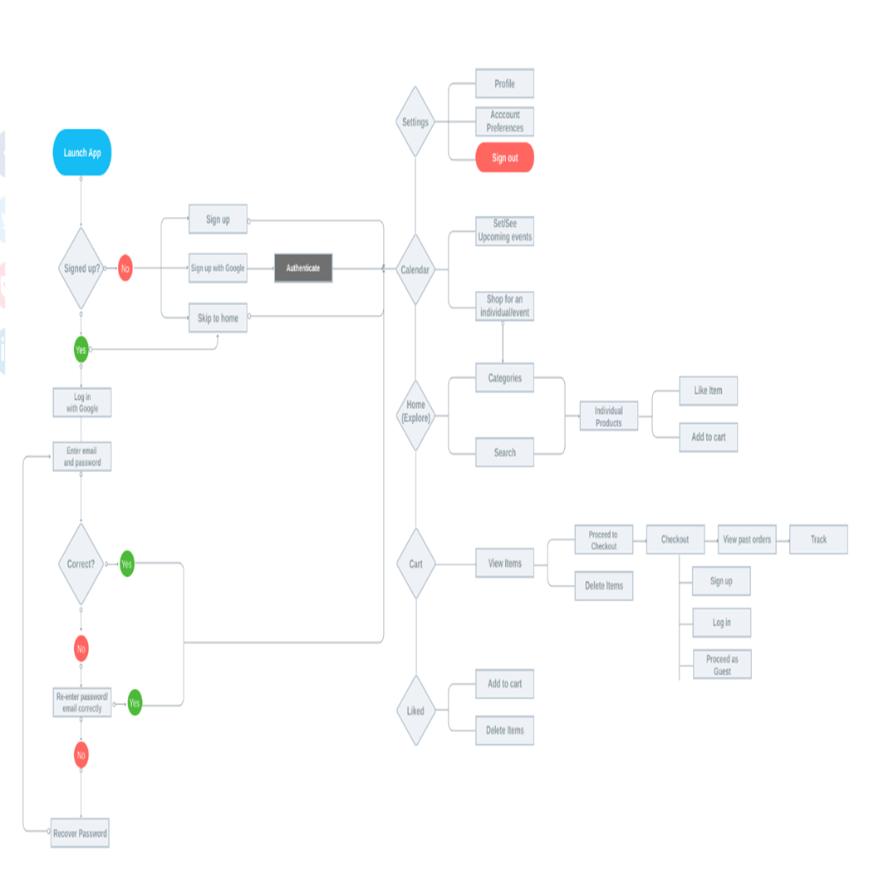
final use case diagram:

