Slide 1


Generating $g g→H→4l$ $tree$ $×$ $loop$ interference events with $dim$-$6$ operators using MadGraph
Jay Sandesara, Rafael Coelho lopes de sa, Lailin xu

Slide 2
Introduction
Something like this - Follow up on Lailins presentation now with cpG*cXX interference terms
With some more introduction here

Slide 3
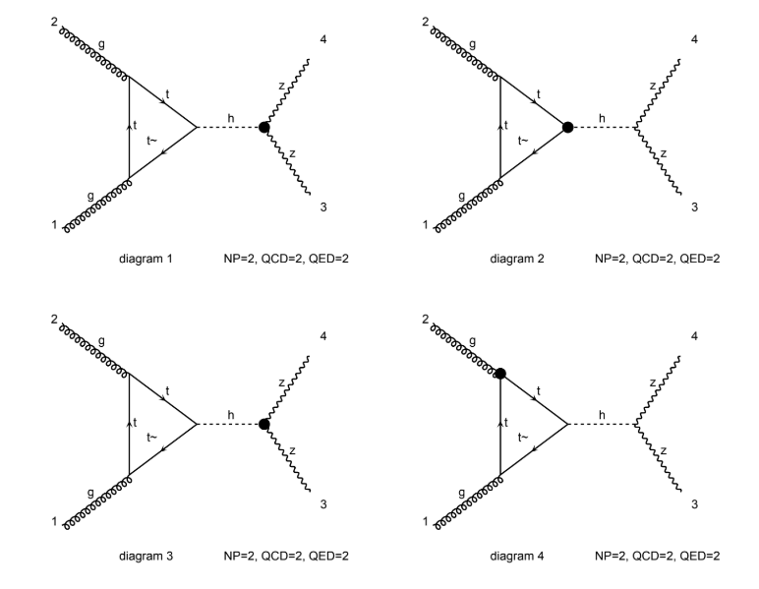
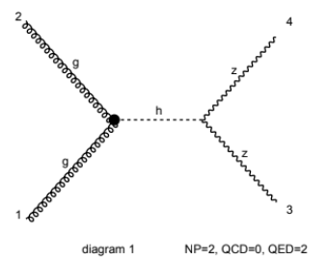
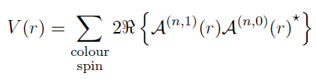
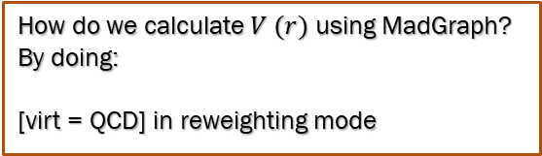
How do we generate the cpG*cXX interference?
By calculating virtual corrections to the cpG tree diagram from one-loop diagrams that are pure loop induced with no tree counterpart
x
How do we calculate $V (r)$ using MadGraph? By doing:
[virt = QCD] in reweighting mode

Slide 4
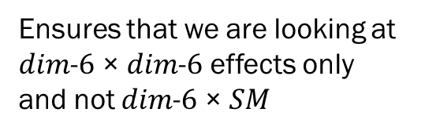
First try the straightforward approach in reweighting mode:
change process g g > h > z z QED=2 QCD=2 NP=2 NP^2==4 [virt=QCD]
Ensures that we are looking at
$dim$-$6$ × $dim$-$6$ effects only
and not $dim$-$6$ × $SM$

Slide 5
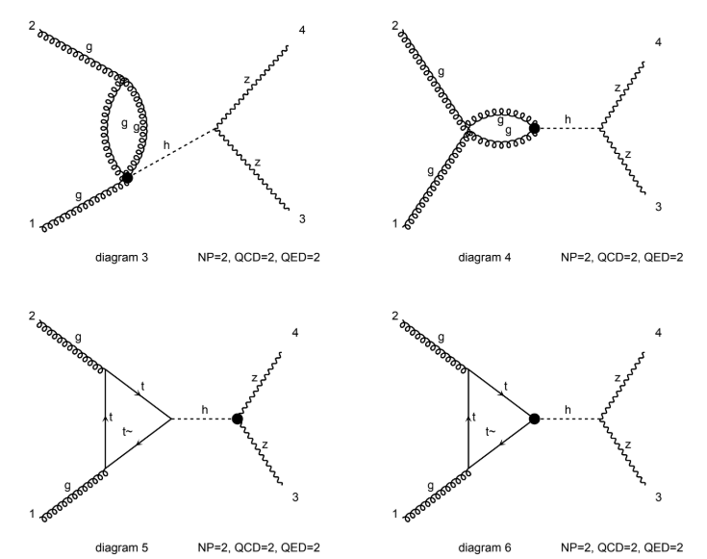
First try the straightforward approach in reweighting mode:
change process g g > h > z z QED=2 QCD=2 NP=2 NP^2==4 [virt=QCD]
Ensures that we are looking at
$dim$-$6$ × $dim$-$6$ effects only
and not $dim$-$6$ × $SM$
x

Slide 6
First try the straightforward approach in reweighting mode:
change process g g > h > z z QED=2 QCD=2 NP=2 NP^2==4 [virt=QCD]
Ensures that we are looking at
$dim$-$6$ × $dim$-$6$ effects only
and not $dim$-$6$ × $SM$
This type of diagrams which are proportional to cpG must be somehow removed or suppressed to give meaningful results.
x

Slide 7
change process g g > h > z z QED=2 QCD=2 NP=2 NP^2==4 [virt=QCD] /g
Removes the gluon propagator diagrams from computation, giving us the desired interference
x

Slide 8
change process g g > h > z z QED=2 QCD=2 NP=2 NP^2==4 [virt=QCD] /g
Removes the gluon propagator diagrams from computation, giving us the desired interference
x
This strategy, however, creates an unexpected problem: counterterms

Slide 9
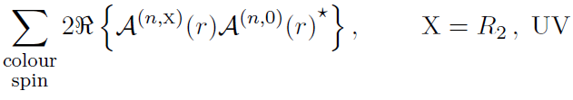
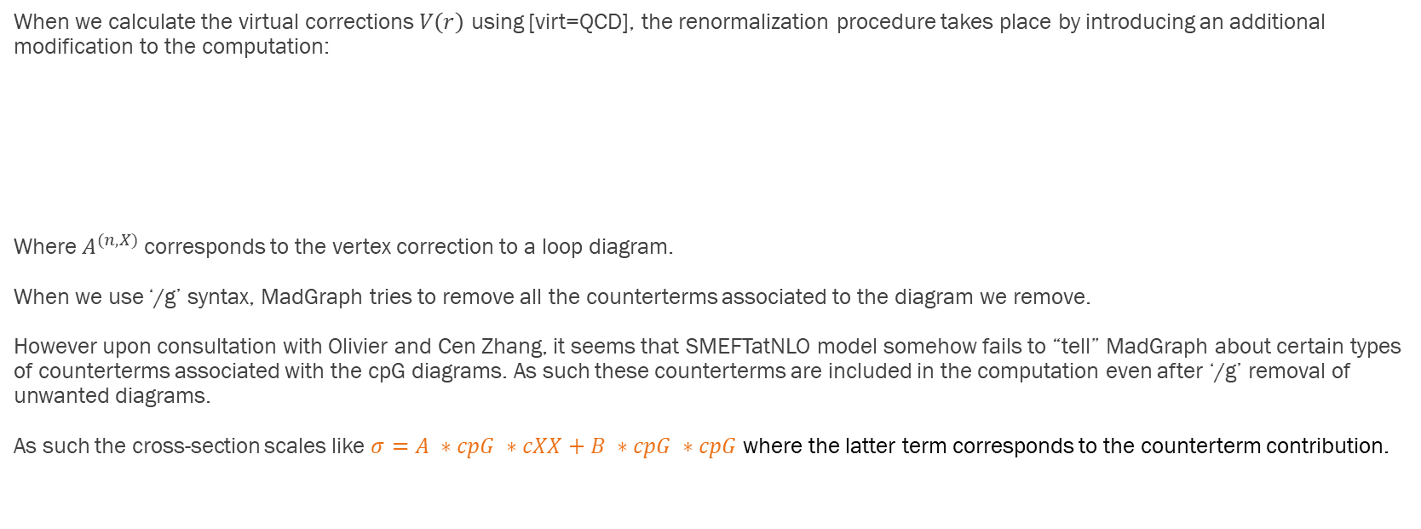
Issue with Counterterms
When we calculate the virtual corrections $V\left(r\right)$ using [virt=QCD], the renormalization procedure takes place by introducing an additional modification to the computation:
Where $A^{(n,X)}$ corresponds to the vertex correction to a loop diagram.
When we use ‘/g’ syntax, MadGraph tries to remove all the counterterms associated to the diagram we remove.
However upon consultation with Olivier and Cen Zhang, it seems that SMEFTatNLO model somehow fails to “tell” MadGraph about certain types of counterterms associated with the cpG diagrams. As such these counterterms are included in the computation even after ‘/g’ removal of unwanted diagrams.
As such the cross-section scales like $σ=A ∗cpG ∗cXX+B ∗cpG ∗cpG$ where the latter term corresponds to the counterterm contribution.

