Slide 1
IDS 575 - Machine Learning
Customer Segmentation
Group 18:
Sangeeta Baitalik - 653896036
Suruchi Jain - 659781101
Shruti Chanda - 670617428
Jin rong Qiu - 673250167

Slide 2
Data Curation
Cleaned and analysed the data
Data Exploration
Studied the features of the dataset like age, gender, etc.
Model Development
Kmeans
KNN
DBSCAN

Slide 3
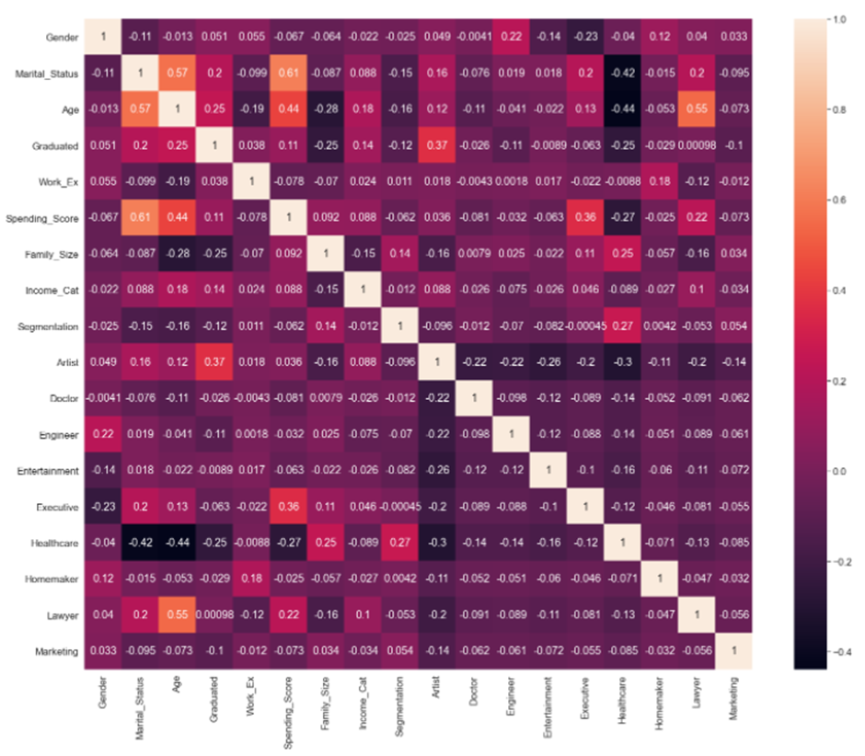
Data Exploration
Correlation Matrix
The heatmap shows correlation of each variable present in the dataset
Highest correlation to be seen amongst Age, Gender, work experience and income category
Work Experience of the population is high for 0-2 years while lowest for 12 years

Slide 4
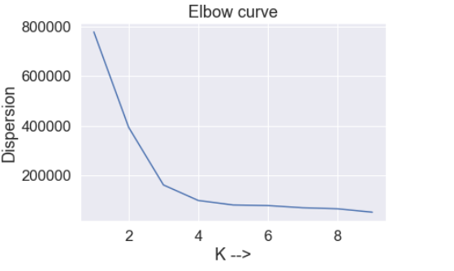
K-Means Algorithm
Here, we have implemented the k-means unsupervised learning algorithm and it assigns every data point to the closest cluster, while maintaining the centroids as small as possible.
Elbow Curve Plot takes the costs and the number of trials corresponding to different ‘k’.
Silhouette Score Plot takes the scores and the number of trials and corresponding to different ‘k’ with the accuracy of 44.8%
Since we are using random test and training splitting method the elbow curve and silhouette score for every rum varies

Slide 5
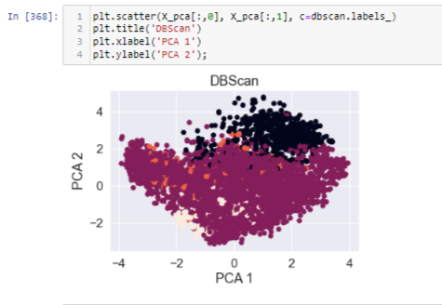
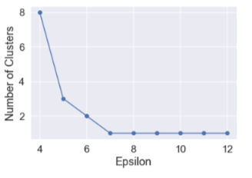
DBSCAN – Unsupervised Algorithm
DBSCAN is not useful with customer segmentation. The matching score between customer segmentation and the DBScan cluster is only 0.47%.
Notes:
DBScan is a density-based clustering algorithm that does not specify the number of clusters, and it is not sensitive to outliers. DBScan is a form of unsupervised clustering algorithm that can automatically identify clusters based on the data input and parameters. The major difference between DBScan and K-means is that DBScan can find arbitrary shapes on it own. It has amazing performance at handling outliers and noise because anything that is not within reachable distance from the core point is considered an outlier.

Slide 6



DBSCAN - Unsupervised Algorithm
Accuracy with eps = 4.35
At eps = 4, model returns 8 clusters with the accuracy of -0.011%.
At eps = 5, model returns only 3 clusters with the accuracy of -0.000245%.
So, a higher or lower eps value would give us a very poor results.
Accuracy with eps = 4
Accuracy with eps = 5
Notes:
It is difficult to find the number of eps that would give us exact four clusters because it is somewhere in between eps of 4 and 5. Therefore, we have to try to input different eps values to check which one will give me four clusters. After several trials, we found that eps set to 4.35 would give us four clusters.

Slide 7
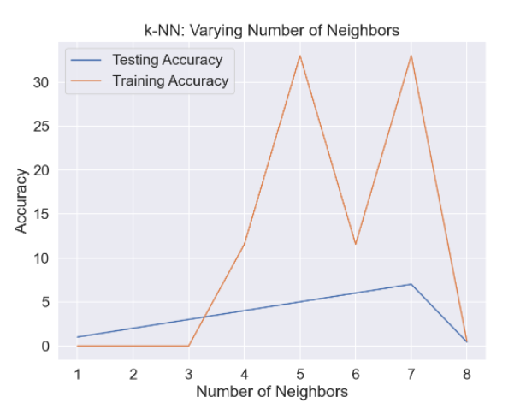
KNN - Supervised Algorithm
We have implemented KNN supervised algorithm to predict the future subscription tiers based in their age, graduated, work experience, and spending score and put them in a correct segment with the closest proximity.
From the graph, we can conclude that testing data is underfitting with the accuracy of 48.36
KNN’s main disadvantage of becoming significantly slower as the volume of data increases makes it an impractical choice in environments where predictions need to be made rapidly.

Slide 8
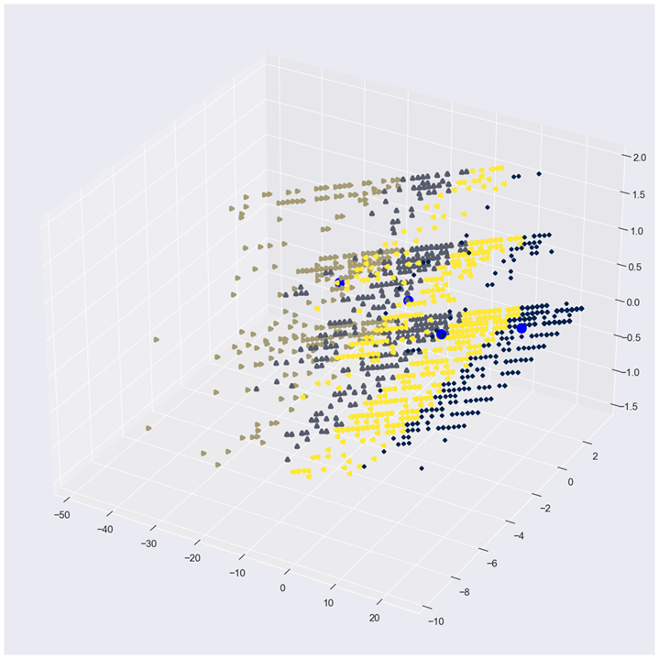
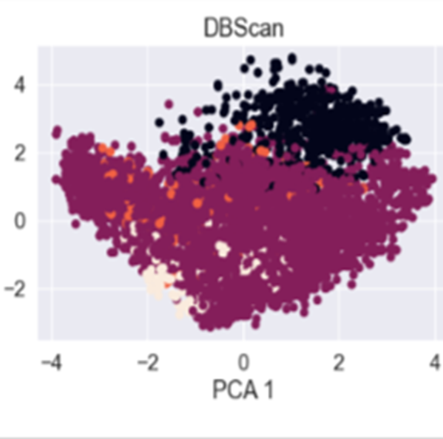
Insights
K- Means
DBSCAN
KNN
Accuracy – 44.8%
Unsupervised Algorithm
Cluster based
Accuracy – 4% to 5%
Unsupervised Algorithm
Radial Based Clustering
Accuracy – 48.36%
Supervised Algorithm
Neighbours Based

Slide 9
Thank You!

