Slide 1

Notes:
Good Morning/Evening. My name is ____________________ and I am a/the <title> with UltimateMatch. I want to thank all of you for taking time out of your busy schedule today to be with us.
Today/tonight we are going to share three very important pieces of information with you. First, we are going to tell you a little bit about our Company. Second, we will introduce you to our incredible service. A service that currently helps millions of single Americans across the nation connect. And, last but certainly not least, we will show you how you can capitalize on one of the fastest growing industries on the Internet and begin earning a lucrative income starting today!

Slide 2
Agenda
New…Wholesale Memberships Price
Update…Eligibility Requirements
Update…Ultimate Success System
New…Commissionable Service
New…National Conference
New … Spring Fling

Slide 3


Strategic Partners
Just under …
3 million members!
Gateway
www.soulmate.com

Slide 4
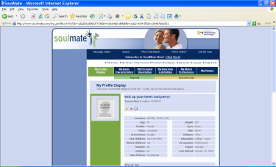
Profiles / Member
PAID
UNPAID
~ Search ~ Instant Message ~ eMail ~ Express Interest ~ Wink
~ Search Only ~ Receive One-way Comm

Slide 5
SoulMate Community
Representative Pool

Income for Life
Marketing Assistance Pool

Income One Year
Referral Code
Ultimate

Slide 6
Industry Standard
Online Dating Industry
~5% Paid Members Most Month-to-Month

Slide 7
Revolutionize & Dominate
Online Dating Industry
www.SoulMate.com
90% Paid Members Most Annual

Slide 8

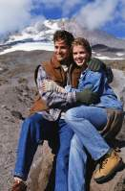

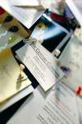


“Ultimate” Picture
Travel
Interest
Singles
Blogs
Jobs
Proven Products & Services
Voice Over IP

Slide 9

Enhancements
Increase
  Earnings
  Retention
  Momentum
Align
  Vision
  Strategy

Slide 10
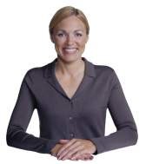
Wholesale Membership
$79.95!
March 20, 2006
Additional $10 Discount!
Customer for life
No Change To Compensation!


Slide 11

Eligibility
30 Calendar Days
April 28, 2006
Annual Memberships Only
No Additional Grace Periods


Slide 12

Ultimate Success System
Monthly Fee
April 28, 2006
$9.95 Recurring Monthly Fee
Discount for 6/12 Months
Grandfather Representatives
No Impact To QUR Status

Slide 13
Ultimate Success System
15/15 In Lieu
April 28, 2006
Pay initial $485
15 Annual Customers/QURs
60 Days
Waive $485
Pay Fast Start & Leadership

Slide 14
www.ultimatematchtravel.com
New Service
March 20, 2006
Commissionable Service
7-Level Commission Plan
Bonus Pool


Slide 15
Customer Commission
10 Annual Dating Customers*
Paid on personal plus 7 levels
Compressed to pay all levels
Paid On Non-Representative Referrals!
Paid 1st Friday of each month
Refer 7 cruise cabins – Get one Free!
* Maximum of 5 Marketing Assistance

Slide 16
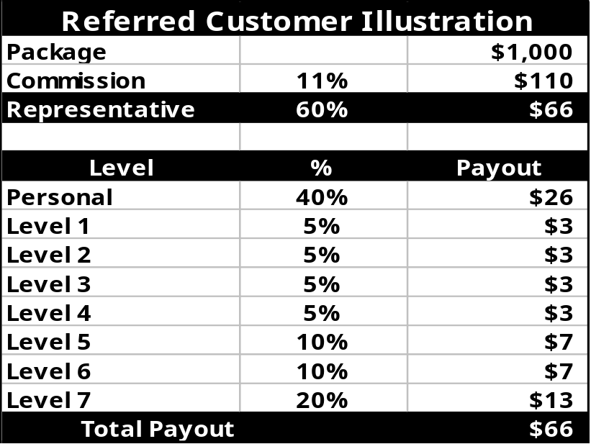


Customer Commissions
Compressed!
Note: This is an example of how the UltimateMatch Compensation for our Travel Program is designed to work and is not intended to state or infer what a Representative can, may or will earn. No average or typical downline Representative organization or periodic income has been established for UltimateMatch Representatives and commission percentages vary.

Slide 17
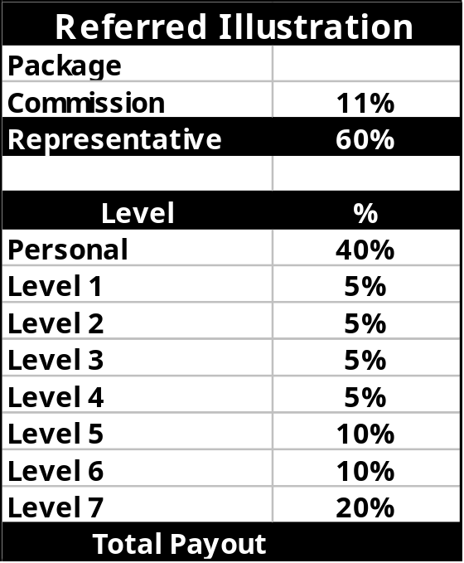

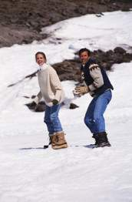
Referred Customers
Note: This is an example of how the UltimateMatch Compensation for our Travel Program is designed to work and is not intended to state or infer what a Representative can, may or will earn. No average or typical downline Representative organization or periodic income has been established for UltimateMatch Representatives and commission percentages vary.

Slide 18
Bonus Commissions
Commission For Non-Referred
Commission For RXE Partners
Qualified to Participate
Allocated On Total Personal Referred
Paid Quarterly

Slide 19
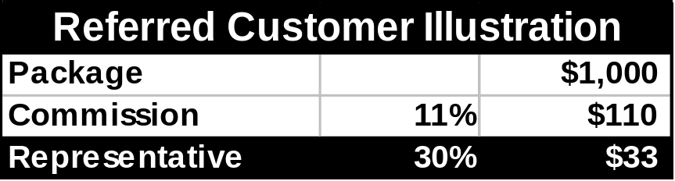
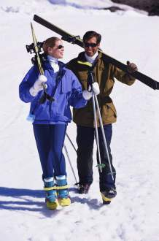


Bonus Commissions
Performance!
Note: This is an example of how the UltimateMatch Compensation for our Travel Program is designed to work and is not intended to state or infer what a Representative can, may or will earn. No average or typical downline Representative organization or periodic income has been established for UltimateMatch Representatives and commission percentages vary.

Slide 20

Non-Referred Customers
e.g. 6 Trips Total of $5,500 for % of Pool!
Note: This is an example of how the UltimateMatch Compensation for our Travel Program is designed to work and is not intended to state or infer what a Representative can, may or will earn. No average or typical downline Representative organization or periodic income has been established for UltimateMatch Representatives and commission percentages vary.

Slide 21

National Conference
Austin, Texas
September 21-23, 2006
Early Arrival Events
Training & Recognition
Senior Directors Reception
Executive Directors Private Dinner

Slide 22
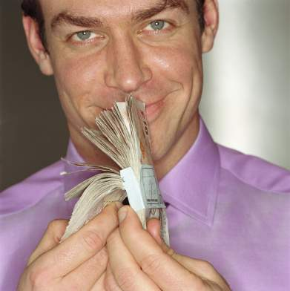
Spring Fling!
Starts Monday
Ends April 30, 2006
Build Team
Build Your Income
Win cash and prizes
Earn Pass to Dos Arroyos June 2006!

