Slide 1


Slide 2
What difference would …
$500
Truth
About You
$1,000
$10,000
$100,000

Slide 3
Truth About Money
M1
M2
M3
Time for Money
Money for Money
Multiple Source
96% Controls 3%
? Controls ?
1% Controls 97%

Slide 4
Traditional Business Model
CEO … $250,000
VP … $100,000
MGR …$50,000
EMP …$20,000

Slide 5
Networking Business Model
CEO … You!
What to look for …
1. Strong Company
2. Service – not product!

Slide 6


How to Make Money
Build Team of CEOs
Maintain 10 Customers

Slide 7
The Company
Network marketing company
Founded fall of 2003 by Stephen R. Smith . “The Undisputed Network Marketing Expert”
Invested millions in research & development
Official launch June 1, 2005
Headquartered in Austin, Texas
Professional and proven management team

Slide 8

Secure online dating community
Just under 3 million daters online!
Fastest growing industry on the Internet
$ 1.8 billion U.S. market and growing
One half the adult population is single
~24.6 million visitors in January 2006
Crest of wave to “social network/community”
  $ 24.95 Monthly  $ 49.95 Quarterly  $ 99.95 Annual

Slide 9
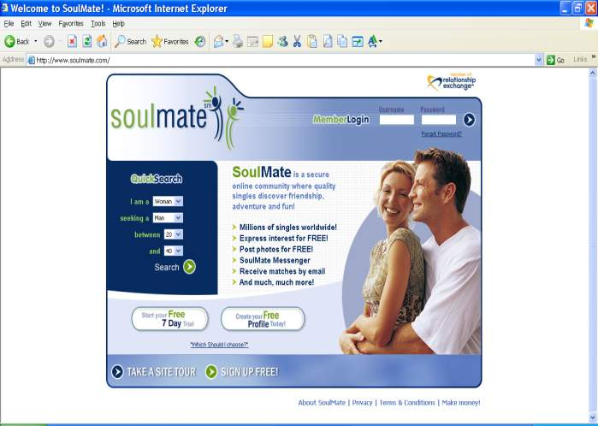
www.soulmate.com
Free Trial or … Create Free Profile

Slide 10
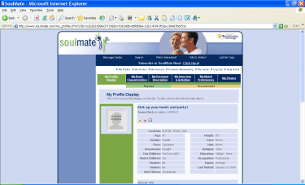
Profiles / Member
PAID
UNPAID
~ Search ~ Instant Message ~ eMail ~ Express Interest ~ Wink
~ Search Only ~ Receive One-way Comm

Slide 11

Strategic Partners
Just under …
3 million members!
Gateway
www.soulmate.com

Slide 12
Industry Standard
Online Dating Industry
~5% Paid Members Most Month-to-Month

Slide 13
Revolutionize & Dominate
Online Dating Industry
www.SoulMate.com
90% Paid Members Most Annual

Slide 14






“Ultimate” Picture
Travel
Interest
Singles
Blogs
Jobs
Proven Products & Services
Voice Over IP

Slide 15
Lucrative Income
Sponsor a few representatives
Gather a few customers
Teach others to do the same
Earn an incredible income!
Build Success Units
Gather. Sponsor. Teach.
Maintain 5 Customers

Slide 16
Fast Start Commissions
Customer Acquisition Commissions
 Level  QURs  Amount  Payout 
YOU!
3
$ 50
$ 150
2
9
$ 10
$ 90
3
27
$ 50
$ 1,350
4
81
$ 110
$ 8,910
One paying customer triggers 100%!
$10,500
Note: This is an example of how the UltimateMatch Standard Compensation Plan is designed to work and is not intended to state or infer what a Representative can, may or will earn. No average or typical downline Representative organization or periodic income has been established for UltimateMatch Representatives.

Slide 17
Fast Start Commissions
Customer Acquisition Commissions
 Level  QURs  Amount  Payout 
YOU!
3
$ 50
$ 150
2
9
$ 10
$ 90
3
27
$ 50
$ 1,350
4
81
$ 110
$ 8,910
7
2,187
$ 50
$ 109,350
Note: This is an example of how the UltimateMatch Standard Compensation Plan is designed to work and is not intended to state or infer what a Representative can, may or will earn. No average or typical downline Representative organization or periodic income has been established for UltimateMatch Representatives.

Slide 18
Leadership Bonuses
Customer Acquisition Bonus
Fast Start
Bonus
$50
Director
+ $20
Senior
Director
+ $30
Executive
Director
+ $50
1
$50 $70 $100 $150
$ 10
2
$ 20
$ 50
$ 100
3
$ 50
$ 110
4
5
$ 10
$ 20
6
$ 50
One paying customer triggers 100%!
7
Paid to unlimited levels!

Slide 19
Overcome Barriers
Provide first paying customer
Meet qualification to trigger bonuses
Marketing Assistance
Consulting Services
Pay optional $14.95
Receive first paying annual customer
Trigger 100%
Assist to acquire additional customers

Slide 20
Member Commissions
Customer Acquisition Commissions
 Level  Representative  Customers  Payout* 
YOU!
5
$ 0.99
1
3
15
$ 0.99
2
9
45
$ 0.99
3
27
135
$ 1.98
7
2,187
10,935
$ 5.94
$64,953 Level 7 alone!
Note: This is an example of how the UltimateMatch Standard Compensation Plan is designed to work and is not intended to state or infer what a Representative can, may or will earn. No average or typical downline Representative organization or periodic income has been established for UltimateMatch Representatives.
*with marketing assistance

Slide 21
Annual Memberships*
Customer Acquisition Commissions

Earn up to …
$ 84,166 annually!

When we do the work for you!
10% Success $ 8,416 per year!
Note: This is an example of how the UltimateMatch Standard Compensation Plan is designed to work and is not intended to state or infer what a Representative can, may or will earn. No average or typical downline Representative organization or periodic income has been established for UltimateMatch Representatives.
*with marketing assistance

Slide 22

www.ultimatematchtravel.com
New Service
March 20, 2006
Commissionable Service
7-Level Commission Plan
Bonus Pool
Maintain 5 Additional Customers

Slide 23



Referred Customers
Customer Illustration
Compressed!
Package
Commission
11%
Representative
60%
Level
%
Personal
40%
Level 1
5%
Level 2
5%
Level 3
5%
Level 4
5%
Level 5
10%
Level 6
10%
Level 7
20%
Total Payout
Note: This is an example of how the UltimateMatch Compensation for our Travel Program is designed to work and is not intended to state or infer what a Representative can, may or will earn. No average or typical downline Representative organization or periodic income has been established for UltimateMatch Representatives and commission percentages vary.

Slide 24



Bonus Commissions
Customer Illustration
Performance!
Package
$1,000
Commission
11%
$110
Representative
30%
$33
Note: This is an example of how the UltimateMatch Compensation for our Travel Program is designed to work and is not intended to state or infer what a Representative can, may or will earn. No average or typical downline Representative organization or periodic income has been established for UltimateMatch Representatives and commission percentages vary.

Slide 25
You Can Do It!
“Would you like to make a little extra money?”
“How would you like to meet someone special today?”
“Let us beat your best price!”
You can …
  Bring someone to a business presentation
  Invite someone to attend a conference call
  Hand someone a brochure or card
  Invite someone to watch a presentation
Notes:
So, we have introduced you to an incredible compensation plan that gives you unlimited opportunity to earn immediate cash and to build a residual income. The big question now is, “Can you do it?” The answer is simply, “YES you can.”
Building your business is as simple as inviting people who are interest in making money to attend one of our Business Opportunity Presentations, inviting someone to attend one of our two weekly conference calls or handing someone a brochure or business card to send them to one of our Internet sites or to watch a multimedia presentation.
It is as simple as extending an invitation and filling out a form! So how do you get started?

Slide 26
"Unless you join the generation of the future, you will be relegated to living in the past.
Unless you're comfortable with the information superhighway, you'll be road kill on it."
-- Dr. Denis Waitley

Slide 27
Get Started Now!
Become…
  $485…Ultimate Representative
  $14.95…Optional Marketing Assistance
Become…
  $50 … Independent Representative
  [Fully Refundable Deposit]
- OR -
Notes:
You join today. We offer two options. You may become a Qualified Ultimate Representative by paying an optional $485 for our Ultimate Success System and $14.95 for Marketing Assistance to acquire your first annual paying customer and the fully refundable $50 deposit is waived. Or, you may pay the $50 fully refundable deposit and become an Independent Representative.
We recommend that you become a Qualified Ultimate Representative. Why? Because when you become a Qualified Ultimate Representative you receive all the tools, training and support you need to jump-start and build your new business and your income.

Slide 28
Join Today!
  $485 Ultimate Representative
  $14.95 Optional Marketing Assistance
  
No additional fees!
Optional Ultimate Success System*
Professionally designed marketing websites
Real-time commissions and genealogy reports
Innovative marketing tools
Training and support
*Bi-annual renewal fees waived for active Qualified Ultimate Representatives.
Notes:
When you become a Qualified Ultimate Representative you receive your first paying annual customer, the referral commissions for your new customer and access to our turnkey Ultimate Success System, which provides you with :
Two professionally designed websites – one for your dating prospects and one for your business opportunity prospects
A real-time back office system that tracks all of your commissions and your organization so you can track your earnings, payments and contact information
Innovative marketing tools for on and offline prospecting, and
Training and support tools to get you up and making money quickly
Bi-annual maintenance fees for the optional system are waived for all Qualified Ultimate Representatives. With the Ultimate Success System, you can leave the administrative work to us and focus your efforts on what you do best – make money!
Don’t wait. Get started today and receive your first paycheck next Friday!

Slide 29

Your Future is Now!

