Slide 1

MSPM’S Deogiri Institute of Engineering and Management Studies, Aurangabad Department of Computer Science and Engineering Subject:Theory of Computation Topic:Pattern Matching Submitted by Shruti Deshpande(36133)
Sayali Salunke(36134)
Github Link: Under the Guidance of Prof. Sarika Chavan Asst.Prof.Department of CSE (Deogiri Institute Engineering and Management Studies) 2019-2020

Slide 2
Problem Statement:
To check if a string is present in an another string, for example, the string "programming" is present in the string "C programming". If it is present, then it's location (i.e. at which position it is present) is printed.

Slide 3
Algorithm and Approach Used:
We are implementing naive string search algorithm in this program.
We create a function match which receives two character arrays and returns the position if matching occurs otherwise returns -1.

Slide 4
Naive string search algorithm:
Naïve pattern searching is the simplest method among other pattern searching algorithms. It checks for all character of the main string to the pattern. This algorithm is helpful for smaller texts.
The time complexity of Naïve Pattern Search method is O(m*n). The m is the size of pattern and n is the size of the main string.

Slide 5
Algorithm:
naivePatternSearch(pattern, text)
Input: The text and the pattern
Output: location, where patterns are present in the text
Begin
patLen := pattern Size
strLen := string size
for i := 0 to (strLen - patLen), do
for j := 0 to patLen, do
If text[i+j] ≠ pattern[j], then
break the loop
done
if j == patLen, then
display the position i, as there pattern found
done
End

Slide 6
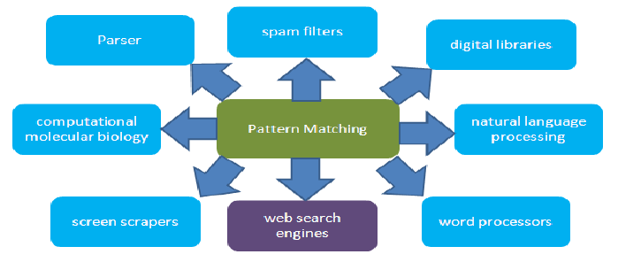
Applications:

Slide 7
CODE:
#include <stdio.h>
#include <string.h>
int match(char [], char []);
int main() {
char a[100], b[100];
int position;
printf("Enter some text\n");
gets(a);
printf("Enter a string to find\n");
gets(b);
position = match(a, b);
if (position != -1) {
printf("Found at location: %d\n", position + 1);
} else {
printf("Not found.\n");
}
return 0;
}

Slide 8
int match(char text[], char pattern[])
{
int c, d, e, text_length, pattern_length, position = -1;
text_length = strlen(text);
pattern_length = strlen(pattern);
if (pattern_length > text_length)
{
return -1;
}
for (c = 0; c <= text_length - pattern_length; c++)
{
position = e = c;

Slide 9
for (d = 0; d < pattern_length; d++) {
if (pattern[d] == text[e]) {
e++;
}
else {
break; }
}
if (d == pattern_length)
{
return position;
}
}
return -1;
}

Slide 10
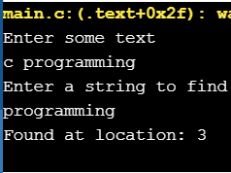
Output:

Slide 11
THANK YOU!!

