Slide 1
Distributional Reduction:
Unifying Dimensionality Reduction and Clustering
Using Gromov-Wasserstein Optimal Transport
Presented by: Shruti Goyal

Slide 2
Motivation
• Dimensionality Reduction (DR) and Clustering are foundational unsupervised learning tasks.
• Traditionally treated separately or sequentially.
• This paper proposes a unified framework using Optimal Transport — specifically, the Gromov-Wasserstein distance.

Slide 3
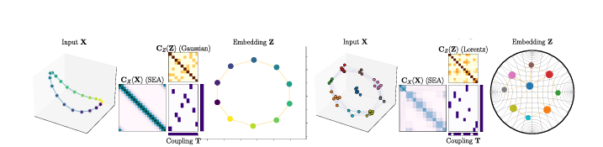
Core Idea
• Treat data as probability distributions over similarity graphs.
• Learn a reduced distribution that captures structure and prototypes.
• Use Gromov-Wasserstein distance to align original data with low-dimensional embedding.

Slide 4
Distributional Reduction (DistR)
• Combines clustering and DR in one optimization problem.
• Learns low-dimensional prototypes + their relative importance.
• Outputs: Embedding Z, prototype weights h_Z, transport plan T.

Slide 5
Optimization Objective
Minimize Gromov-Wasserstein discrepancy:
min_Z, h_Z GW(C_X(X), C_Z(Z), h_X, h_Z)
• C_X: similarity matrix of original data
• C_Z: similarity of prototypes
• GW: Gromov-Wasserstein distance

Slide 6
Algorithm Overview
1. Initialize prototypes Z and weights h_Z.
2. Alternate optimization:
- Fix T, update Z via gradient descent
- Fix Z, update T via OT solver (Mirror Descent or CG)
3. Efficient via low-rank factorizations.

Slide 7
Empirical Results
• Benchmarked on image and genomic datasets (MNIST, COIL-20, PBMC, etc).
• Outperforms traditional DR→Clustering pipelines.
• Metrics: Homogeneity, Silhouette Score, NMI.
• Versatile across Euclidean and hyperbolic spaces.

Slide 8
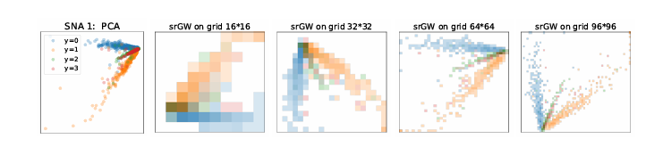
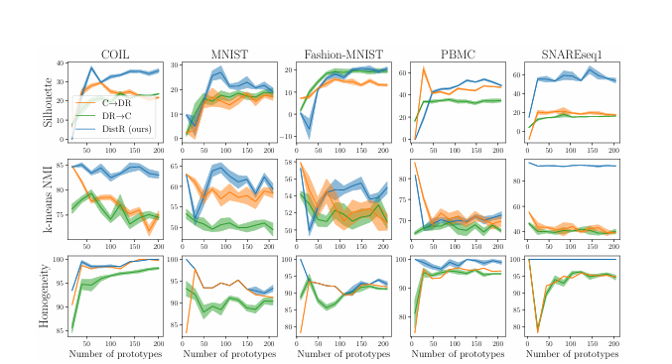

Slide 9
Conclusion
• DistR unifies clustering and DR using optimal transport.
• Learns interpretable, low-dimensional prototypes.
• Scalable, versatile, and principled framework for unsupervised learning.

