Slide 1


Enhancing Facial Expression Recognition with DDAMFN
This presentation introduces our contribution to the 7th ABAW challenge at ECCV2024, utilizing a Dual-Direction Attention Mixed Feature Network (DDAMFN) for multitask facial expression recognition. We'll explore how this innovative approach achieves results far beyond the proposed baseline for the Multi-Task ABAW challenge.
by Shruti Goyal

Slide 2
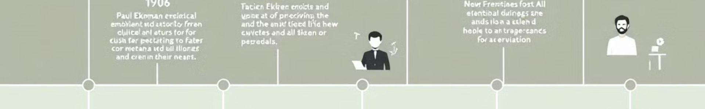
Background on Facial Emotion Recognition
1
Ekman's Classification
Ekman's classification of human expression faces into emotions laid the foundation for facial emotion recognition research.
2
Recent Advancements
Researchers like Liu et al. and Kim et al. have refined methodologies, synthesizing insights from cognitive psychology, computer vision, and machine learning.
3
Valence and Arousal Integration
The integration of valence and arousal dimensions added depth to emotional state interpretation, enabling more nuanced insights into human affective experiences.

Slide 3





DDAMFN Architecture Overview
Base: MobileFaceNet
Dual Direction Attention
Global Depthwise Convolution
Task-Specific Layers
Utilizes MobileFaceNet for initial feature extraction
Three fully-connected layers for multitask outputs
Incorporates two attention heads for enhanced feature focus
Applies GDConv layer for final feature processing

Slide 4
Dataset: s-AffWild2
Dataset Overview
Annotations
Subset of Aff-Wild2 dataset 221,928 total image frames Preestablished train-validation-test partition
Valence-arousal values Eight basic expressions 12 action units Filtered out invalid annotations

Slide 5
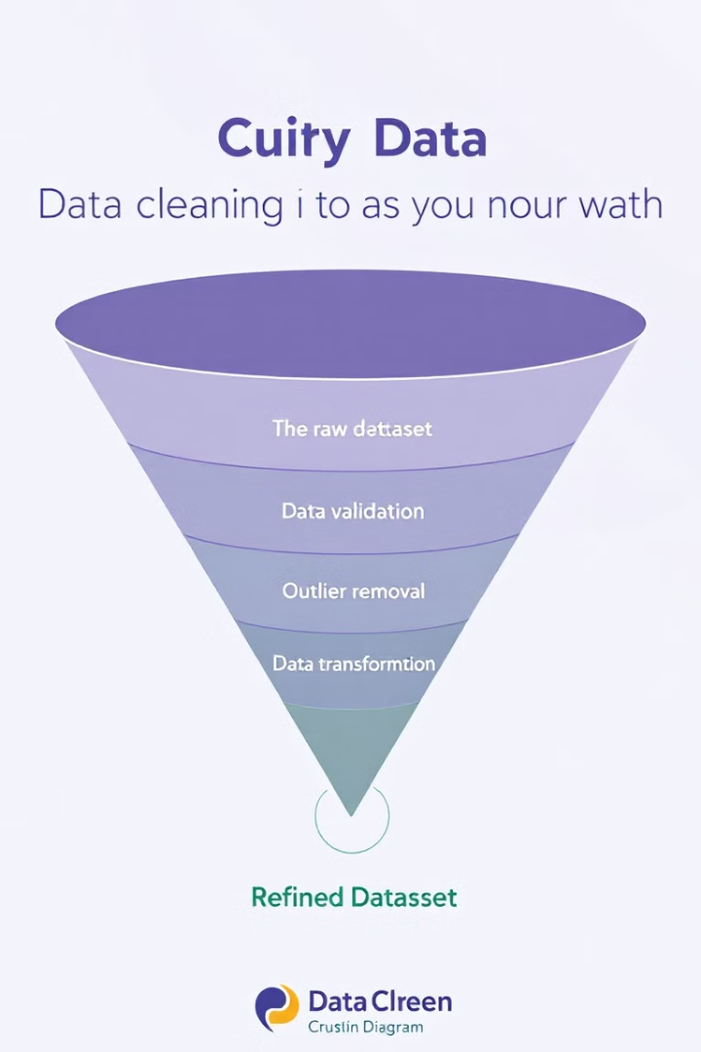
Dataset Curation Process
Filtering Criteria
Transformation
Removed frames with invalid annotations (-5 for valence/arousal, -1 for expressions/AUs)
Converted expressions and action units to binary values (0 or 1)
Refined Dataset
52,154 frames for training, 15,440 frames for validation after filtering

Slide 6



Multitask Approach
Valence-Arousal Prediction
1
2 output units
Emotion Recognition
2
8 output units
Action Unit Detection
3
12 output units
Our DDAMFN architecture is adapted for multitask learning, with three separate fully-connected layers at the end of the network to handle different aspects of facial expression recognition simultaneously.

Slide 7




Key Innovations
Attention Mechanism
Enhances network's ability to focus on crucial facial features
Mixed Feature Extraction
Combines different levels of features for comprehensive analysis
Multitask Learning
Simultaneously handles valence-arousal, emotion, and action unit recognition
These innovations allow our DDAMFN to capture intricate details within facial expressions, leading to improved performance across multiple facial analysis tasks.

Slide 8

Future Directions and Impact
Performance Evaluation
Application Potential
Compare multitask solution with independent single-task performance
Explore use in mental health monitoring and user experience design
Continued Refinement
Further optimize architecture for real-world, on-the-wild applications
Our DDAMFN approach shows promise in advancing facial expression recognition, with potential impacts across various fields from human-computer interaction to psychological research and clinical diagnostics.

