Slide 1

Covid 19
Analysis and Impact on South Asian countries
Aryan Sood E23MCAG0047
Shruti Pathak E23MCAG0033
Shashwat Sharma E23MCAG0085

Slide 2
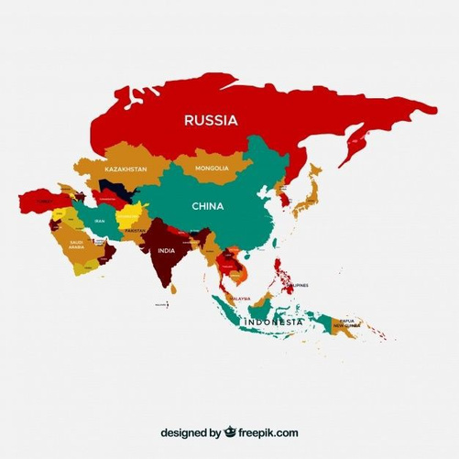

India
Russia
China
Japan
Sri Lanka
Philippines
Indonesia
Bangladesh
Afghanistan
Pakistan

Slide 3

Covid19, short for Corona Virus Disease is an infectious disease caused by the severe acute respiratory syndrome coronavirus 2 (SARS-CoV-2). The virus spreads through respiratory droplets through making close contact with an infected person.

Slide 4

SYNOPSIS
This study aims to focus on the impact of COVID-19 in various South Asian countries based on various metrics, examining geographical variations and the influence of various government policies, public health measures, geographical measures, and socioeconomic disparities.
This research seeks insights into effective pandemic responses by comparing South Asia’s experience to other regions. Moreover, we aim to contribute knowledge that informs future public health anticipation in South Asia.

Slide 5

Targeted Focal Points
Population density
Climate
Seasons
Economies
Epidemiological Data
Mortality rates
Recovery rates
Vaccination rates

Slide 6

ML Algorithm Approaches
MCDM
It deals in making decisions in situations where there are multiple conflicting area to consider. In COVID19 analysis it can help in treatment prioritization, Resource allocation, Epidemiological modelling, Vaccine distribution, Risk Management.
LSTM
It‘s particularly effective in tasks like time series
prediction,. LSTM‘s have
unique cell structure with gates that regulate
the flow of information,
enabling them to retain
information over long
sequences and mitigate
the vanishing gradient
problem.

Slide 7
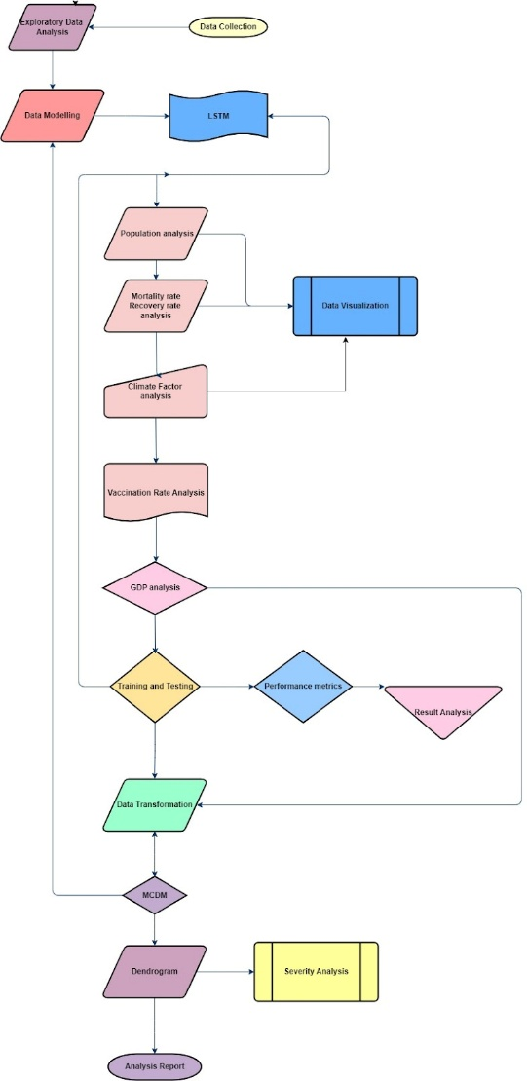

Slide 8
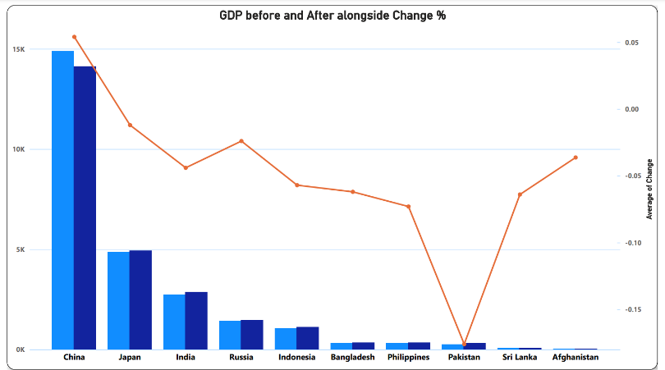
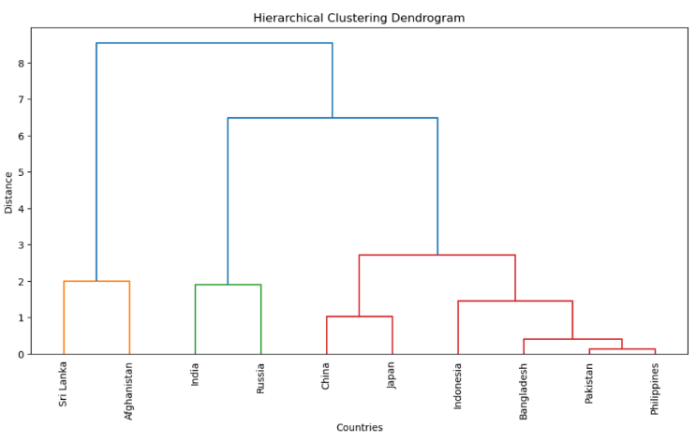
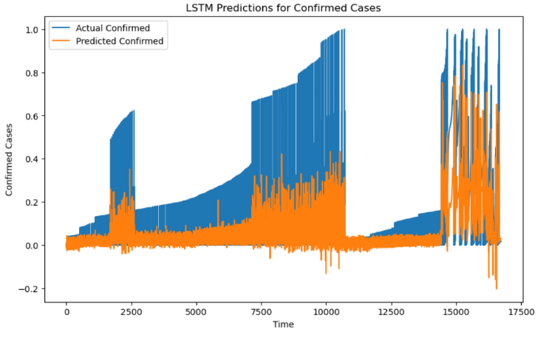
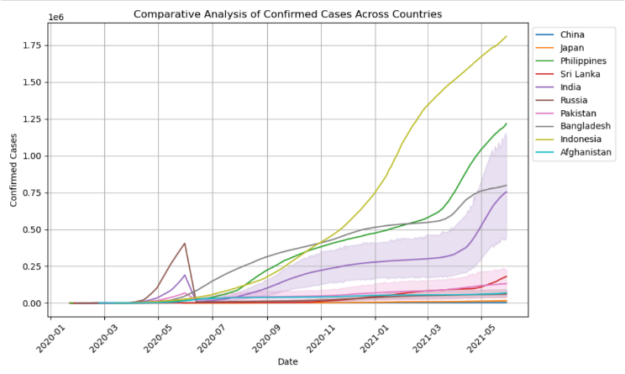

Slide 9


Datasets Instances
Individual datasets of all the countries included .
Information comprised- Active cases, Recovery rates, Death rates, Climatic conditions, Population
Demographics of the countries
Vaccination Datasets
GDP Datasets

Slide 10
Thank You!

