Slide 1
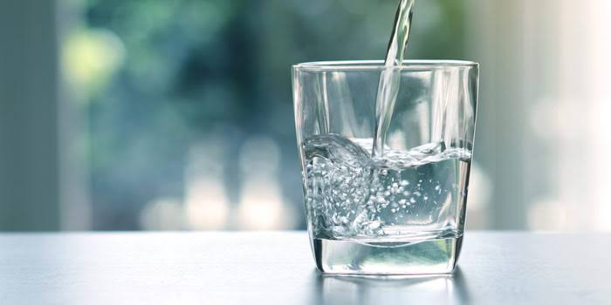
Water management
Our Water,Our Future,
Ours to protect…..

Slide 2
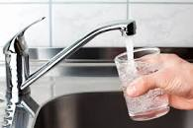
Introduction:
This project aims to:
1.Provide water saving solution to user.
2.Minimise the wastage of water.
3.Makes the user understand the value of water.

Slide 3
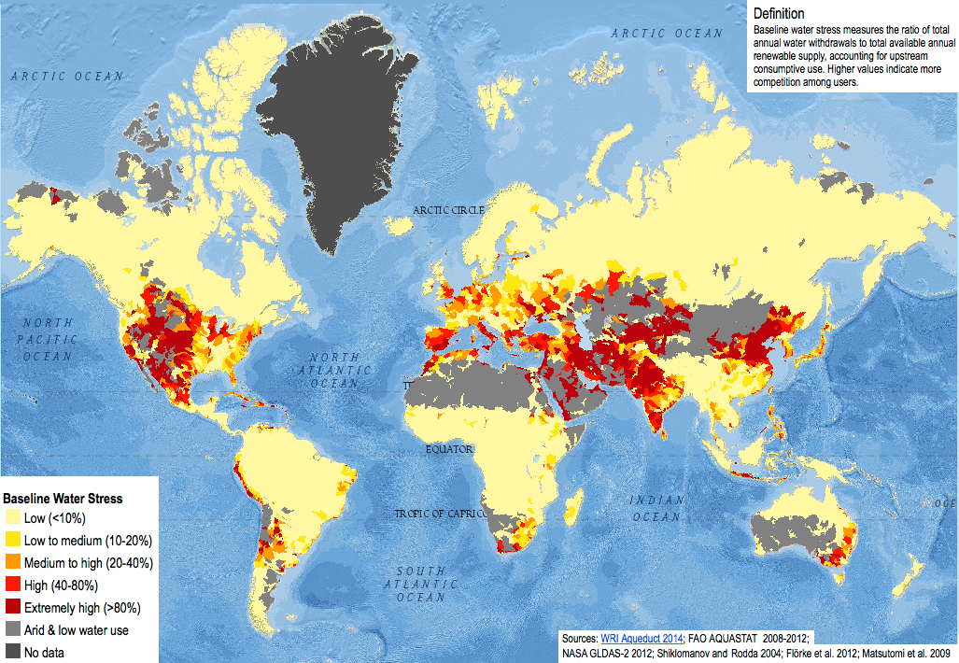
Water stress in different parts of world
Water stress is the ratio of annual water withdrawals to total available supply.
Higher value of water stress means more competition among users for water.
From this map we can see that India has higher value of water stress.So its high time that we take strict actions to save water!!
Image source-: https://en.wikipedia.org/wiki/Water_scarcity

Slide 4
Objective:
Water flow sensor and microcontroller will control the amount of water supplied to each house.
Takes input data from user about his family member details.
Analyses the data to determine the amount of water required by the family and accordingly displays the price.
User can request for extra water if required at extra charges.

Slide 5
Uses Of Water In Households
Drinking
4 L
Required: 130 L
Used: 185 L
5 L
cooking
Bathing
35 L
Washing
20 L
Site - https://www.thehindu.com
Cleaning home
7 L
flushing
35 L
7 L
Washing utensils
Other uses
2O L

Slide 6
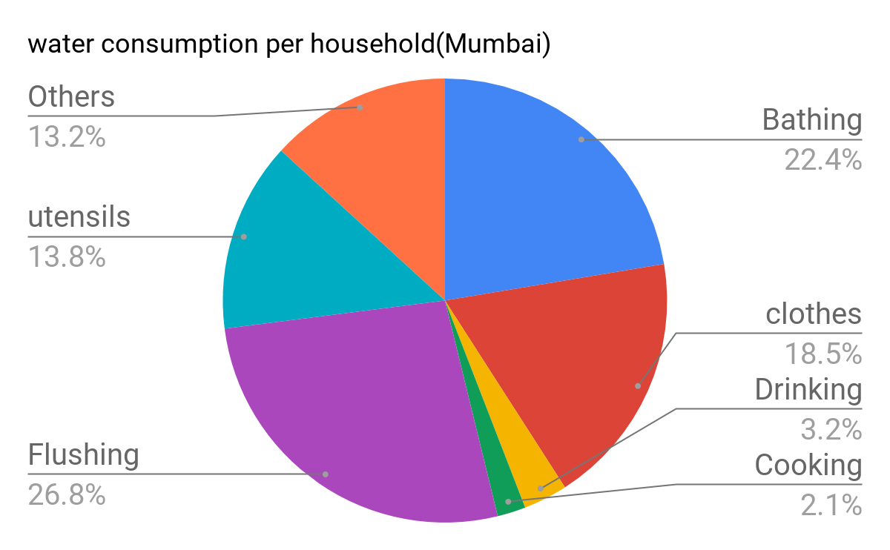
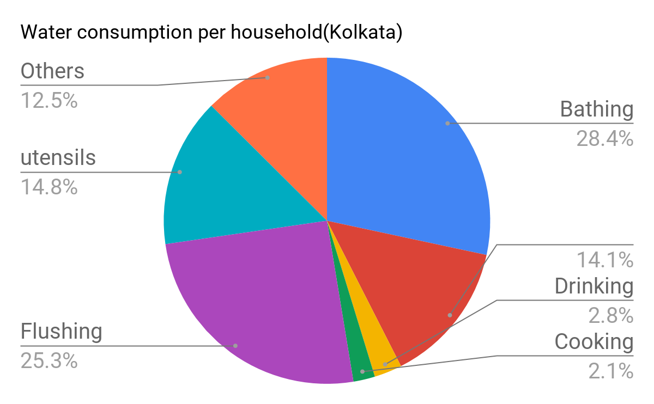
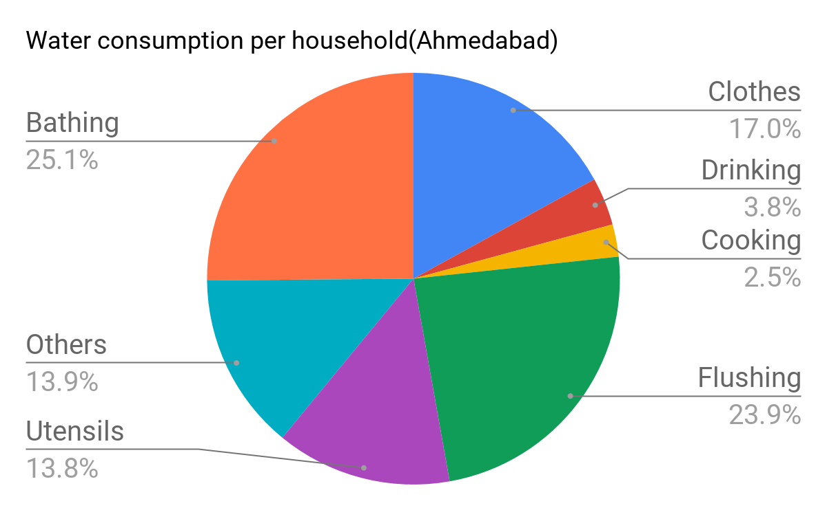
Water Consumption per household per day(per capita)
Information source-: http://indiaenvironmentportal.org.in/files/Water%20consumption%20patterns.pdf

Slide 7
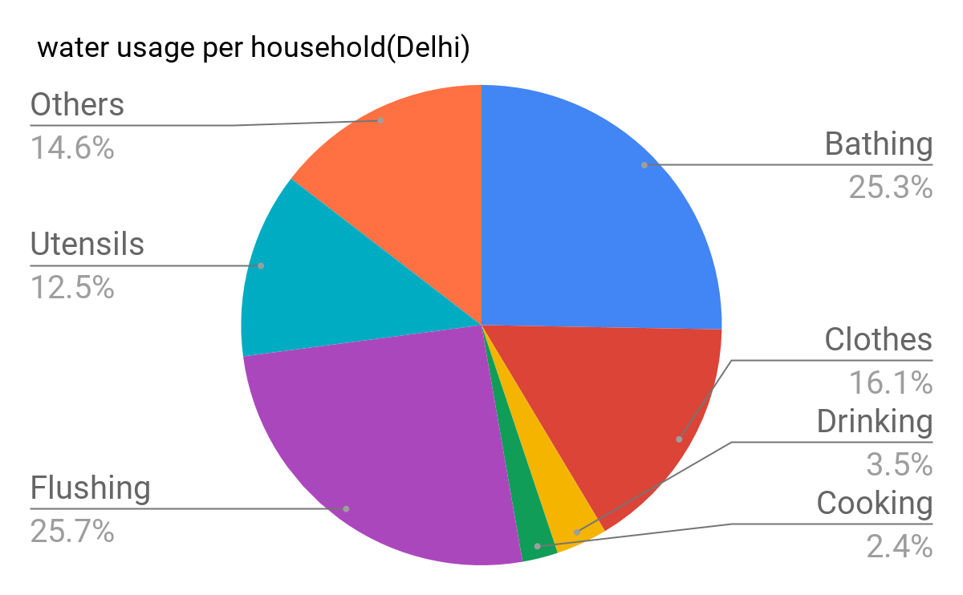
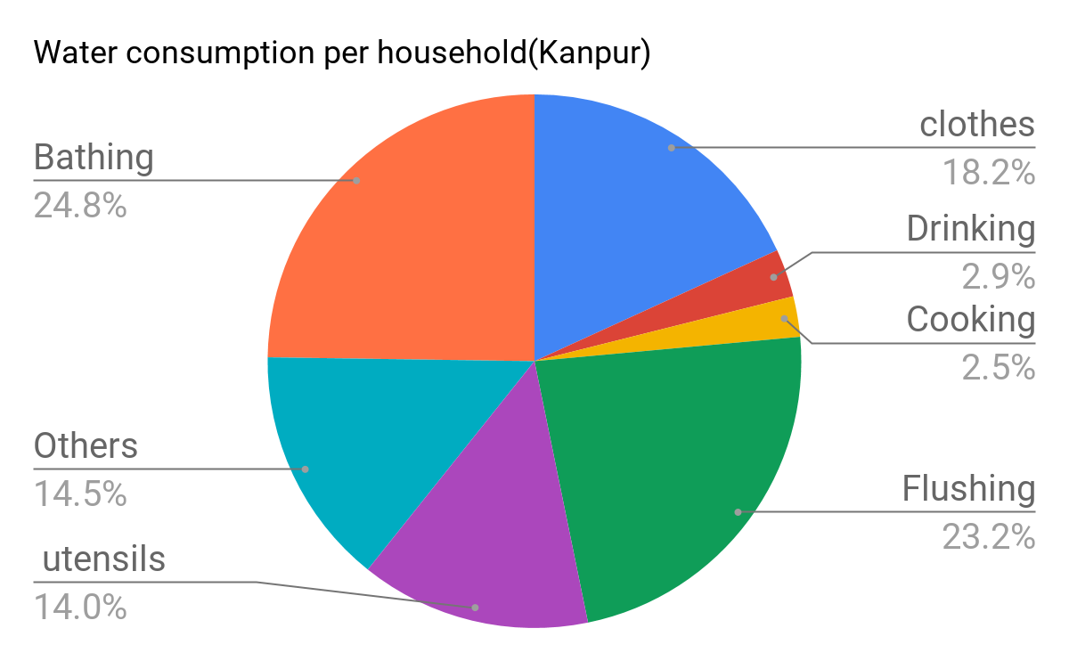
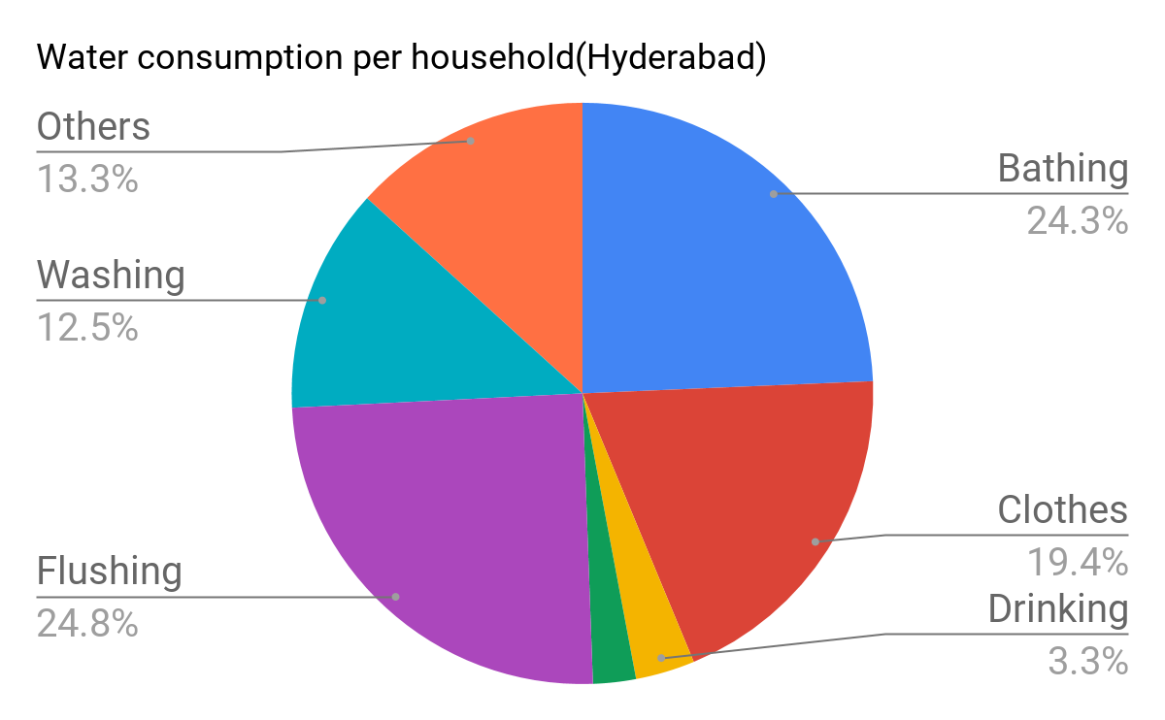
Information source-: http://indiaenvironmentportal.org.in/files/Water%20consumption%20patterns.pdf

Slide 8
Water Consumption by a particular age group:
Age group | Male (in L) | Female (in L)
0-5 year | 108 L | 108 L
5-12 year | 120 L | 122 L
12-18 year | 131 L | 136 L
18-45 year | 120 L | 125 L
45 above | 100 L | 104 L

Slide 9
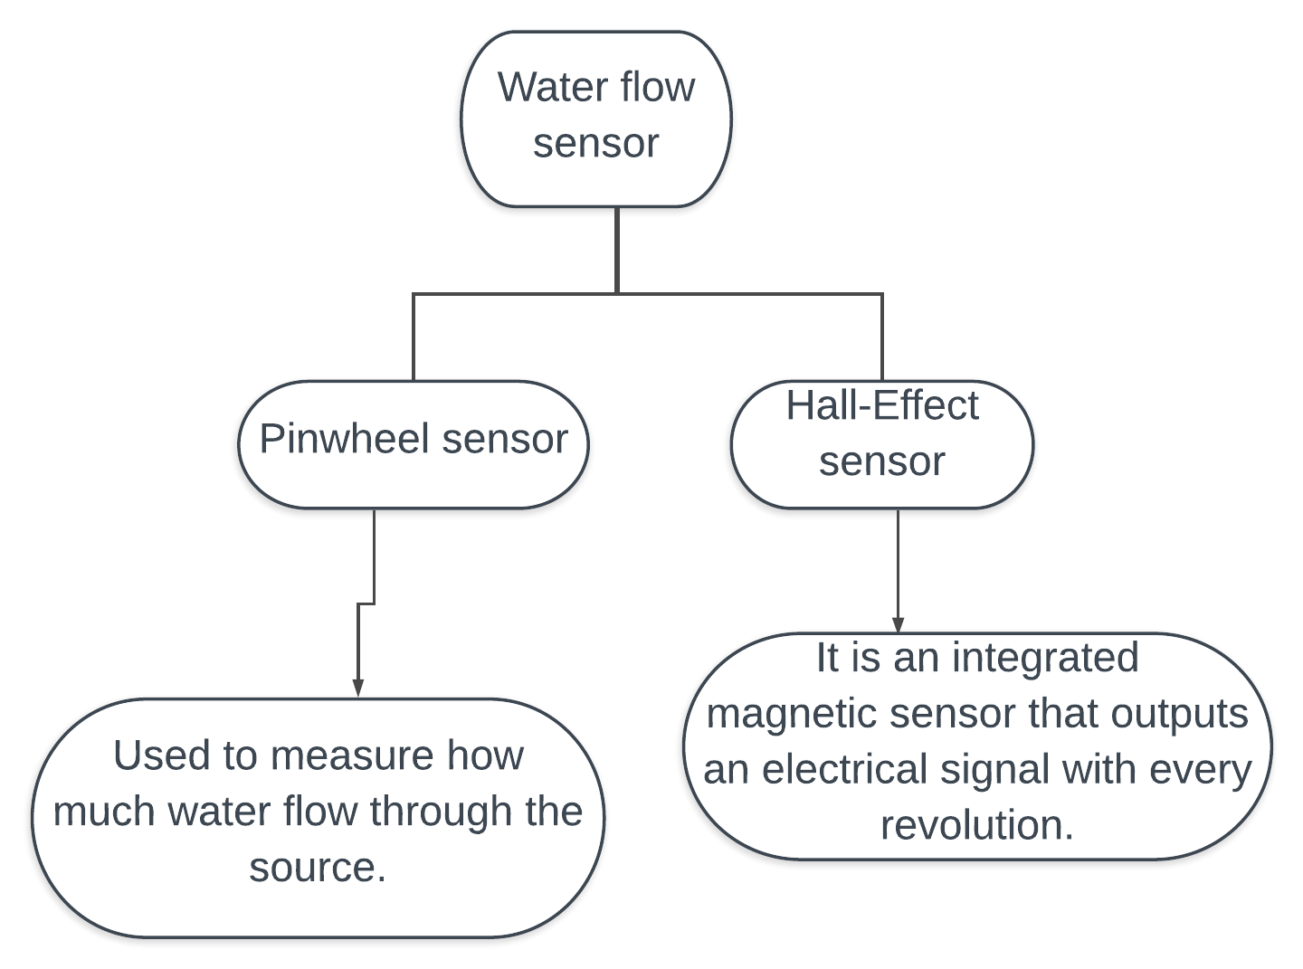
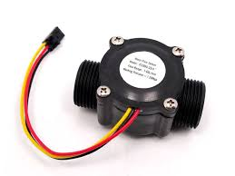
Sensor
In this project water flow sensor measures how much water flow through the source (tap).

Slide 10
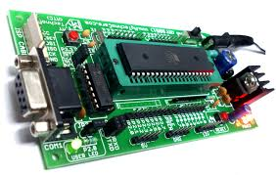
Microcontroller
1.Microcontroller used: microcontroller 8051
2.The water flow sensor measures the volume of water flowed through the source and accordingly the microcontroller switch off the tap when the desired amount of water is supplied.

Slide 11
Conclusion:
With the help of this project we proposed to minimise wastage of water in households by supplying the amount of water which is required by the user.

