Slide 1
Next Word
Prediction App
BiLSTM · NLP · Deep Learning · Streamlit
Shruti Gupta & Shreya Sinha
Information Technology Students | AI & NLP Enthusiasts
AI Project Presentation

Slide 2
OVERVIEW
Project Overview & Tech Stack
Python 3.10
Next Word Prediction System
An intelligent NLP application that predicts the most likely next word in a sequence, powered by a Bidirectional LSTM neural network trained on 50,000 synthetic sentences.
TensorFlow / Keras
NumPy
Streamlit (Web Deploy)
Git & GitHub (Version Control)

Slide 3
PROBLEM
Problem Statement
"Given a sequence of words, predict the most probable next word."
Core Task
Real-World Use
Key Challenge
Predict the next word given all previous words in a sentence
Foundation of chatbots, auto-complete, AI writing assistants
Understanding long-range context — solved with BiLSTM memory
Example: 'I am' → happy / tired / hungry

Slide 4
DATASET
Dataset Details
50K
30K
Mix
Rich
Synthetic Sentences
Vocabulary Words
Everyday + Technical
Contextual Diversity
Dataset Design: The dataset was synthetically generated with a balance of everyday conversational language and technical terminology. Capping vocabulary at 30,000 words ensures the model generalises well without an unwieldy softmax output layer.

Slide 5
ARCHITECTURE
Model Architecture
1. Embedding Layer
Word → Dense vector representation (semantic meaning)
2. Bidirectional LSTM
Learns context from both past and future words simultaneously
3. Dropout
Regularisation — prevents overfitting on training data
4. Dense + Softmax
Output probability distribution over entire vocabulary

Slide 6
TRAINING
Training Configuration
Loss Function
Sparse Categorical Crossentropy
Training Progress
Optimizer
Adam
Validation Split
10%
Early Stopping
Enabled
Epochs
25

Slide 7
DEPLOYMENT
Streamlit Web Deployment
01
Interactive Interface
02
User Input
Clean web UI built with Streamlit — no front-end code required
User types any sentence into the text field
03
Model Inference
04
Real-Time Prediction
BiLSTM model processes tokens and runs forward pass
Predicted next word displayed instantly in green result box

Slide 8
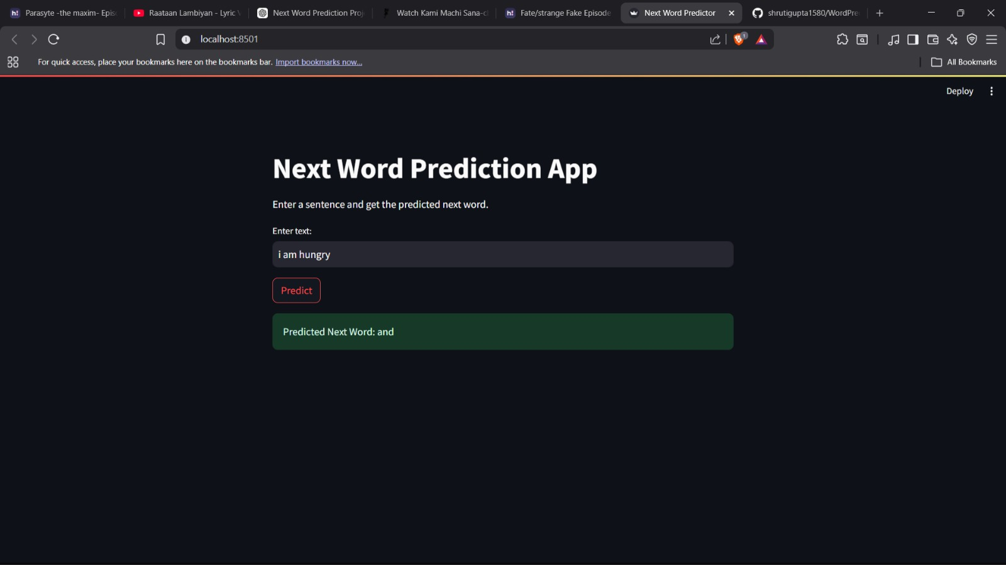

DEMO
Live App Screenshots
Input: "i am hungry"
Predicted Next Word: and
Input: "i am hungry and i want to"
Predicted Next Word: play

Slide 9
RESULTS
Results & Observations
📈
Improved Accuracy
🔀
Diverse Predictions
Accuracy increased substantially with a larger, more diverse dataset
Model generates varied and contextually appropriate next words
🧠
Statistical Learning
📊
Probabilistic Modelling
Captures language patterns through BiLSTM's memory cells
Softmax output enables ranked predictions across 30K vocabulary

Slide 10
FUTURE
Future Improvements
Temperature Sampling
Add creativity control so predictions are tunable from conservative to imaginative
Top-K Visualization
Display ranked list of top-k next words with confidence probabilities
Transformer Architecture
Upgrade from BiLSTM to a Transformer model for state-of-the-art performance
Cloud Deployment & Scale
Deploy on AWS/GCP with load balancing for multi-user real-time access

Slide 11
Thank You!
Questions & Discussion
Shruti Gupta & Shreya Sinha
Information Technology | AI & NLP
Next Word Prediction using BiLSTM

