Slide 1
The Need for Mental Health Outreach in the Workplace
Insights from the Open Sourcing Mental Illness Survey
Laura Cooper, Shruti Hedge and Monalisa Swami

Slide 2
Introduction
Use to establish the audience and why they should care

Slide 3
About the Data
Use to address where did the data come from and how we used it
We might want to cover limitations here.
We should cover how we modified the data during cleaning (e.g., grouping by age, only including the non-self employed).

Slide 4
How are mental health Disorders Distributed?
Use to address why questions are important
Use to address interpretation of the data

Slide 5
What mental Health Benefits are offered by other companies?
Use to address why questions are important
Use to address interpretation of the data

Slide 6
What are some factors that might limit Outreach effectiveness?
If you are considering expanding mental health outreach in your workplace, it is important to understand some of the factors that might influence the effectiveness of this outreach.
It is important to understand what might make employees less (or more) likely to reach out for help, either through a coworker, supervisor, or by seeking help outside of work (which may require taking medical leave).

Slide 7

Questions asked
To understand more about what might impact employee willingness to reach out, we asked the following questions:
Is there a difference in the proportion of employees feel that disclosing a physical health disorder would have negative consequences and that disclosing a mental health disorder would have negative consequences?
Could an experience at prior workplace impact beliefs about whether disclosing a mental health disorder would have negative consequences in current workplace?
How do anonymity policies vary by company size and whether or not the current employer is primarily tech oriented?
How does perceived ease of requesting leave for a mental health issue vary by employee demographic characteristics as well as current employer characteristics?
How does comfort level with discussing a mental health disorder with a supervisor vary by employee demographic characteristics as well as current employer characteristics?
How does comfort level with discussing a mental health disorder with coworkers vary by employee demographic characteristics as well as current employer characteristics?

Slide 8
Impact of disclosing a mental health disorder versus a physical health disorder

Slide 9
Impact of experiences at previous workplace

Slide 10

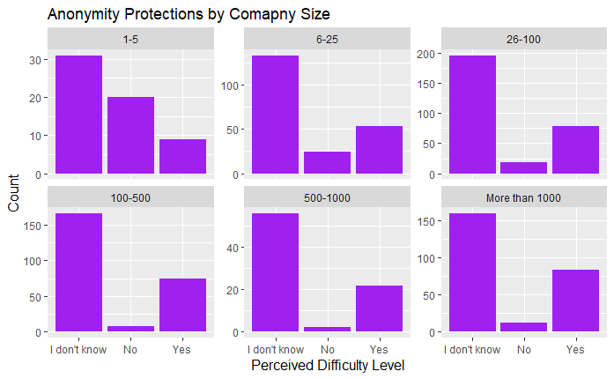
Perceptions of Anonymity Policies by Company Size
The finding: Across all company sizes, most respondents indicate that they do not know what their current company's anonymity policy is towards those using mental health services.
Notes:
Difference is statistically significant, but with a warning the approximation may be wrong.

Slide 11
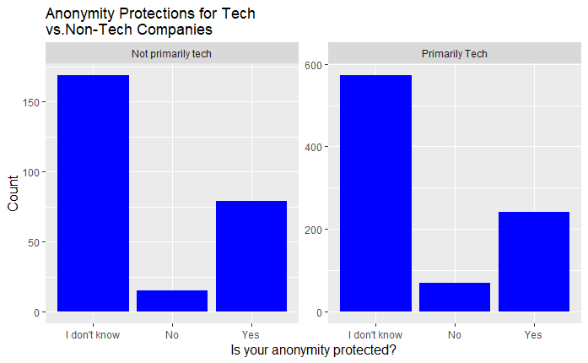
Perceptions of Anonymity Policies by Company type
The finding: Among tech focused companies and non-tech focused companies, the majority of respondents indicated that respondents indicate that they do not know what their current company's anonymity policy is towards those using mental health services.
Notes:
Difference is not statistically significant.

Slide 12
perceived ease of requesting leave for a mental health disorder
We looked at how answers to the question “If a mental health issue prompted you to request a medical leave from work asking for that leave would be?” varied when doing a crosstab table with reported company characteristics and other employee perceptions/experiences.
Reported Characteristic | Is there a relationship? | Finding
Gender
Age Group
Company Size
Does current company provide mental health benefits
Has current company ever discussed mental health
Does current employer offer other mental health resources
Have you ever seen a poor response to a mental health issue in the workplace?
Notes:
We used a chi-squared test on each cross tab to see if it was statistically significant.

Slide 13
Comfort level in discussing a mental health issue with a supervisor
We looked at how answers to the question “Would you feel comfortable discussing a mental health disorder with your immediate supervisor” varied when doing a crosstab table with reported company characteristics and other employee perceptions/experiences.
Independent Variable | Is there a relationship? | Finding
Gender
Age Group
Company Size
Have you ever seen a poor response to a mental health issue in the workplace?
Does employee think discussing a mental health disorder with employer would have negative consequences?
Notes:
We used a chi-squared test on each cross tab to see if it was statistically significant.

Slide 14
Comfort level in discussing a mental health issue with Coworkers
We looked at how answers to the question “Would you feel comfortable discussing a mental health disorder with your coworkers” varied when doing a crosstab table with reported company characteristics and other employee perceptions/experiences.
Independent Variable | Is there a relationship? | Finding
Gender
Age Group
Company Size
Does employee think that coworkers would view them negatively if they knew you had a mental health issue?
Have you ever seen a poor response to a mental health issue in the workplace?
Notes:
We used a chi-squared test on each cross tab to see if it was statistically significant.

Slide 15
Conclusion: Suggestions For Mental Health outreach
If you are looking to expand mental health outreach in the workplace (e.g., through offering other resources or having formal conversations), here are some suggestions:
Make sure that policies surrounding requesting leave for any medical reason (including mental health) are clear to employees.
Make sure that policies surrounding anonymity of disclosure of mental health issues are clear.
Offer trainings to supervisors and employees on dealing with mental health issues in the workplace.
Review policies to see if they may lead employees to believe that they will be penalized for disclosing a mental health issue or seeking help for one.

