Slide 1
The Need for Mental Health Outreach in the Workplace
Insights from the Open Sourcing Mental Illness Survey
Laura Cooper, Shruti Hedge and Monalisa Swami

Slide 2
Introduction
Use to establish the audience and why they should care

Slide 3
About the Data
Use to address where did the data come from and how we used it
We might want to cover limitations here.
We should cover how we modified the data during cleaning (e.g., grouping by age, only including the non-self employed).

Slide 4
How are mental health Disorders Distributed?
Use to address why questions are important
Use to address interpretation of the data

Slide 5
What mental Health Benefits are offered by other companies?
Use to address why questions are important
Use to address interpretation of the data

Slide 6
What are some factors that might limit Outreach effectiveness?
If you are considering expanding mental health outreach in your workplace, it is important to understand some of the factors that might influence the effectiveness of this outreach.
It is important to understand what might make employees less (or more) likely to reach out for help, either through a coworker, supervisor, or by seeking help outside of work (which may require taking medical leave).

Slide 7

Questions asked
To understand more about what might impact employee willingness to reach out, we asked the following questions:
Is there a difference in the proportion of employees feel that disclosing a physical health disorder would have negative consequences and that disclosing a mental health disorder would have negative consequences?
Could an experience at prior workplace impact beliefs about whether disclosing a mental health disorder would have negative consequences in current workplace?
How do anonymity policies vary by company size and whether or not the current employer is primarily tech oriented?
How does perceived ease of requesting leave for a mental health issue vary by employee demographic characteristics as well as current employer characteristics?
How does comfort level with discussing a mental health disorder with a supervisor vary by employee demographic characteristics as well as current employer characteristics?
How does comfort level with discussing a mental health disorder with coworkers vary by employee demographic characteristics as well as current employer characteristics?

Slide 8
Impact of disclosing a mental health disorder versus a physical health disorder

Slide 9
Impact of experiences at previous workplace

Slide 10

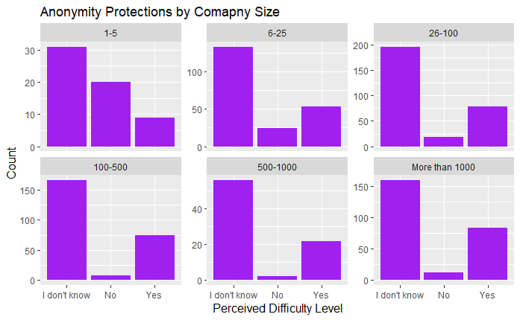
Perceptions of Anonymity Policies by Company Size
The finding: Across all company sizes, most respondents indicate that they do not know what their current company's anonymity policy is towards those using mental health services.
Notes:
Difference is statistically significant, but with a warning the approximation may be wrong. P value set at .01 instead of .05.

Slide 11
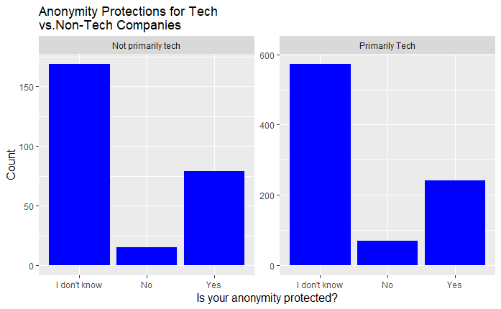
Perceptions of Anonymity Policies by Company type
The finding: Among tech focused companies and non-tech focused companies, the majority of respondents indicated that respondents indicate that they do not know what their current company's anonymity policy is towards those using mental health services.
Notes:
Difference is not statistically significant. P value set at .01 instead of .05.

Slide 12
perceived ease of requesting leave for a mental health disorder
We looked at how answers to the question “If a mental health issue prompted you to request a medical leave from work asking for that leave would be?” varied when doing a crosstab table and bar chart with reported company characteristics and other employee perceptions/experiences.
Notes:
We used a chi-squared test on each cross tab to see if it was statistically significant. P value set at .01 instead of .05. Interestingly, for women the second most common answer is “Somewhat Difficult”, while for men the second most common answer is “Very Easy.”

Slide 13
perceived ease of requesting leave for a mental health disorder
Reported Characteristic | Finding
Gender | “Somewhat easy” is the most common answer across genders.
Age Group | “Somewhat easy” most common answer for 17-27 and 37-57.
Company Size | As company size goes up, may be thought as easier to request leave.
Does current company provide mental health benefits | Those who do not have mental health benefits answer that it is somewhat difficult to request leave the most often. Those who do, answer that it is somewhat easy the most often.
Has current company ever discussed mental health | Most common response is somewhat easy to request leave. For those who had a discussion, second most common response is very easy. For those with no discussion, second most common is somewhat hard.
Does current employer offer other mental health resources | Most common response is somewhat easy to request leave. For those with other resources, second most common response is very easy. For those without, second most common is somewhat hard.
Have you ever seen a poor response to a mental health issue in the workplace? | Those who did not have an experience most commonly answer that it is very easy to request leave. Those who have most commonly answer that it is somewhat easy or somewhat hard to request leave.
Notes:
What we found generally is that most employees responding will say that it is somewhat easy to request leave. However, having mental health benefits, discussion on mental health, and other mental health resources may make it more likely that employees would find it easy to request leave (and the reverse).

Slide 14
Comfort level in discussing a mental health issue with a supervisor
We looked at how answers to the question “Would you feel comfortable discussing a mental health disorder with your immediate supervisor” varied when doing a crosstab table and bar chart with reported company characteristics and other employee perceptions/experiences.
Independent Variable | Finding
Gender | Most respondents across genders indicate that they would be comfortable discussing mental health with supervisor.
Age Group | Most respondents 17-37 and 37-57 responded that they would feel comfortable discussing a mental health with supervisor.
Company Size | Most respondents working for a company with 1-500 employees say they would be comfortable. Most with 500-1000 employees say maybe. Most with 1000+ say no (but yes is a close second).
Have you ever seen a poor response to a mental health issue in the workplace? | Most respondents who haven’t experienced a poor response say they would be comfortable. Those who observed are evenly split across yes, no, and maybe. Those who experienced are evenly split between yes and maybe.
Does employee think discussing a mental health disorder with employer would have negative consequences? | Most people who responded that they feel that discussing a mental health disorder would have a negative impact also are not comfortable discussing a mental health issue with a supervisor. The reverse is also true.

Slide 15
Comfort level in discussing a mental health issue with Coworkers
We looked at how answers to the question “Would you feel comfortable discussing a mental health disorder with your coworkers” varied when doing a crosstab table and bar chart with reported company characteristics and other employee perceptions/experiences.

Slide 16
Comfort level in discussing a mental health issue with Coworkers
Independent Variable | Finding
Gender | Across all genders the most common response is “maybe.” However, a higher proportion of female respondents indicate that they do not feel comfortable.
Age Group | The majority of respondents 17-37 and 37-57 indicated that they might feel comfortable discussing a mental health disorder with coworkers, the second most common response being that they would not.
Company Size | Respondents from companies with 1-5 and 6-25 employees are evenly split among the three responses (yes, no, maybe). For the 26-100, 100-500, and 500-1000 employee companies, most indicate that they may be comfortable. Respondents from companies with1000+ employees select the “no” answer the most often.
Does employee think that coworkers would view them negatively if they knew you had a mental health issue? | When asked about experience with a poorly handled response to mental health, respondents across all categories except for “N/A”, also answered that they may be comfortable discussing a mental health disorder with coworkers.
Have you ever seen a poor response to a mental health issue in the workplace? | Those who feel that they would be viewed negatively by coworkers answer more often that they would not feel comfortable discussing mental health with coworkers. Those who feel like they are negatively viewed are evenly split between maybe being comfortable and not being comfortable.
Notes:
Interestingly, those who stated “Yes, I observed” a poor response to mental health in the workplace were evenly split between the maybe and no answers when also asked if they would feel comfortable discussing a mental health disorder with coworkers. However, those who stated that they experienced a poorly handled response selected “Maybe” most often when also asked if they would feel comfortable discussing a mental health disorder with coworkers. The remainder were about evenly split between the “no” and “yes” answers. This may indicate that observing a poorly handled response to a mental health issue in the workplace may have a greater negative effect on willingness to discuss with coworkers than those experiencing it.

Slide 17
Conclusion: Suggestions For Mental Health outreach
Mental health benefit provision is a first step for mental health outreach. It is also helpful to offer other resources (e.g., formal discussions and other resources).
If you are looking to expand mental health outreach in the workplace (e.g., through offering other resources or having formal conversations), here are some suggestions:
Make sure that policies surrounding requesting leave for any medical reason (including mental health) are clear to employees.
Make sure that policies surrounding anonymity of disclosure of mental health issues are clear.
Offer trainings to supervisors and employees on dealing with mental health issues in the workplace.
Review policies to see if they may lead employees to believe that they will be penalized for disclosing a mental health issue or seeking help for one.
Consider anonymous surveys to get a better idea of your company’s culture to help determine what problem areas exist.

