Slide 1

B2B ChatBot for
Construction Industry
Using Machine Learning, Deep Learning & Its Tools
By: Shruti Hemant Agarwal
(Data Science, Roll No. 01, Sem VI)
School of Emerging Science and Technology, Gujarat University

Slide 2
OUTLINE
ABSTRACT
INTRODUCTION
LITERATURE REVIEW
PROJECT WORKFLOW
METHODOLOGY
OUTCOME
REFERENCE
FUTURE WORK

Slide 3
ABSTRACT
Man-made consciousness based chatbots appear to be one of the main colleagues of construction site engineers. For a site engineer, it is hard to deal with the connection between plan, implementation and gear use. Consequently, continuous help will increase the usefulness. The subfields of Artificial Intelligence such as machine learning, natural language processing have been applied to tackle complex problems and support decision-making for real-world construction problems.
The project purposes of a Rule Based ChatBot in the Construction Industry which can access Real time data about materials, Construction site action related photograph and progress sharing, Easy admittance to area related drawings and information, Easy sharing of project work, distribution center information, Publishing day to day progress report effectively and precise, Tracking ongoing action, Easy admittance to development records and drawings.

Slide 4
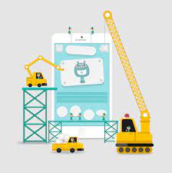
INTRODUCTION
Chatbot is widely popular now-a-days and catching speed as an application of computer communication. Some programs respond intelligently like human.
Chatbots play a crucial job for organizations as they can easily deal with a blast of client questions and messages with next to no log jam.
Chatbots are also referred to as virtual assistants.
They have without any assistance diminished the client care responsibility for us via computerizing a larger part of the cycle. They do this by using strategies supported with Artificial Intelligence, Machine Learning, and Data Science.
Unfortunately, construction sector is not as successful as other sectors in technology usage. Especially low productivity in Construction Sector shows us there is a long way to go in the sector.

Slide 5

What is a ChatBot?
A chatbot is an AI-based software designed to interact with humans in their natural languages. These chatbots are usually converse via auditory or textual methods, and they can effortlessly mimic human languages to communicate with human beings in a human-like manner. A chatbot is arguably one of the best applications of natural language processing.
Chatbots can be categorized into two primary variants –
Rule-Based and Self-learning.
In this project, I will be making a Rule – Based Chatbot.
The Rule-based approach trains a chatbot to answer questions based on a set of pre-determined rules on which it was initially trained.

Slide 6
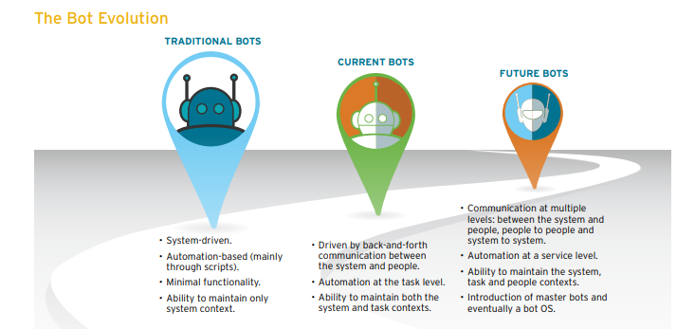
Chatbot is broadly famous now-a-days and getting speed as a utilization of PC correspondence.
A few projects answer wisely like human. This kind of program is known as a Chatbot.
Chatbots are PC programs that can take part in significant discussion with people.
They can accurately comprehend and answer text, voice or even picture-based directions.
Hence, chatbots could be utilized to robotize data search, trigger alarms and help you in performing undertakings on the web.
ChatBots can oversee work processes to increment area-based collaboration with hardware and designers for arranging and cost control.
The Bot Evolution

Slide 7
Why Construction Industry?
Construction area isn't quite developed as different areas in innovation utilization. The development of the construction business is seriously restricted by the horde complex difficulties it faces.
Additionally, construction industry is one the least digitized businesses on the planet, which has made it challenging for it to handle the issues it right now faces.
As per Construction Industry Institute, esteem added exercises are only 10% of movements of every sort in the area.
Innovation use in the area isn't quite as compelling as it ought to be.
There are different arrangement utilizing in the area; notwithstanding, area needs imaginative area explicit arrangements and new businesses can accomplish that with their inventive methodology.
One of the revolutionary ideas in this industry is use of chatbots.

Slide 8
Why ChatBot In Construction Industry?
Construction can be defined as a complicated manufacturing process. We have a lot of internal and external data for the construction planning. In order to create an optimized solution to increase the productivity, we need AI based analysis and solutions.
ChatBot offers a practical solution for engineers working in the construction industry, which can be easily integrated into the communication structure they are currently using.
On the other hand, artificial intelligence can play important role to optimize the process.
In order to do that we should create ChatBot based user friendly data sharing interface.
ChatBot will learn the needs of the engineer and creates patterns to make proper decisions.
ChatBots can manage workflows to increase location based interaction with equipment and engineers for planning and cost control.

Slide 9
LITERATURE REVIEW
An extant review of literature was conducted to identify the existing applications of artificial intelligence in the construction industry.
It was observed that most of the studies focused on using specific AI Techniques in achieving stated goals, hence, the need to focus our search on specific AI techniques.
The search was limited to articles in English.
All chatbots come under the NLP (Natural Language Processing) concepts.
NLP is composed of two things:
NLU (Natural Language Understanding): The ability of machines to understand human language like English.
NLG (Natural Language Generation): The ability of a machine to generate text similar to human written sentences.

Slide 10
PROJECT WORKFLOW
1. Gathering Knowledge about Domain & ChatBot
2. Problem Definition
3. Determining the factors to be included in Chatbot
4. Data
Collection
8. Model
Testing
7. Model
Training
6. Data Preprocessing
5. Storing Data in JSON Format
9. Integrating Model with GUI
10. Model Evaluation
11. Obtaining Results
12. Conclusion
&
Outcome

Slide 11
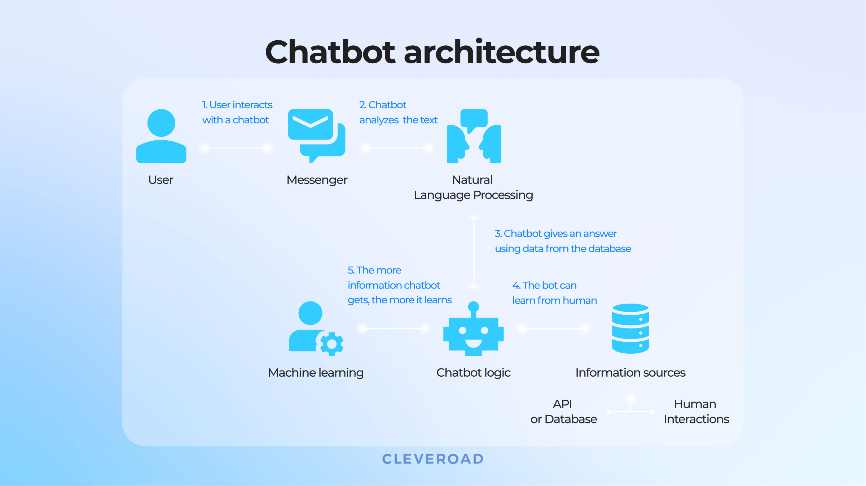

Slide 12
METHODOLOGY
Selection of OS
Microsoft Windows is used for this project because it is user friendly & it is also robust.
Selection of Coding Language
Python is used as it is comparatively easy and user friendly.
Creating a Chatbot
For creating a Chatbot, a program has to be written. The Chatbot is created in such a way to help the user, improve the communication and amuse the user.

Slide 13
Creating a Chat
The chat is created using a pattern that is known to the user and could be easy to understand. Chat dialog box show up to create conversation.
Pattern Matching
It is a technique of artificial intelligence used in the design of a Chatbot. The input is matched with the inputs saved in the database and corresponding response is returned.
Design
The design of a Chatbot is very simple. It answers to the questions asked by the user or shows a predefined menu available.
Conversation
The conversation follows a Basic English language and interacts in an easy to read manner. The conversation between the user and the Bot is entertaining. It is like talking to other person.

Slide 14
Creating the dialog box
All the packages required for creating the dialog box are imported. The size of the dialog box and text area inside the dialog box is given. Vertical scrollbar is used so that the screen is scrolled as the conversation goes on.
Creating the GUI
A graphical user interface (GUI) is an interface through which a user interacts with electronic devices such as computers and smartphones through the use of icons, menus and other visual indicators or representations (graphics).
In this project a GUI is created to chat with the bot. Firstly the training and testing files are imported along with other libraries then with the use of tkinter the specifications are made.

Slide 15
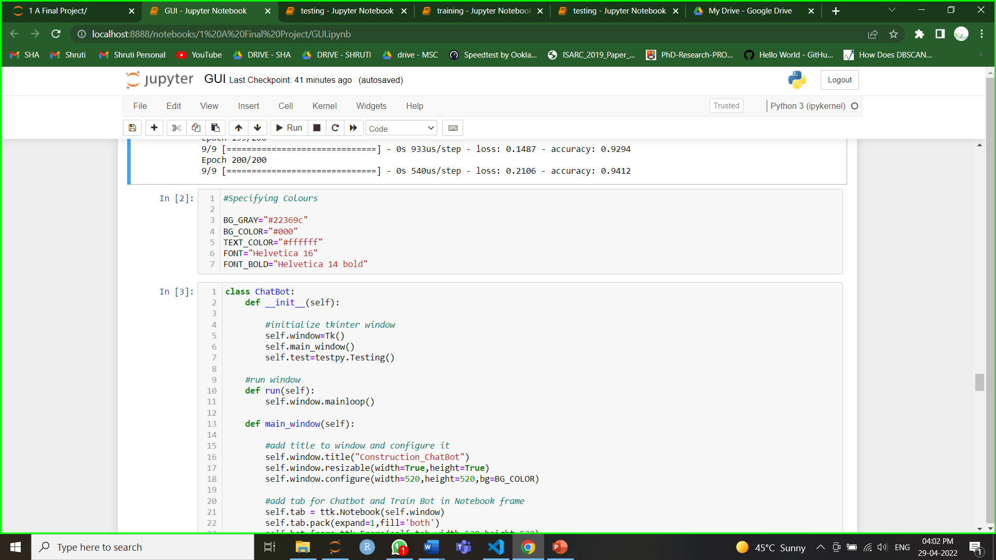
A Glimpse of GUI Code

Slide 16
Data Analysis
Creating a database
A JSON file named “intents” was made from scratch using primary data. A JSON file is a file that stores simple data structures and objects in JavaScript Object Notation (JSON) format, which is a standard data interchange format.
Attributes Used
The attributes used are ‘tag’, ‘patterns’ & ‘response’. Where tag is the name of the particular group of similar words. Patterns are the questions expected to be asked by the user. Response is the output given by bot.
About Data
The data was gathered from different websites and then converted into appropriate format to be used.

Slide 17
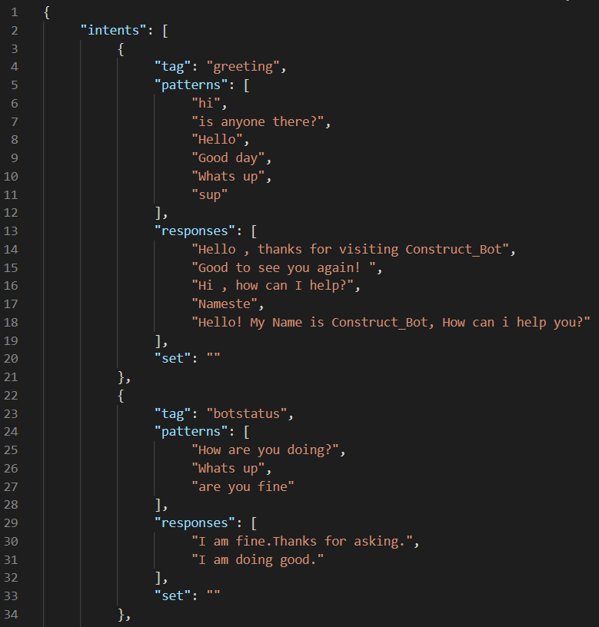
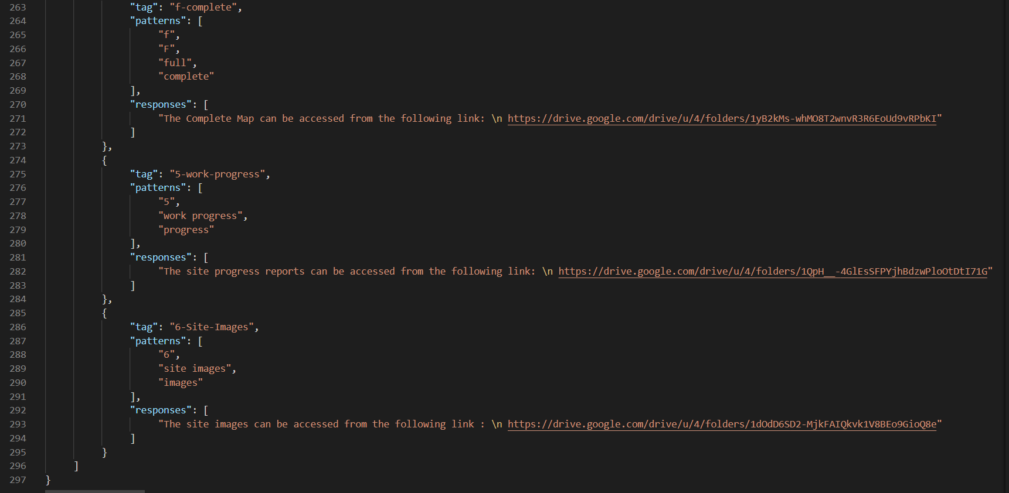
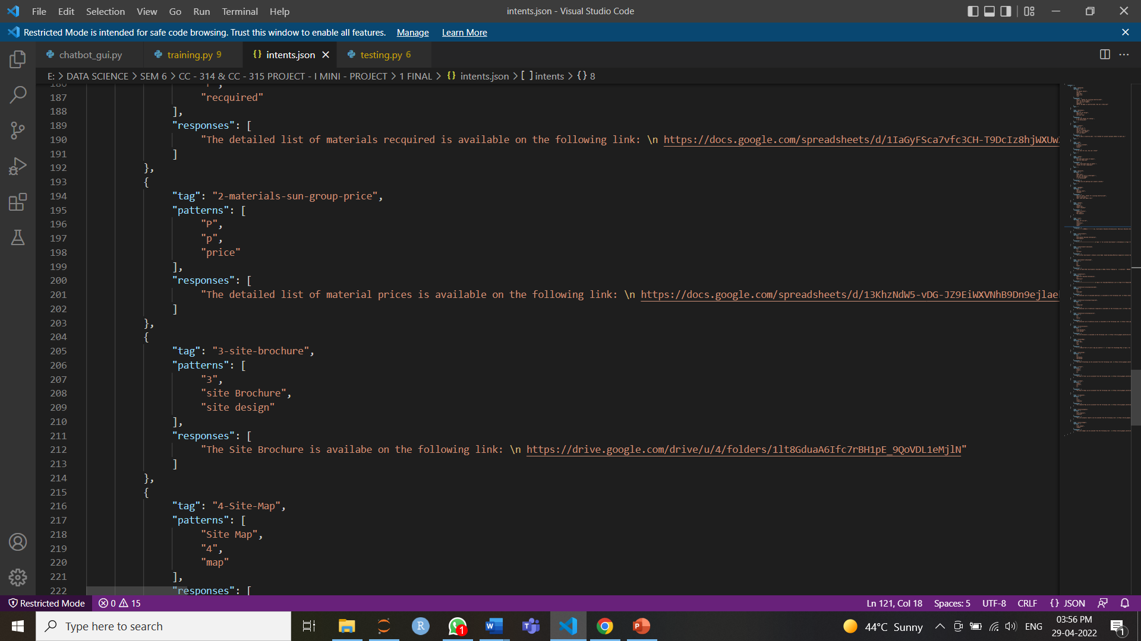
A Glimpse of Dataset

Slide 18
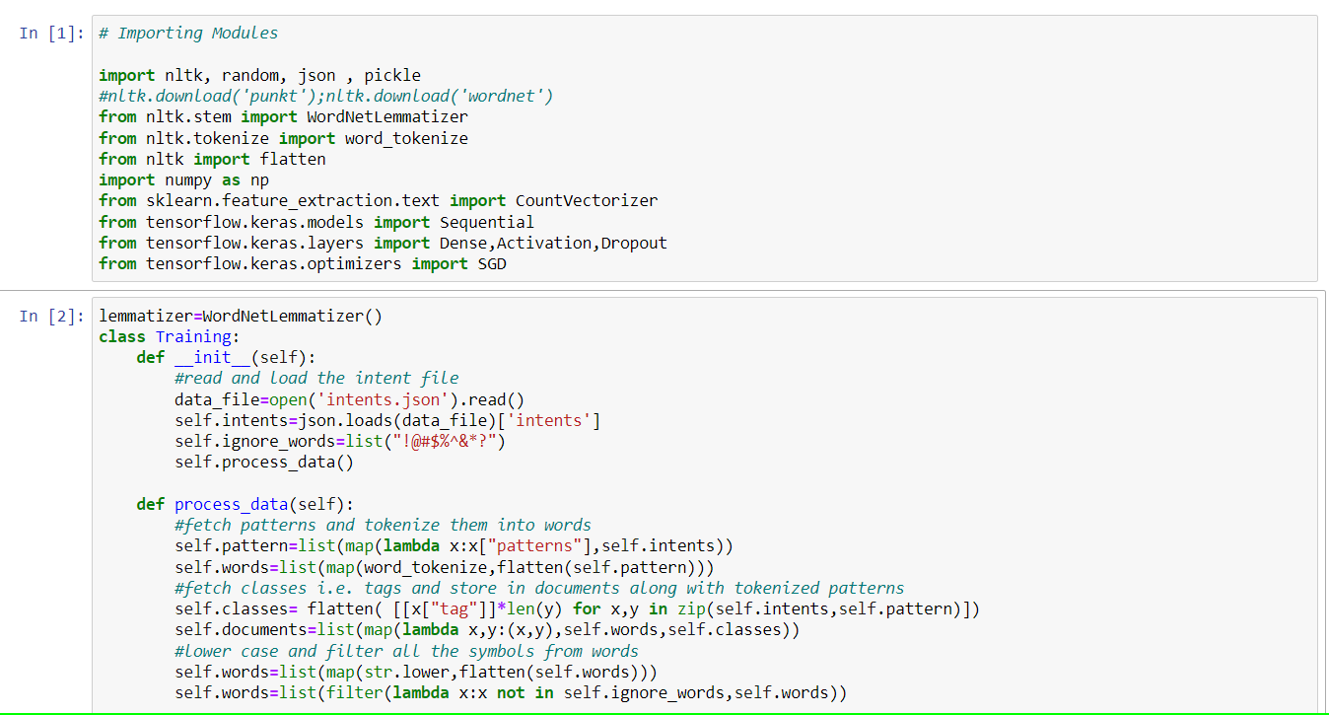
Model Training - The dataset is trained using various functions like sequential models.

Slide 19
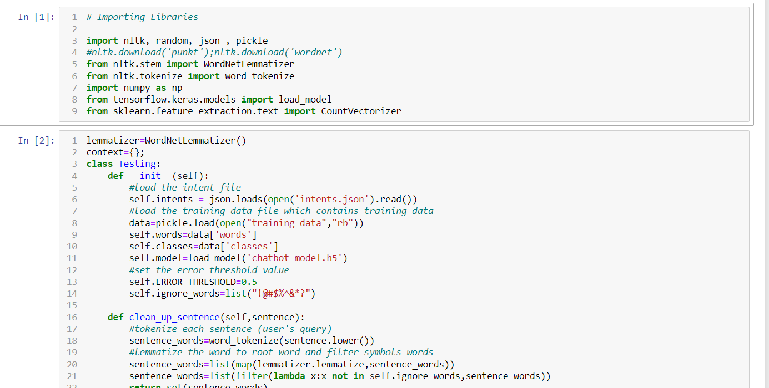
Model Testing – A testing class is prepared and different functions are defined inside it which are to be used further.

Slide 20
Files Obtained
After the project is complete, all these files are obtained.
intents.json: This file contains sets of tags, patterns, and responses. The intent of every class has a set and filter to check in which contexts the user query belong to.
training.py: This file is used to create the model and train our python chatbot.
training_data.file: This file contains lists of words, patterns, and training sets in a binary format which we get when we train our chat bot model.
chatbot_model.h5: This file stores the trained model neurons weights and also the configuration of the model.
testing.py: This file is used to predict in which tag(classes) the user’s query belongs to and return a random response from that tag.
chatbot_gui.py: This file is the GUI for the Chatbot where users can interact with the bot.

Slide 21
Libraries Used
NumPy: fundamental package for scientific computing in Python.
Tkinter: Python's de-facto standard GUI (Graphical User Interface) package.
Json: JavaScript Object Notation (JSON) is a standardized format commonly used to transfer data as text that can be sent over a network
Nltk: leading platform for building Python programs to work with human language data.
Random: in-built module of Python which is used to generate random numbers.
Pickle: the process whereby a Python object hierarchy is converted into a byte stream.
TensorFlow: a collection of workflows to develop and train models.
Sklearn: Scikit-learn (Sklearn) provides a selection of efficient tools for machine learning and statistical modeling including classification, regression, clustering and dimensionality reduction via a consistence interface in Python.

Slide 22
Some Concepts & Methods used
Lemmatization: the process of grouping together the different inflected forms of a word so they can be analyzed as a single item.
Map function: used to link “Functions” with every element of the “Iterables” and return the generator.
Tokenizing: the process of splitting a stream of texts like sentences into smaller chunks(tokens) like words.
Stemming: the process of reducing words into their word stem i.e. root of the words.
Bag of words: the process that one-hot encodes textual data and converts into a fixed-size vector length.
SGD optimizer: a few samples are selected randomly instead of the whole data set for each iteration.
Function classify: This function will predict the tag(classes) for the user’s query.

Slide 23
OUTCOME
The ChatBot:
Is an AI driven B2B ChatBot that gives all the data connected with construction work on field and materials required.
Is a quick and simple method for following the advancement and apparatus.
Can team up everything at a solitary spot and access it with a couple of words or snaps.
Can make work for Engineers and Coordinators easy.
Can reduce the load of Sub-Engineer.
Is an ease & Sorted system of information.

Slide 24
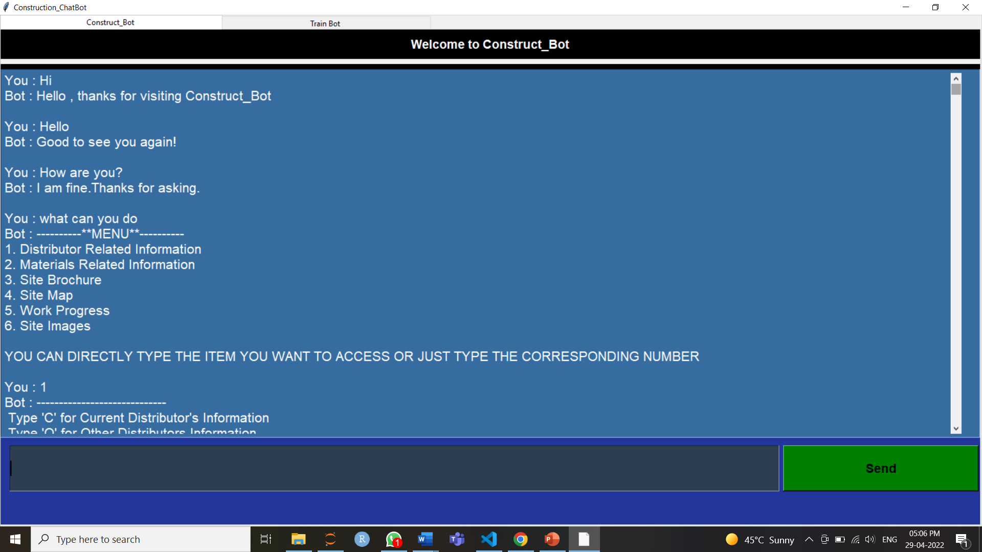

Slide 25
REFERENCE
RESEARCH PAPER – I
RESEARCH PAPER – II
RESEARCH PAPER – III
CONSTRUCTION SECTOR & CHATBOT – I
CONSTRUCTION SECTOR & CHATBOT – II
CODE REFERENCE – I
CODE REFERENCE – II
CODE REFERENCE - III
DATASET INFORMATION – I
DATASET INFORMATION – II
TYPES OF CHATBOT
CHATBOT HISTORY
BLOG

Slide 26
FUTURE WORK
A Dynamic & More Interactive ChatBot which can :
Connect with messaging tools
Iot devices
Generate real time data
Automatically add data

Slide 27
Thank You
Shruti Hemant Agarwal
(Data Science, Roll No. 01, Sem VI)

