Slide 1
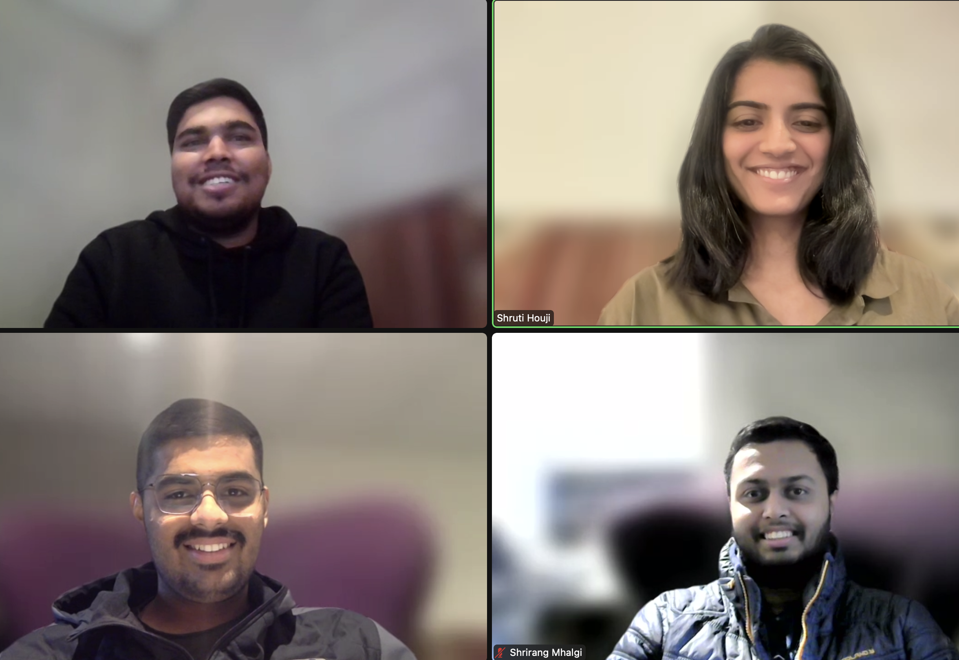

HCDR- Home Credit Default Risk
Team Members: Shruti Houji (sghouji@iu.edu) Shrirang Mhalgi (srmhalgi@iu.edu) Chinmay Pathak (crpathak@iu.edu) Dipak Bange (djbange@iu.edu)

Slide 2
Topics covered for phase 4
Building neural network model
Hyperparameter Tuning of all the models
Leakage in the dataset
Check for cardinal sins in project
Kaggle Submission
Future Scope

Slide 3
Project Description
Built a machine learning model to predict whether a person is viable to take a loan or not
Building a neural network using PyTorch framework
Hyperparameter Tuning-selecting optimal parameters to improve model performance
Leakage present in HCDR project
Finding any cardinal sins in the project
Compared the final accuracies of neural network and LGBM model

Slide 4
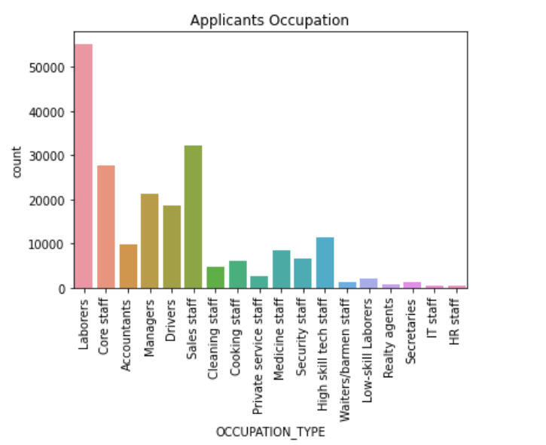
Visual EDA
Categorical variable counts plots like pie charts
Correlation analysis plot
Bivariate Distribution plots of numerical columns like kernel density plot, bar graphs, etc
Correlation of new features and distribution with target variable

Slide 5
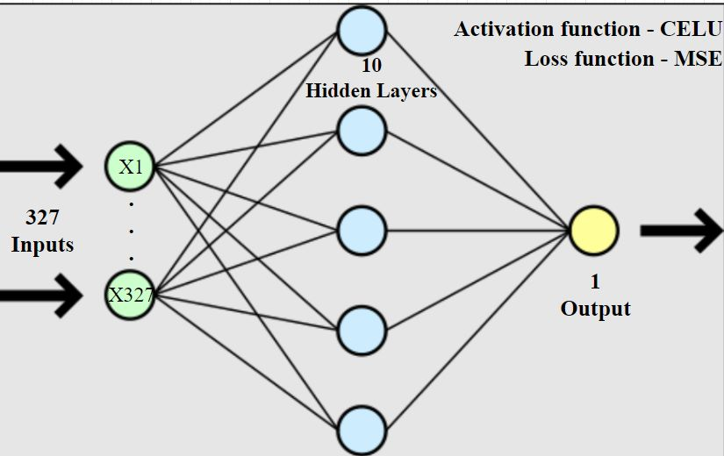
Building Neural Network Model

Slide 6
Hyperparameter Tuning
GridSearchCV technique used for finding the best parameters on the following models:
1)Logistic
2)Decision Tree
3)Random Forest
4)XG Boost
5)LGBM parameters
5)Neural Network- hidden layers, activation function, learning rate, n iterations, etc.

Slide 7
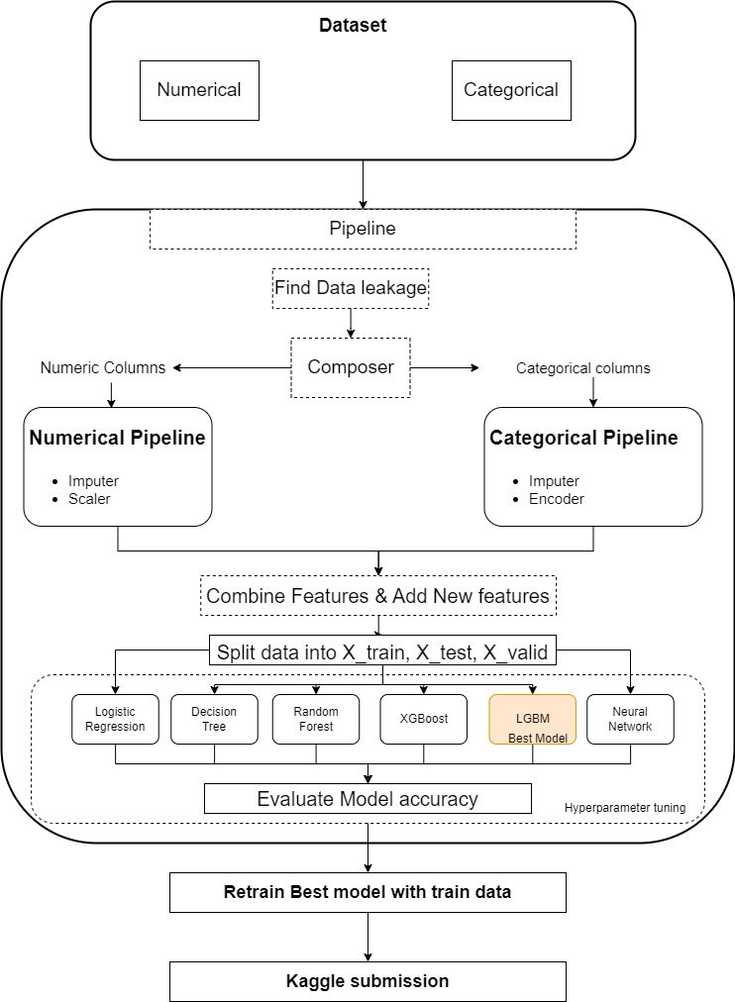
Modeling Pipelines

Slide 8
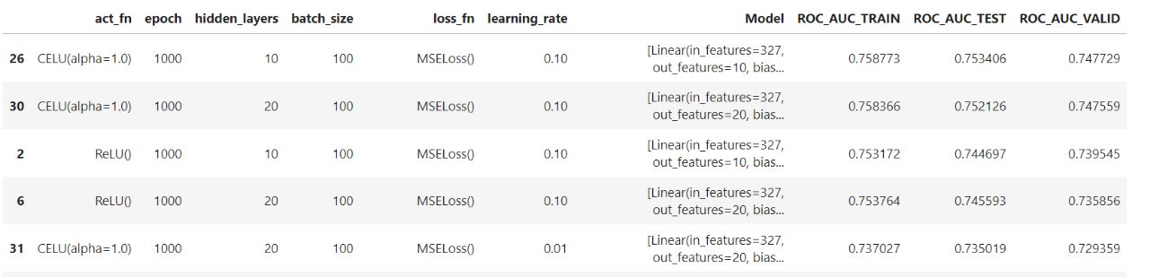
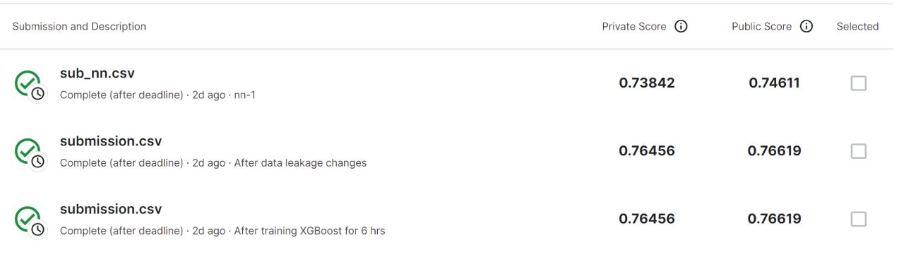
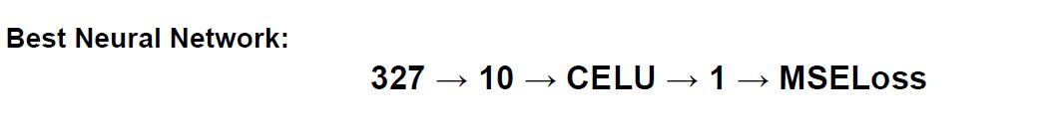
Results and Discussion of Results

Slide 9
Conclusion and Future Scope
Built neural network model with accuracy of 74%
Hyperparameter tuning done on models
LGBM model with highest Kaggle accuracy of 76% on the test data
Found data leakage
Checked for cardinal sins
For future:-
Experimenting with different neural network architectures
Attempt to improve accuracy to improvise loan lending process

