Slide 1

Presentation on ANPR
Automated Number Plate Recognition
Presented by
Chanchal Zope-187003
Shruti Jagtap-187010
Saiprajakta Kadam-187012
Under guidance of
Prof. Prachi Deshpande
Department of Information Technology
Government Polytechnic Aurangabad

Slide 2
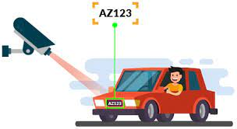
Introduction
Automatic Number Plate Recognition (ANPR) is a highly accurate system capable of reading vehicle number plates without human intervention
ANPR is supporting the safety and security of citizens.
The detected number plate can be stored and used for retrieving more information from it.

Slide 3
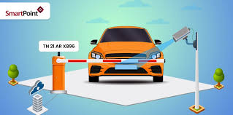
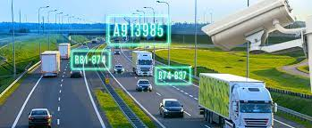
Need of ANPR
Huge number of vehicles moving on road, it is difficult for human eyes to track details of all vehicles.
Any rule violation act can be tracked and the person would receive a e-fine at his place if number plate is caught, here ANPR is helpful.
Managing vehicles at parking area is tedious work it can be minimized by using ANPR.
The track of vehicles passed through particular area can be tracked and that data can be used for investigating purpose.

Slide 4
SOLUTION
We are building automated AI based solution.
It will work continuously 24x7 without any delay or error with good accuracy.
And it will avoid human errors.
Second approach is to develop the webapp.

Slide 5
Implementation
Dataset preparation
Label the dataset using labelimg tool
Model selection
Model training
Model testing on unknown data to check accuracy
Cropping detected plate
Applying OCR technique to extract vehicle number from plate
Webapp creation using Flask API, Python, Html, Js

Slide 6
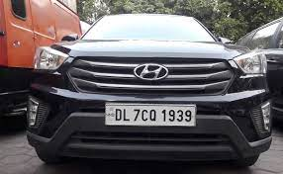
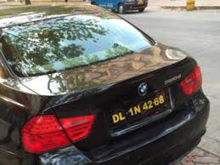
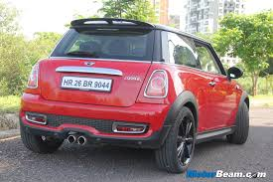
1. Dataset preparation
Collected around 800 images of cars having number plate.
Images are with different angles.
The images have different brightness and exposure for best possible real world conditions.

Slide 7
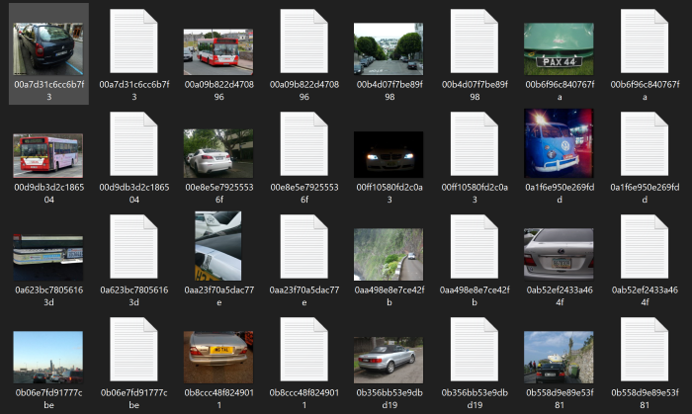

2. Label the dataset using labelimg tool
Labelimg tool is used to label the dataset.
It is open source and easy to use.
Gives label in yoloV4 format.

Slide 8
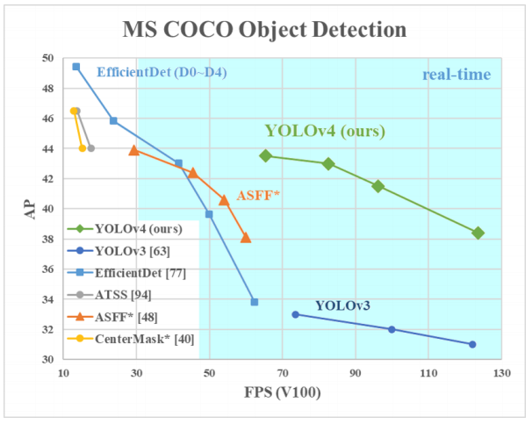
3. Model selection
Model should be accurate while detecting.
We have used yoloV4 object detection model given by darknet framework.
It is heavyweight but detects efficiently.

Slide 9
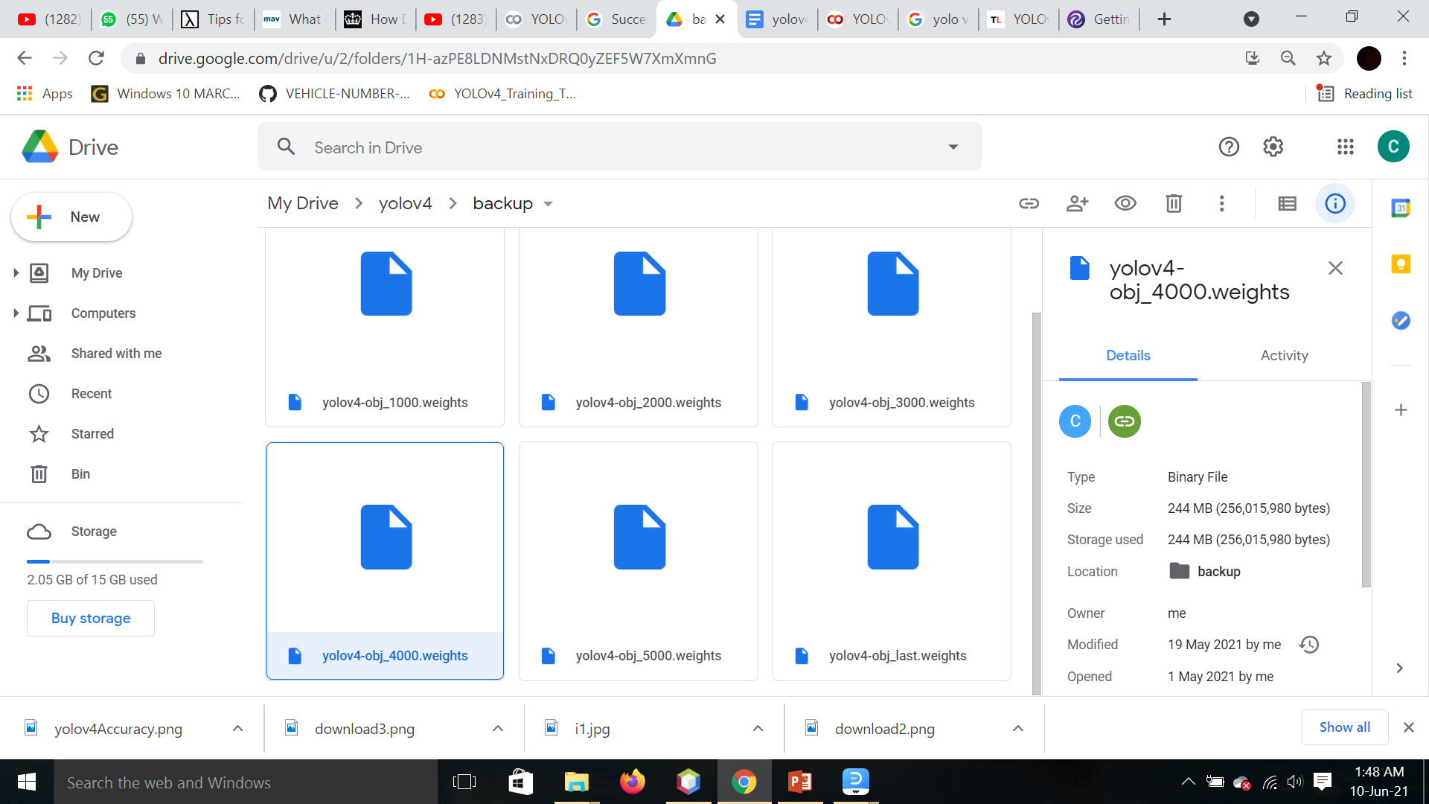
4. Model training
Model has been trained with 4000 iteration.
Batch size 64

Slide 10
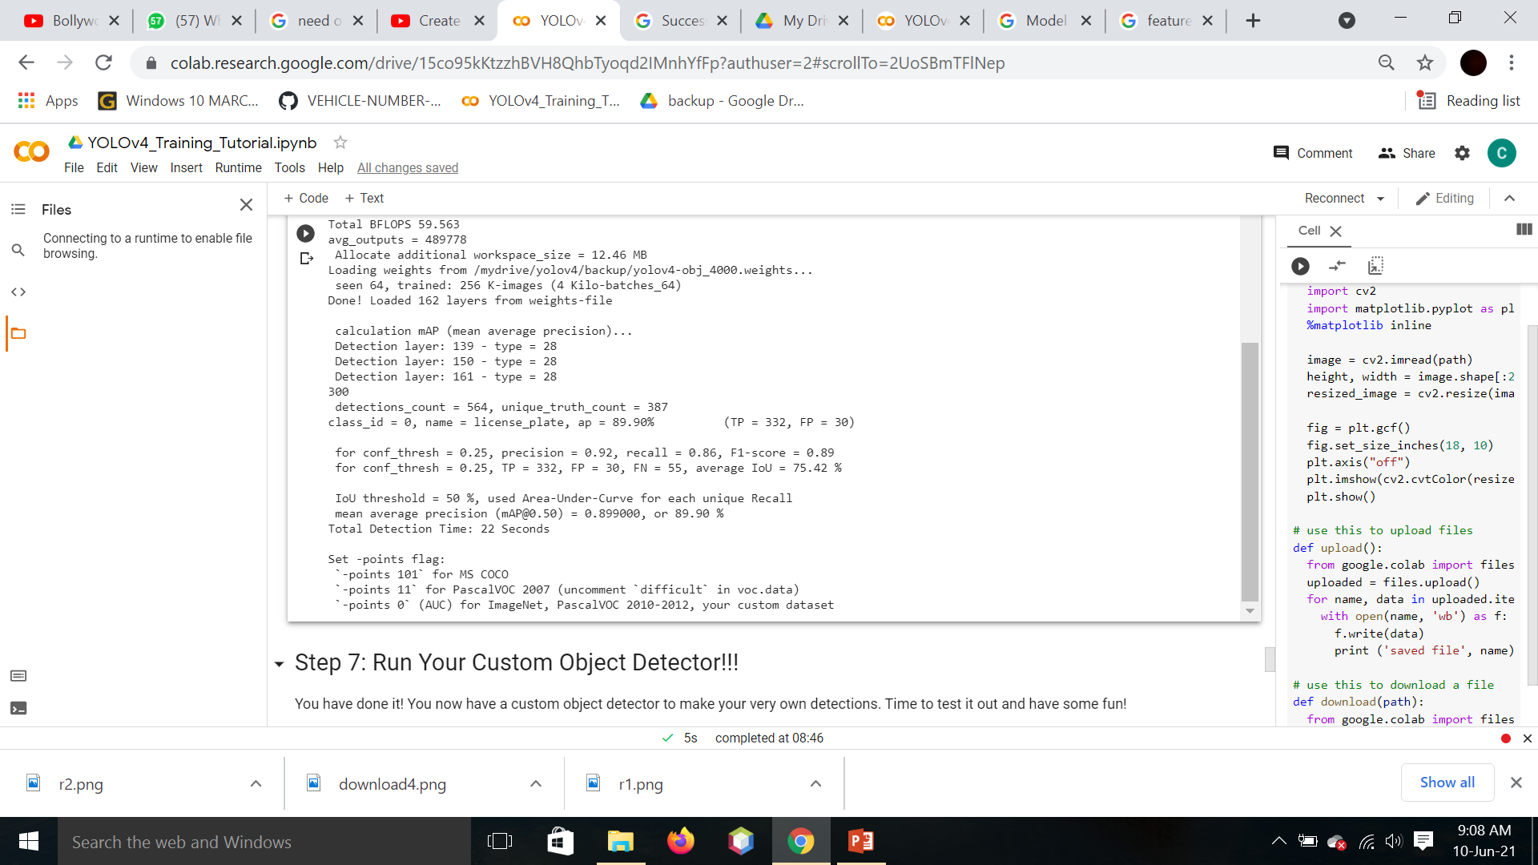
5. Model testing on unknown data to check accuracy
For testing we have used 200 different images of vehicles with number plates with different angles and amount of exposure.
Mean Average Precision of the model is almost 90%

Slide 11
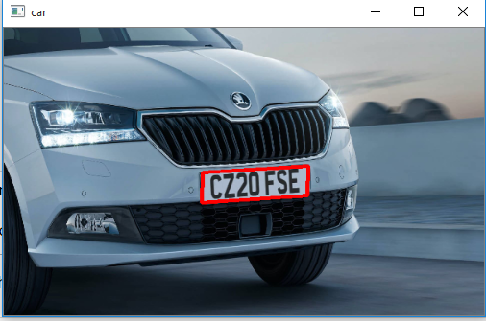
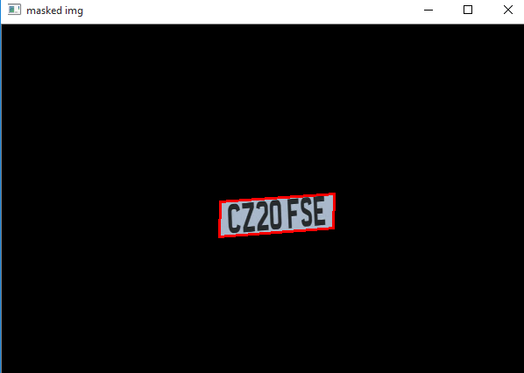
6. Cropping detected plate
After the detection of number plate, only that concerned area is cropped using OpenCV and remaining area is masked.

Slide 12
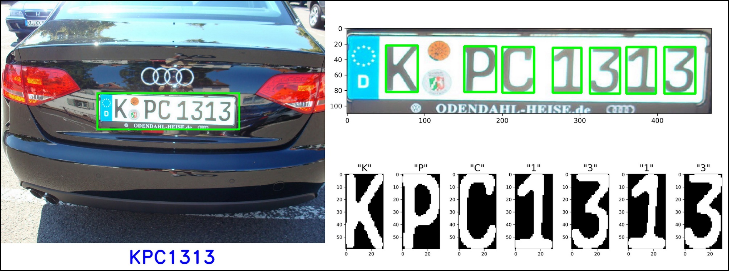
7. Applying OCR technique to extract vehicle number from plate
The cropped number plate is then processed using OCR(Optical Character Recognition Technique) to extract the characters on number plate.

Slide 13
8. Webapp creation using Flask API, Python, Html
Creating webapp using Python, HTML, Flask API.
Library used for prediction is TensorFlow.
Tensorflow is based on SSD algorithm.
Library for OCR is easyocr.
Flask API is used to integrate html pages and python code.

Slide 14
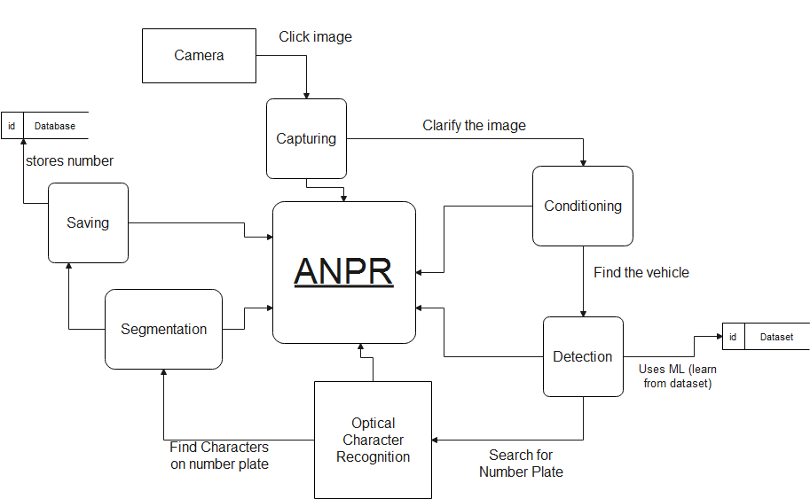
Model flow

Slide 15
Thank you!

