Slide 1
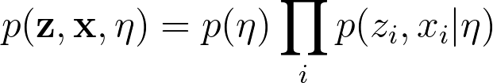
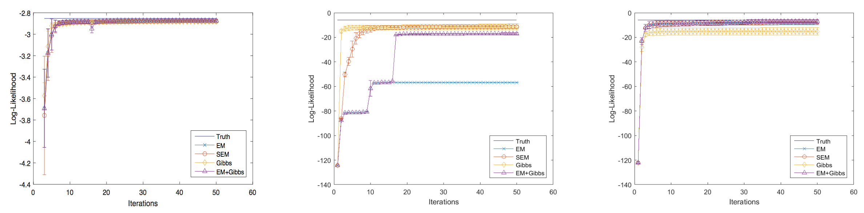
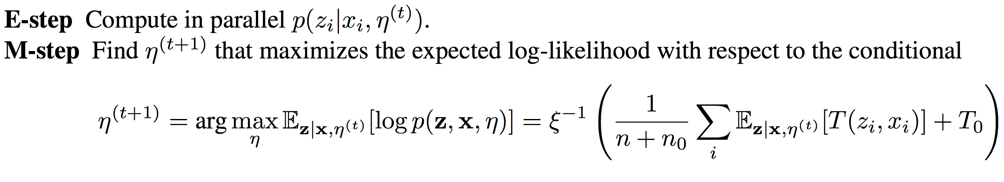
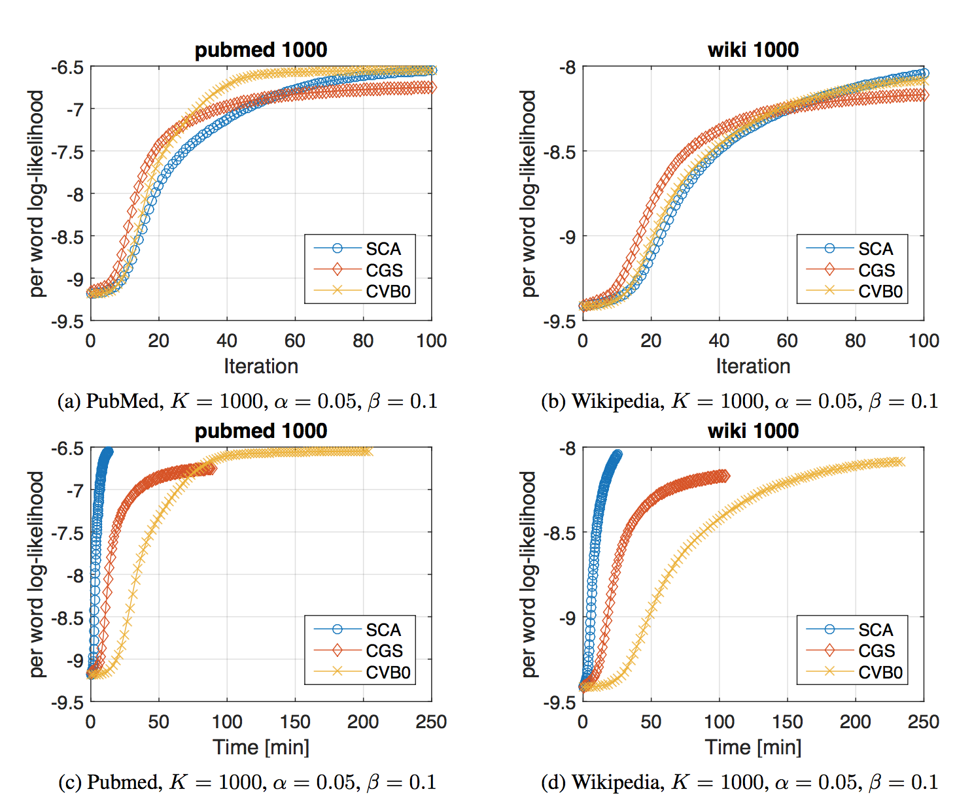
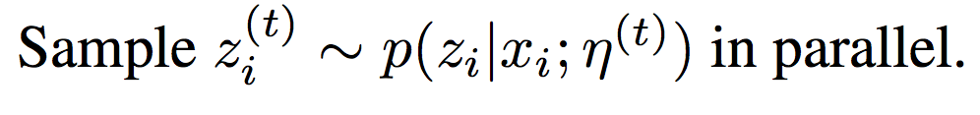
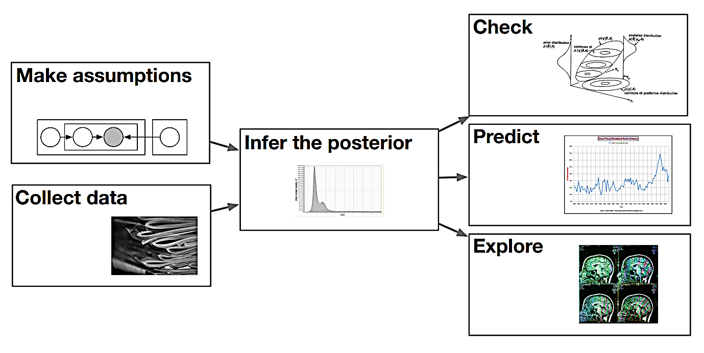
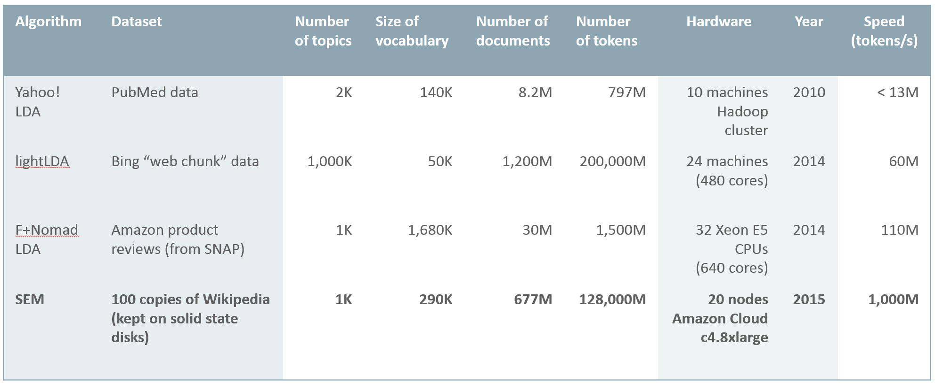
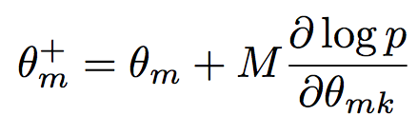

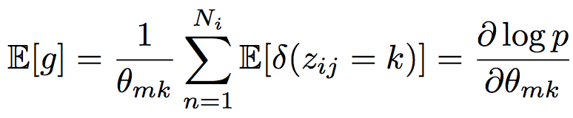
Stochastic Optimization Maximization for Latent Variable Models
Manzil Zaheer ¹, Satwik Kottur ²
¹ Machine Learning Department ² Department of Electrical and Computer Engg
INTRODUCTION
APPROACH
RESULTS
Latent Variable Models (LVM)
Have become a staple of statistical modelling: clustering, topic models, subspace estimation
Discovering the hidden thematic structure of objects in a human-understandable format
Share common structure:
Global variables: pervade the dataset
Local variables: labels for data points
Inference
Estimating posterior distribution (or the most likely assignment) of all the latent variables
Intractable
Even approximate methods do not scale as data dependencies introduced by global state
LVM with complete
data likelihood :
Assume distribution in exponential family:
E Step:
S Step:
M Step:
Find parameters that maximize expected log-likelihood wrt conditional
Gaussian Mixture Models (n = 100,000, K = 10)
Latent Dirichlet Allocation (LDA)
Topic modelling, LVM using Dirichlet priors
Vocabulary, dataset size:
PubMed:
0.14 million 700 million
2. Wikipedia:
0.21 million
1.1 billion
Sampling (eg. Gibbs)
Variational (eg. EM)
CONNECTIONS TO SGD
MOTIVATION
Can be seen as SGD on MAP for LVM
Collapse E and M steps to get update equation:
Now we also have S step
Collapse E , S, M steps to get update equation:
Expectation Maximization (variational)
E-step: Compute distribution of hidden variables given data (independent)
M-step: Maximize lower bound by conditional expectation wrt previously computed distribution
Stochastic Expectation Maximization (SEM)
Asychronous, parallel, stochastic in nature
CONCLUSION
An inference method for LVM that is a stochastic version of EM with emperical justification
Speed-up over current state-of-the-art inference algorithms for LDA with decent accuracy
Future Work
Theoretical guarantees about convergence

