Slide 1

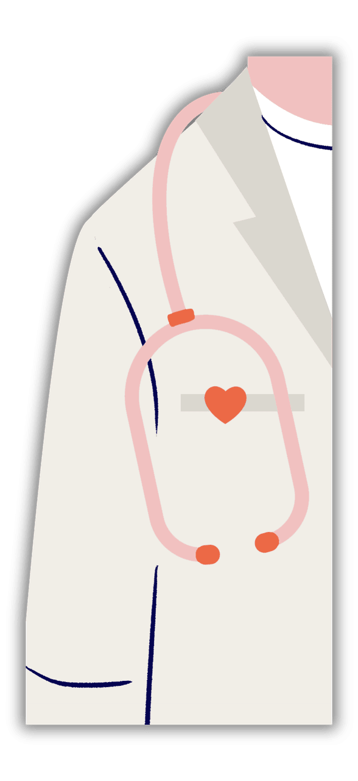




Traction Layer AI
AN END-TO-END AMBIENT AI SYSTEM FOR CLINICAL DOCUMENTATION
Presented By :
Name | USN
Shrutika Ambure | 01fe23bcs198
Sanjana Shetti | 01fe23bcs057
Pavan Nagesh | 01fe24bcs402
Rohan Kabadi | 01fe23bcs418
Guide: Prof. Vijay Biradar

Slide 2

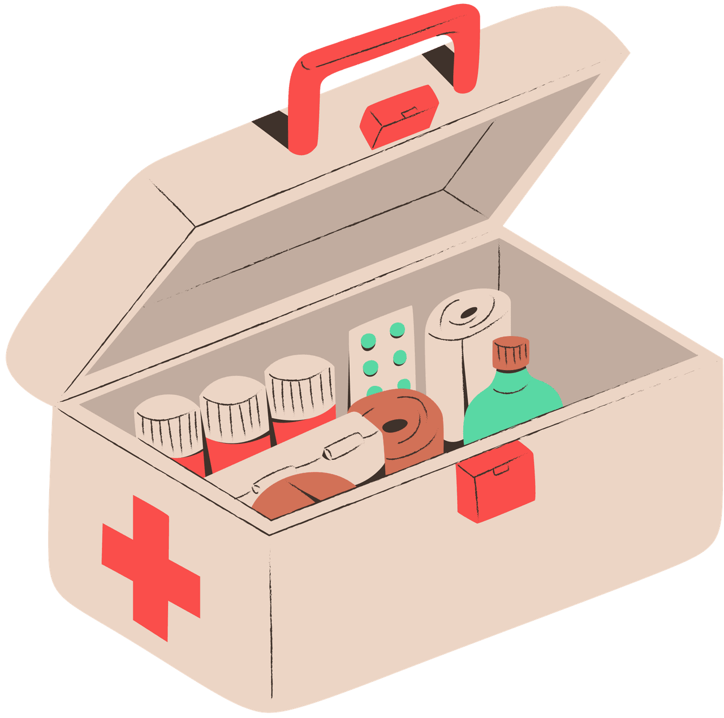

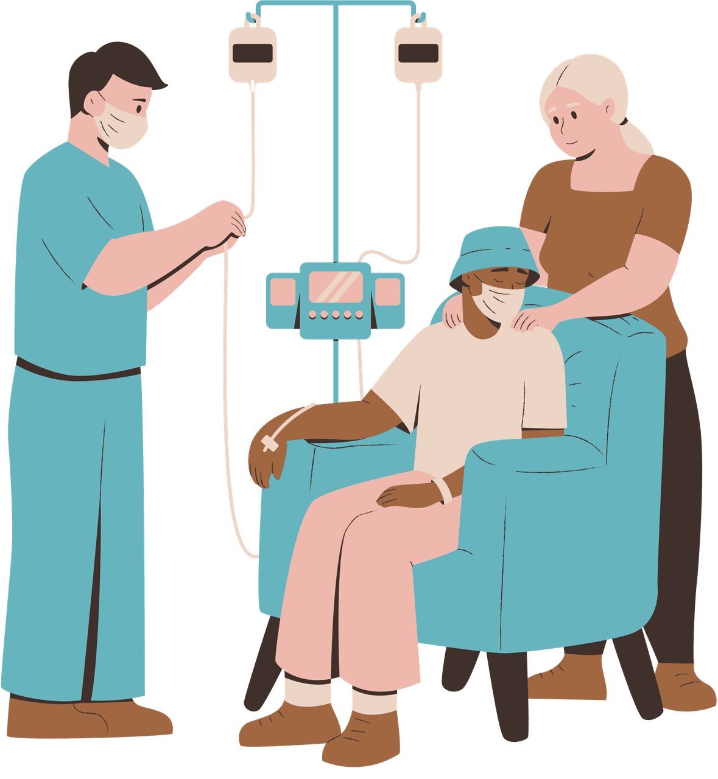
Literature Survey
Traditional clinical documentation is performed manually, which is time-consuming and increases the workload of doctors.
Existing Speech-to-Text (ASR) systems convert doctor–patient conversations into text but do not generate structured medical records.
Most current systems lack speaker diarization and cannot accurately distinguish between doctor and patient speech.
Recent studies have used Large Language Models (LLMs) to extract clinical entities and generate SOAP notes from medical conversations.
Retrieval-Augmented Generation (RAG) techniques improve access to historical patient records by combining semantic search and information retrieval.
However, existing solutions usually focus on individual tasks and do not provide a complete end-to-end system integrating transcription, speaker identification, SOAP generation, privacy protection, and continuity-aware retrieval.

Slide 3

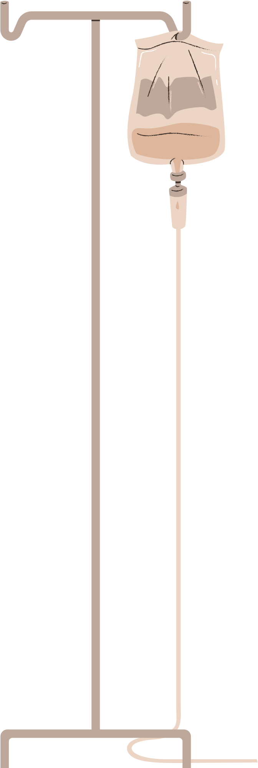


Problem Statement
Our project addresses the challenge of manual clinical documentation, which is time-consuming and increases doctors' workload. Existing systems mainly provide speech transcription and lack structured clinical documentation. Therefore, an AI-based solution is developed to automatically generate accurate SOAP notes from doctor–patient conversations.

Slide 4

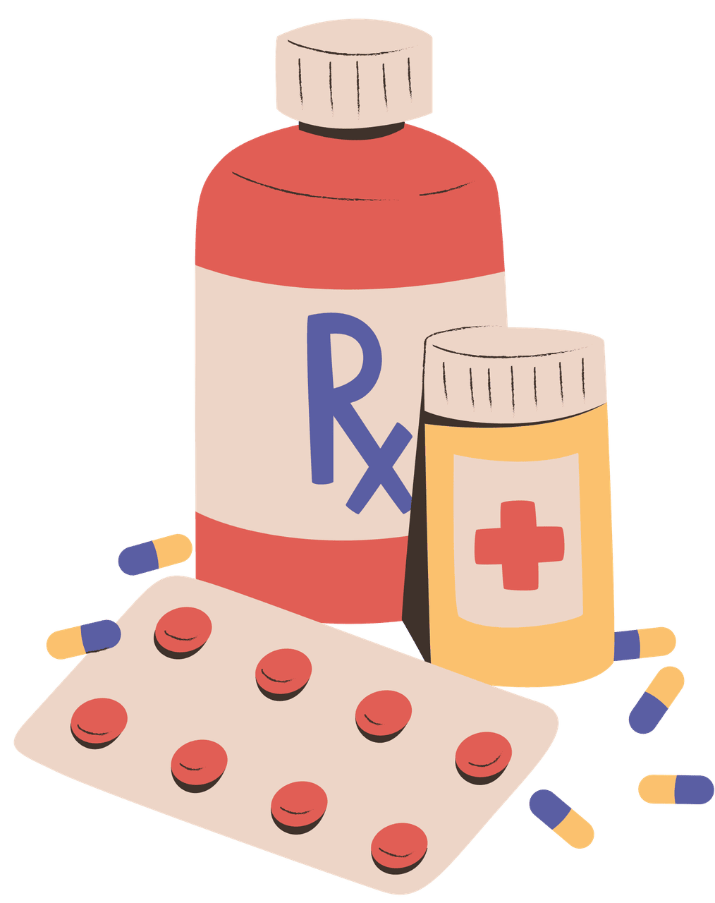


Scope
  Processing doctor–patient consultation audio.
  Speech transcription and speaker identification.
  Clinical entity extraction and SOAP note generation.
  The system protects patient privacy by hiding personal information and helps doctors access previous patient records when needed.

Slide 5
Objectives
To develop an AI-based system that automatically converts doctor–patient conversations into structured clinical documentation.
  To implement ASR, speaker diarization, semantic analysis for accurate consultation processing and speaker identification.
  To extract important clinical entities such as symptoms, diagnoses, and vital signs from consultation transcripts.
To generate standardized SOAP notes and remove sensitive patient information to ensure privacy and secure clinical documentation.
To implement Hybrid RAG-based patient history retrieval and provide a user-friendly interface for consultation management and review.

Slide 6
Proposed Solution
The proposed system is an AI-driven clinical documentation platform that automatically converts doctor–patient consultation audio into structured SOAP notes. The system uses Automatic Speech Recognition (ASR), speaker identification, clinical entity extraction, and Hybrid RAG retrieval to generate accurate clinical documentation while maintaining patient privacy and supporting patient history retrieval.

Slide 7
Functional Requirements
The system shall accept doctor–patient consultation audio as input.
The system shall convert consultation speech into text using ASR.
The system shall identify and separate doctor and patient speakers.
The system shall extract clinical information and generate SOAP notes.
The system shall store records and retrieve patient history for future consultations.

Slide 8
Non-Functional Requirements
The system shall ensure security and privacy of patient data.
The system shall provide high accuracy in transcription and note generation.
The system shall be reliable and available during consultation processing.
The system shall provide fast response and retrieval performance.
The system shall offer a user-friendly and easy-to-use interface.

Slide 9


Task Identification
Authentication Module – Handles clinician login and secure access to the system.
Audio Processing Module – Accepts consultation audio and performs speech-to-text conversion.
Speaker Identification Module – Identifies and separates doctor and patient speech segments.
Clinical Entity Extraction Module – Extracts symptoms, diagnoses, medications, and other clinical information.
SOAP Note Generation Module – Generates structured SOAP notes from consultation transcripts.

Slide 10
Task Identification
Sensitive Information Removal Module – Removes confidential patient information before storage.
Hybrid RAG Retrieval Module – Retrieves relevant historical consultation records and patient history.
Database Management Module – Stores consultation data, transcripts, and generated SOAP notes.
Frontend Dashboard Module – Provides interfaces for audio upload, note review, and patient history management.

Slide 12

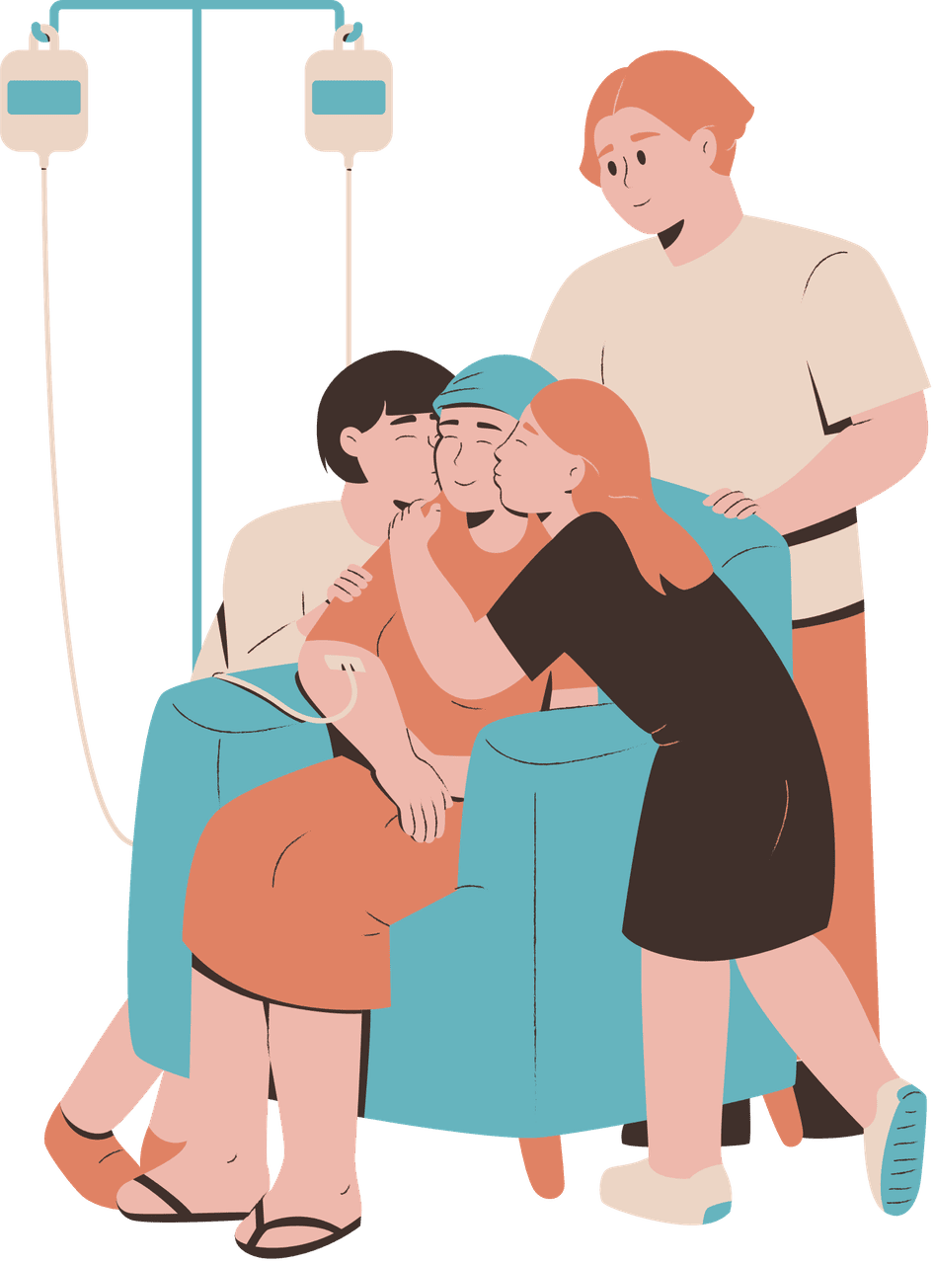
Applicability of the Problem Solution in the Societal Context
• Reduces administrative workload for healthcare professionals.
• Allows doctors to spend more time on patient care.
• Improves quality and consistency of medical documentation.
• Enhances continuity of care through patient history retrieval.
• Supports digital transformation in healthcare systems.

Slide 13

Module Testing and Validation
Unit testing performed on individual modules.
Integration testing verified communication between modules.
Acceptance testing validated complete workflow execution.
Performance testing evaluated processing and retrieval speed.
All major test cases were executed successfully.

Slide 14
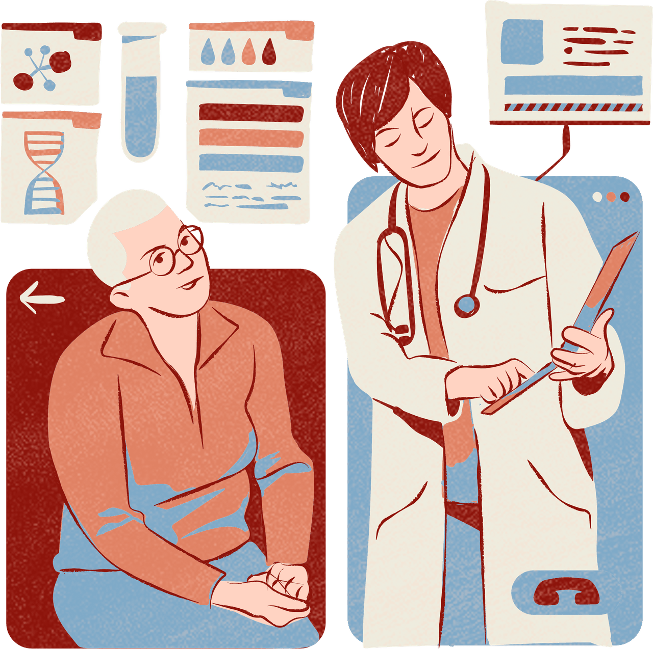
Intermediate Result Analysis
Doctor voice enrollment completed successfully.
Speaker diarization accurately identified speakers.
Structured SOAP notes were generated correctly.
Hybrid RAG retrieved relevant historical consultations.
Overall system demonstrated reliable and efficient performance.

Slide 15
THANK YOU

