Slide 1


Zomato restaurant recommendation SYSTEM
Presented by
Group-no17
Kanchan Mahajan(1524)
Shrutika makhamale(1542)
Prashant Karhale Akshay Tilekar
Center Coordinator (External Guide)

Slide 2
Introduction
Bangalore has a unique food culture. Restaurants from all over the world can be found here in Bengaluru, with various kind of cuisines.
Some might even say that Bangalore is the best place for foodies. The food industry is always at a rise in Bangalore, with 12,000 plus restaurants currently active in the city, the number is still increasing..

Slide 3
Bangalore(officially known as Bengaluru) is the capital and largest city of the Indian state of Karnataka. With a population of over 15 million, Bangalore is the third largest city in India and 27th largest city in the world.
Zomato is one of such an app which gives the users the ratings and the reviews on restaurants all over india.
Ratings or the Reviews are considered as one of the most important factors that’s why we choose the recommendation.

Slide 4
Why the Recommendation system?
Benefits users in finding items of their interest.
Help item providers in delivering their items to the right user.
Identity products that are most relevant to users.
Personalized content.
Help websites to improve user engagement.

Slide 5
Purpose
Zomato is one of such an app which gives the users the ratings and the reviews on restaurants all over India.
Ratings or the Reviews are considered as one of the most important/deciding factors which determine how good a restaurant is.
Hence here in our project we will use the real time Data set which has various factors/ features a user would look into regarding a restaurant. We are limiting our data to Bangalore City only.
The Zomato dataset gives us information about factors affecting the establishment of different types of restaurant at different places in Bengaluru, aggregate rating of each restaurant.
This dataset has 51717 rows and 17 columns. Here we would aim atending the best Restaurant in bengaluru. Along with the same we can explore various other relationships like the best expensive restaurant, Best Location, Relation between Location and Rating, No. of restaurants in a Location all these relationships could be visualized.

Slide 6
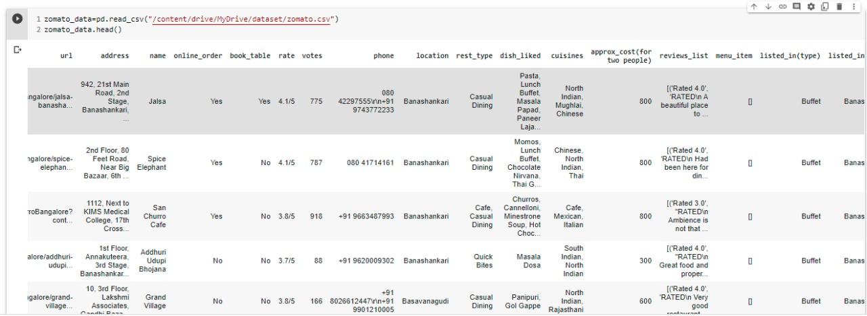
Dataset

Slide 7
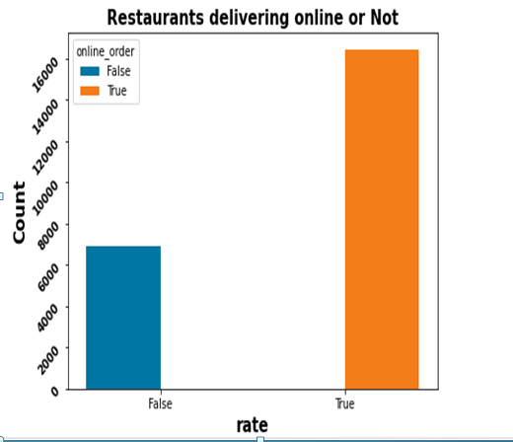
Visualization
Restaurants delivering online or not
The above graph we have almost more than 16000 Restaurants in Bangalore that Accepts online orders through zomato and Almost of 7000 are not accpeting any online orders through zomato.

Slide 8
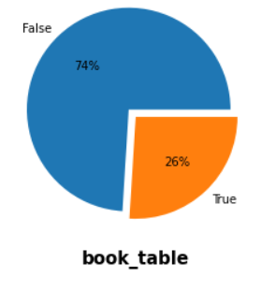
Restaurants allowing table booking or not.
Almost 74 percent of restaurants in Banglore do not provide table booking facility.and 26 percent of restaurant provide table booking In India you cannot find table booking facility in any average restaurants,usually only five star restaurants provides table booking.

Slide 9
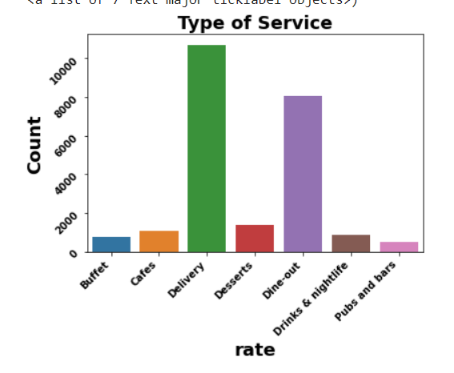
Type of service.
We see that the majority of restaurants offer delivery, which might account for the above conclusion that people at Bangalore prefer to eat at home. Pubs and Bars and Buffet are offered by very less number of restaurants.

Slide 10
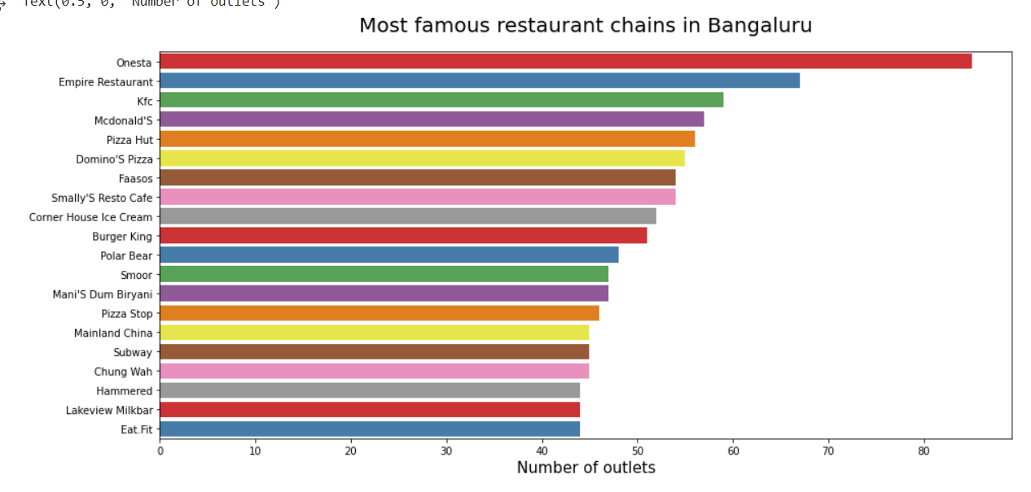
Most famous restaurant chains in Bengaluru.
As you can see Cafe coffee day,Onesta,Just Bake has the most number of outlets in and around bangalore.

Slide 11
Main Steps to build a model using (NLP)
LowerCase : converting the text to its lowercase format is quite easy
def wordlower():
test="HELLO" print test.lower()
Tokenization : Tokenization is essentially splitting a phrase, sentence, paragraph, or an entire text document into smaller units, such as individual words or terms. Each of these smaller units are called tokens.
import spacy
nlp = spacy.load("en_core_web_sm")
doc = nlp("Apple is looking at buying U.K. startup for $1 billion")
for token in doc:
print(token.text, token.pos_, token.dep_)
:

Slide 12
Remove Punctuation :There are numerous ways to remove punctuation from a string in Python. To remove all punctuation from a string, you can use the translate() method. You need to use this method with the string.punctuation method,
import string
PUNCT_TO_REMOVE = string.punctuation
def remove_punctuation(text):
return text.translate(str.maketrans('', '', PUNCT_TO_REMOVE)
Stopwords removal : English is one of the most common languages, especially in the world of social media. For instance, "a," "our," "for," "in," etc. are in the set of most commonly used words.
import nltk
from nltk.corpus import stopwords
set(stopwords.words('english'))

Slide 13
Tf-idf
Tfidftransformer you will systematically compute word counts using CountVectorizer and then compute the Inverse Document Frequency (IDF) values and only then compute the Tf-idf scores.
Tfidfvectorizer is convert a collection of raw documents to a matrix of TF-IDF features.
tfidf_vectorizer=TfidfVectorizer(use_idf=True)
fitted_vectorizer=tfidf_vectorizer.fit(docs)
tfidf_vectorizer_vectors=fitted_vectorizer.transform(docs)

Slide 14
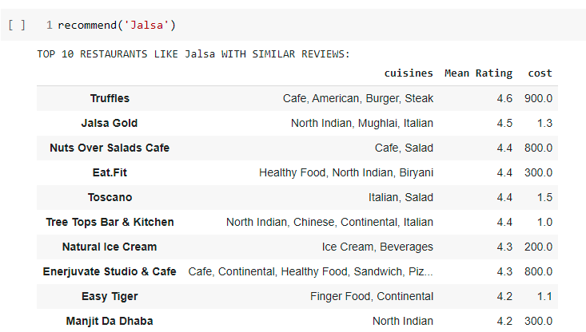
Recommendation
Using TF-IDF :

Slide 15
K-Nearest Neighbors (KNN):
KNN algorithm:- K-Nearest Neighbours In pattern recognition, the k-nearest neighbour’s algorithm (k-NN) is a non-parametric method used for classification and regression. In both cases, the input 21 consists of the k closest training examples in the feature space. The output depends on whether k-NN is used for classification or regression. In k-NN classification, the output is a class membership. An object is classified by a majority vote of its neighbours, with the object being assigned to the class most common among its k nearest neighbours (k is a positive integer, typically small). If k = 1, then the object is simply assigned to the class of that single nearest neighbour.
K-Nearest Neighbors (KNN) is one of the simplest algorithms used for regression and classification problems in Machine Learning. This takes the data and classifies new data points based on measures of similarity (e.g., distance function). Classification to its neighbour’s is achieved by majority vote.

Slide 16
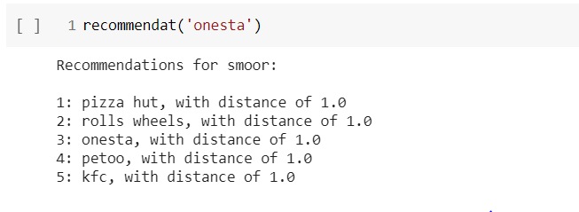
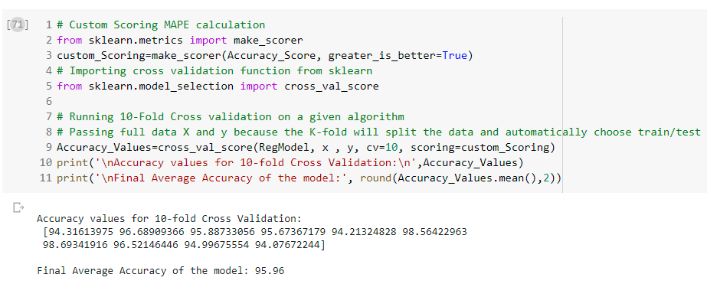
Recommendation
Using KNN:

Slide 17
Future Scope
As the dataset is pretty straight forward we did not split the data for the future research can be continued to enhance the delivery option available making users to pick as there is no necessity for them to come to the outlets the best cuisines will be delivered to their locations and also in our research we observed direct walk in for table booking outlets and low taking reservation there is scope to work even in this part more by running of different models for better accuracy.
There is also chance to add versions to the models and follow approach production network. We can also train the algorithms used again for better analysis of features in static and real time.
There is also scoped to retrain the paradigm for the studied model and can also find a pathway to check the paradigm production. To extend the existing system to a chain of multiple restaurants.

Slide 18
Conclusion
Our system implements recommendation system to provide restaurant recommendations based on their previous reviews and rating.
The recommendations are pretty much accurate as per our tests. Our system can be easily extended to other cities and cuisines.
Our system has immense potential and is multipurpose as it can come handy for businesses as well as the average user.
The field of restaurant recommendations is one of the uncharted territories and our system is a small step in a giant ocean.
A recommender system which suggests restaurants according to user’s food item preference based on the reviews received by Zomato about these restaurants. We also kept in mind the side items favored while making the recommendation. We believe that this information may be useful for the extensive review data available on such sites.

Slide 19
Thank You!

