Slide 1
EVENT MANAGEMENT SYSTEM
Simplifying Event Booking

Slide 2
Our Event management systems is designed to streamline and automate various aspects of planning, executing, and evaluating events. It offers a centralized platform to manage tasks, resources, and communication, ultimately aiming to improve efficiency, reduce costs, and enhance the overall event experience.

Slide 3




LIMITATIONS OF Existing Management Platforms
Cvent
Whova
vFairs
Bizzabo
Not Easy to Use or Beginner Friendly
Limited Customizability
Pricing Details are not Transparent
Expensive. Especially for Smaller events

Slide 4

TECHNOLOGY STACK
JAVA + Spring Boot for implementing Back-end logic
Java Servlet for handling data flow and server side logic.
HTML, CSS, Javascript for Front End Development
JUnit for creation and development for test cases for the app.
MongoDB + Hibernate for Database and querying requirements.
GitHub as Version control and collaboration platform

Slide 5
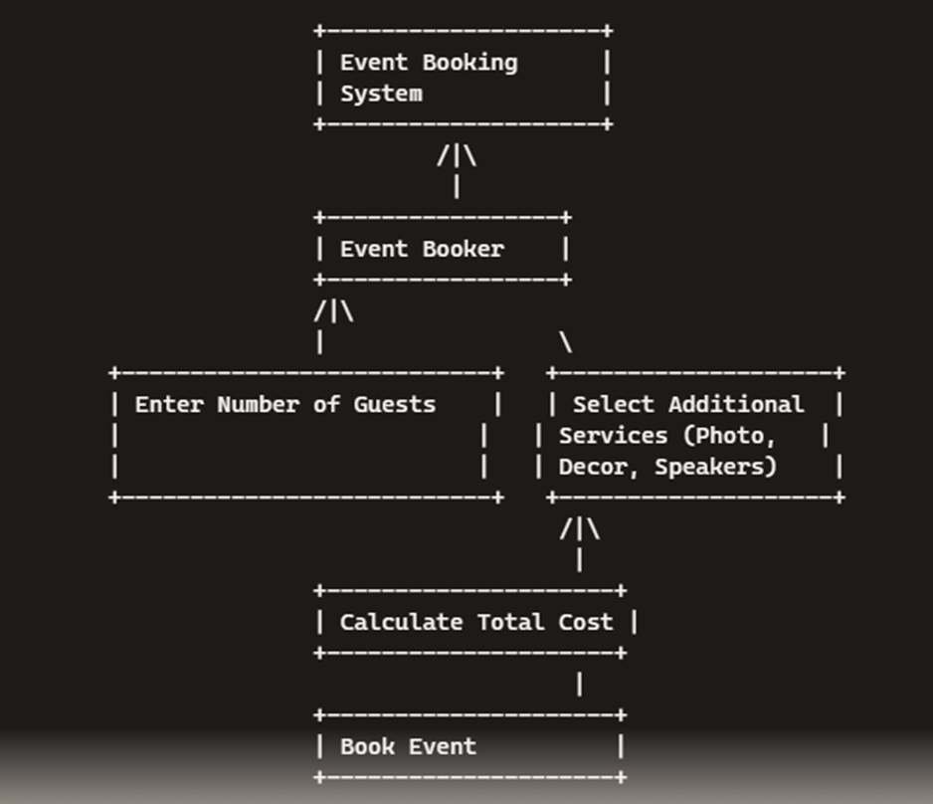
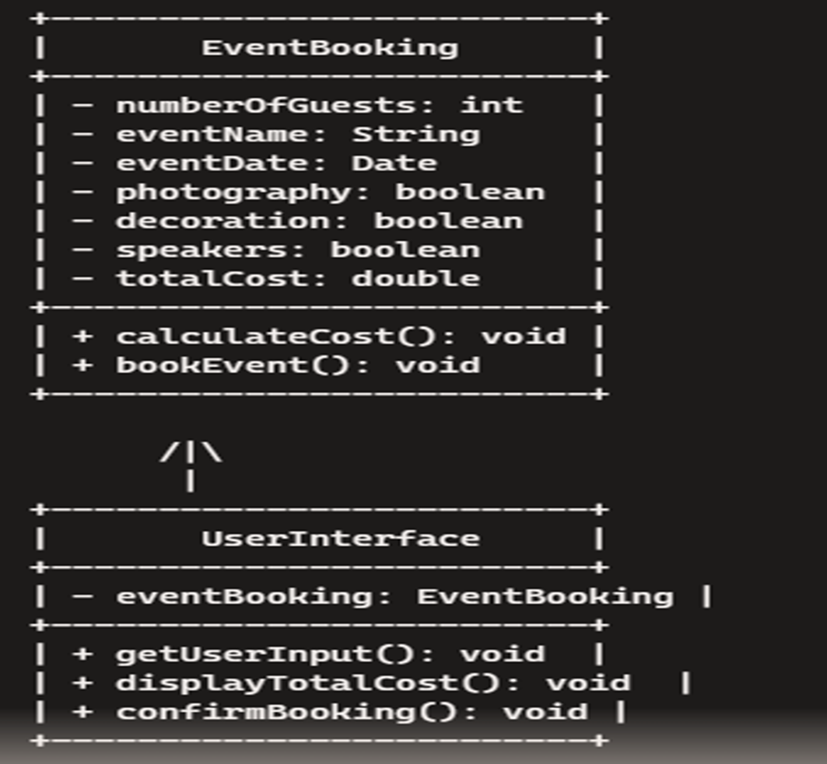
DESIGN AND ARCHITECTURE

Slide 6
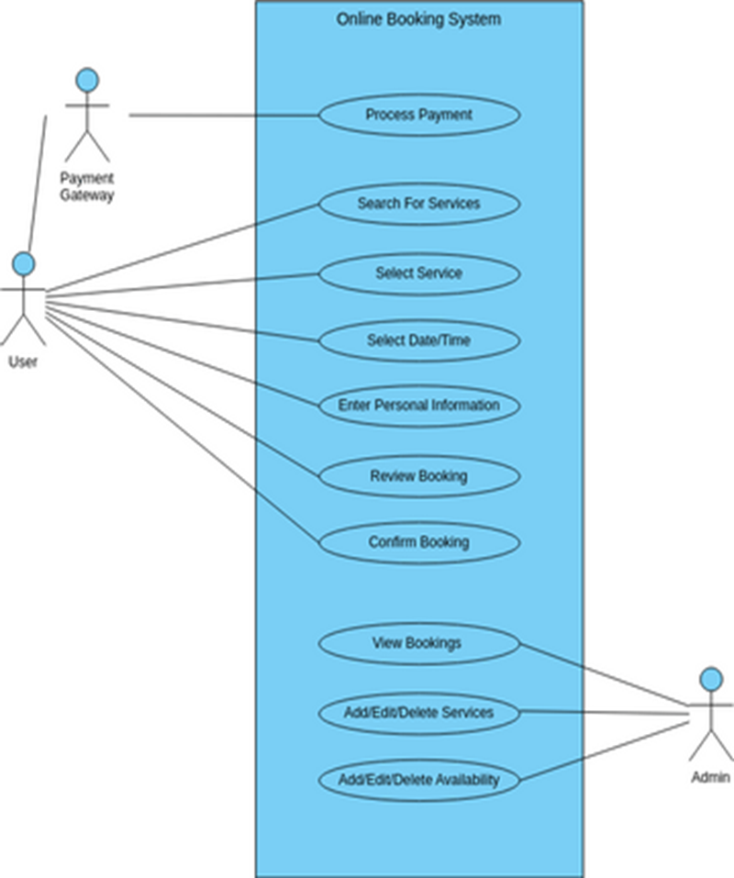

Slide 7
FEATURES AND FUNCTIONALITY
User-Friendly Interface
Secure User Authentication
All in One Platform
Session Tracking
Intuitive for both organizers and attendees
Safe and reliable user verification system.
Offer a comprehensive suite of features for managing all aspects of an event.
Check the progress of every aspect on the app in real time

Slide 8
DEVELOPMENT WORKFLOW
Front-End Development
Payment Integration
Architecture and Database Design
Back-End Development
Create tables for Users, Events, Bookings, Payments, and GuestList with relevant fields.
Develop servlets for request handling, event management, booking processing, and cost calculation.
Build user interface with simple forms, dynamic cost display, and photographer service selection.
Integrate secure payment gateways and manage transaction data in the database.

Slide 9
ROLES OF EACH MEMBER
— AEKULA JHANSI (TEAM LEAD)
2310030332
—HIMAVARSHA REDDY
2310030147
—M. RUTHVIKA REDDY
2310030266
—DANDU ARUNA
2310030071
—SHRUTI KAMMA
2310030244
- Frontend Developer
- Coordinates project
- Ensures quality user interface.
- Backend Developer.
- Handles server-side logic
- Data processing.
- Frontend Developer.
- Collaborates with Jhansi on user interface design.
- A Database Administrator.
- Works with all the members in the group.
- Backend Developer.
- Works with Hima Varsha on server-side implementation.

Slide 10
THANK YOU

