Slide 1
IST687 – Applied Data Science
Chapter 18
What’s Your Vector, Victor ?

Slide 2
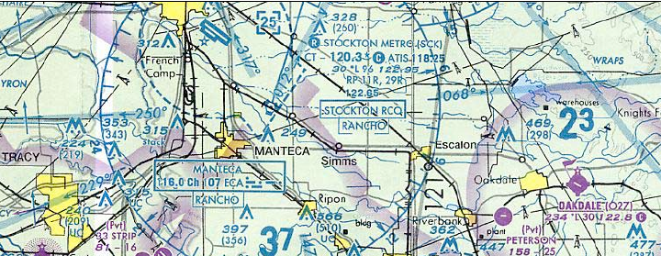
Data Science
In the previous chapter, we explored an unsupervised learning technique known as association rules mining. In this chapter, we will examine a set of supervised learning approaches known as support vector machines (SVMs). SVMs are flexible algorithms that excel at addressing classification problems.

Slide 3
Data Science
Chapter Objectives
Basic understanding and application of a data mining technique known as “supervised learning” via a support vector machine (SVM) model
Set up the appropriate “training” and “test” dataset environments for SVM processing
Train a support vector machine algorithm utilizing the “training” dataset
Recognize and evaluate support vector machine parameters and their respective impact on the “training” data set
Process “test” dataset to validate how well the SVM learned from the “training” dataset

Slide 4
Supervised Learning
Train algorithm on an initial set of data, i.e. we want to learn mapping X --> Y, where xϵX is some object and yϵY is a class label
Test algorithm on a new set of data
Validate ‘trained’ algorithm predicted the right outcome

Slide 5
Supervised Learning: Example
Train a machine learning algorithm to predict the weather
Collect weather data over a period of time
Sunny, cloudy
Temperature
Barometer
Wind speed & direction
Train a machine learning algorithm with these collected variables
Collect more weather data and predict the weather via our trained algorithm and validate the prediction

Slide 6
Supervised Learning: Other Examples
text categorization (e.g., spam filtering)
fraud detection
optical character recognition
machine vision (e.g., face detection)
natural-language processing (e.g., spoken language understanding)
market segmentation (e.g.: predict if customer will respond to promotion)
bioinformatics (e.g., classify proteins according to their function)

Slide 7
Supervised Learning: Strategy
Substantial number of training cases that the algorithm can use to discover and mimic the underlying pattern
Use the results of this process on a test data set to determine how well algorithm performed, i.e. “cross validate”
Cross Validate: the process of verifying that the trained algorithm can carry out its prediction or classification task accurately on novel data

Slide 8
Model Evaluation
Two fundamental concepts
Training error: train a model (e.g. a decision tree model) on the training data set, then test the model on the same training set. The error rate is called “training error”, which evaluates how well the model fits the training data.
Test error: test the model on a test data set that is different from the training set. The error rate is called “test error”, which evaluates how well the model generalizes to unseen data.

Slide 9
Overfitting
Overfitting means a model fits the training data very well, but generalizes to unseen data poorly.
How do I know if my model is overfitting?
Your model is overfitting if its training error is small (fits well with training data), but the test error is large (generalizes poorly to unseen data)

Slide 10
Evaluation methods to Avoid Model Overfitting
But…we have to estimate how good a model is before using it in real predictions.
Some evaluation methods have been designed to test the model on training data while controlling model overfitting.
Hold-out test
Cross validation

Slide 11
Hold-out Test
Hold-out test
split the training data to two subsets, using one subset for training, and the other for testing.
The splitting ratio is determined by the training set size in that both subsets cannot be too small.
50/50 or 2:1 are common splitting ratios.

Slide 12
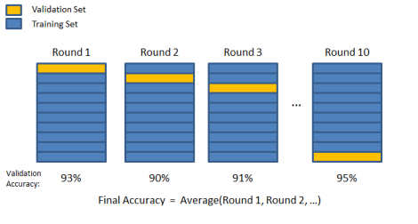
Cross-Validation (CV)
N-fold Cross validation (CV)
N is determined by the training set size. The larger the N, the longer it takes to run the experiment.
5 or 10 are common choices for N.
http://chrisjmccormick.wordpress.com/2013/07/31/k-fold-cross-validation-with-matlab-code/

Slide 13
Hold-out Test vs. Cross Validation
Hold-out test
Pros: fast
Cons: high variability in the result depending on the split
Cross validation
Pros: less variability and thus more reliable error estimation
Cons: takes longer time

Slide 14
Evaluation Measures
Accuracy
Precision
Recall
F-measure
Confusion matrix

Slide 15
Evaluation Measures: Accuracy
Accuracy: total correct / total
So you get 90% accuracy, isn’t that great?!
Maybe not, it depends on your baseline:
Random guess baseline:
50% for binary classification
1/n for n-class classification
Majority Vote Baseline:
It’s a trivial classifier that classify all examples to the majority class.
E.g. If a spam data set include 90% spams and 10% regular mails, the majority vote baseline is 90%, meaning this trivial classifier predicts everything as spam and get 90% accuracy.
A good classifier has to beat this baseline to claim effectiveness.

Slide 16
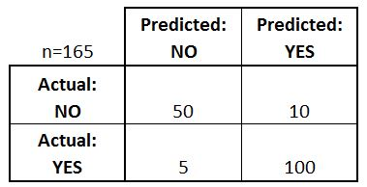
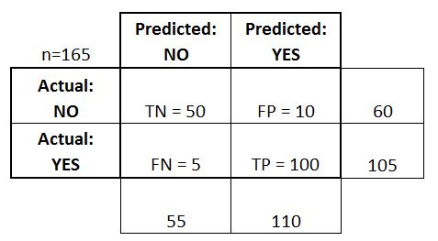

Evaluation Measures: Confusion matrix
Confusion Matrix for two classes (binary classifier)
Accuracy = (TN+TP)/n = 150/165

Slide 17
Evaluation Measures: Recall and Precision
Recall and Precision for each class:
Recall _{Class=No} = TN/(TN + FP) = 5/6
Recall _{Class=Yes} = TP/(FN+TP) = 100/105
Precision _{Class=No} = TN/ (TN+FN) = 50/55
Precision _{Class=Yes} = TP/(TP+FP) = 100/110
F₁-measure = 2/(1/P+1/R)=2PR/(P+R)

Slide 18

Support Vector Machine (SVM)
1963
A. Chervonenkis V. Vapnik

Slide 19
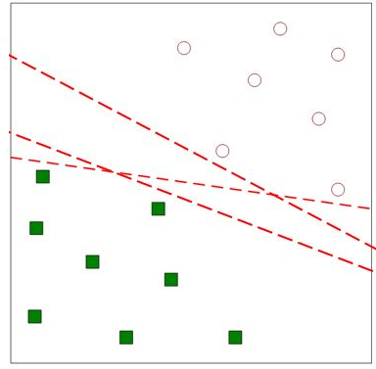
What is SVM?
Each data point is given a specific position in multidimensional space
Support Vector Machine aims to describe geometric boundaries between data points/regions
Each of these are possible solutions
But which one is the best?

Slide 20
What is SVM?
Goal is to maximize the margin between points of different categories
Support Vectors are training examples that are located on the margins
Only support vectors determine decision boundary
Therefore, B1 is a better separator as the line is further from the bordering data points than B2.

Slide 21
What is SVM?
Chapter Use Case
Develop a “support vector machine” (SVM) to classify emails as spam or not spam
SVM: map a low dimensional problem into a higher dimensional space;
Novel data point to be mapped via a SVM into higher dimensional space and indicate whether the point was above or below the planar separation
Goal:
being able to describe geometric boundaries between different regions;
most cleanly separate data into categories (classification)
Kernel: mapping algorithm
Input data (independent variables from a given case)
Kernel – formula run on each case’s vector of input data
Output data: position of that case in a multidimensional space

Slide 22
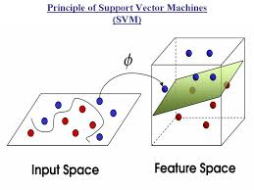
What is SVM
SVM Illustration
planar separation
SVM
support vectors
projected points in a 3 dimensional space
2 dimensional points

Slide 23
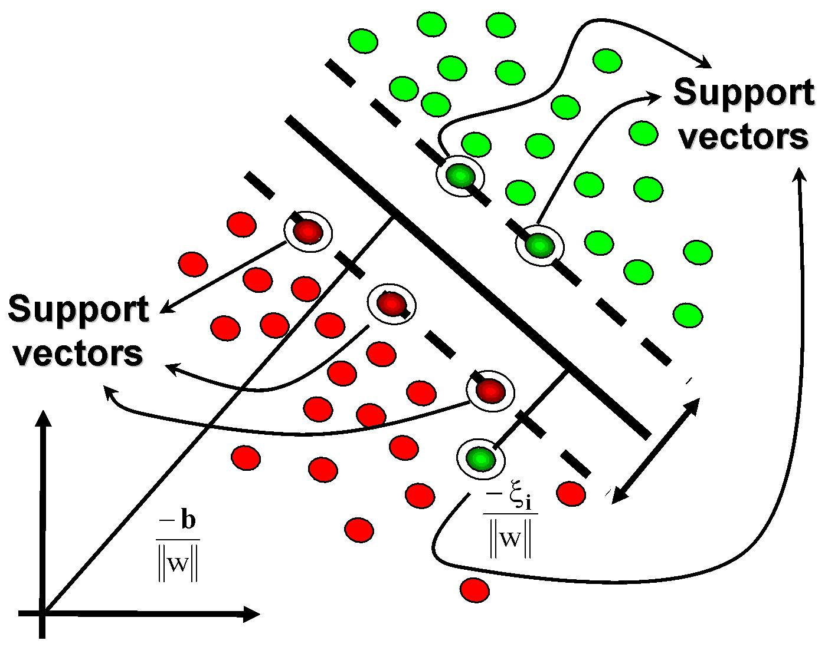
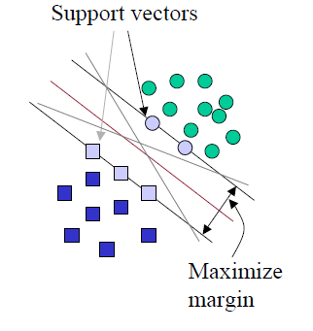
What is SVM
SVM Illustration
link
Not Spam
Spam

Slide 24
SVM Pros and Cons
Weaknesses
Require a number of parameters for each kernel type
Interpretability
Easy interpretation for linear kernel
Difficult to interpret the model generated by nonlinear kernels
Strengths
High tolerance to noisy data
Flexibility in data representation: well-suited for continuous- or discrete-valued inputs and outputs
Probabilistic prediction result
Scalability: successful on extremely large problems
Successful on a wide array of real-world data

Slide 25
R: Example 1
SVM setup
R “kernalab” package
spam data set
http://archive.ics.uci.edu/ml/datasets/Spambase

Slide 26
R: Example 1
> install.packages("kernlab") # install package
> library(kernlab) # activate package
> data(spam) # load R supplied data set
> str(spam) # structure, Inspect contents
> dim(spam) # dimension, overview
> table(spam$type) # delineates spam, nonspam counts

Slide 27
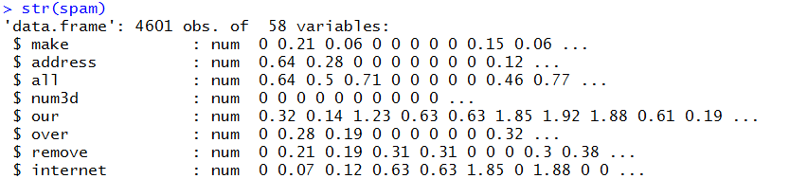

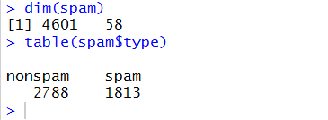
R: Example 1

Slide 28
R: Example 1
SVM setup
Divide spam data set into a “training” and “test” data set
Suggested delineation
2/3^{rds} -> Training
1/3rd -> Test
Create a data set of 4601 random indexes utilizing sample function
Create 2/3rd cut point
Create trainData data set using 2/3rd cut point and previously created random indexes
Create testData data set using ‘pseudo’ 1/3rd cut point and previously created random indexes

Slide 29
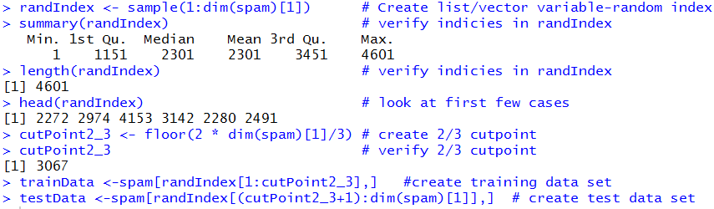
R: Example 1

Slide 30
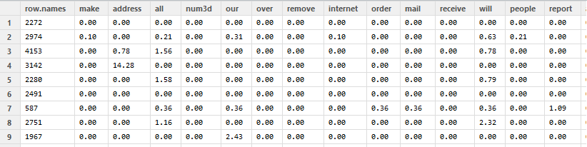
R: Example 1

Slide 31
R: Example 1
Train support vector model
svmOutput <- ksvm(type ~ ., data=trainData,kernel="rbfdot",kpar="automatic",C=5,cross=3,prob.model=TRUE)
type ~ specifies the model we want to test, i.e. want to have the type variable (spam, non-spam) as the output variable we want to predict
“.” use all other variables in the data frame to predict type
Data specifies the data frame to use in the analysis, i.e. trainData

Slide 32
R: Example 1
Train support vector model
svmOutput <- ksvm(type ~ ., data=trainData,kernel="rbfdot",kpar="automatic",C=5,cross=3,prob.model=TRUE)
rbfdot - kernel function that projects the low dimensional problem into higher dimensional space, i.e. getting the maximum separation of distance between spam and non spam cases
kpar refers to a variety of parameters that can be used to control the radial bias function kernel (rbfdot)
C argument refers to “cost of constraints”
High C value impact (summary slide)
Low C value impact (summary slide)

Slide 33
R: Example 1
Train support vector model
svmOutput <- ksvm(type ~ ., data=trainData,kernel="rbfdot",kpar="automatic",C=5,cross=3, prob.model=TRUE)
cross refers to the cross validation model that the algorithm uses
“overfitting”

Slide 34
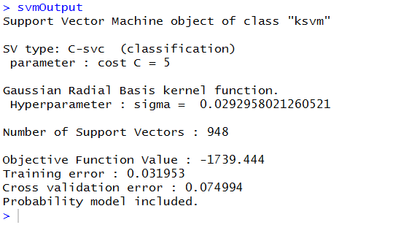
R: Example 1

Slide 35
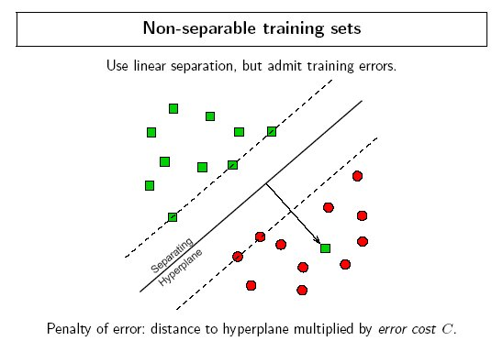
Cost Parameter
Spam

Slide 36
Cost Parameter
ksvm Cost Parameter Impact Summary
Higher Cost ‘C’ Value | Less Classification Mistakes Fewer Problem Points | Smaller Margin of Separation | Specialized Model | Higher Cross Validation Error | Lower Training Error
Lower Cost ‘C’ Value | More Classification Mistakes More Problem Points | Higher Margin of Separation | Generalized Model | Lower Cross Validation Error | Higher Training Error

Slide 37
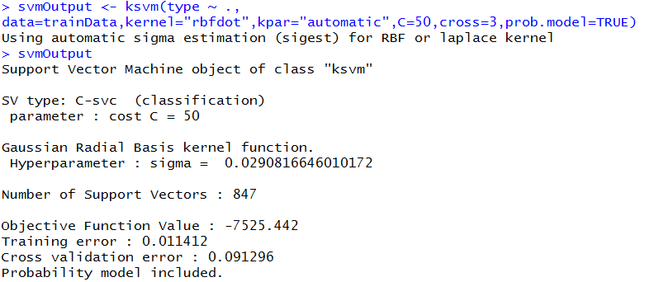

R: Example 1
C=5

Slide 38
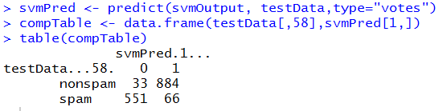
R: Example 1
Predict “testData” where svmOutput had C=5
Interpretation
0 – spam 1 – not spam
33 cases not spam but classified as spam
884 cases not spam and classified as not spam
551 cases spam and classified as spam
66 cases classified as spam but not spam
33 + 66 = 99 error cases
99/1534 = .05867 total error rate %
Cross Validation Error : .0749
Accuracy rate: 94.2%

Slide 39
R: Example 2
Data Mining is a powerful tool to analyze bank customers’ profiles and design an optimal strategy for promoting new offers based on this analysis.
To solve real-word data mining task in bank domain we chose Bank Marketing Dataset from UCI repository. It is a relatively new dataset (2012) about direct marketing campaigns of Portuguese banks.
Bank Marketing Data Set http://archive.ics.uci.edu/ml/datasets/Bank+Marketing
The dataset (4521x 17) includes multivariate attributes (numeric and categorical):
age of client
type of his/her job (‘blue-collar’, ‘housemaid’, etc.)
education
marital status
attributes related to bank credit history (has credit or not, has housing loan or not, etc.)
the output variable ‘y’ indicates whether a client subscribed a term deposit
etc.
Output variable (desired target):
y - has the client subscribed a term deposit? (binary: 'yes','no')

Slide 40
R: Example 2
# install package
install.packages('e1071',dependencies=TRUE)
library(e1071)
# reading data
bank_data = read.csv("bank.csv", sep=";", header=TRUE)
# predicting y
model <- svm(y~., data = bank_data)

Slide 41
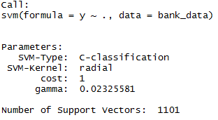
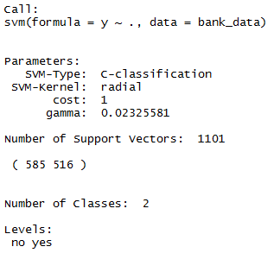
R: Example 2
# short description of the model, e.g. number of support vectors, classes, etc.
print(model)
summary(model)

Slide 42
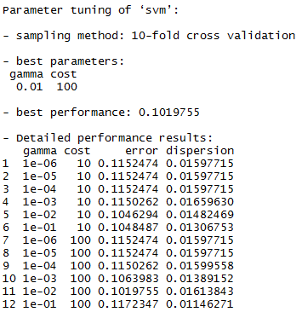
R: Example 2
# tuning the model to achieve the lowest error rate, 10-fold cross-validation accuracy
tuned <- tune.svm(y~., data = bank_data, gamma = 10^(-6:-1), cost = 10^(1:2))
summary(tuned)

Slide 43
Appendix: Visualization
A visualization from Coursera https://class.coursera.org/ml-003/lecture/72, 07:12-9:00

Slide 44
IST687 – Applied Data Science
End of Chapter 18 Audio Lecture
What’s Your Vector, Victor ?

