Slide 1



EAI LAB ASSIGNMENT
Machine Health Monitoring System
Temperature
4 thermocouples
Vibration
4 accelerometers
Temperature & Vibration Based Predictive Maintenance
Department of Computer Engineering (AI & ML)
Pimpri Chinchwad College of Engineering
Academic Year 2025–26
ML Classification
Random Forest

Slide 2



Problem Statement
Why monitoring matters
Industrial machines can develop faults such as imbalance, looseness and angular misalignment before complete failure. Continuous monitoring of temperature and vibration can help identify abnormal machine behaviour.
The problem
Traditional manual inspection may not detect early changes in machine condition.
Proposed solution: a machine health monitoring system that…
Processes real sensor data
Monitors temperature and vibration
Compares sensor values with health thresholds
Classifies machine condition using Machine Learning
Provides visual health monitoring and maintenance indications

Slide 3


Objectives
01
02
03
Monitor machine temperature using thermocouple sensors.
Monitor machine vibration using accelerometer features.
Preprocess and clean real-world sensor data.
04
05
06
Define healthy, warning and critical monitoring zones.
Classify machine operating conditions using Random Forest.
Visualize machine health trends for predictive maintenance.

Slide 4
Dataset and Sensor Data
2083
records
33
original columns
4
machine health conditions
Dataset: UTK-ASL Digital Twin Predictive Maintenance Source: Cutsforth InsightCM – final.csv
Temperature
4 thermocouples
Vibration
4 accelerometers: RMS, Peak, Peak-to-Peak, Crest Factor and other vibration measurements
Other recorded information
Tachometer speed, voltage, timestamp, machine status
Sensors
Data Collection
Preprocessing
Threshold Analysis
ML Classification
Machine Health Dashboard

Slide 5
Data Preprocessing Pipeline
01
Raw Sensor Dataset
02
Datetime Conversion
03
Missing Value Detection
04
Remove Unusable Column
05
Median Imputation
06
Feature Selection
07
Train-Test Split
08
Random Forest Model
Median imputation
Missing numerical sensor readings were handled using median imputation.
Column removed
Tachometer_Gap_volt was removed because the column had no usable values.
Feature selection
Temperature and vibration features were selected for the health analysis.
Train-test split
A stratified 80:20 train-test split was used for classification.

Slide 6

Threshold-Based Machine Health Monitoring
SAFE
WARNING
CRITICAL
Normal behaviour close to the healthy baseline.
Sensor value has increased above the warning threshold and requires monitoring.
Sensor value has crossed the critical threshold and requires attention.
Dataset-derived baseline thresholds
Parameter | Healthy baseline | Warning threshold | Critical threshold
Temperature | 73.37 °F | 76.47 °F | 77.24 °F
Vibration (RMS) | 0.0897 g | 0.0937 g | 0.0947 g
Important: these thresholds are dataset-derived monitoring indicators and are NOT manufacturer-defined safety limits.

Slide 7
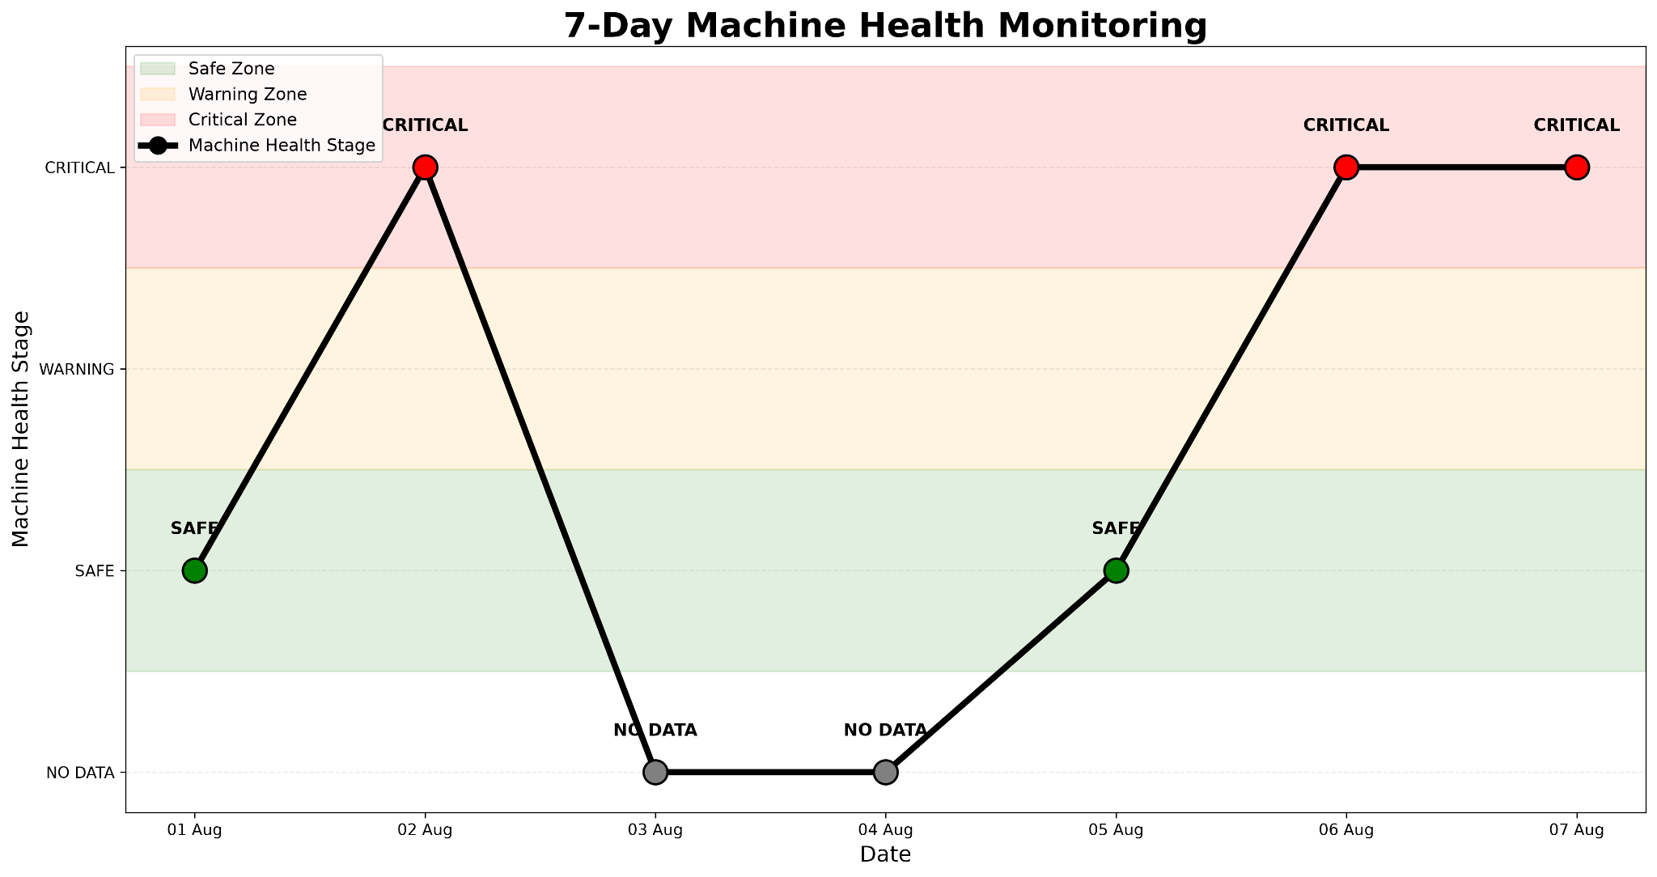
7-Day Machine Health Monitoring
Key observation
Machine health changes across the monitoring period, with critical conditions appearing on 02 Aug, 06 Aug and 07 Aug.
3
of 5 days with data are CRITICAL
NO DATA
03 Aug and 04 Aug are shown as NO DATA. They are not treated as healthy or faulty.
01 Aug
SAFE
02 Aug
CRITICAL
03 Aug
NO DATA
04 Aug
NO DATA
05 Aug
SAFE
06 Aug
CRITICAL
07 Aug
CRITICAL

Slide 8
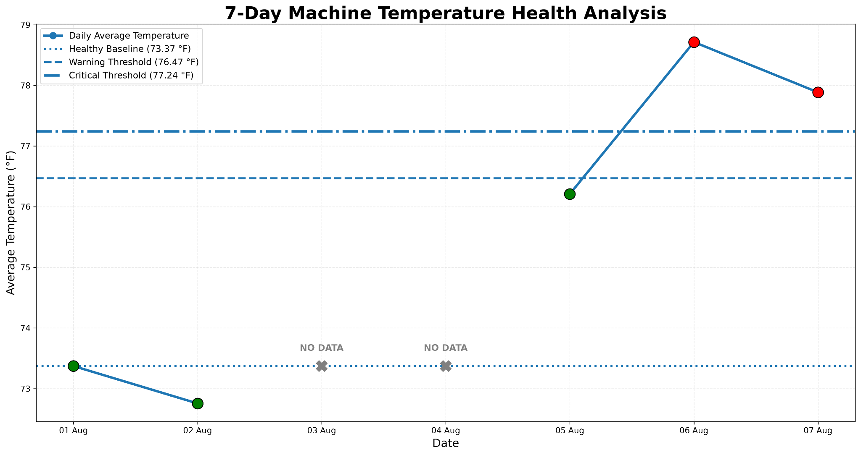
7-Day Machine Temperature Health Analysis
Key observation
Temperature stays close to the healthy baseline during the initial period, rises significantly on 06 Aug and remains above the critical threshold on 07 Aug.
77.24 °F
critical threshold
NO DATA
03 Aug and 04 Aug have no readings.
01 Aug
73.37 °F
SAFE
02 Aug
72.76 °F
SAFE
03 Aug
NO DATA
04 Aug
NO DATA
05 Aug
76.21 °F
SAFE
06 Aug
78.71 °F
CRITICAL
07 Aug
77.89 °F
CRITICAL

Slide 9
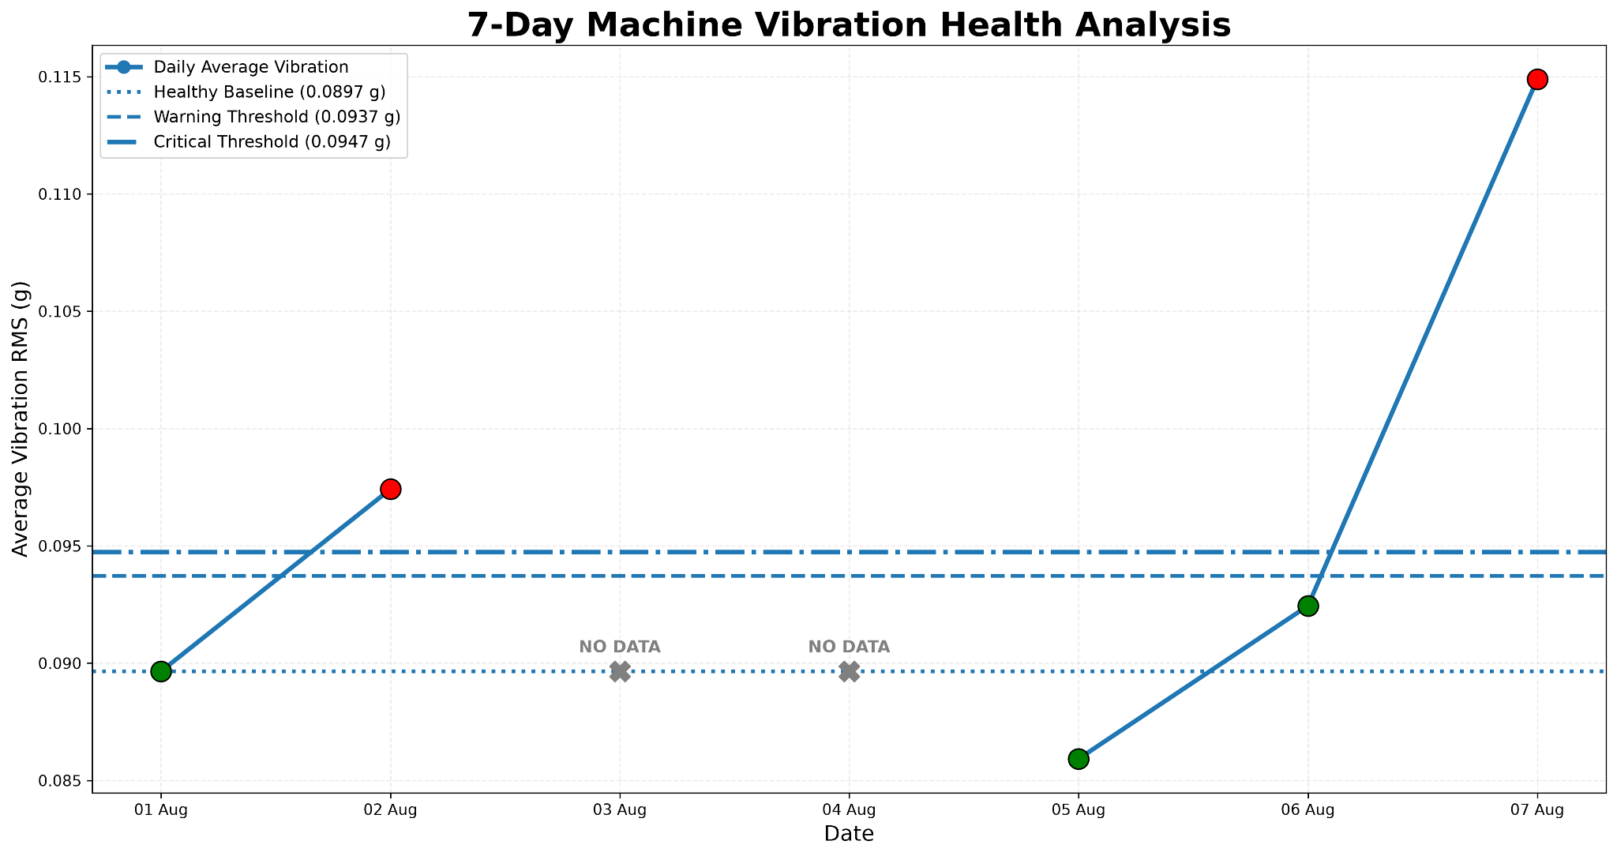
7-Day Machine Vibration Health Analysis
Key observation
Vibration rises significantly on 02 Aug and especially on 07 Aug, where it reaches 0.1149 g and exceeds the critical threshold.
0.1149 g
07 Aug peak (critical: 0.0947 g)
Thresholds
Baseline 0.0897 g, warning 0.0937 g. 06 Aug (0.0924 g) is below warning.
01 Aug
0.0897 g
SAFE
02 Aug
0.0974 g
CRITICAL
03 Aug
NO DATA
04 Aug
NO DATA
05 Aug
0.0859 g
SAFE
06 Aug
0.0924 g
SAFE
07 Aug
0.1149 g
CRITICAL

Slide 10
Machine Health Classification using Random Forest
INPUT
Temperature and vibration sensor features
ALGORITHM
Random Forest Classifier
OUTPUT
Machine health condition
99.76%
Accuracy
99.76%
Precision
Classes
99.76%
Recall
99.76%
F1-score
angular_misalignment
baseline
imbalance
looseness
Why Random Forest?
Works well with tabular sensor data
Handles nonlinear relationships
Robust for multiple sensor features
Provides reliable classification for this dataset
Stratified 80:20 train-test split
99.76% is the result on the current stratified hold-out test set, not a guarantee of real-world machine performance.

Slide 11
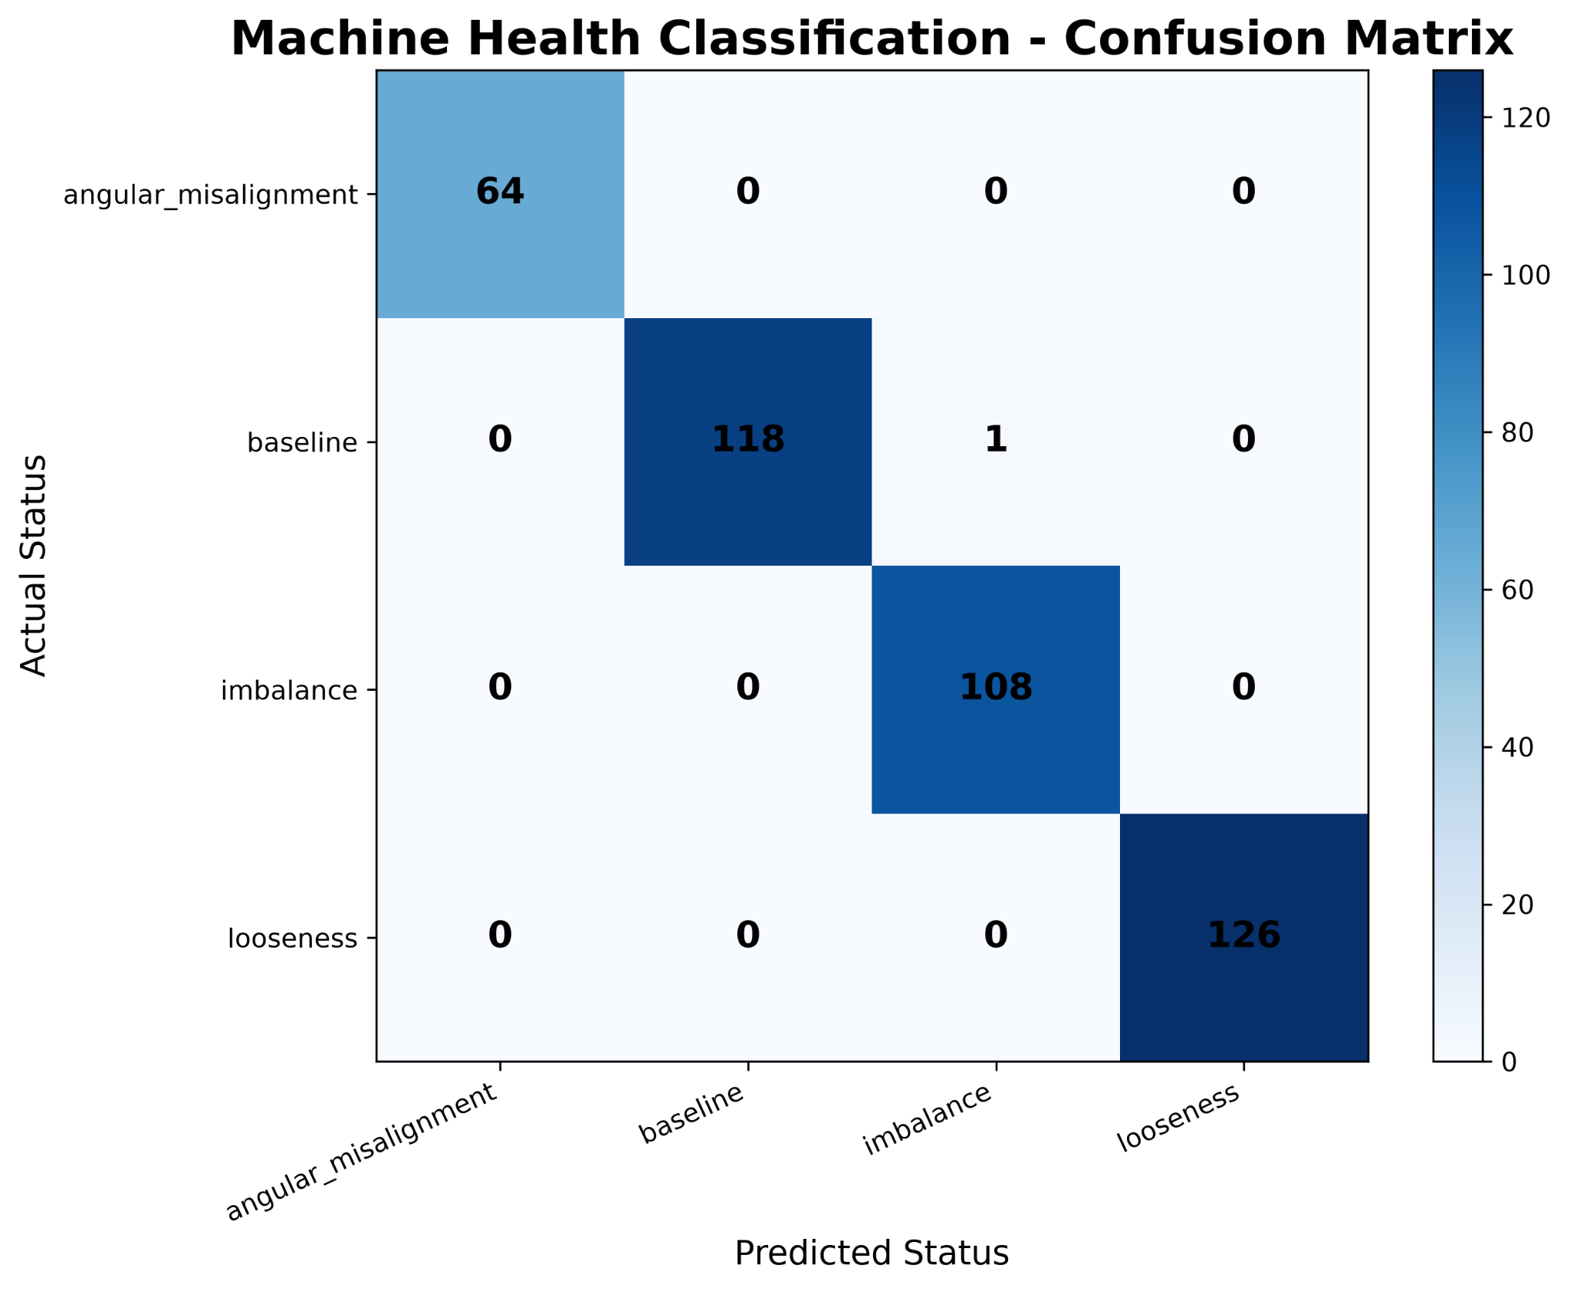
Model Evaluation – Confusion Matrix
417
test samples
416
correct
1
incorrect
Actual class | Correct | Note
angular_misalignment | 64 | –
baseline | 118 | 1 predicted as imbalance
imbalance | 108 | –
looseness | 126 | –
Only one misclassification: a baseline sample predicted as imbalance. Accuracy: 99.76%.
Result is on the current stratified hold-out test set.

Slide 12
Conclusion and Future Scope
CONCLUSION
Real machine sensor data was successfully analyzed.
Temperature and vibration were used as important machine-health indicators.
Threshold analysis identified safe and critical monitoring periods.
Random Forest achieved 99.76% accuracy on the current hold-out test set.
The system provides a foundation for predictive maintenance monitoring.
FUTURE SCOPE
Real-time IoT sensor integration
Continuous machine-health monitoring
Email/SMS maintenance alerts
Time-series based anomaly detection
Remaining Useful Life (RUL) prediction
Integration with industrial dashboards
Validation using data from different machines and operating conditions
References: UTK-ASL Digital Twin Predictive Maintenance Dataset (Cutsforth InsightCM, final.csv); predictive-maintenance research literature associated with the dataset.

