Slide 1
HD MACHINE LEARNING MINI RESEARCH
Reproducing and Critically Evaluating a
Stacking-Based Ensemble for Heart Disease Prediction
Published result → reproduction → leakage audit → duplicate-aware solution
1,025
723
302
Original records
Exact duplicates
Unique observations
70.54% of rows
Central finding: the strongest contribution is not a higher headline accuracy — it is a more credible evaluation protocol.
Shruti Kuhar (s226259763) • Deakin University

Slide 2
PAPER UNDERSTANDING
02
Research problem, SOTA and research gap
Selected paper: Bhagat, Sharma & Agarwal — stacking-based heart attack prediction
RESEARCH PROBLEM
98.53%
6
Predict heart disease from structured clinical attributes using supervised machine learning.
Published stacking accuracy
Base classifiers
SOTA CONTEXT
1,025
14
• Linear/probabilistic: Logistic Regression, Naive Bayes
• Instance-based: K-Nearest Neighbours
• Tree ensembles: Decision Tree, Random Forest, XGBoost
• Ensemble strategy: stacking combines complementary model behaviour
Records used
Columns incl. target
Reproduction question
Can the high published performance be reproduced — and does it remain credible when the test set is genuinely independent?
GAP ADDRESSED
The paper asks whether stacking heterogeneous classifiers can improve heart-disease prediction beyond individual models.

Slide 3
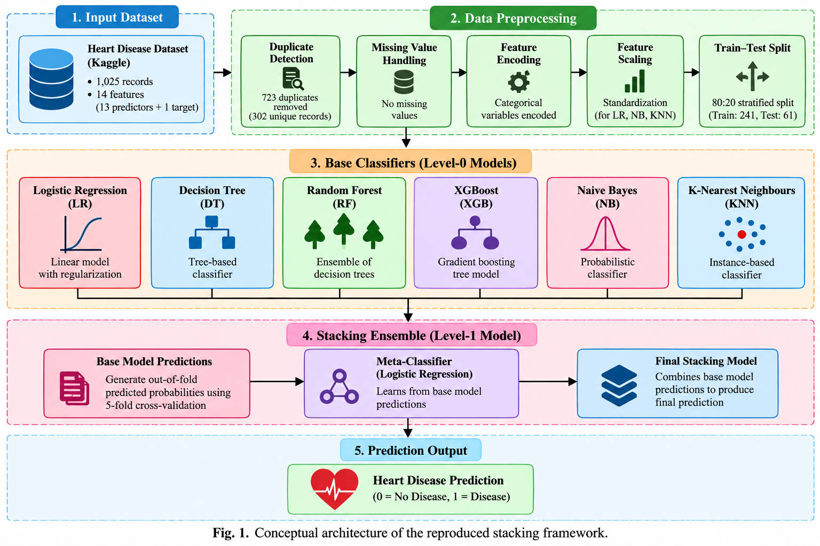
REPRODUCTION STUDY
03
Dataset, features and experimental protocol
Reproducing the paper while clearly separating paper-stated details from implementation assumptions
526
499
0
13
1
Heart disease
No heart disease
Missing values
Predictors
Binary target
EXPERIMENTAL PROTOCOL
• 80:20 stratified split → 820 training / 205 testing
• Models: LR, DT, RF, XGBoost, NB and KNN
• Five-fold stacking; Logistic Regression meta-classifier
• Scaling for scale-sensitive models; tree models unscaled
• Metrics: Accuracy, Precision, Recall, F1, ROC-AUC, Balanced Accuracy and MCC
• random_state = 42 and unspecified hyperparameters treated as reproduction assumptions

Slide 4
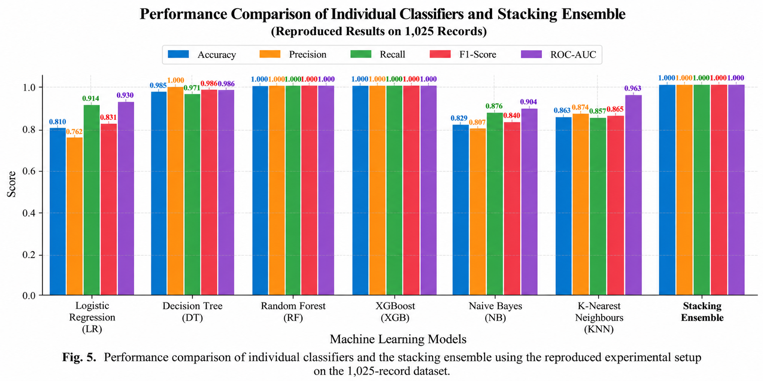
EXPERIMENTAL FINDINGS
04
Part 1 reproduction: apparently exceptional performance
The initial experiment reproduces the paper's high-performance pattern — but requires critical inspection
100%
100%
Random Forest
XGBoost
100%
98.54%
Stacking
Decision Tree
Published stacking benchmark: 98.53%
• LR = 80.98%; NB = 82.93%; KNN = 86.34%.
• Tree-based models exceed the published scores.
• A 100% test result triggered a data-quality and leakage audit rather than being accepted at face value.

Slide 5
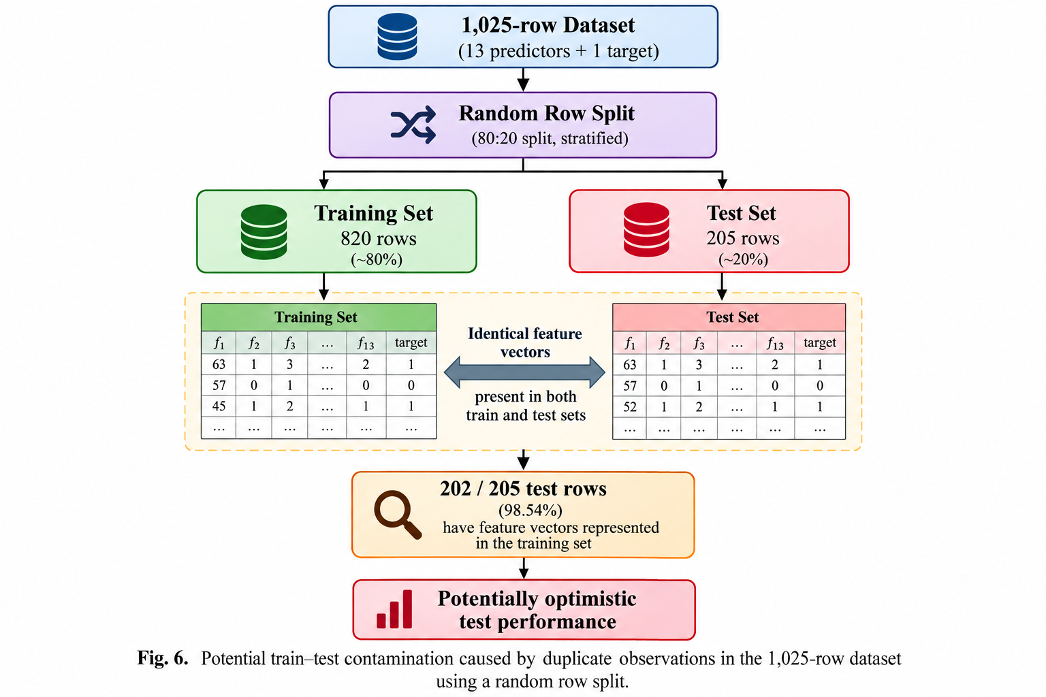
CRITICAL ANALYSIS
05
Why the 100% result is not the main success
Exact duplicates make a conventional random row split vulnerable to train–test contamination
723
302
Exact duplicate rows
Unique observations
70.54%
202 / 205
98.54%
Test rows represented
in training
Feature-vector overlap
Interpretation
Flexible models can recognise patterns already present in training. Therefore, the perfect hold-out score is weak evidence of generalisation to genuinely unseen observations.

Slide 6
PROPOSED SOLUTION
06
Duplicate-aware tuned stacking
The methodological improvement first fixes evaluation validity, then optimises the ensemble
1
Deduplicate
2
Split first
3
Tune
4
Stack
5
Evaluate
1,025 → 302
unique rows
241 train /
61 test
5-fold CV
on training
LR + tuned RF
+ tuned XGB
Unseen unique
test records
PROPOSED ENSEMBLE
WHY THIS IS DIFFERENT
• Duplicates removed before any split
• Zero exact train–test overlap
• RF and XGB tuned on training folds only
• Reduced heterogeneous stack
• Passthrough exposes original features to the meta-model
Logistic
Regression
Tuned
Random Forest
Tuned
XGBoost
↓ ↓ ↓
Logistic Regression Meta-Classifier + Passthrough

Slide 7
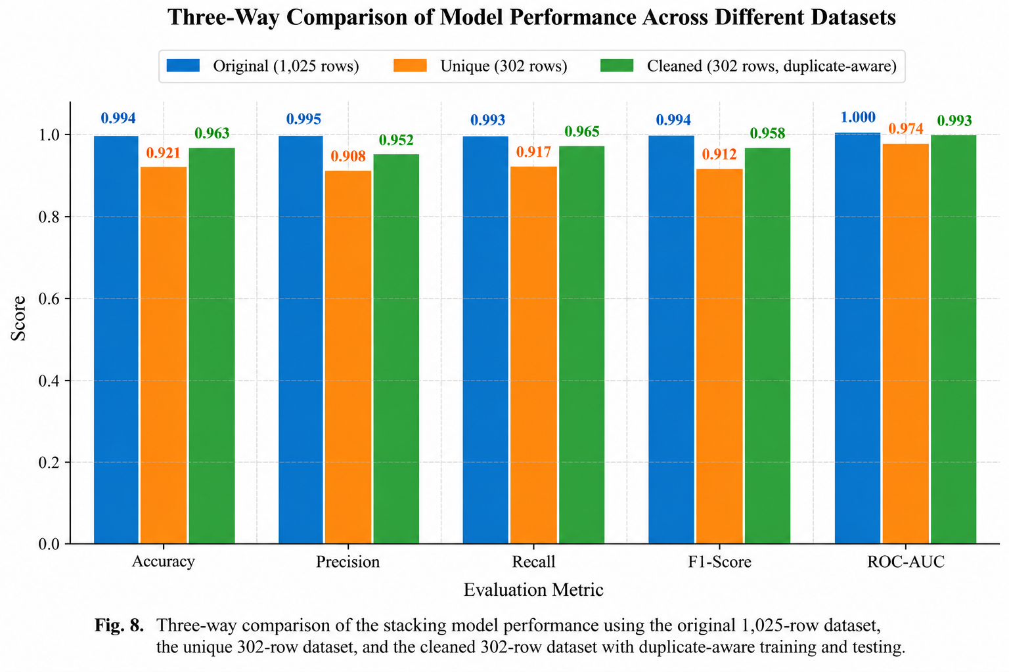
COMPARATIVE ANALYSIS
07
What changed under the stricter evaluation?
Same modelling problem, but a much more demanding estimate of generalisation
75.41%
80.33%
Baseline stack
unique hold-out
Tuned stack
unique hold-out
+4.92 pp
+6.06 pp
Accuracy gain
Recall gain
Repeated validation (50 fold-level evaluations)
83.44% accuracy • 90.25% recall
85.53% F1 • 90.42% AUC
AUC changed very little → tuning mainly improved threshold-dependent classification, especially recall.

Slide 8
IMPLEMENTATION EVIDENCE
08
Live Colab demonstration: what to show on screen
Spend ~45–60 seconds here; show only the outputs that prove the experimental story
01
Dataset audit
02
Duplicate check
03
Leakage diagnostic
df.shape → (1025, 14)
missing = 0
723 exact duplicates
302 unique rows
202 / 205 test rows
represented in training
04
Part 1 outputs
05
Proposed model
06
Final evidence
RF, XGB, stacking
= 100% accuracy
RandomizedSearchCV
best RF/XGB params
80.33% hold-out
+ repeated-CV summary
The proposed outputs have been added to the report with the .ipynb file.

Slide 9
REFLECTION
09
Lessons learned, limitations and future improvements
The HD-level takeaway is the quality of the experimental reasoning, not simply the maximum score
KEY LESSONS
LIMITATIONS
FUTURE WORK
• High accuracy can be misleading when train and test data are not independent.
• Data auditing should precede model optimisation.
• Multiple metrics reveal trade-offs hidden by accuracy alone.
• Only 302 unique observations remain.
• No patient identifiers or external cohort.
• Some original-paper implementation details are unspecified.
• Repeated CV is a robustness analysis, not fully nested tuning.
• Patient/group-level splitting where identifiers exist.
• Nested cross-validation.
• External validation on an independent cohort.
• Probability calibration and explainability.
Final message: credible generalisation is more valuable than impressive headline accuracy.

