Slide 1
Retail Sales Analysis Project
Shruti Mehan & Rupali Grover
St. Joseph’s University, Bengaluru

Slide 2
Introduction
Retail organizations use data analytics to understand sales performance and customer behavior.
This project analyzes retail sales data using Excel and Python to generate insights.

Slide 3
Objectives
• Analyze sales performance
• Identify top product categories
• Study customer behavior
• Identify monthly and seasonal trends
• Support data-driven decisions

Slide 4
Tools & Technologies
Excel:
• Data cleaning
• Pivot tables
• Charts
Python:
• Pandas & NumPy
• Matplotlib

Slide 5
Dataset Description
Transaction-level retail data including:
• Customer details
• Product category
• Quantity sold
• Unit price
• Total sales

Slide 6
Data Preprocessing
• Corrected data types
• Handled missing values
• Removed duplicates
• Created Total Sales column

Slide 7
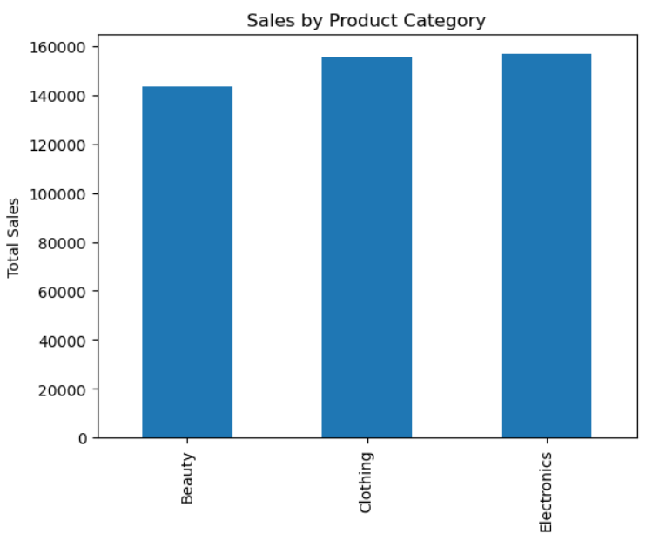
Visualization: Product Category Sales
Electronics generated the highest sales followed by Clothing and Beauty.

Slide 8
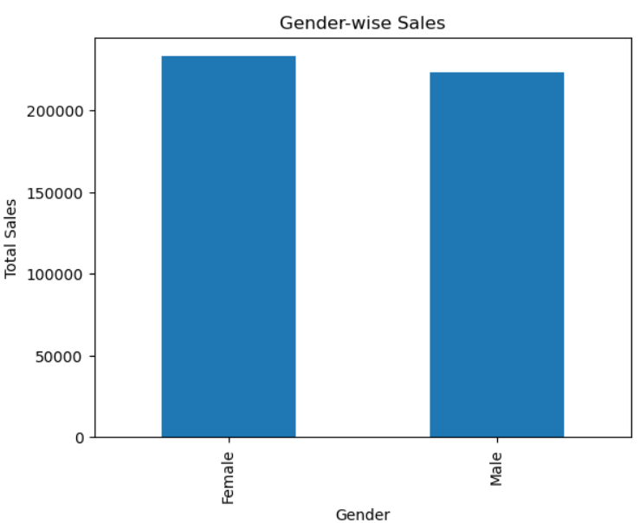
Visualization: Gender-wise Sales
Female customers contributed slightly higher total sales than male customers.

Slide 9
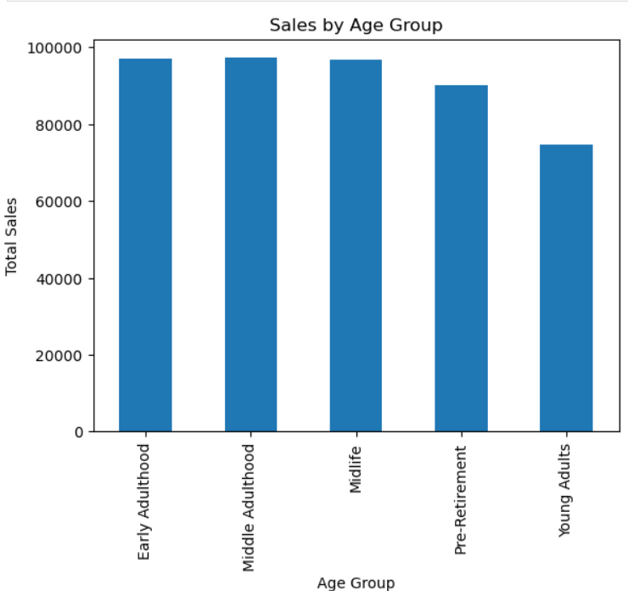
Visualization: Age Group Sales
Early and middle adulthood age groups contributed the most revenue.

Slide 10
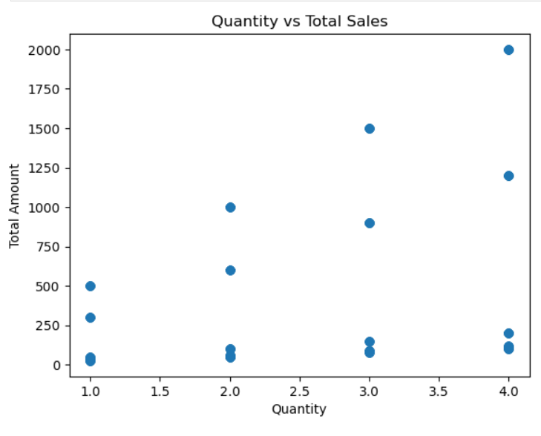
Visualization: Quantity vs Sales
Positive relationship observed between quantity sold and total sales.

Slide 11
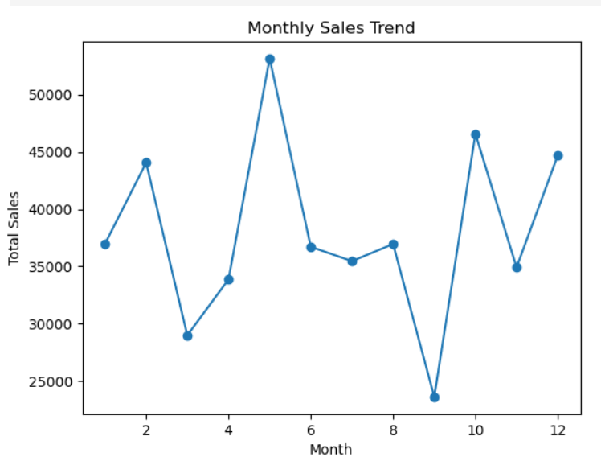
Visualization: Monthly Sales Trend
Sales fluctuated across months indicating seasonal patterns.

Slide 12
Key Insights
• Certain categories drive most revenue
• Seasonal sales variation exists
• Specific age groups contribute higher sales

Slide 13
Learnings
• End-to-end data analysis experience
• Improved data visualization skills
• Practical use of Excel & Python

Slide 14
Conclusion
Retail sales analysis helps improve business decisions.
Data-driven insights enhance performance and planning.

