Slide 1
Online dresser
Team: hackover
Theme 4: Experience

Slide 2
Problems and our solutions
Consumers’ key Concerns – look & feel of garments
Consumers are dissatisfied due to size fitments issues
With massive increase in fast fashion comes our responsibility to encourage sustainability and maintain circular economy
Virtual
Trial Room
Look &
feel
Online
Dresser
Enhanced
User Review &
Size Assistant
Size Fit
Resell
Option to
Resell

Slide 3



Virtual trial room
TECHNOLOGY STACK
Programming Framework: Python, Flask
Facial and Body Recognition: OpenCV, Dlib, Haar cascades dataset
Front End:
HTML, CSS, Bootstrap, JS

Slide 4
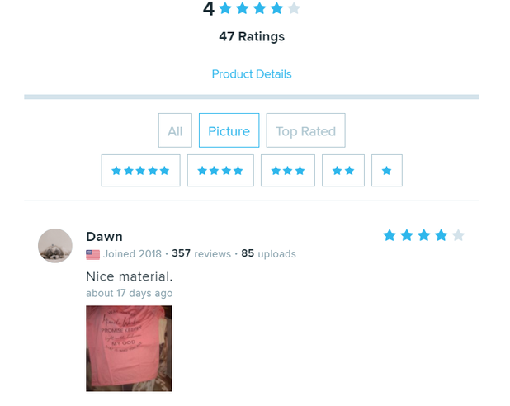
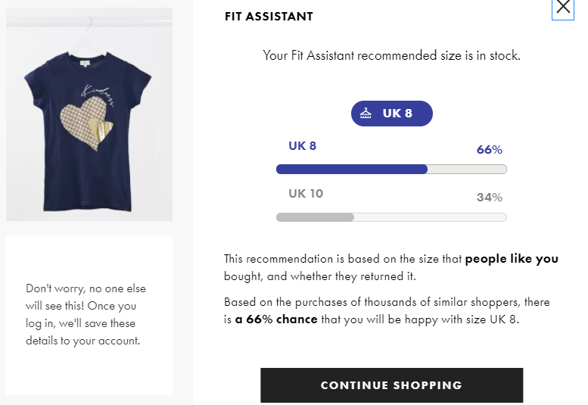

Enhanced User review & size fit
Avail option to upload Photos and Videos
Layout:
Size Fit Assistant
Layout: After a set of questionnaire user gets recommended

Slide 5
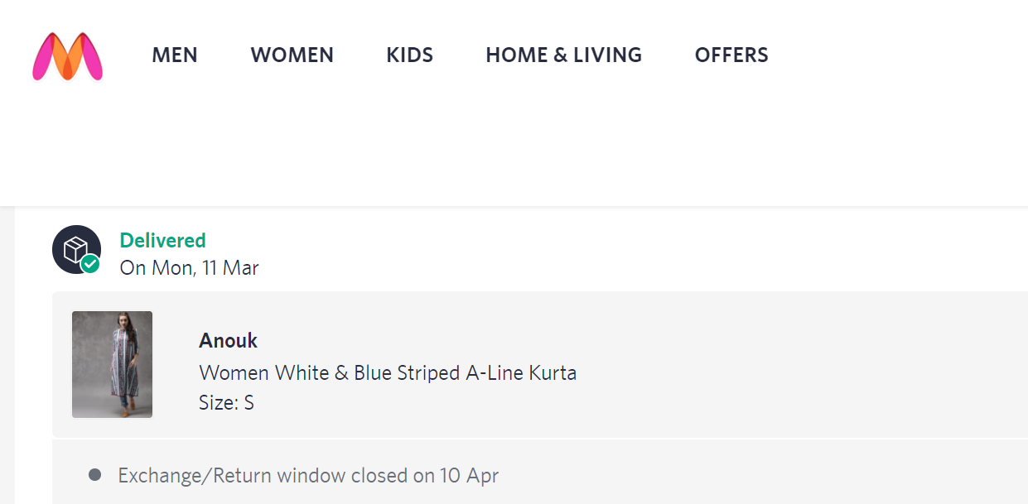
Option to resell
Once return/replace period gets over, user gets a chance to resell the product and others can get it for a lesser price.
Layout:
RESELL

