Slide 1
Movie Recommendation System
By Shruti Suresh Mogaveera

Slide 2
Introduction
Online platforms provide thousands of movies
Users face difficulty choosing relevant movies
Recommendation systems help users discover similar content
This project builds a content-based movie recommendation system

Slide 3
Problem Statement
Large movie collections make selection difficult
Manual searching is time-consuming
Users need personalized movie recommendations

Slide 4
Objectives
To build a movie recommendation system
To analyze movie data and genres
To recommend similar movies based on content
To use machine learning techniques

Slide 5
Dataset Description
Dataset used: movies.csv
Contains movie titles and genres
Attributes: movieId, title, genres
Used for content-based recommendations

Slide 6
Technology Stack
Programming Language: Python
Development Environment: Google Colab
Libraries: Pandas, NumPy, Scikit-learn
Version Control: GitHub

Slide 7
Methodology
Load and preprocess movie dataset
Combine title and genre features
Apply TF-IDF vectorization
Compute cosine similarity
Generate movie recommendations

Slide 8
Algorithm Used
TF-IDF (Term Frequency–Inverse Document Frequency)
Converts text data into numerical vectors
Cosine Similarity measures similarity between movies

Slide 9
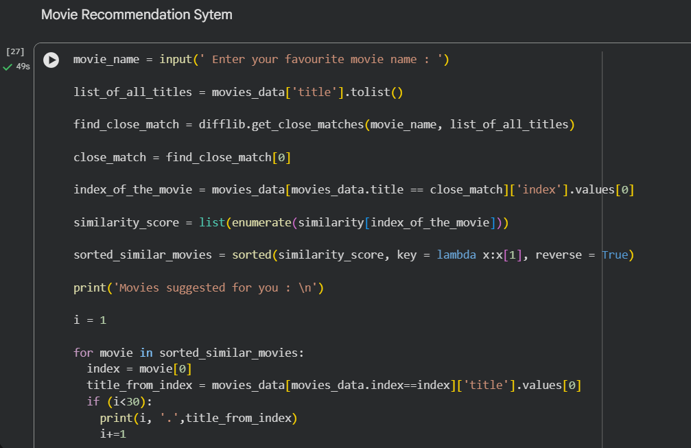
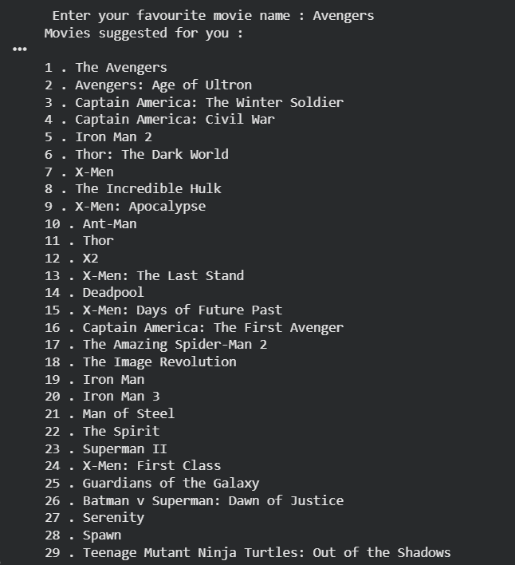
Results and Output
System recommends movies similar to input movie
Recommended movies based on genre and title similarity

Slide 10
Conclusion and Future Scope
Successfully implemented content-based recommendation system
Provides relevant movie suggestions
Future scope: add ratings, hybrid models, web interface

