Slide 1

QUANTITATIVE FINANCE · CRYPTOCURRENCY RESEARCH
Statistical Arbitrage in Cryptocurrencies
BTC/USD Momentum Research Project
Shruti Narmeti · Quantitative Finance · 2025

Slide 2



The Research Question
Can Bitcoin's recent price movement predict its next move?
This project tests two competing hypotheses using historical data — not intuition.
Momentum
Reversal
Recent upward movement continues into the next period.
Recent movement fades or reverses over the next period.

Slide 3
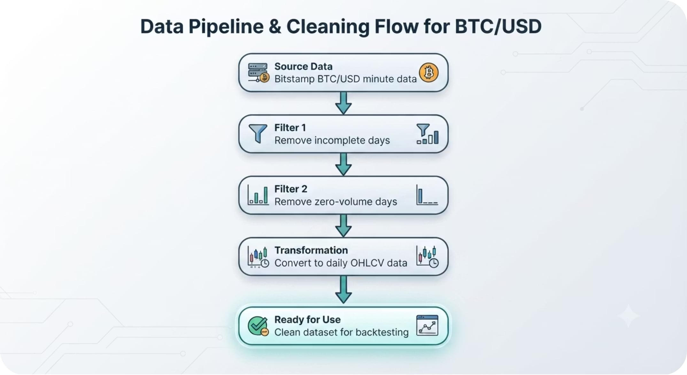

Data & Cleaning
Source
Bitstamp BTC/USD minute-level OHLCV data, 2012 – early 2025
Processing Steps
Minute-level data aggregated into complete daily observations
Incomplete trading days removed
Zero-volume days filtered out
Clean data prevents false trading signals and ensures reliable backtest results.

Slide 4
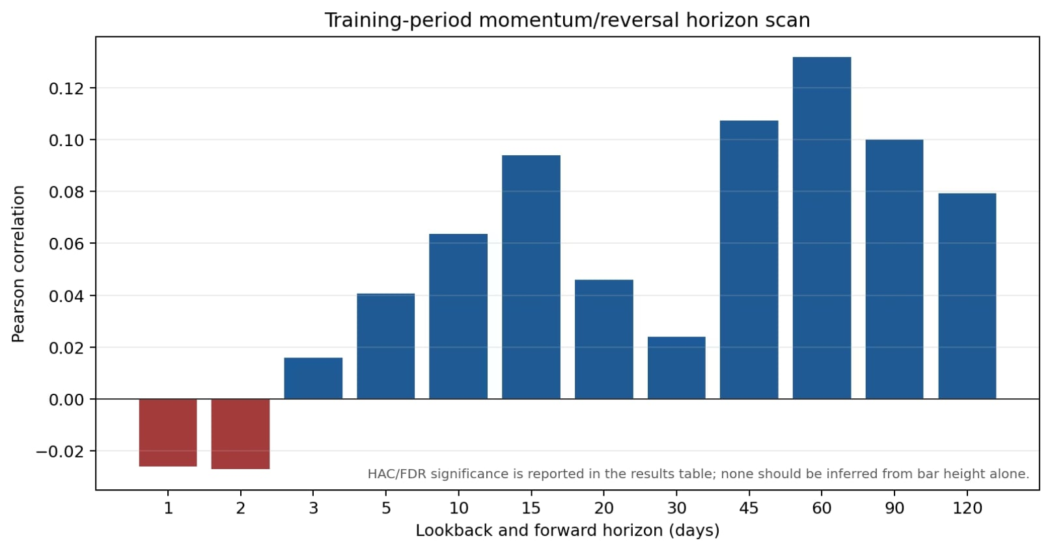

Momentum Horizon Scan
What We Tested
Twelve lookback horizons: 1, 2, 3, 5, 10, 15, 20, 30, 45, 60, 90, and 120 days.
Positive correlation → momentum signal
Negative correlation → reversal signal
Key finding: Medium and longer horizons were directionally positive; the final 30-day rule was selected using validation performance.

Slide 5
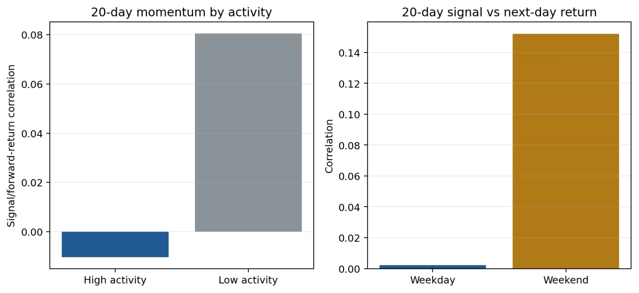
Activity & Seasonality Tests
Why Test These?
Crypto trades 24/7 — entry timing and market activity may influence signal quality.
Volume activity: Tested whether high- or low-volume periods strengthen the 20-day signal
Weekday vs. weekend: Tested whether day-of-week entry timing affects next-day returns
Results were interesting but not strong enough to use as final strategy filters.

Slide 6

Strategy Selection
Training
Test
2015–2019: signal discovery and testing
2022–2025: honest out-of-sample evaluation
Validation
2020–2021: rule selection and tuning
The validation period selected the final rule; the test period was kept fully separate for unbiased evaluation.
Final Rule: 30-Day Long-Only Momentum
Signal
Action
Otherwise
Bitcoin was up over the past 30 days
Hold BTC for the next day
Stay in cash — no position

Slide 7
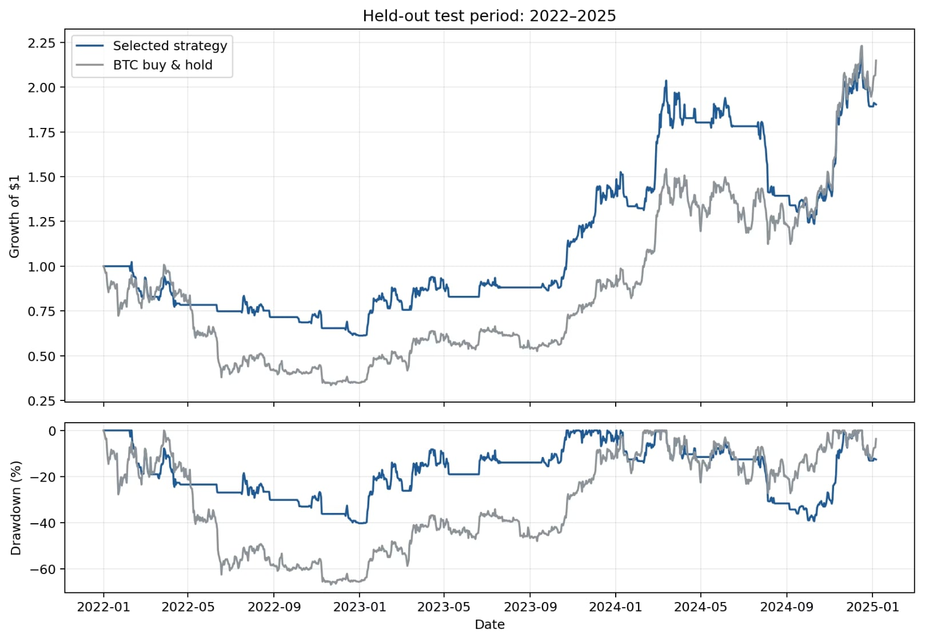

Held-Out Test Performance
Test period: 2022-01-01 to 2025-01-06
Interpreting the Results
Buy-and-hold had higher total return (119.3% vs. 90.3%)
Strategy had lower volatility (36.7% vs. 53.7%)
Strategy had much smaller drawdowns (−40.2% vs. −66.8%)
Sharpe ratios were nearly identical (0.76 vs. 0.75)
The strategy trades some upside for meaningfully lower risk.

Slide 8
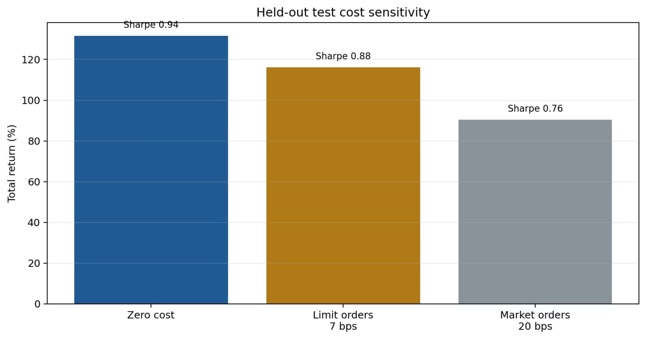



Trading Costs & Robustness
Cost Assumptions
Base case: 20 bps per unit of turnover (market orders). Costs matter — a strategy can look profitable before costs and fail after them.
Costs reduce performance meaningfully — but the strategy remains profitable across all scenarios.
Zero Cost
Limit Orders (7 bps)
Market Orders (20 bps)
Return: 131.6% · Sharpe: 0.94
Return: 116.2% · Sharpe: 0.88
Return: 90.3% · Sharpe: 0.76

Slide 9
Conclusion
What We Found
A disciplined BTC momentum rule that reduces volatility and drawdowns versus buy-and-hold — with nearly identical Sharpe ratios.
Important Limitations
Does not prove a guaranteed market edge
Strategy remains directionally exposed to Bitcoin
Alpha was not statistically significant
Future Directions
Test multiple cryptocurrencies and cross-sectional momentum
Incorporate funding-rate and liquidation data
Apply rolling walk-forward validation

