Slide 1

ASSIGNMENT
By Shruti Sharma

Slide 2

Meesho is an Indian social commerce platform founded by Vidit Aatrey and Sanjeev Barnwal in 2015.
It allows small businesses and individuals to start their online stores through social media platforms like WhatsApp, Facebook, and Instagram. Meesho provides a platform where sellers can source products from suppliers, market them to potential customers, and manage orders and payments.
.
H&M, short for Hennes & Mauritz AB, is a Swedish multinational clothing retail company known for its fast-fashion clothing offerings. Founded in 1947 by Erling Persson, H&M has grown into one of the world's largest fashion retailers with operations in over 70 countries.

Slide 3
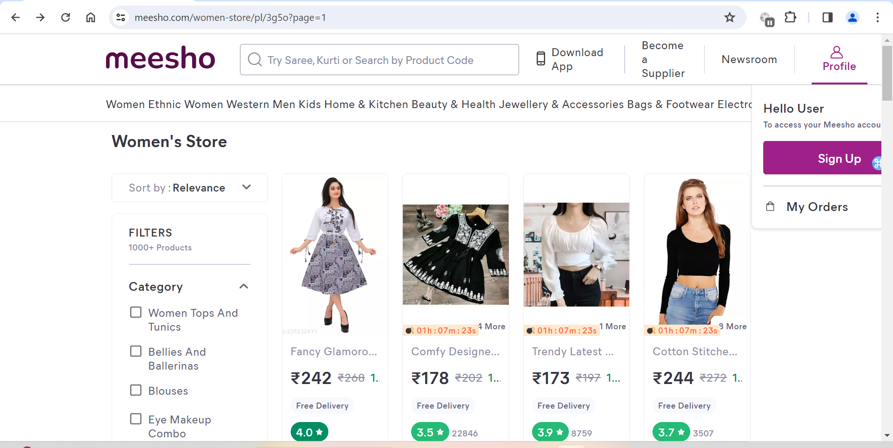
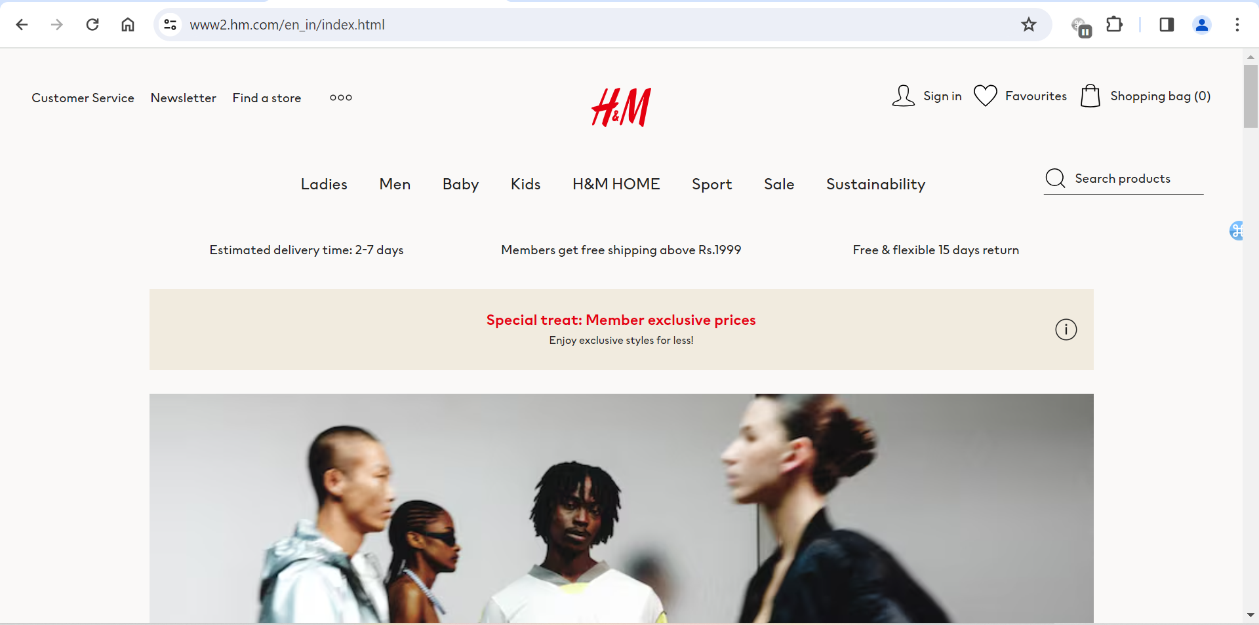
COMPARISON: 1 Standard Size of Zoom in Chrome is 100%
Meesho
H&M
During 100% zoom size of chrome the cart option is not visible along with other option on Home page.
During 100% zoom size all the options visible on Home page.

Slide 4
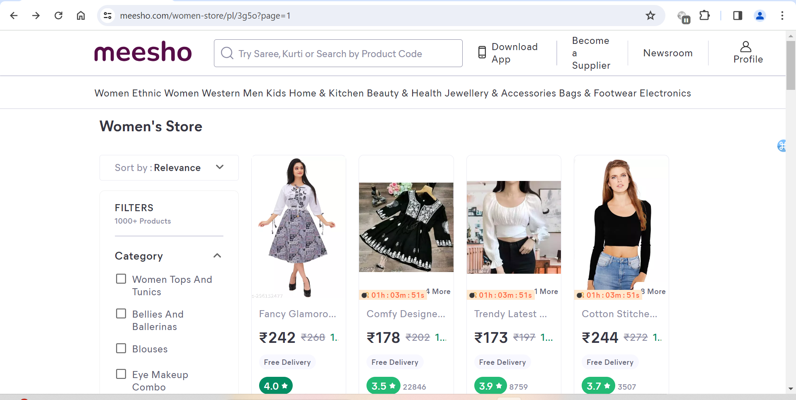
COMPARISON: 2 PLP (Product Listing Page) content should be aligned properly, so that user can view/differentiate about the products properly.
Meesho
H&M
The space between two continuous categories should be defined/ increased.
The space between categories are defined properly here.

Slide 5
COMPARISON: 3 Additional offers & New Member benefits should be highlighted on Home page.
Meesho
H&M
Meesho’s home page don’t showcase the newly offers, new member benefits.
H&M highlighted the offers like: 1. Members get free shipping above Rs.1999.

Slide 6


