Slide 1
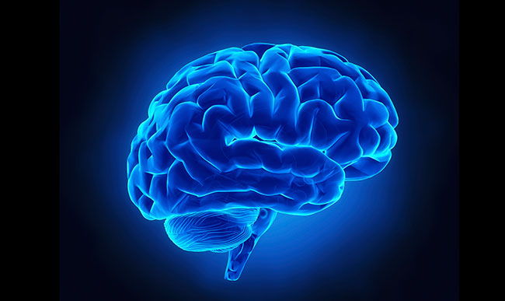
Brain MR Image Segmentation using RBF Neural Network
Under the Supervision of
Prof. (Dr.) Jamuna Kanta Sing
By -
Shruti Pathak
Reg. No.- 163613 of 2022 - 2023
Exam Roll No.- MCA244020
MCA- 2nd Year 2nd Semester
JADAVPUR UNIVERSITY

Slide 2
Overview
Introduction
Proposed Method
Experiments & Results
Conclusion
References

Slide 3
Introduction
The brain, as the central nervous system controlling speech, memory, cognition, and movement, faces increasing threats from diseases due to stress, lifestyle, injuries, and aging.
Magnetic Resonance Imaging (MRI) is a cutting-edge, non-invasive technique for precisely visualizing the shape and function of brain tissues to diagnose brain illnesses.
Image segmentation in brain MRIs is crucial for applications such as surgical planning, brain tissue classification, and tumor detection.
Brain MRI segmentation involves dividing an MRI scan into distinct structures like white matter, gray matter, CSF (cerebrospinal fluid ), and regions such as the cortex, ventricles, or tumors.
To make brain MRI segmentation more accurate when the structure varies, researchers use different methods. These range from basic image processing to more advanced machine learning and deep learning techniques.

Slide 4
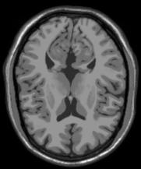
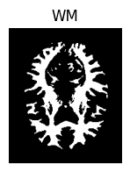
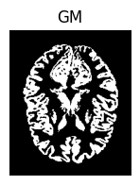
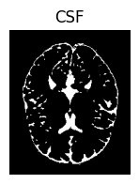
Introduction

Slide 5
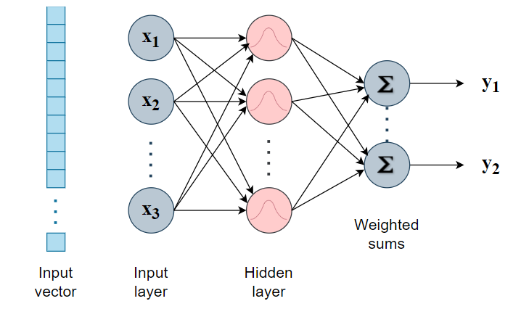
Proposed Method
In this project, a Radial Basis Function Neural Network (RBFNN) is employed specifically for the segmentation of brain MR images into white matter, grey matter, and cerebrospinal fluid (CSF) regions.
A radial basis function (RBF) neural network is a type of artificial neural network that uses radial basis functions as activation functions.

Slide 6
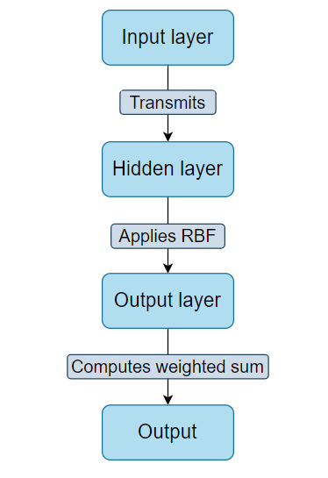
Proposed Method
The network consists of three layers: an input layer, a hidden layer with radial basis functions, and an output layer.

Slide 7
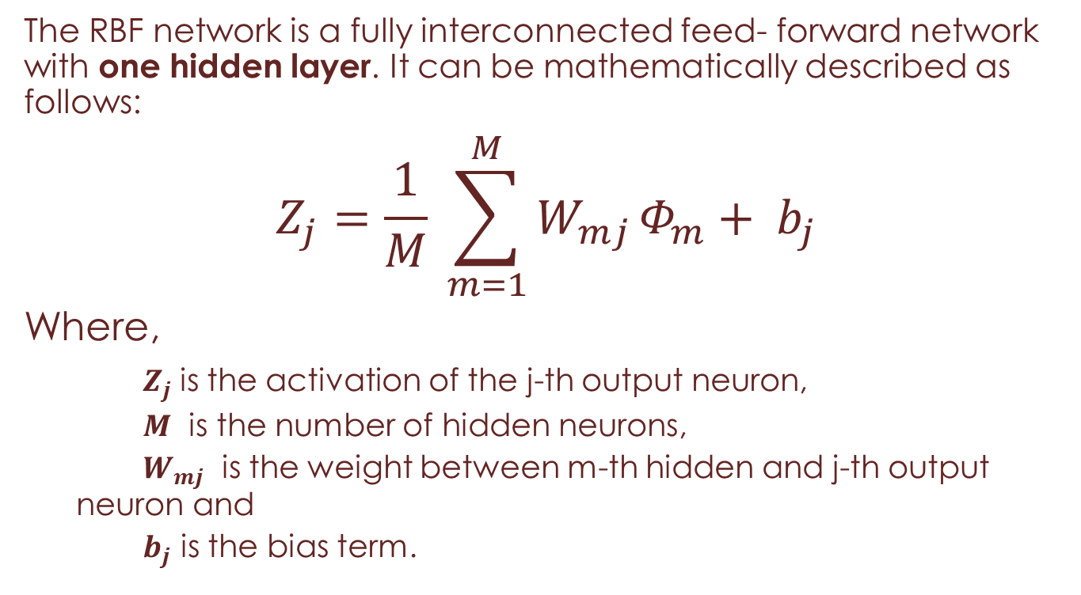
Proposed Method
The RBF network is a fully interconnected feed- forward network with one hidden layer. It can be mathematically described as follows:
$$Z_{j}=\frac{1}{M} \sum_{m=1}^{M}{W_{mj}}Φ_{m}+ b_{j}$$
Where,
$Z_{j}$ is the activation of the j-th output neuron,
$M$ is the number of hidden neurons,
$W_{mj}$ is the weight between m-th hidden and j-th output neuron and
$b_{j}$ is the bias term.

Slide 8
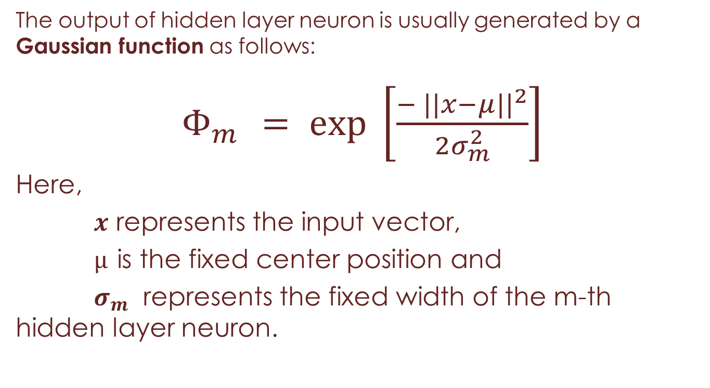
Proposed Method
The output of hidden layer neuron is usually generated by a Gaussian function as follows:
$Φ_{m }= \exp{ \left[\frac{{− ||x−μ||}^{2}}{2σ_{m}^{2}}\right]}$
Here,
$x$ represents the input vector,
$µ$ is the fixed center position and
$σ_{m}$ represents the fixed width of the m-th hidden layer neuron.

Slide 9
Proposed Method
Radial basis function networks (RBFNs) work by comparing the input to known examples from the training data to classify it.
Here’s a simplified explanation of how it works:
RBFNs process input vectors through an input layer.
RBF neurons in the hidden layer assess input proximity using Gaussian functions based on neuron centers.
Hidden layer outputs are integrated in the output layer.
Classification is achieved by computing weighted sums of hidden layer outputs.
The final output represents the input's classification.

Slide 10
Experiments
Database:
The dataset of this study is downloaded from BrainWeb, which is acquired from the McConnell Brain Imaging Center of the Montreal Neurological Institute, McGill University .
This database contains a collection of realistic MRI data generated by an MRI simulator. It encompasses various parameters such as variations in slice thickness, noise levels, and intensity non-uniformity (INU).
As the “Ground Truth” , I utilize the discrete anatomical model, which assigns class labels (0=Background, 1=CSF, 2=Grey Matter, 3=White Matter etc..) to each voxel.

Slide 11
Experiments
The dataset in my work consists of 11 T1-weighted MRI volumes on normal brain, each yielding 51 images of dimensions 181 pixels by 217 pixels, intentionally manipulated with varying noise and intensity non-uniformity (INU) levels , as meticulously delineated in the table below -
 | Volume 1 (%) | Volume 2 (%) | Volume 3 (%) | Volume 4 (%) | Volume 5(%) | Volume 6 (%) | Volume 7 (%) | Volume 8 (%) | Volume 9 (%) | Volume 10 (%) | Volume 11 (%)
Noise | 0 | 1 | 1 | 3 | 3 | 5 | 5 | 7 | 7 | 9 | 9
INU | 0 | 20 | 40 | 20 | 40 | 20 | 40 | 20 | 40 | 20 | 40

Slide 12
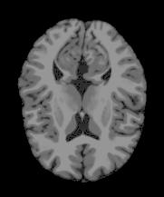
Experiments
Data Extraction:
At first, I extracted the data from RAWB files into PGM files, and further transformed them into JPEG format for visualization and analysis.
Pre-Processing:
Pre-processing brain MR images is fundamental for quality assurance in quantitative analysis, involving operations to enhance quality and remove non-brain tissues, laying the foundation for accurate segmentation.
Skull- stripping
Normalization

Slide 13
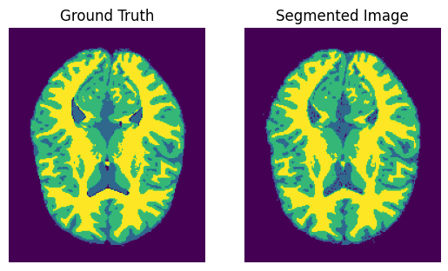
Experiments
Segmentation:
Then I use RBFNN for segmenting brain MRI volumes into white matter, grey matter, and cerebrospinal fluid (CSF), accommodating variations in noise and intensity non-uniformity (INU) percentages across multiple volumes, ensuring comprehensive analysis and reliable segmentation results across diverse imaging conditions.
Split the datasets
Standardization
Training
Evaluation

Slide 14
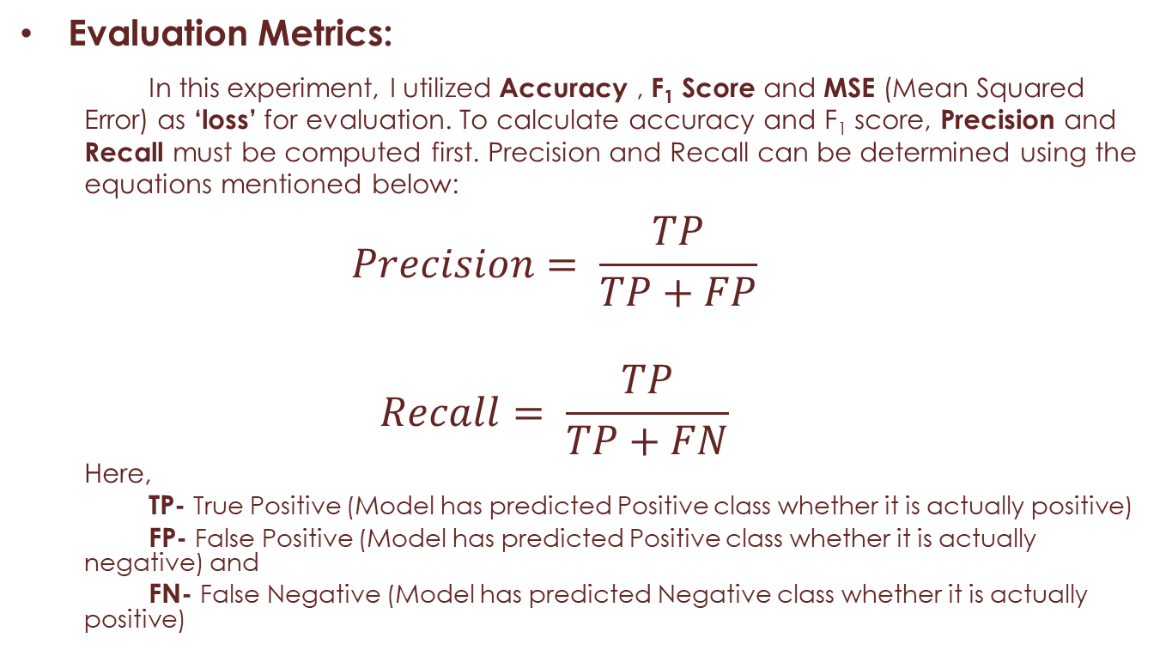
Experiments
Evaluation Metrics:
In this experiment, I utilized Accuracy , F₁ Score and MSE (Mean Squared Error) as ‘loss’ for evaluation. To calculate accuracy and F₁ score, Precision and Recall must be computed first. Precision and Recall can be determined using the equations mentioned below:
$$Precision= \frac{TP}{TP+FP}$$
$$Recall= \frac{TP}{TP+FN}$$
Here,
TP- True Positive (Model has predicted Positive class whether it is actually positive)
FP- False Positive (Model has predicted Positive class whether it is actually negative) and
FN- False Negative (Model has predicted Negative class whether it is actually positive)

Slide 15
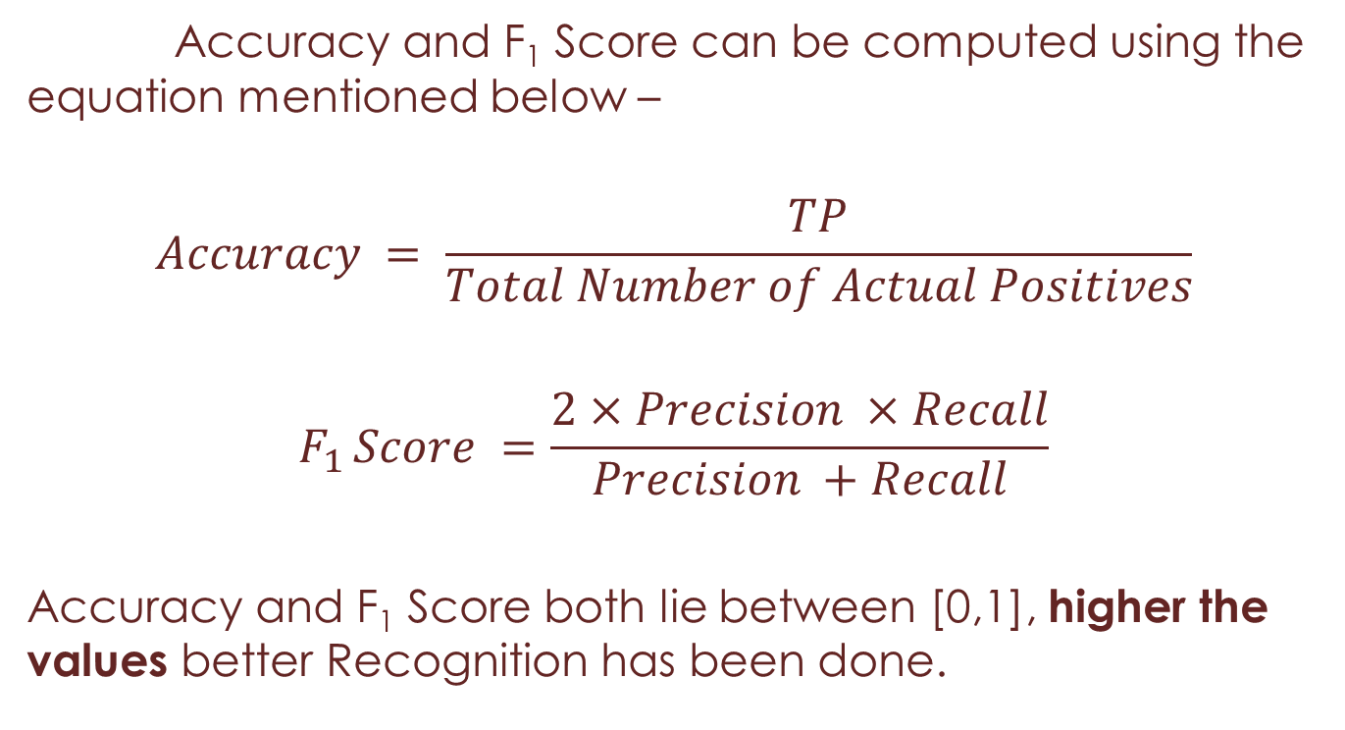
Experiments
Accuracy and F₁ Score can be computed using the equation mentioned below –
$$Accuracy = \frac{TP}{Total Number of Actual Positives}$$
$$F_{1 }Score =\frac{2×Precision ×Recall}{Precision +Recall}$$
Accuracy and F₁ Score both lie between [0,1], higher the values better Recognition has been done.

Slide 16
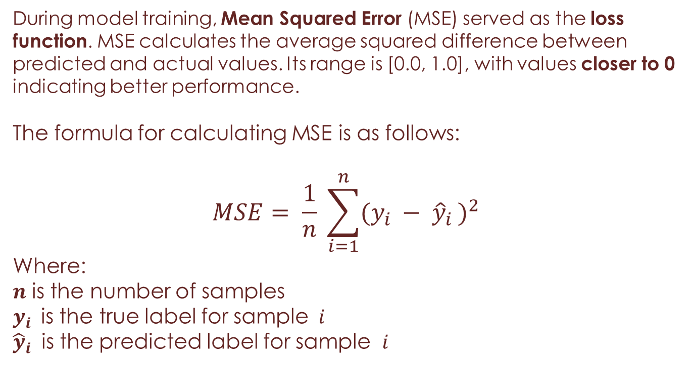
Experiments
During model training, Mean Squared Error (MSE) served as the loss function. MSE calculates the average squared difference between predicted and actual values. Its range is [0.0, 1.0], with values closer to 0 indicating better performance.
The formula for calculating MSE is as follows:
$$MSE= \frac{1}{n} \sum_{i=1}^{n}{({y_{i }− {\hat{y}}_{i })}^{2}}$$
Where:
$n$ is the number of samples
$y_{i }$ is the true label for sample $i$
${\hat{y}}_{i }$ is the predicted label for sample $i$

Slide 17
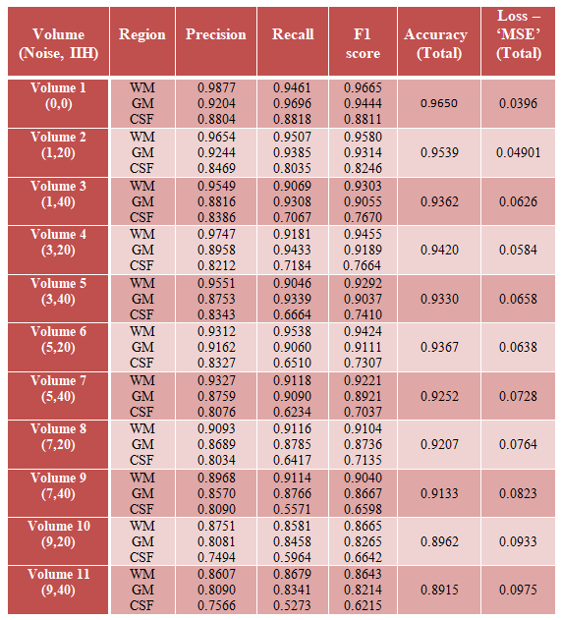
Results
Experiment Results with Different Data Partitioning Ratios –
Dataset- 70% Train, 15% Validation, 15% Test :-

Slide 18
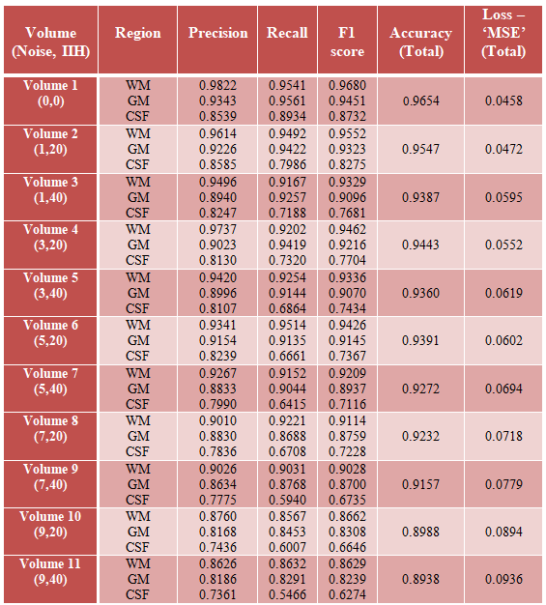
Results
Dataset- 60% Train, 20% Validation, 20% Test :-

Slide 19
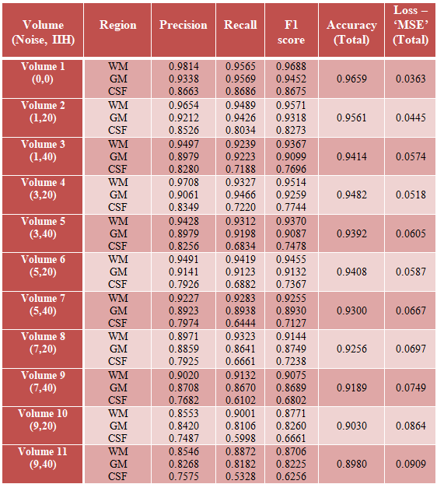
Results
Dataset- 50% Train, 25% Validation, 25% Test :-

Slide 20
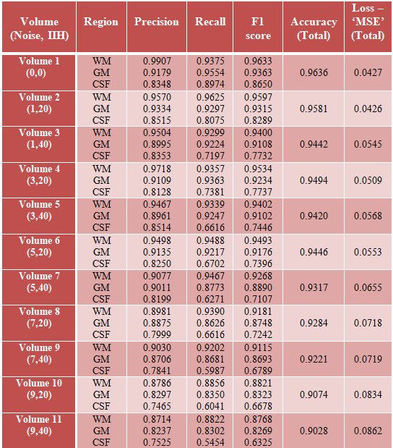
Results
Dataset- 40% Train, 30% Validation, 30% Test :-

Slide 21
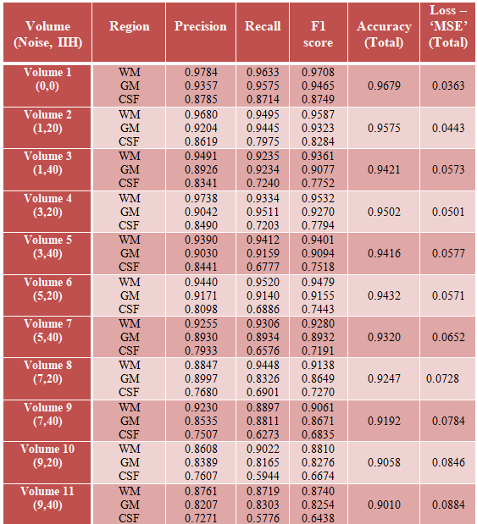
Results
Dataset- 30% Train, 35% Validation, 35% Test :-

Slide 22
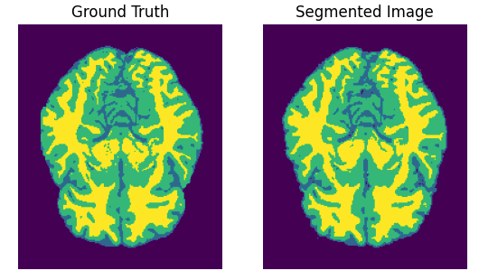
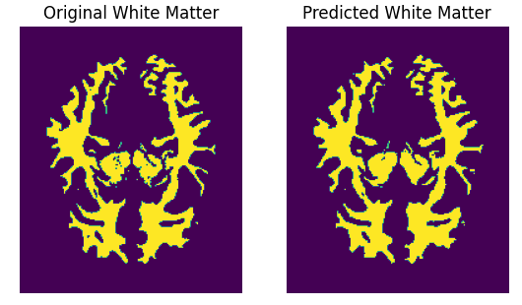
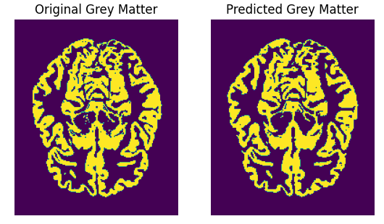
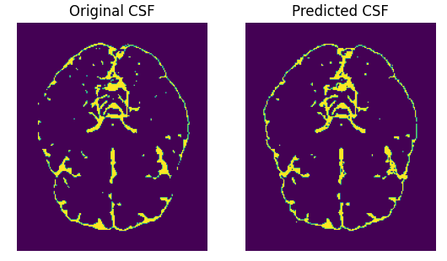
Results
The original and the predicted masks of a random slice (slice- 62) from volume – 1(0,0)

Slide 23
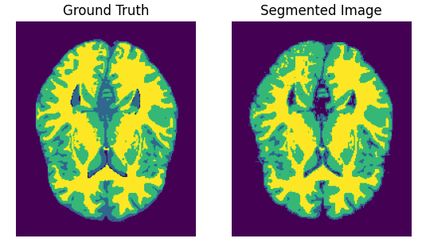
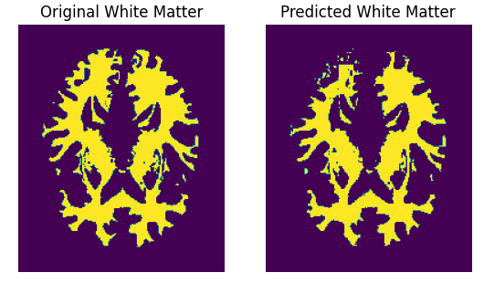
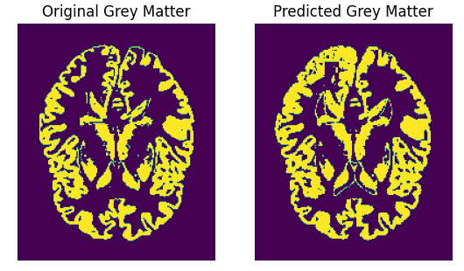
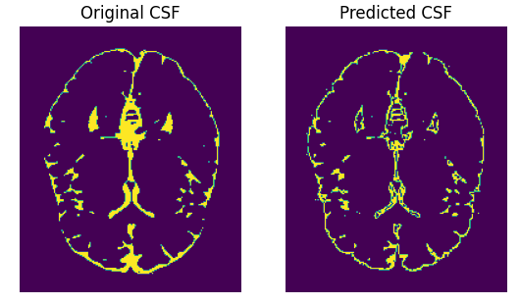
Results
The original and the predicted masks of a random slice (slice- 73) from volume – 3(1,40)

Slide 24
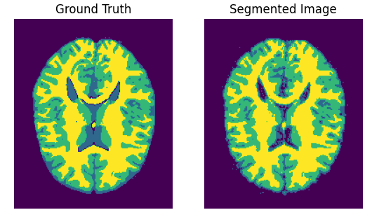
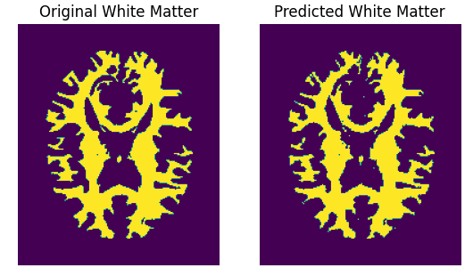
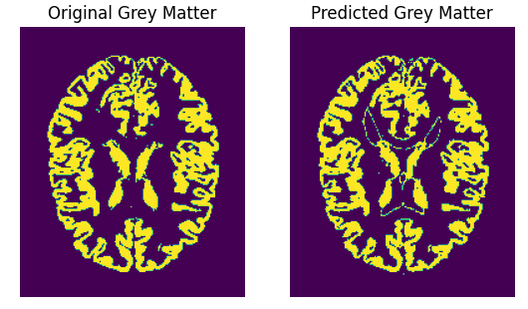
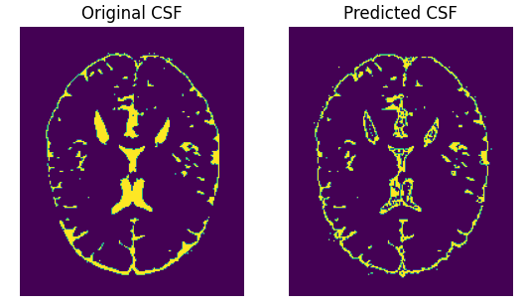
Results
The original and the predicted masks of a random slice (slice- 85) from volume – 4(3,20)

Slide 25
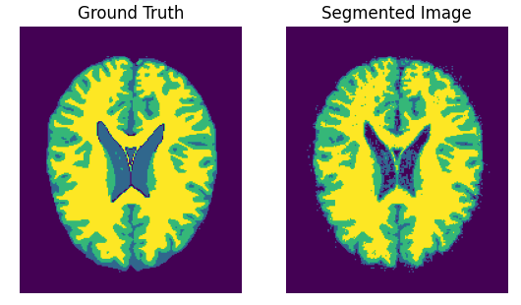
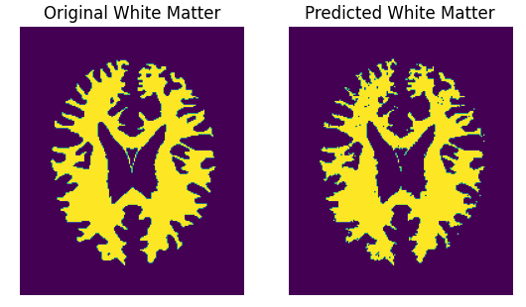
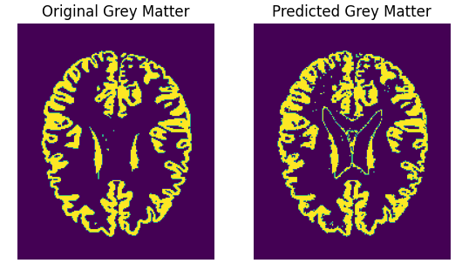
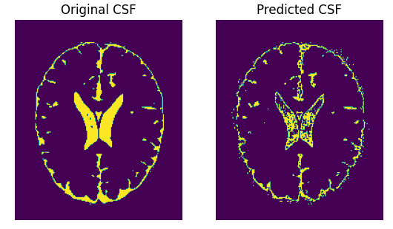
Results
The original and the predicted masks of a random slice (slice- 92) from volume – 6(5,20)

Slide 26
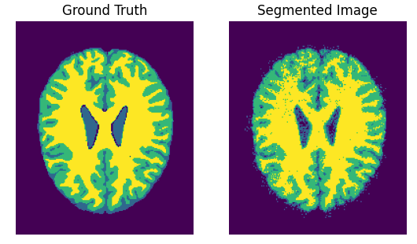
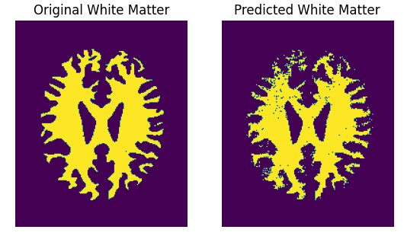
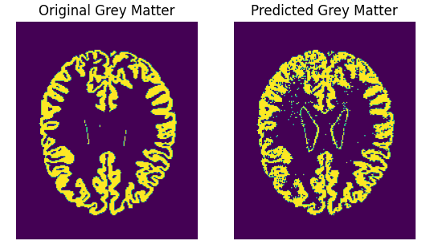
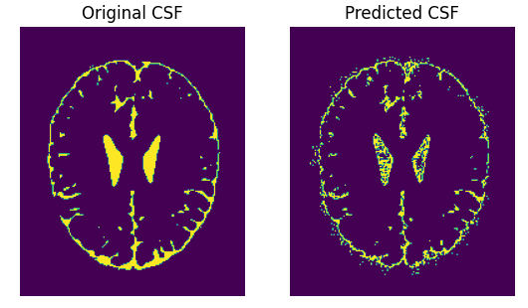
Results
The original and the predicted masks of a random slice (slice- 98) from volume – 9(7,40)

Slide 27
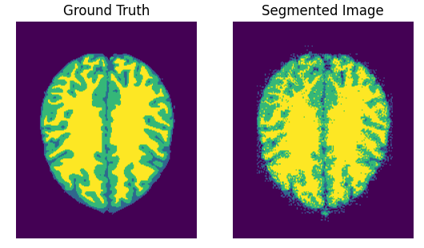
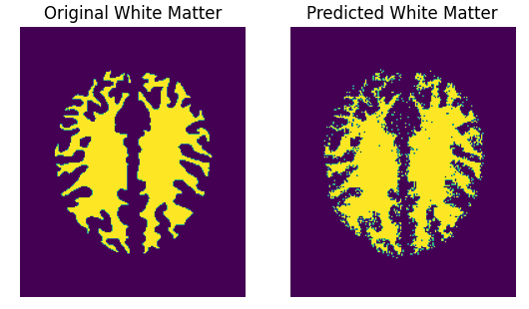
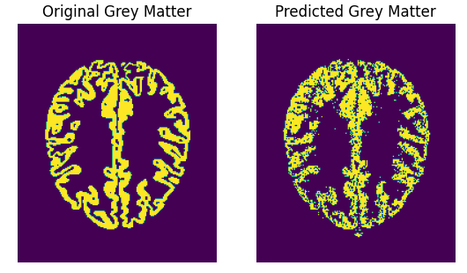
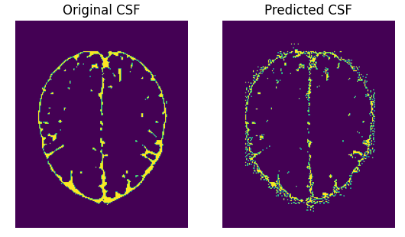
Results
The original and the predicted masks of a random slice (slice- 108) from volume – 11(9,40)

Slide 28
Conclusion
Medical image segmentation is vital for visualization, diagnosis, and treatment planning in clinical settings.
Ongoing advancements in medical models lead to new segmentation challenges and the need for new techniques.
This project highlights the effectiveness of Radial Basis Function Neural Network (RBFNN) for accurate brain MRI segmentation, delineating structures like CSF, grey matter, and white matter with promising outcomes.
RBFNN's ability to identify patterns enables precise segmentation, while future research may explore other ML and Deep Learning methods like CNNs.
It is important to acknowledge that the proposed algorithm is not without challenges. The increased complexity and computational requirements may lead to longer processing times. Despite computational challenges, RBFNN advancements offer hope for improved efficiency.
Ultimately, this study demonstrates the effectiveness of RBFNN in brain MRI segmentation, contributing to the understanding of neuroanatomy and supporting clinical diagnosis and therapy planning for neurological illnesses.

Slide 29
References
Sing, J. K., D. K. Basu, M. Nasipuri, and M. Kundu. "Self-adaptive RBF neural network-based segmentation of medical images of the brain." In Proceedings of 2005 International Conference on Intelligent Sensing and Information Processing, 2005., pp. 447-452. IEEE, 2005.
Sing, J. K., Basu, D. K., Nasipuri, M., & Kundu, M. (2005). Segmentation of MR images of the human brain using fuzzy adaptive radial basis function neural network. In Pattern Recognition and Machine Intelligence: First International Conference, PReMI 2005, Kolkata, India, December 20-22, 2005. Proceedings 1 (pp. 364-368). Springer Berlin Heidelberg.
Hyunseok Seo, Masoud Badiei Khuzani, Varun Vasudevan, Charles Huang, Hongyi Ren, Ruoxiu Xiao, Xiao Jia, Lei Xing1, “Machine Learning Techniques for Biomedical Image Segmentation: An Overview of Technical Aspects and Introduction to State-of-Art Applications”, Med Phys. 2020 Jun; 47(5): e148–e167.
Slabaugh, Greg, Quynh Dinh, and Gozde Unal. "A variational approach to the evolution of radial basis functions for image segmentation." In 2007 IEEE Conference on Computer Vision and Pattern Recognition, pp. 1-8. IEEE, 2007.
https://en.wikipedia.org/wiki/Radial_basis_function_network
https://www.educative.io/answers/what-are-radial-basis-function-neural-networks

Slide 30
Thank You

