Slide 1


INSTITUTE FOR ADVANCED COMPUTING AND
SOFTWARE DEVELOPMENT, AKURDI, PUNE
Plant Disease Detection Using CNN
PG-DBDA MARCH 2024
Submitted By:
Group No: 09
243547 Shagufta Nadaf
243549 Shruti Patil
Mr. Abhijit Nagargoje Mr. Rohit Puranik
Project Guide Centre Coordinator

Slide 2

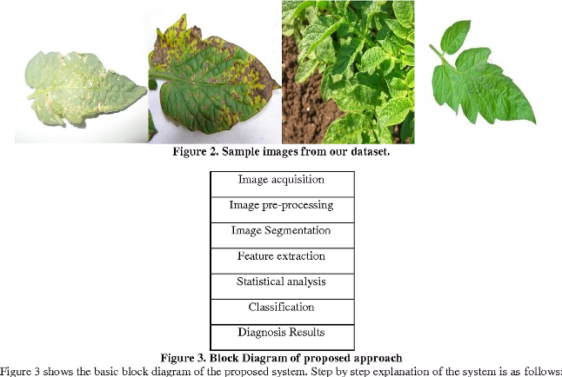
Introduction to Plant Disease Detection
Detecting plant diseases early is crucial for maintaining healthy crops and preventing widespread damage. This presentation will explore how Convolutional Neural Networks (CNNs) can be leveraged to build robust plant disease detection models, from dataset preparation to real-world deployment.

Slide 3
Overview of Convolutional Neural Networks (CNNs)
Architecture
Applications
Advantages
CNNs are a specialized type of neural network designed to process grid-like data, such as images. They use convolutional layers to extract visual features and fully connected layers for classification.
CNNs have been successfully applied to a wide range of computer vision tasks, including image classification, object detection, and image segmentation.
CNNs excel at capturing spatial relationships and patterns in visual data, making them well-suited for plant disease detection tasks.

Slide 4

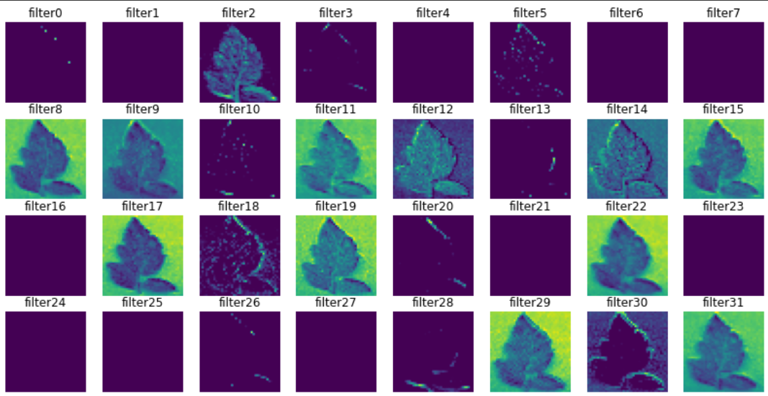
Advantages of Using CNNs for Plant Disease Detection
1
Automated Feature Extraction
2
High Accuracy
With the right architecture and training data, CNNs can achieve state-of-the-art performance in plant disease classification tasks.
CNNs can automatically learn and extract relevant visual features from plant leaf images, reducing the need for manual feature engineering.
3
Scalability
4
Robustness
CNNs can be trained on large datasets and deployed to handle real-world plant disease detection at scale.
CNNs are generally robust to variations in lighting, angle, and other environmental factors that can affect plant leaf images.

Slide 5

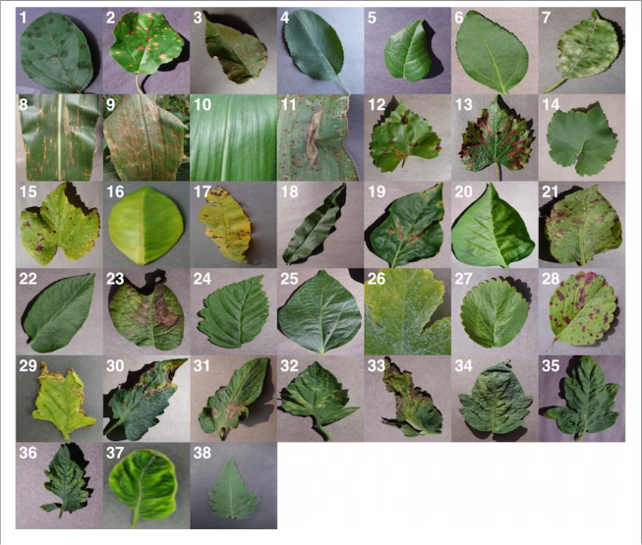
Dataset Preparation and Preprocessing
Data Collection
Data Augmentation
Acquire a comprehensive dataset of high-quality plant leaf images, covering a diverse range of healthy and diseased samples.
Apply techniques like rotation, flipping, and scaling to artificially expand the dataset and improve model generalization.
Image Preprocessing
Train-Val-Test Split
Normalize the images, resize them to a consistent size, and convert them to a format suitable for CNN input.
Divide the dataset into training, validation, and testing sets to ensure proper model evaluation and prevent overfitting.

Slide 6

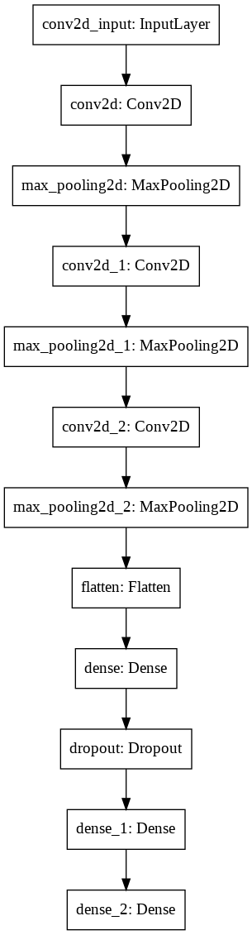
CNN Architecture Design
1
Convolutional Layers
Extract low-level visual features like edges and textures, and higher-level features like disease patterns.
2
Pooling Layers
Reduce the spatial dimensions of feature maps, while preserving the most important information.
3
Dense Layers
Perform the final classification task, mapping the learned features to the desired plant disease labels.

Slide 7



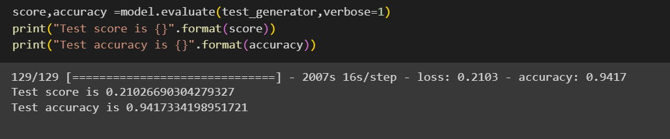


Training and Validation of the CNN Model
Loss Minimization
Accuracy Maximization
Train the CNN model to minimize the loss between the predicted and true disease labels.
Monitor the model's performance on the validation set and fine-tune the hyperparameters to achieve the highest possible accuracy.
Prevent Overfitting
Model Evaluation
Employ techniques like dropout and early stopping to ensure the model generalizes well to unseen data.
Assess the final model's performance on the held-out test set to estimate its real-world effectiveness.

Slide 8

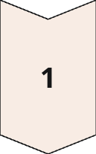
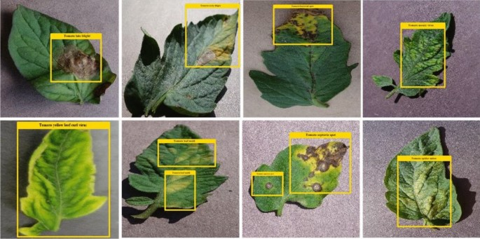
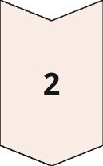
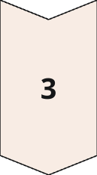
Deployment and Real-World Application
Mobile App
Develop a user-friendly mobile application that can capture plant leaf images and provide disease diagnosis in real-time.
Edge Deployment
Deploy the CNN model on edge devices, such as IoT sensors, to enable distributed and scalable plant disease monitoring.
Integration
Integrate the plant disease detection system with agricultural management platforms to provide comprehensive insights and recommendations to farmers.

Slide 9

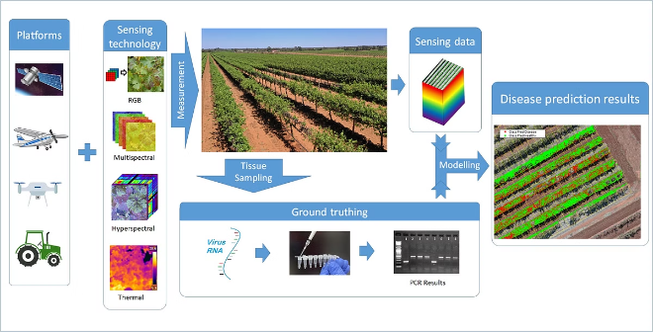
Conclusion and Future Directions
1
Recap
2
Future Outlook
In this presentation, we have explored the benefits of using Convolutional Neural Networks for automated plant disease detection.
Continued advancements in deep learning and computer vision will likely lead to even more accurate and versatile plant disease detection models.
3
Collaboration
4
Ongoing Research
Interdisciplinary collaboration between computer scientists, agronomists, and plant biologists will be crucial for developing practical, end-to-end solutions.
Exciting future directions include multi-modal sensing, transfer learning, and integration with precision agriculture technologies.

Slide 10
THANK YOU

