Slide 1
Module: Data Analytics
BRAZILIAN E-COMMERCE ANALYTICS
An end-to-end analysis of the Olist marketplace dataset — from raw order data to
actionable findings on delivery performance and revenue drivers.
Notes:
Today I'm walking through an analysis I did on the Olist dataset — a Brazilian e-commerce marketplace. I looked at two things: whether delivery performance actually affects customer satisfaction, and where the business's revenue is really coming from.

Slide 2
THE DATA
Eight Raw Tables, One Analysis-Ready Table
99,441
112,650
103,886
MASTER TABLE
orders
order_items
payments
112,650
99,224
32,951
3,095
order-line rows × 37 columns
reviews
products
sellers
99,441
71
98,666
customers
category translation
unique orders
Grain & joins Payments and reviews are one-to-many with orders, so both are aggregated to one row per order_id before merging — this keeps the master table at a clean order-item grain instead of silently duplicating orders.
775 orders dropped from the master table — these are orders with no line items at all (mostly canceled / unavailable status), not a data error.
Source: https://www.kaggle.com/datasets/olistbr/brazilian-ecommerce
2
Notes:
I started with eight raw tables — orders, order items, payments, reviews, products, sellers, customers, and a category-translation table — and joined them into one master table at the order-item level: about 112,000 rows across 37 columns. The tricky part was that payments and reviews are one-to-many with orders, so I aggregated those down to one row per order before merging — otherwise I'd have silently duplicated orders. I also dropped 775 orders that had no line items at all, mostly canceled or unavailable orders — that's expected, not a data quality bug.

Slide 3
THE BRIEF
Two Business Questions Frame the Analysis
01
02
Does late delivery actually hurt customer satisfaction — and if so, where should the business focus to fix it?
Where is revenue coming from — categories, regions, time — and which sellers are driving it?
Delivery & Satisfaction
Revenue & Sellers
3
Notes:
Two questions framed the whole analysis: does late delivery actually hurt satisfaction, and if so where should the business focus to fix it — and separately, where is revenue coming from, and which sellers are driving it.

Slide 4
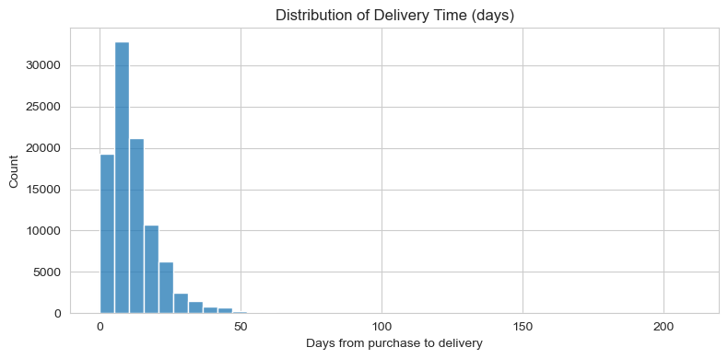
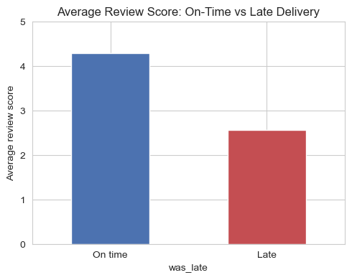
QUESTION 1 · DELIVERY
Late Delivery Devastates Review Scores
4.29
on-time avg (88,168 orders)
2.57
late avg (7,662 orders)
-1.7 pts
Delivery takes a median of 10 days (mean 12.1), but the tail runs long — some orders take months.
Headline finding: an order that arrives late drops from a near-perfect 4.29★ average to 2.57★ — the single biggest lever on satisfaction in this dataset.
4
Notes:
Let's start with delivery. Looking at the distribution here, The median delivery time is 10 days, mean 12.1 — the mean's a bit higher because of a thin tail of outlier orders that took exceptionally long, in rare cases over 100 days. But the bulk of orders, as you can see, cluster tightly between about 5 and 20 days.
Now, the question I actually cared about: does being late matter to the customer? I split every order into on-time versus late, based on whether it arrived after the estimated delivery date, and looked at the average review score for each group. On-time orders — about 88,000 of them — average 4.29 stars, basically a near-perfect score. Late orders — around 7,600 — drop to 2.57. That's a swing of almost 1.7 points on a 5-point scale. To put that in perspective, that's the difference between a customer who'd recommend you and one who's actively frustrated. Of every factor I could have looked at, this was the single strongest lever on satisfaction in the entire dataset.

Slide 5
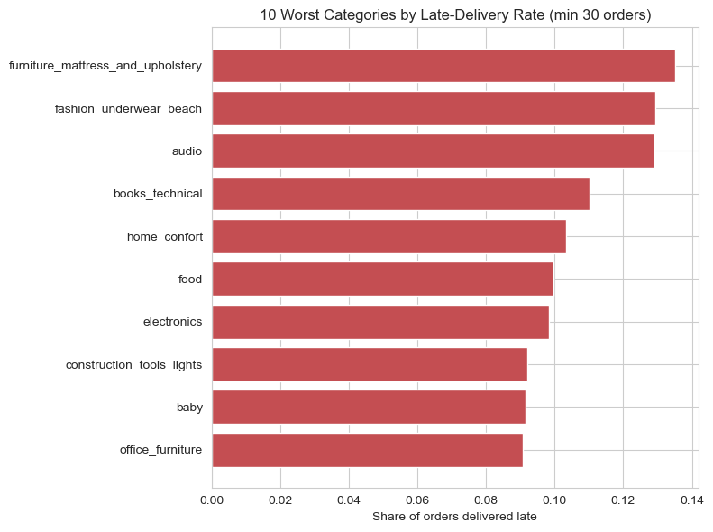
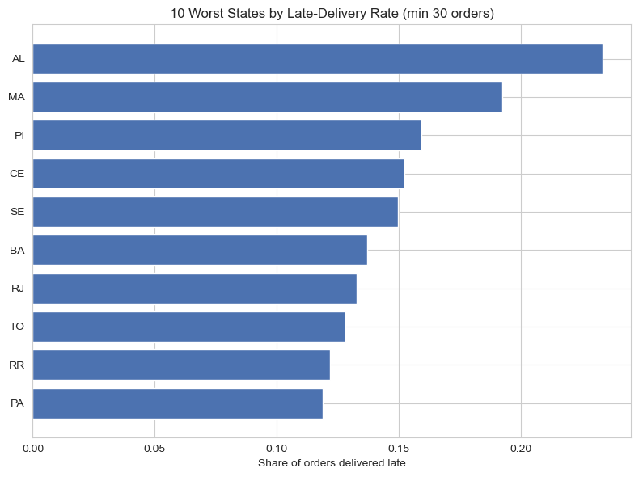
QUESTION 1 · DEEP-DIVE
Where Lateness Concentrates
The twist: at the category level, lateness rate and average review score are only weakly correlated (r = -0.25). A category's identity isn't destiny — this points to fixing carrier/routing reliability broadly (worst states cluster in Northeast Brazil), not to treating certain product types as inherently doomed.
5
Notes:
So if lateness is the problem, where does it actually happen? On the left, I grouped orders by product category and calculated what share arrived late — I set a minimum of 30 orders per category so I wasn't drawing conclusions from tiny sample sizes. Furniture, underwear and beachwear, and audio equipment are the worst offenders, all above 12% late.
On the right, same idea but by customer state. This is where it gets more interesting — the worst-performing states are heavily concentrated in Brazil's Northeast: Alagoas, Maranhão, Piauí, Ceará, Sergipe — some pushing past 20% of orders arriving late, nearly double the national baseline.
Here's the twist, though. I went one step further and checked whether a category's lateness rate actually predicts its review score — and the correlation is weak, only -0.25. So even though individual late orders get punished hard, a category being generally late-prone doesn't reliably translate to that category having worse reviews overall. What that tells me is this isn't a product problem — it's a logistics and carrier-routing problem, and it's geographically concentrated. Fix the delivery network serving the Northeast, and you'd expect broad satisfaction gains, not narrow category-by-category fixes.

Slide 6
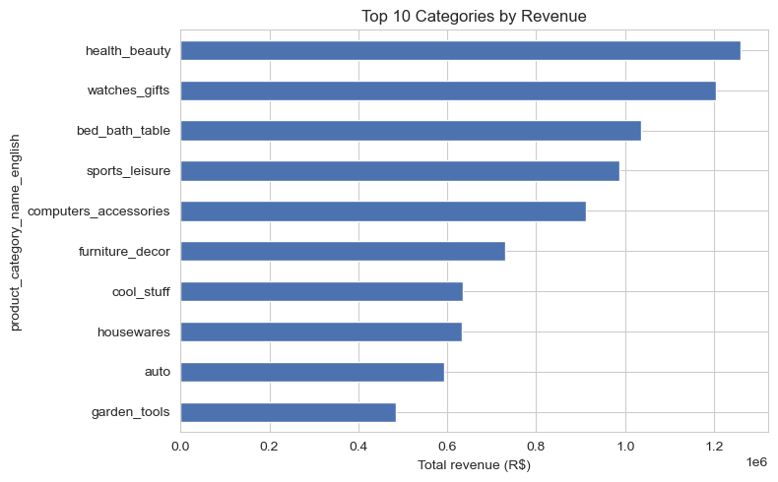
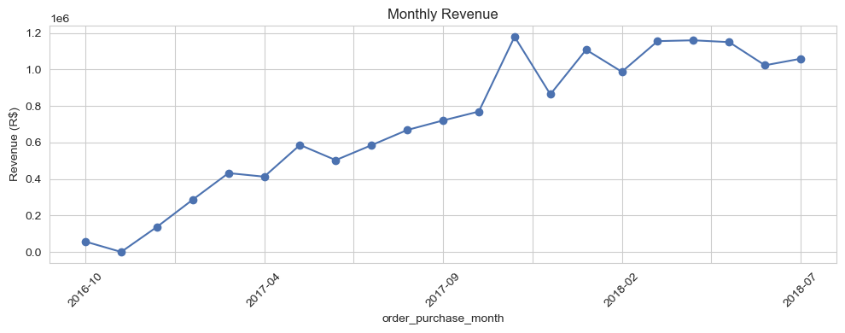
QUESTION 2 · REVENUE
The Revenue Landscape
Monthly revenue climbed steadily through the dataset's history, roughly tracking Olist's own marketplace growth over this period.
Health & beauty, watches/gifts and bed/bath/table lead — but no single category dominates; the top 10 are fairly evenly spread.
R$ 1.26M
R$ 201
top category: health_beauty
avg price — watches_gifts, highest of the top 10
6
Notes:
Shifting to the second question — where's the revenue actually coming from. By category, health and beauty leads at about 1.26 million reais, followed closely by watches and gifts, then bed/bath/table. What stands out is how even this spread is — the top 10 categories are all within a fairly tight band of each other. There's no single category the business is dangerously dependent on.
On the right, monthly revenue over time — a pretty clean growth story. Revenue climbs steadily from the start of the dataset, with some month-to-month noise but no real plateau or decline, which lines up with what we'd expect from a marketplace like Olist scaling up during this period.

Slide 7
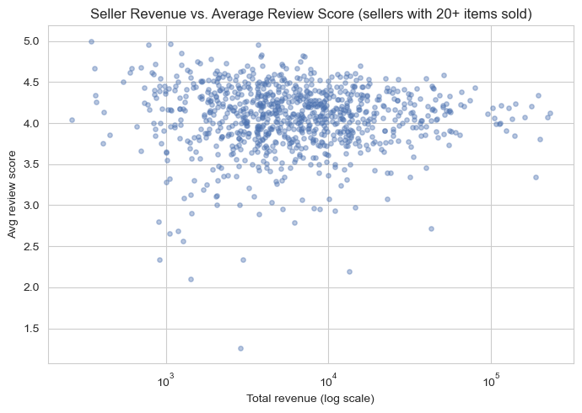
QUESTION 2 · REVENUE
Revenue Is Concentrated by State — Sellers Less So
R$ 5.92M
São Paulo (SP) — 41,374 orders
2.8× the #2 state (Rio de Janeiro, R$ 2.13M). Almost every category's single largest state is SP — it dominates the map, not any one product line.
Rio de Janeiro
R$ 2.13M
Minas Gerais
R$ 1.86M
Rio Grande do Sul
R$ 886K
Paraná
R$ 801K
Sellers: no revenue/quality trade-off — high-revenue sellers (log scale) hold review scores just as well as small ones, so growing top sellers doesn't come at a satisfaction cost.
7
Notes:
Now, geography tells a very different story than category did. São Paulo alone generated 5.92 million reais — 2.8 times more than the next closest state, Rio de Janeiro. Minas Gerais, Rio Grande do Sul, and Paraná round out the top five, but they all trail far behind São Paulo.
On the right, I looked at individual sellers — specifically, does chasing higher revenue come at the cost of review quality? I plotted total seller revenue on a log scale against average review score, restricted to sellers with at least 20 items sold so the averages are meaningful. The pattern is reassuring: there's no real trade-off. High-revenue sellers hold their review scores just as well as smaller ones. So growing the top sellers doesn't inherently put customer satisfaction at risk.

Slide 8
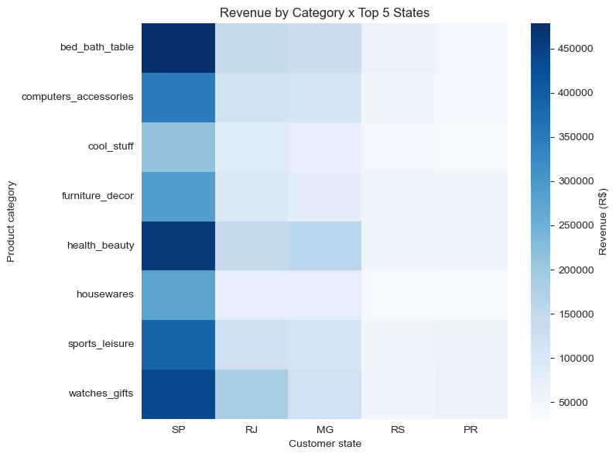
QUESTION 2 · DEEP-DIVE
Category Preferences Barely Shift by Region
TOP CATEGORY PER STATE
SP
bed_bath_table
9.2%
RJ
watches_gifts
10.2%
MG
health_beauty
9.9%
RS
bed_bath_table
8.0%
PR
watches_gifts
8.8%
Reading it: the top category never exceeds ~10% of a state's revenue, and SP is the darkest column for every single category. Regional merchandising would move the needle less than simply growing overall reach in SP and RJ.
8
Notes:
Last piece of the revenue picture: I wanted to know whether different states actually prefer different products, which would justify things like regional inventory or region-specific promotions. So I looked at, for each of the top 5 revenue states, which category drives the most revenue there.
The answer is mixed but leans toward "not really." São Paulo and Rio Grande do Sul are both led by bed/bath/table. Rio de Janeiro and Paraná are led by watches and gifts. Minas Gerais leans toward health and beauty. But look at the share numbers — in every single state, the top category only accounts for around 8 to 10% of that state's total revenue. And on the heatmap, São Paulo is the darkest column for literally every category, not just its "specialty" ones. So the honest takeaway is that regional merchandising would be a pretty low-leverage move here — the bigger opportunity is just growing overall reach in São Paulo and Rio, rather than tailoring category mix by region.

Slide 9
TAKEAWAYS
What The Business Should Do With This
1
Fix delivery reliability first
It's the single largest lever on satisfaction (4.29 → 2.57★). Prioritize carrier performance in the Northeast (AL, MA, PI, CE, SE) — the worst on-time regions.
2
Don't chase category-specific fixes
Weak category-level correlation (r = -0.25) means this is a logistics/routing problem, not a product-category problem.
3
Double down on SP & RJ
SP alone drives 2.8× the revenue of the #2 state and dominates every category — geographic reach beats category-specific regional plays.
4
Scale top sellers with confidence
Revenue and review score aren't in tension for high-volume sellers, so growth doesn't have to cost satisfaction.
9
Notes:
Pulling it together: fix delivery reliability first — it's the biggest lever on satisfaction, and the Northeast states are the clear priority. Don't chase category-specific fixes — this is a logistics problem, not a product problem. Keep doubling down on São Paulo and Rio geographically rather than category-targeted plays. And scale the top sellers with confidence, since growth there doesn't cost you satisfaction.

