Slide 1
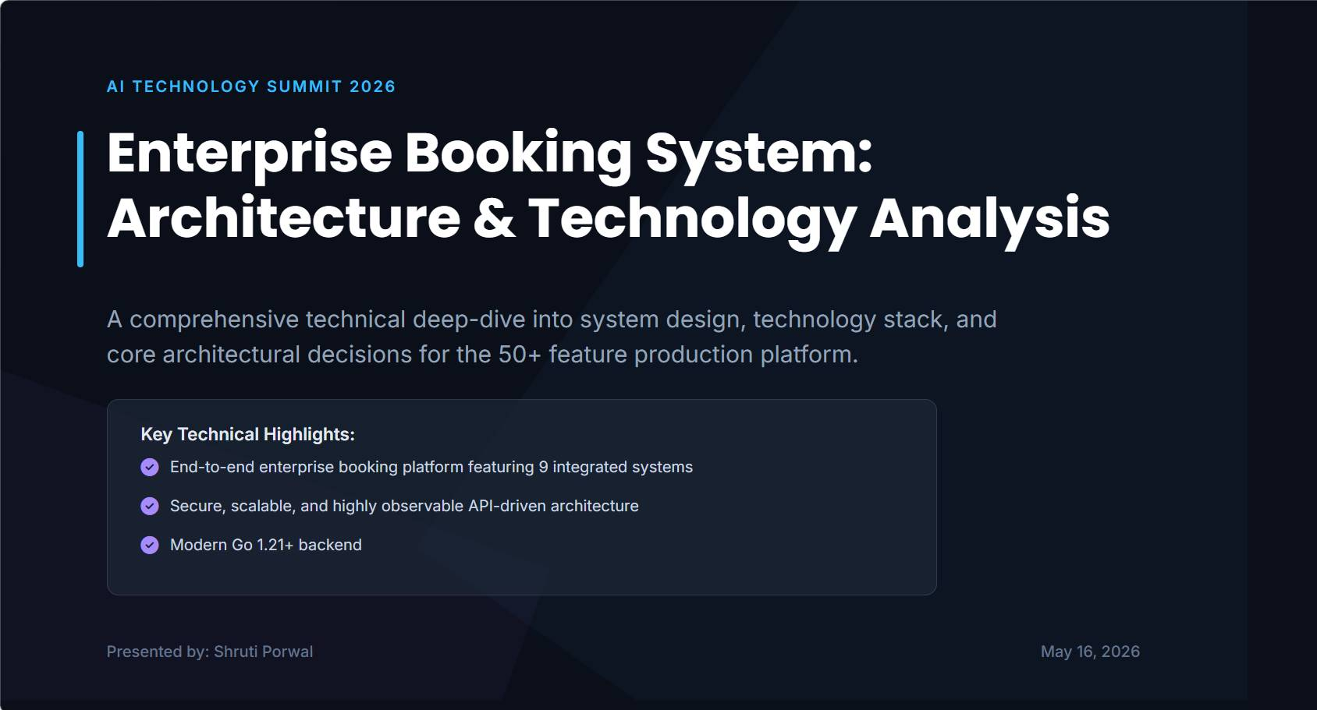

Slide 2
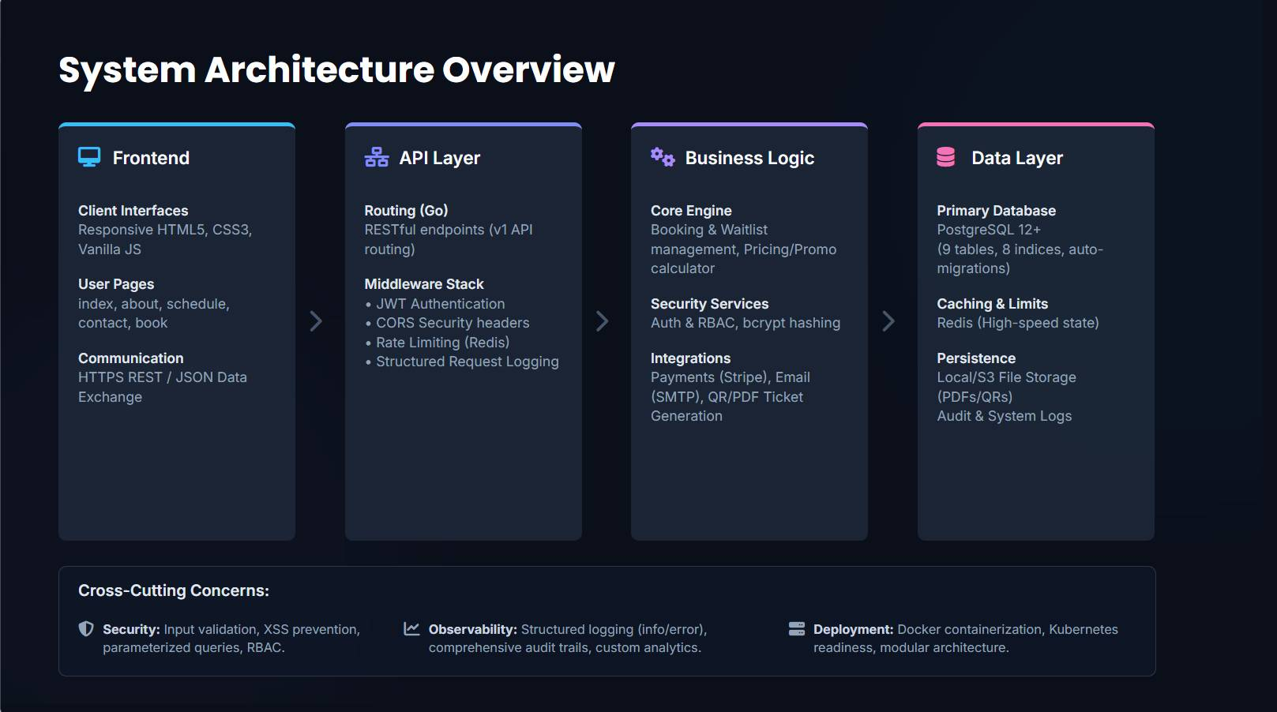

Slide 3
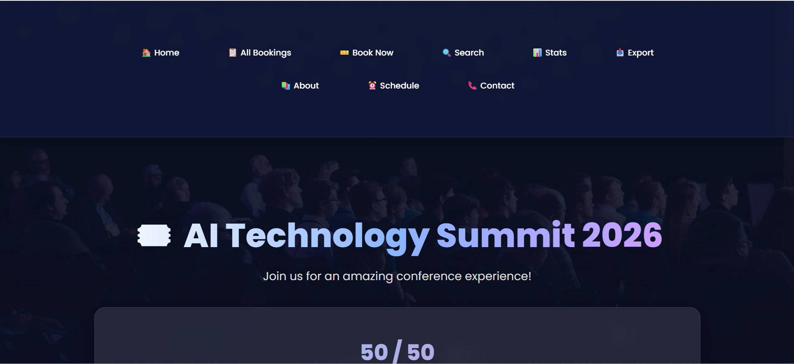
WEBSITE FRONTEND UI DEMO VIDEO

Slide 4
Advanced Features in Go Booking Application
Concurrent booking management using sync.Mutex
Real-time ticket availability tracking
Unique booking reference generation
Search functionality using name, email, and booking ID
Booking cancellation with automatic ticket recovery
CSV export support for reporting
Statistics dashboard for ticket analytics
HTML template rendering with reusable pages
Input sanitization and email validation
REST-style HTTP route handling

Slide 5
Pros and Cons of Go Booking System
Pros
• Fast backend performance and low memory usage
• Excellent concurrency support with goroutines
• Easy deployment with single binary
• Strong validation and modular design
• Simple and maintainable code structure
Cons
• No database integration (data stored in memory)
• No authentication or authorization
• Limited enterprise scalability
• No payment gateway support
• No automated logging and monitoring

Slide 6
Future Enhancements
Database integration using MySQL/PostgreSQL
JWT authentication and admin panel
Docker and Kubernetes deployment
Payment gateway integration
Email and SMS notifications
Monitoring with Prometheus and Grafana
CI/CD automation pipelines
Cloud deployment support

