Slide 1


SMART INDIA HACKATHON 2026
TITLE PAGE
Problem Statement ID – SIH25083
Problem Statement Title- Digital Health Record Management System for Migrant Workers in Kerala aligned with Sustainable Development Goals
Theme- MedTech / BioTech / HealthTech
PS Category- Software/Hardware
Team Name - CodeCatalysts

Slide 2
IDEA TITLE: SHRAMIKCARE Digital Health Record Management System for Migrant Workers in Kerala
Proposed Solution
Detailed explanation of the proposed solution:
AI-powered digital health platform for continuous healthcare support.
Digital Health Passport with QR Code stores medical history, allergies and emergency information.
AI scans handwritten prescriptions and converts them into digital medicine records.
Multilingual Voice AI and visual medicine reminders support workers with low digital literacy.
Locates nearby free healthcare facilities, health camps and government welfare schemes.
How it addresses the problem:
Reduces language barriers between migrant workers and healthcare providers.
Prevents loss of prescriptions and improves medicine dosage understanding.
Provides easy access to free healthcare and government benefits.
Enables doctors to quickly view critical medical information through QR access.
Innovation and uniqueness of the solution:
One QR-based Digital Health Passport that stays with the worker even when they change jobs, locations or hospitals.
Converts handwritten prescriptions into structured digital medicine records, reducing errors and preventing prescription loss.
Voice AI + visual medicine guidance helps workers understand healthcare instructions despite language and literacy barriers.
A single platform connecting workers to doctors, free healthcare facilities, health camps and government welfare schemes.

Slide 3
TECHNICAL APPROACH
Technologies to be used(e.g.programming languages, frameworks,hardware):
Frontend:
React.js – Responsive role-based portals
HTML5, CSS3 & JavaScript – UI and accessibility
QR Scanner & Web Speech API – Worker–Doctor interaction
Backend:
Node.js + Express.js – REST APIs and business logic
JWT / Session Authentication – Secure role-based access
Role-Based Access Control – Worker, Doctor & Government
Database:
MongoDB – Users, health records, consultations, prescriptions, camps & notifications
Real-time database-driven statistics and health alerts
AI & Smart Features:
OCR/AI – Extract medicine, dosage, frequency & instructions from prescriptions
Speech Recognition & Text-to-Speech – Multilingual voice assistance
Translation – English, Hindi, Malayalam & Bengali

Slide 4
FEASIBILITY AND VIABILITY
Analysis of the feasibility of the idea:
• Technical Feasibility:
Technically SHRAMIKCARE is feasible because its key technologies can be integrated into one practical platform
• Operational Feasibility: Can be piloted in selected migrant worker clusters, connecting workers, doctors and healthcare services before wider deployment.
• Economic Feasibility:
Uses open-source and existing digital infrastructure, while reducing paperwork, repeated tests and unnecessary healthcare costs.
Potential Challenges and Risks:
Challenge 1: Low Digital Literacy Some migrant workers may have limited experience with smartphones and digital applications, making text-based healthcare systems difficult to use.
Challenge 2: Doctor Adoption & OPD Workload Overcrowded public hospitals may make doctors reluctant to use systems that require additional data entry or increase consultation time.
Challenge 3: Language & AI Accuracy Different languages and handwritten prescriptions can create challenges in accurate translation, medicine recognition and dosage interpretation.
Challenge 4: Limited Internet Connectivity Poor connectivity in some worker camps may affect real-time access to digital health records, voice assistance and healthcare services.
Strategies for overcoming these challenges:
1. Voice-First & Visual Design Use voice instructions, icons and simple screens instead of relying on complex text.
2. Minimum Doctor Interaction
Doctor only needs to scan the worker's QR and view the medical profile; prescription digitization can be handled through AI.
3. Multilingual AI Assistance
Support Hindi, Bengali, Odia, Assamese and Malayalam through voice-based interaction

Slide 5
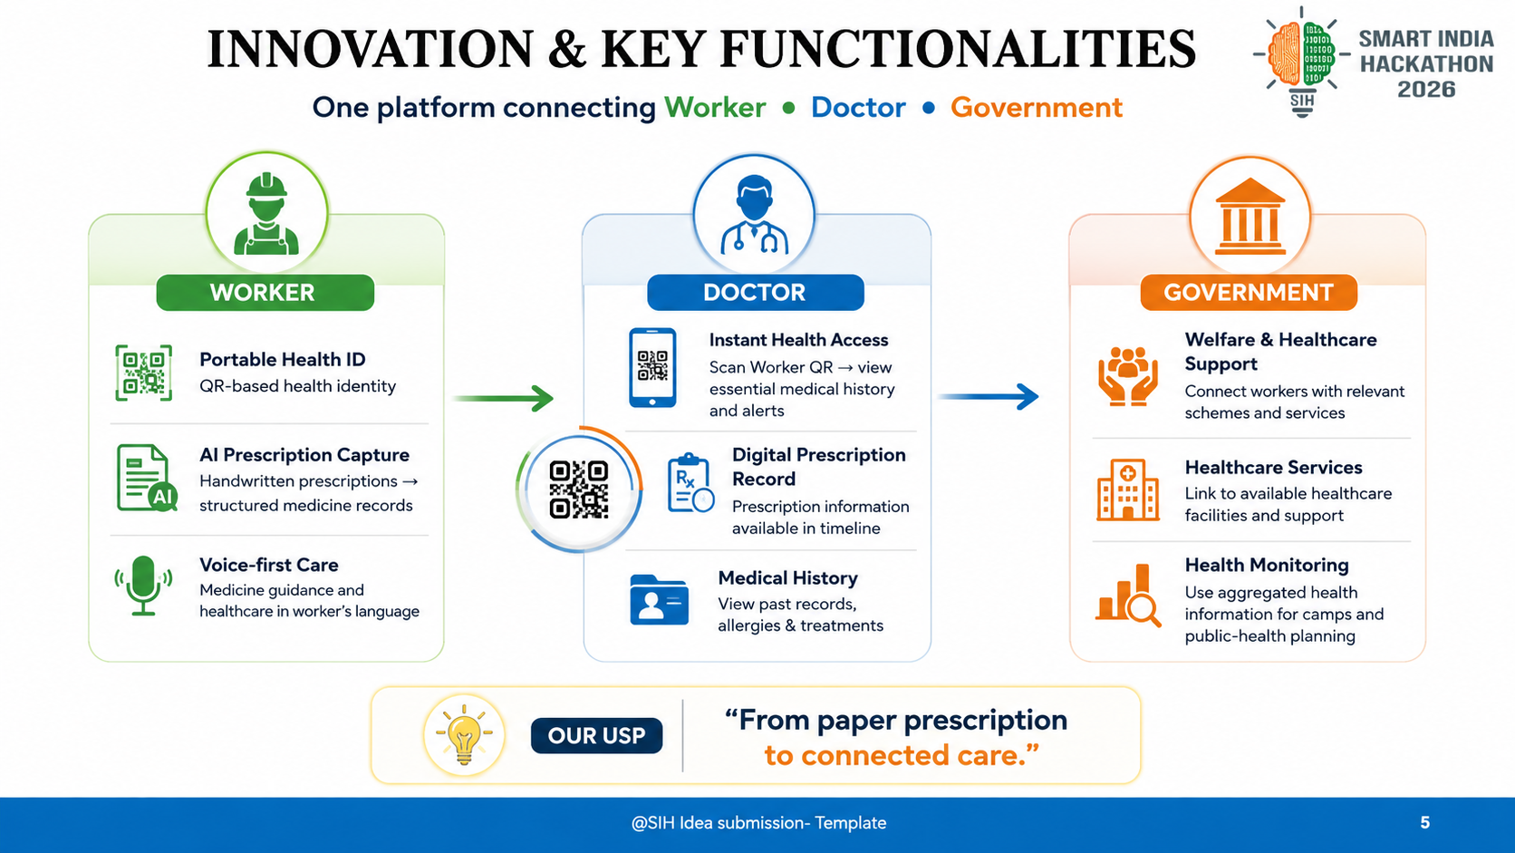
IMPORTANT INSTRUCTIONS

Slide 6
IMPACT AND BENEFITS
IMPACT
WORKER:
Health Goes With Them — Records stay accessible even when they change jobs or locations.
Easy Healthcare — Voice and multilingual support make medical information easier to understand.
DOCTOR
Quick Medical History — Scan the QR to access important records.
Less Paperwork — Digital prescriptions reduce manual work.
GOVERNMENT
Better Scheme Reach — Workers can find relevant welfare and healthcare support.
Health Monitoring — Health trends can help plan camps and services.
BENEFITS & FUTURE SCOPE
Healthcare Continuity — Workers can carry their medical history across jobs, locations and hospitals.
Digital Health at Labour Camps — Health stations can support registration, basic screening and healthcare guidance.
Early Disease Detection — AI can identify emerging health patterns and support preventive action.
Scale Across India — Expand to more languages, states and government welfare schemes.
Smarter Public Healthcare — AI-driven insights can support better planning and targeted health interventions.

Slide 7
RESEARCH AND REFERENCES
Details / Links of the reference and research work
Research :
• World Organization (WHO) – Refugee and Migrant Health →https://www.who.int/health-topics/refugee-and-migrant-health
• Ayushman Bharat Digital Mission – Digital Health Ecosystem & Health Records →https://abdm.gov.in/
• Kerala eHealth – Integrated Digital Healthcare System →https://www.ehealth.kerala.gov.in/
References:
Kerala Health Department – Health Services & Public Health Information →https://health.kerala.gov.in/
Kerala eHealth – Digital Health Services →https://www.ehealth.kerala.gov.in/
Ayushman Bharat Digital Mission (ABDM) – Digital Health ID & Health Records →https://abdm.gov.in/
National Health Authority (NHA) – Digital Healthcare Initiatives →https://nha.gov.in/
WHO – Migrant & Refugee Health – Healthcare Access & Inclusion →https://www.who.int/health-topics/refugee-and-migrant-health
Project References:
Reference Video – Healthcare / Digital Solution Research → https://youtu.be/0Eme2ndv9u8?si=3lM4iyS61ju83oU2
ShramikCare – Working Prototype

