Slide 1


PYTHON PROJECT
(CA277)
SUBMITTED BY - SHRUTI SNEHA
ROLL NO. - BCA/40046/20
CLASS – BCA-5A-GIRLS'
Submitted to - DR. Amrita priyam mA'AM

Slide 2
AIM: Truth & dare discord bot
Objective:
TO MAKE A DISCORD BOT USING PYTHON WITH DISCORD API THAT ACTS ON CERTAIN COMMANDS. WITH THESE COMMANDS, THE USER CAN PLAY TRUTH AND DARE WITH THE BOT. THE BOT HAS SOME EXTRA FEATURES TO EXPLORE.

Slide 3
IMPLEMENTATION OF PROJECT:
This project is made using python. Discord API is used to link the Discord App with the bot. The bot was created using the developers' portal provided by the discord. Then the private login key, TOKEN was used in the code to link the bot to add it's functionality.
The bot responses are made based on the events made in the chat box by the user. The functionality of the bot involves selecting random Truth and Dare questions that are sent to the user accessing the bot. To access the bot, the user has to use the "$" symbol in front of every command or the bot would not be able to respond.
Entering "$help" in the chat will display all sorts of valid commands the user can use to play with the bot.

Slide 4
Features:
The bot plays Truth and Dare with the user.
The bot responds only on some certain commands entered by the user.
The commands to be entered must begin with "$" symbol.
These commands can be of any capitalization, for example: "$Dare", "$DARE", "$dArE" would all be considered the same and the bot will respond anyhow.
The bot has a feature of texting a user personally if the "?" symbol is used in front of the valid commands, for example: using "?$truth" will send a Truth question in the user's personal inbox.
As the code involves Asynchronous programming, the bot's response time is very low. It responds without any delay making it easier for the user to continue playing with the bot.

Slide 5
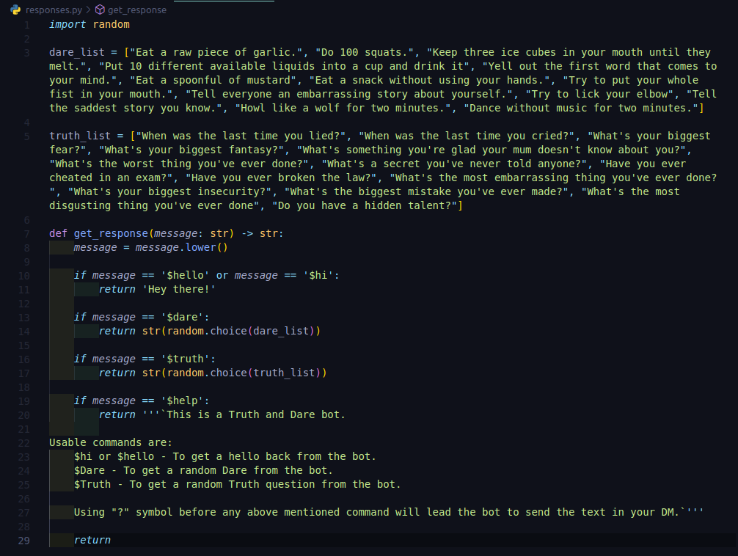
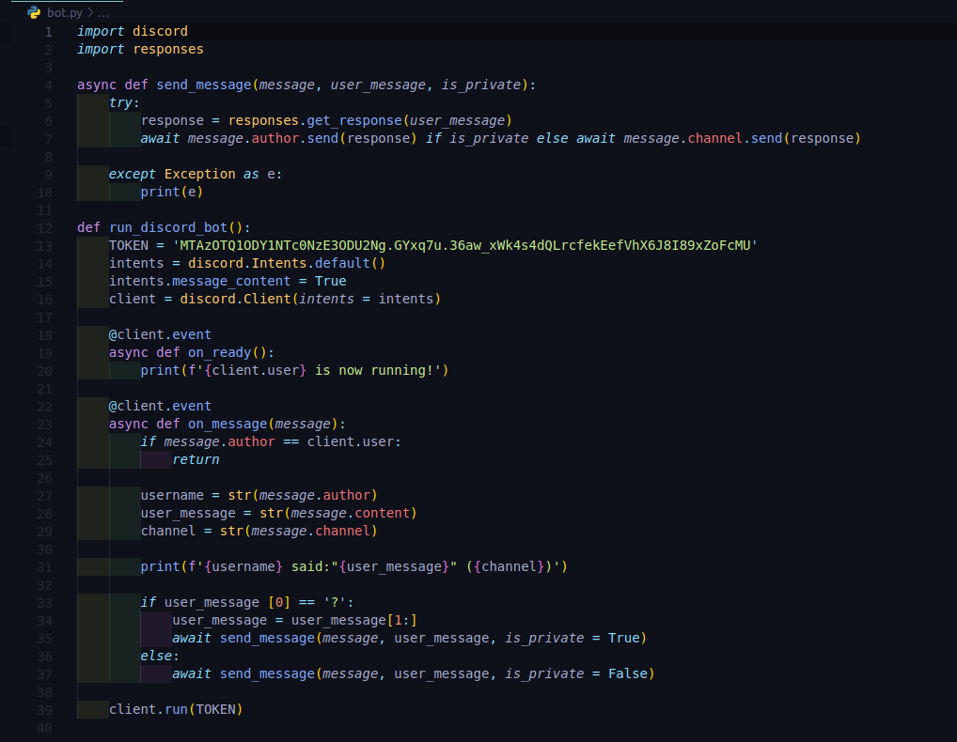
Code:
Code for this discord bot is divided in three sub-files that help managing everything, server, response and link between all the required APIs and code.
responses.py (manages responses of the bot):
bot.py (manages link as well as the working system of the bot):

Slide 6
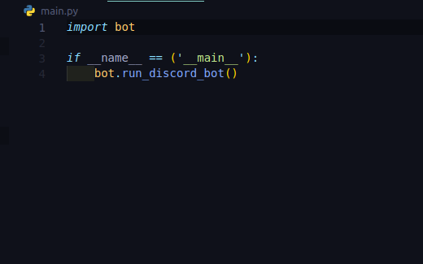
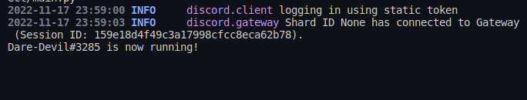
Code:
main.py (runs the bot):
output (shows the bot running on the server):
"Dare-Devil" is the name of the bot. When we execute the main file. It responds "Dare-Devil#3285 is now running!" in the terminal. This ensures us that the bot is running properly.
Main.py is the mail file that is executed in-order-to establish a connection between the bot and the code. Executing main file is necessary for the bot to function.

Slide 7
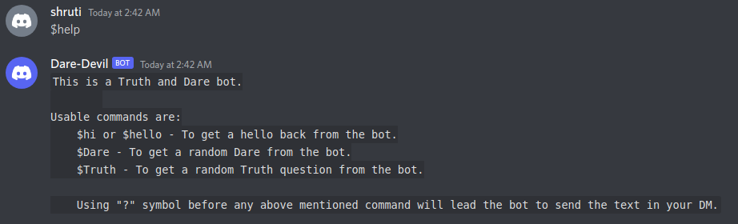
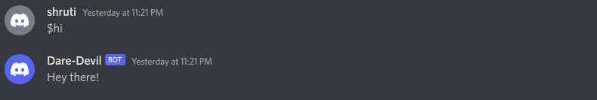
GLIMPSE OF THE BOT:
Using "$help" to view the list of valid commands for the bot:
Using "$hi" to get a response from the bot:
**Use the bot in Discord to view all the other present features and valid commands.

Slide 8
REFERENCE:
Discord Documentation
Discord Developer's Documentation
YouTube

