Slide 1
CUSTOMER CHURN ANALYSIS
Reducing Customer Attrition Through Data-Driven Insights
The Developer Arena — Week 8 Capstone Project | June 2026
500
9
10.6%
Customers Analysed
Features Examined
Current Churn Rate

Slide 2
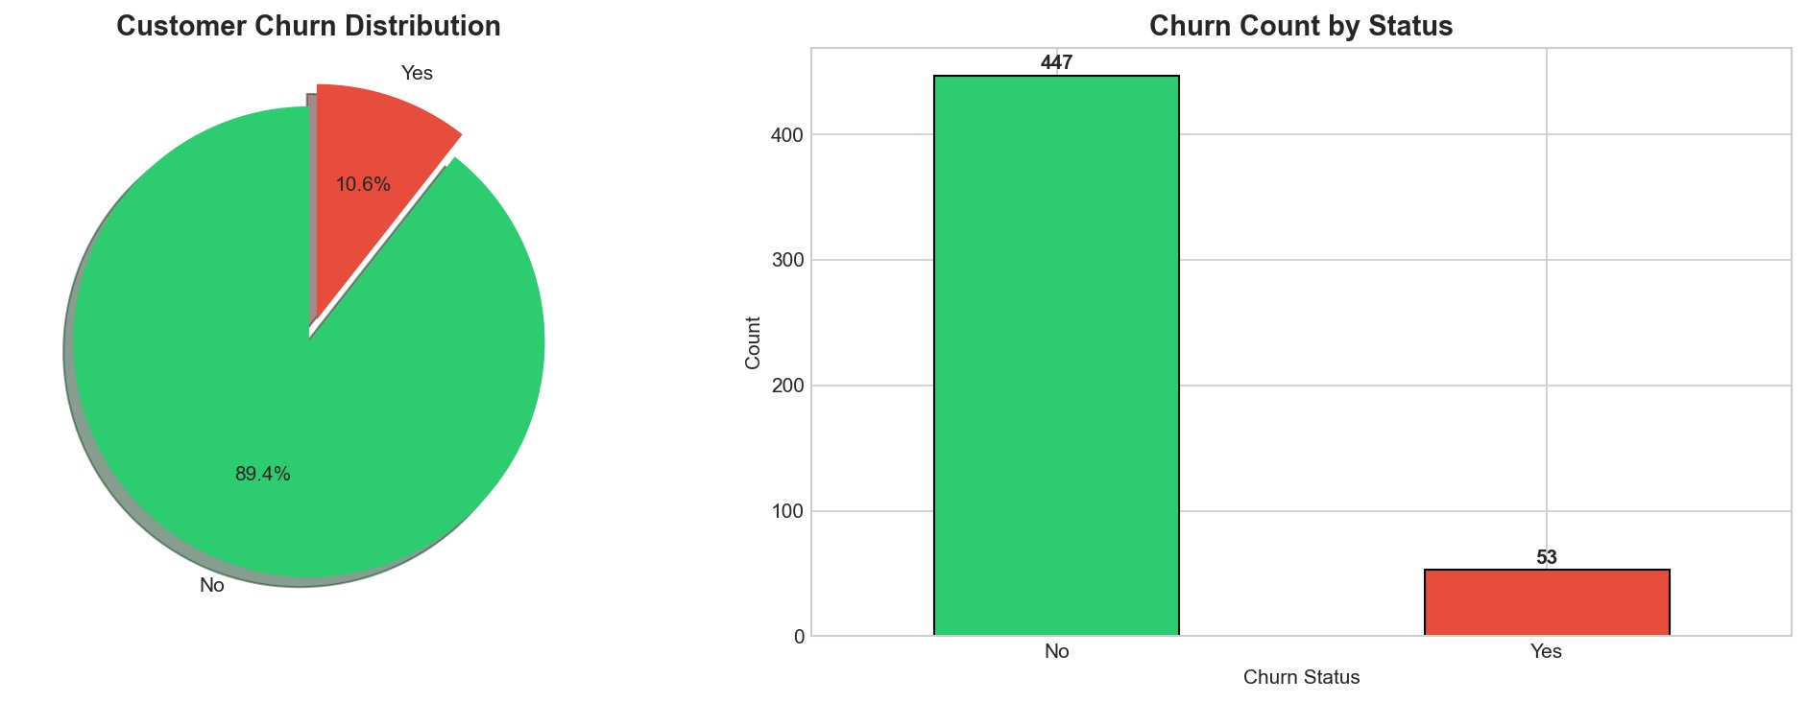
THE BUSINESS PROBLEM
53
Customers Lost
89.4%
Retention Rate
$50K–$75K
OUR GOAL: Identify WHY customers leave and HOW to keep them
Revenue at Risk/yr
Customer Churn Analysis | June 2026

Slide 3
DATASET OVERVIEW
500
9
36.5 mo
$113.64
Customers
Features
Avg. Tenure
Avg. Monthly Charge
Key Features Examined:
Tenure
Duration of customer relationship (months)
Monthly Charges
Monthly billing amount
Contract Type
Month-to-month / One year / Two year
Payment Method
Bank Transfer / Credit Card / Electronic Check
Senior Citizen
Demographic indicator
Paperless Billing
Billing preference
Customer Churn Analysis | June 2026

Slide 4
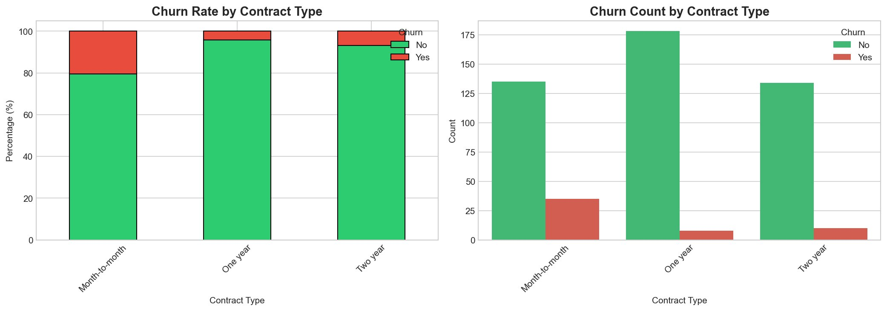
KEY FINDING #1: CONTRACT TYPE MATTERS MOST
20.6%
Month-to-month
HIGH RISK
4.3%
One year
LOW RISK
6.9%
Month-to-month customers are 4.8x more likely to churn than one-year contract customers
Two year
LOW RISK
ACTION: Offer 10-15% discount or 2-months-free to convert month-to-month customers to annual/two-year contracts
Customer Churn Analysis | June 2026

Slide 5
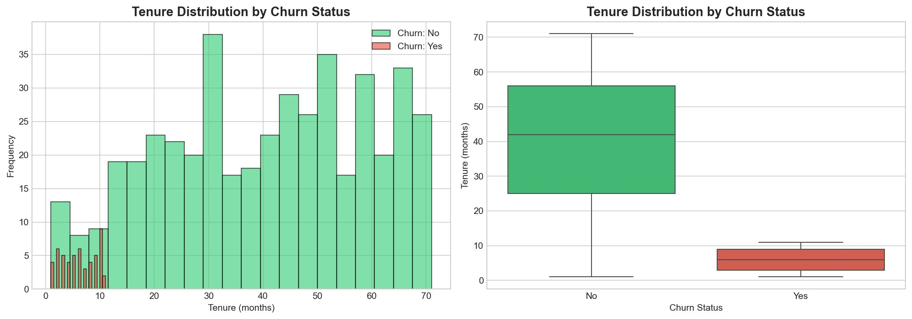
KEY FINDING #2: NEW CUSTOMERS ARE HIGH RISK
6 months
Avg. Tenure — Churned
40 months
Avg. Tenure — Retained
80%
Critical Retention Window: The FIRST 12 MONTHS of every customer relationship
Churned in Year 1
ACTION: Launch a First-Year Success Program — proactive onboarding, weekly check-ins (months 1-3), monthly surveys
Customer Churn Analysis | June 2026

Slide 6
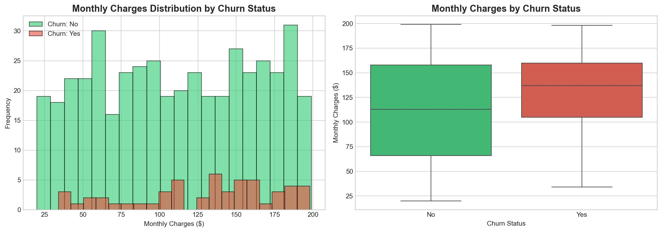
KEY FINDING #3: PRICE AFFECTS RETENTION
$129.77/mo
Churned Customers Pay
$111.72/mo
+16% Price Premium = Higher Churn Risk
Retained Customers Pay
Higher prices create price sensitivity — churned customers pay 16% more on average
ACTION: Review pricing strategy; offer loyalty discounts to long-tenure, high-charge customers
Customer Churn Analysis | June 2026

Slide 7
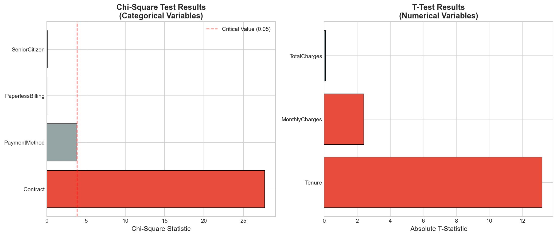
STATISTICAL VALIDATION
Test Results Summary
Contract Type
p < 0.001
✓✓✓
Tenure
p < 0.001
✓✓✓
Monthly Charges
p = 0.016
✓
Payment Method
p = 0.144
✗
Paperless Bill
p = 0.829
✗
Senior Citizen
p = 0.795
✗
✓✓✓ Highly Significant (p<0.001) | ✓ Significant (p<0.05) | ✗ Not Significant
All key findings are statistically validated at the 99.9% confidence level
Customer Churn Analysis | June 2026

Slide 8
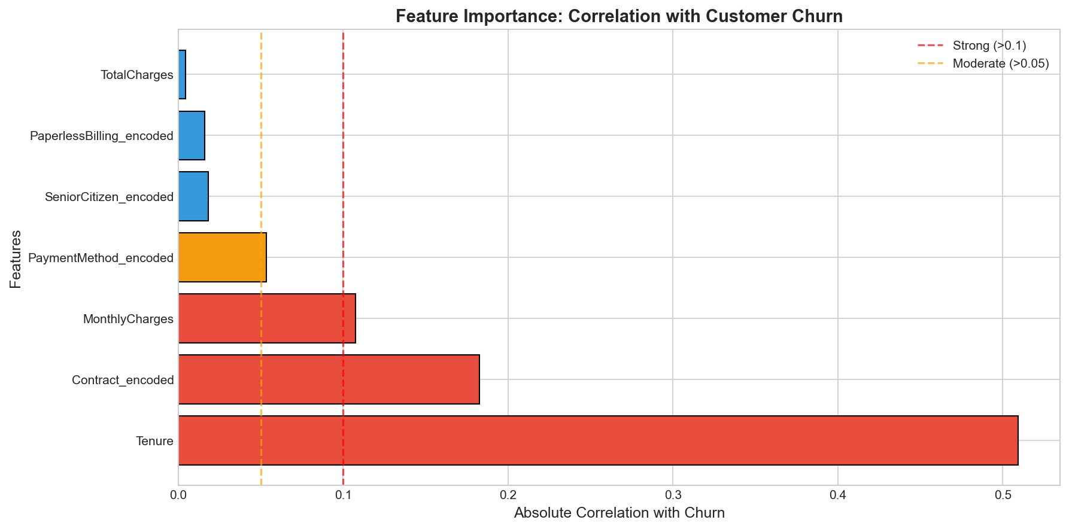
FEATURE IMPORTANCE — WHAT DRIVES CHURN?
Ranked by Impact
#1
Tenure
0.509
#2
Contract
0.183
#3
Monthly Charges
0.107
#4
Payment Method
0.062
#5
Senior Citizen
0.028
#6
Paperless Billing
0.025
#7
Total Charges
0.004
Customer Churn Analysis | June 2026

Slide 9
RECOMMENDED ACTION PLAN
IMMEDIATE (0–3 months)
SHORT-TERM (3–6 months)
LONG-TERM (6–12 months)
1
Launch Contract Upgrade campaign — discounts for annual contracts
1
Implement customer health score system
1
Build predictive churn ML model for proactive intervention
2
Target all 170 month-to-month customers with personalised outreach
2
Set up early warning alerts for at-risk customers (tenure < 12 mo)
2
Develop customer segments with tailored retention strategies
3
Create First-Year Success Program with dedicated onboarding support
3
Create tiered retention offer portfolio
3
Continuous monitoring, measurement, and optimisation
Customer Churn Analysis | June 2026

Slide 10
EXPECTED BUSINESS IMPACT
Scenario: Reduce churn from 10.6% to 8% — a 25% improvement
25%
~13/year
$50K–$75K
Churn Reduction Target
Additional Customers Retained
Annual Revenue Saved
Additional Benefits:
✓ Improved Customer Lifetime Value (CLV) across all segments
✓ Stronger brand loyalty and Net Promoter Score (NPS)
✓ Reduced customer acquisition cost pressure
✓ Valuable data for future predictive modelling and personalisation
Customer Churn Analysis | June 2026

Slide 11
CONCLUSION & NEXT STEPS
Key Takeaways
Next Steps
#1
Contract type is the strongest predictor of churn (p < 0.001)
1. Launch contract conversion campaign immediately
2. Onboard Customer Success team with new framework
#2
First 12 months are critical — 80% of churn occurs in Year 1
3. Deploy early warning system in 90 days
4. Build and deploy predictive ML model by Q4
#3
Price optimisation needed — churned customers pay 16% more
5. Report monthly churn metrics to leadership
Together, these actions can reduce churn to 8% and save $50,000–$75,000 in annual revenue

Slide 12
Thank You
Questions & Discussion
Contract Type:
Strongest predictor — 20.6% vs 4.3% churn rate
Tenure:
Critical first 12 months — 80% churn in Year 1
Monthly Charges:
16% premium — price sensitivity matters
The Developer Arena — Data Analysis Team | June 2026

