Slide 1
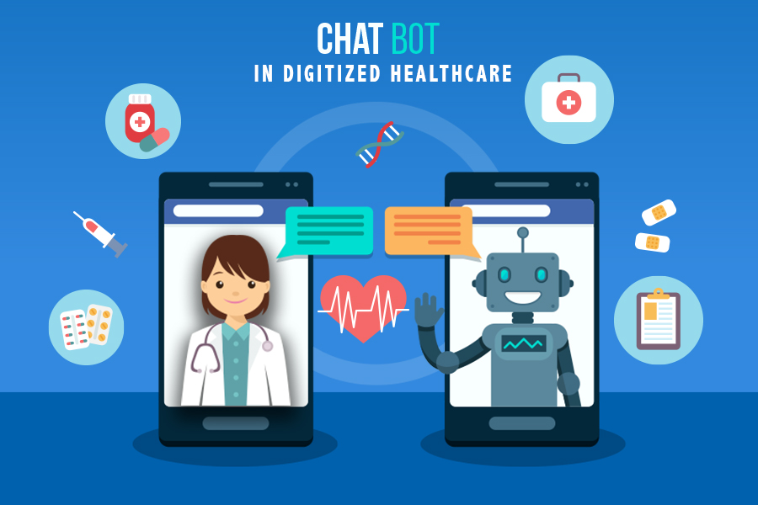
Healthcare Chatbot

Slide 2
Project Description
Our project aims to provide users with a convenient platform to ask questions, seek remedies, and gain understanding about various diseases and health conditions.
Leveraging web scraping techniques, the chatbot gathers relevant data from credible sources, enabling it to offer accurate and informative responses.
For now, we have segregated the scraped data into 3 buckets: information relating to hypertension, cardiovascular health and diabetes.
Users can interact with the chatbot through natural language queries, receiving personalized answers and remedies tailored to their health concerns.
Given a user input, the model is designed to first identify which bucket the query belongs to and then accordingly generates the response using the information sourced from that bucket as per the question posed by the user.

Slide 3
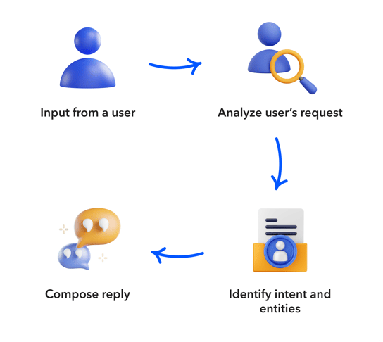
NLP Pipeline
Data Collection : Web scraping techniques to collect data (diseases, symptoms, treatments, remedies, and preventive measures) from relevant healthcare websites and forums using BeautifulSoup (eg. https://my.clevelandclinic.org/health)
Data Preprocessing : Scraped data is preprocessed like text cleaning (lowercase conversion, punctuation marks removal, removing non-ASCII characters, tokenization) and organized into a structured format suitable for analysis.
Word Embeddings : Word2Vec embedding representations are used in the ‘Embedding’ layer of the model. Transfer learning with these pretrained embeddings have improved the model performance with limited available training data.

Slide 4
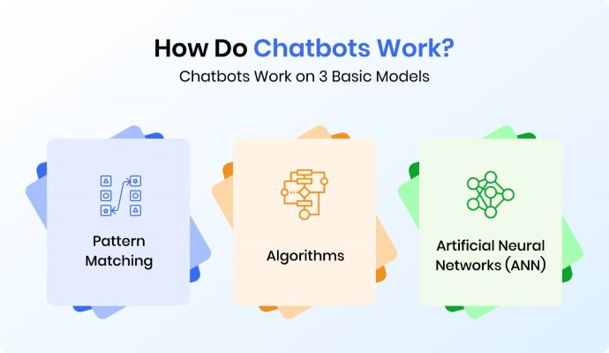
NLP Pipeline (contd.)
Model Training : ML models like intent classifiers and LSTM response generators, are trained using the n-grams of the preprocessed data. Models are fine-tuned to recognize user intents accurately and generate informative responses.
Internal Working : all sequences are padded to ensure uniformity and the model is trained in each of the buckets separately for 100 epochs with ‘Adam’ optimizer, ‘softmax’ activation and ‘categorical cross-entropy’ loss function.
Chatbot Interface : Helper functions are defined to ensure smooth transition between the normal chatbot conversational flow and processing the user input before passing it onto the model. The interface is developed, incorporating NLP capabilities for user interaction, intent recognition, and response generation.

Slide 5
Embedding Techniques
Word2Vec : The code utilizes word embeddings implicitly through the Embedding layer in the LSTM models. The Embedding layer maps each word in the vocabulary to a dense vector representation. In this case, the Embedding layer has a dimension of 100, which means each word is represented by a 100-dimensional vector.
Justification:
Capture semantic relationships between words by representing them as dense vectors in a continuous vector space. This allows the models to learn meaningful representations of words based on their contextual usage in the corpus.
The choice of a 100-dimensional embedding space strikes a balance between capturing sufficient semantic information and computational efficiency. Higher-dimensional embeddings may capture more nuanced semantic relationships but could also increase computational complexity.
Embeddings help the models understand the contextual meaning of words within the sequences of tokens. By learning from the sequential nature of the text data, the models can capture dependencies between words and phrases, leading to more accurate predictions.

Slide 6
Model Architecture
LSTM Model (with transfer learning and pretrained embeddings) for sequence capture and dialogue generation from each of the 3 buckets: Diabetes, Cardiovascular Health, Hypertension.
Architecture:
Input Embedding Layer : converts input sequences of words into dense vectors of fixed size (100 dimensions in this case).
LSTM Layer : network layer with 100 units designed to capture long-term dependencies in sequential data.
Dropout Layer : dropout rate of 0.1 added to prevent overfitting by randomly dropping out a fraction of input units during training.
Output Layer : dense layer with softmax activation, which outputs the probability distribution over the vocabulary size (total_words), predicting the next word in the sequence.
Training : The model is trained using the categorical cross-entropy loss function and the Adam optimizer. The training is conducted for 100 epochs.

Slide 7
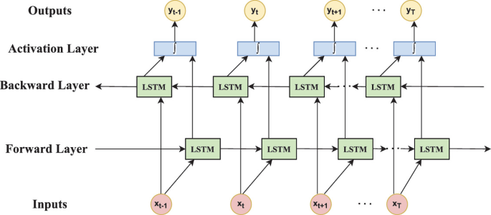
Model Architecture Layout

Slide 8
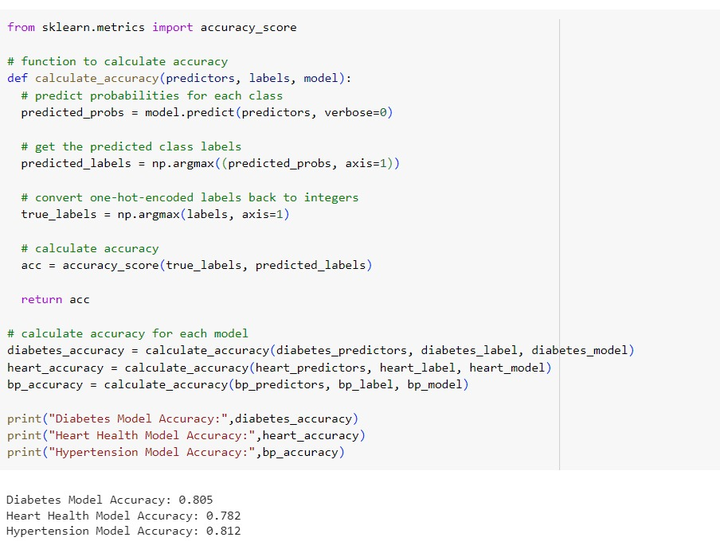
Results & Interpretation
The responses obtained are relevant, informative, and grammatically correct to a large extent ignoring some minor mistakes, which can be avoided by fine-tuning the model further.

Slide 9
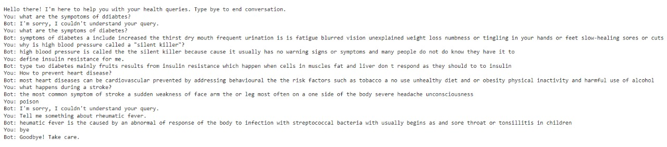
Qualitative Evaluation
The responses obtained are relevant, informative, and grammatically correct to a large extent ignoring some minor mistakes, which can be avoided by fine-tuning the model further.

Slide 10
Practical Applications & Future Scope
Real World Application : The chatbot could be used in healthcare settings to assist users with queries related to the provided buckets in a general and non-specific context like that related to medicine prescription which needs the approval of a certified medical practitioner.
Limitations : The deployment of the chatbot may be constrained by factors such as data quality, domain expertise, ethical considerations, user trust, accessibility, maintenance, and integration challenges.
For now, we have included only 3 buckets due to time constraints, but at a later stage this chatbot can be trained for a variety of different health conditions categorized into several buckets, thereby leading to a multi-faceted chatbot, targeting a wider audience.
The future scope can be extended to including home remedies which can easily be prepared using homemade materials. This is easy but can be very effective a lot many times. This can include ayurvedic medicines. For this dataset needs to web scraped and also surveys can be conducted to get the knowledge from various people since many household homes have different remedies that can cure the same disease like common cold, stomach ache, wounds, etc.

Slide 11
References
JETIR, Chatbot using Natural Language Processing (NLP) Techniques, Sunny Kaushik, Rahul, 2023 (Department of Computer Science & Engineering, Ganga Institute of Technology & Management, Kablan).
JETIR, Dr Bot - Ayurvedic, Allopathic, and Home-made solutions to all your diseases Aash Jain, Jinal Padhiar, Jigar Kadiya and Dr Yogita Mane, 2022.
(IJACSA) International Journal of Advanced Computer Science and Applications, Generating and Analyzing Chatbot Responses using Natural Language Processing, Moneerh, Hadil Shaiba, Marija Bezbradica, 2019.
https://www.analyticsvidhya.com/blog/2021/10/complete-guide-to-build-your-ai-chatbot-with-nlp-in-python/
https://github.com/parulnith/Building-a-Simple-Chatbot-in-Python-using-NLTK

