Slide 1








Shipped by The Voyagers
Arnab Das
Ishani Ray
Priyam Dey
Shruti Singhania

Slide 2





A
B
C
D
E
AGGREGATION PLATFORM
BARS AND
CHARTS
CXR
ANALYSIS
DISEASE
DIAGNOSIS
E-ALERT
SYSTEM

Slide 3
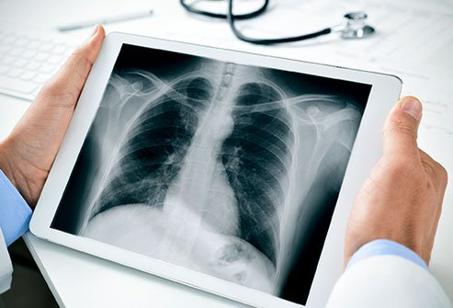




STEP-WISE APPROACH
STEP I
STEP II
STEP III
STEP IV
Capture user data
Upload the Chest X-ray image
Provide diagnosis result
Send a E-mail alert to user and doctor

Slide 4
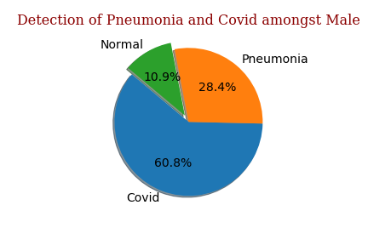
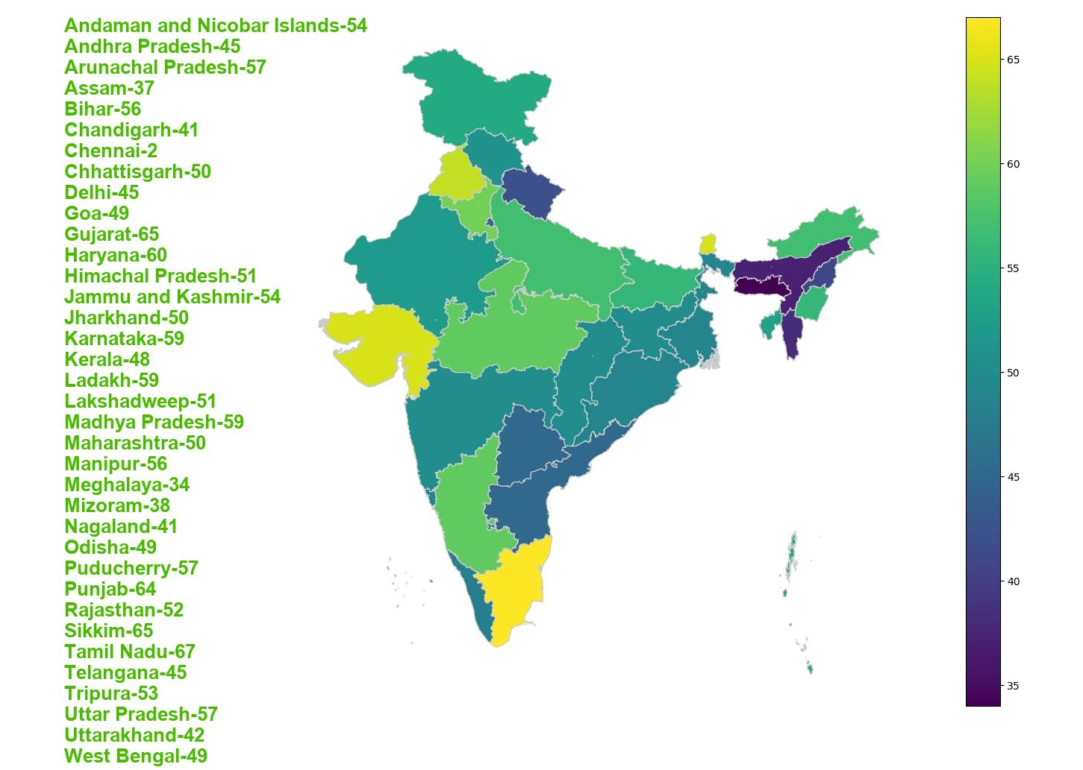
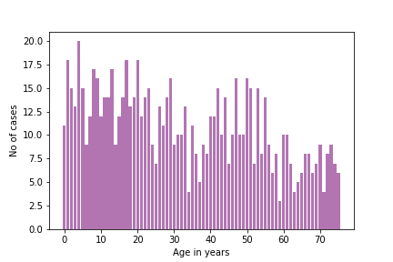
LUNG DISEASE STATISTICS

Slide 5











INFORMATIONAL VIDEOS
ARTICLES ON LUNG
CARE
INFO
DESK
QUIZZES AND TRIVIAS
DOs AND DON’T s
CONTACT INFO OF INTL. LUNG FDNs.

Slide 6


Slide 7











TECH
STACK

Slide 8

FUTURE SCOPE
Deploy to a Kubernetes cluster on AWS
Include more pulmonary diseases
Use DICOM images for analysis and prediction
Add a virtual assistant
Detect severity from Infection Heatmap

Slide 9


The Voyagers

