Slide 1

Bluestock Fintech
Mutual Fund Analytics Project
- Shruti Singhania

Slide 2
Problem & Objective
Project Objective
Data Fragmentation
NAV, AUM, SIP data scattered across AMFI in different formats — no single unified source
Build a full-stack Mutual Fund Analytics Platform that:
→ Ingests NAV / AUM / SIP data via ETL
→ Stores in a normalised SQLite database
→ Computes Sharpe, Sortino, Alpha, Beta
→ Benchmarks vs Nifty 50 / 100 / BSE
→ Surfaces insights via interactive dashboard
No Benchmark Tracking
Investors can't tell if their fund beats Nifty 50 / Nifty 100 without computing tracking error
Slow Reporting
Monthly MF reports are static PDFs. Stakeholders need live, drillable dashboards
2 / 12

Slide 3
Data Sources
All datasets sourced from publicly available, freely accessible AMFI & market data APIs — no proprietary data used.
Source | URL / API | Data Type | Frequency
AMFI India | amfiindia.com | NAV, AUM, Folio, SIP | Daily / Monthly
mfapi.in | api.mfapi.in/mf/{code} | Historical NAV (JSON) | Daily
mfdata.in | mfdata.in/api/v1/schemes/ | NAV + Expense Ratio | Daily
NSE India | nseindia.com/reports | Benchmark Index Prices | Daily
BSE India | bseindia.com | BSE SmallCap Index | Daily
AMFI Monthly Notes | amfiindia.com/research | Industry SIP & Flow Data | Monthly
3 / 12

Slide 4
ETL Architecture
EXTRACT
TRANSFORM
LOAD
mfapi.in REST API
AMFI website scraping
NSE/BSE CSV downloads
Schema normalisation
Date parsing & validation
CAGR / Sharpe / Alpha / Beta
Outlier detection & flagging
SQLite database
Duplicate-key checks
CSV exports for BI layer
4 / 12

Slide 5
EDA Highlights — NAV & AUM
5 / 12

Slide 6
EDA Highlights — SIP & Investor Behaviour
6 / 12

Slide 7
Performance Metrics — Returns & Risk Ratios
Risk-Adjusted Ratios
Fund | Sharpe | Sortino
100033 | 1.09 | 1.83
101206 | 1.03 | 1.80
101207 | 0.16 | 0.28
100016 | -0.20 | -0.35
100025 | -0.57 | -0.94
7 / 12

Slide 8
Performance Metrics — Alpha, Beta & Drawdown
AMFI Code | Alpha | Beta | Max Drawdown | Worst Date
100033 | 0.272 | 0.005 | -16.22% | 2022-05-12
101206 | 0.214 | 0.021 | -11.29% | 2023-07-05
101207 | 0.109 | -0.065 | -35.45% | 2026-05-11
100016 | 0.037 | -0.058 | -24.73% | 2022-09-15
100025 | 0.043 | 0.001 | -4.31% | 2023-07-28
100033
101207
100016
Highest Alpha (0.272) — best outperformer vs benchmark
Worst Drawdown (-35.45%) — recent (May 2026), high risk
Highest VaR / CVaR — biggest tail risk in the portfolio
8 / 12

Slide 9
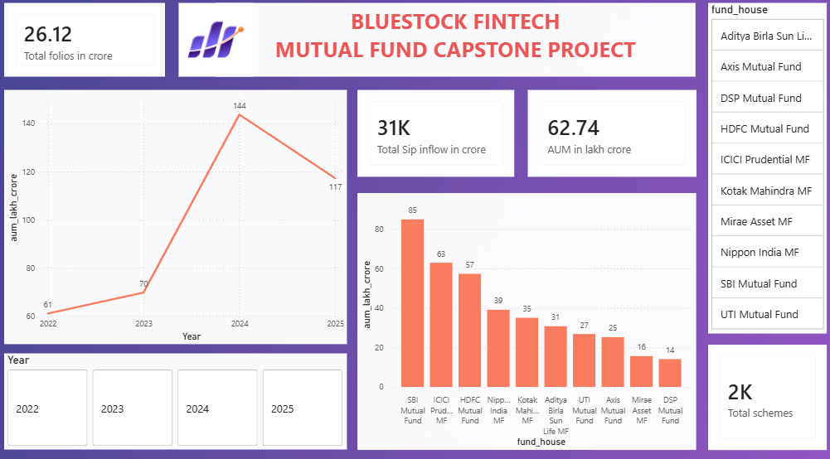
Dashboard — Industry Overview
[ Insert Dashboard Screenshot Here ]
Recommended: Power BI / Tableau — Executive Overview Page
9 / 12

Slide 10
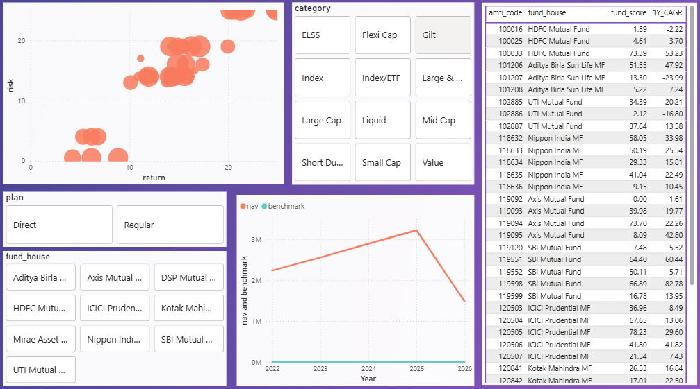
Dashboard — Fund Performance
[ Insert Dashboard Screenshot Here ]
Recommended: Power BI / Tableau — Executive Overview Page
9 / 12

Slide 11
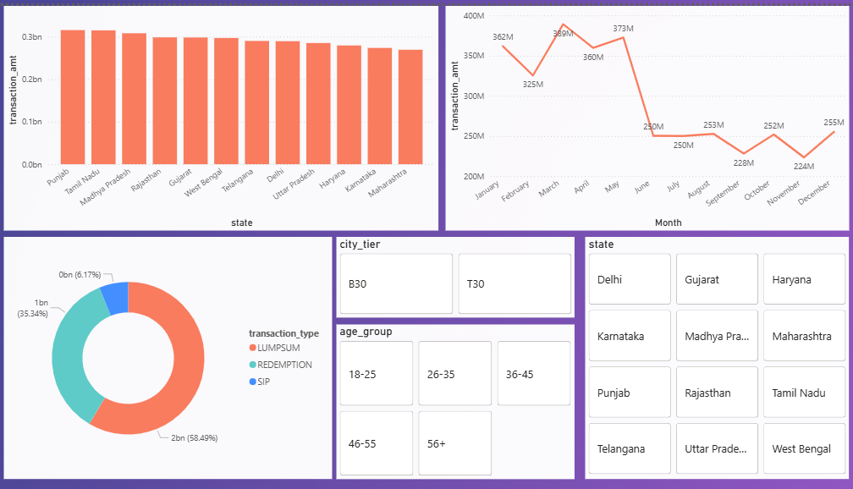
Dashboard — Investor Analytics
[ Insert Dashboard Screenshot Here ]
Recommended: Performance Scorecard / Risk Metrics Page
10 / 12

Slide 12
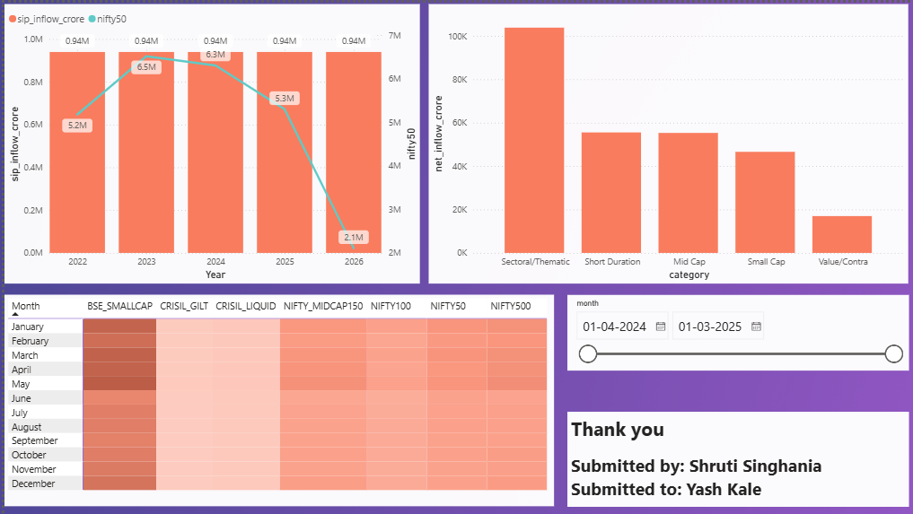
Dashboard — Market Trends
[ Insert Dashboard Screenshot Here ]
Recommended: Power BI / Tableau — Executive Overview Page
9 / 12

Slide 13
Key Findings
NAV grew 73%
100033 = Top Performer
01
Average NAV rose from Rs. 207 → Rs. 358 over 4.5 years, with three distinct market phases
04
1Y CAGR of 53.23%, Sharpe 1.09, Sortino 1.83, Alpha 0.272 — consistently ranks #1
SBI MF leads AUM
101207 = Highest Risk
02
AUM doubled from Rs. 6 → Rs. 12.5 lakh crore (2022–2025). Top 3 AMCs hold ~40% of analysed AUM
05
Max drawdown -35.45% (as recent as May 2026). Negative 1Y CAGR of -23.99%
SIP hit Rs. 31,002 Cr
Young Investors Dominate
03
Monthly SIP inflows grew 170% over the analysis period, hitting a record in Dec 2025
06
26–35 age group is the largest cohort. MP & Punjab lead SIP contributions by state
11 / 12

Slide 14
Thank You

