Slide 1

Programming exercise presentation shruti siva kumar

Slide 2
agenda
Problem Statement
Approach
Implementation & Results
Other Approaches
Discussion

Slide 3
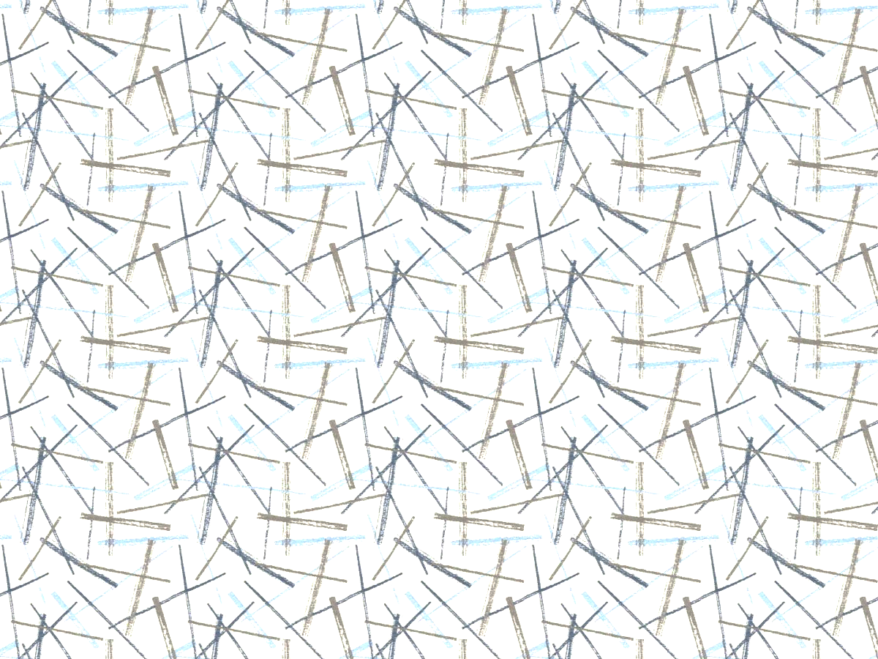

Problem statement
Data: .txt file with coordinates of 2D line segments (x1 y1 x2 y2)
Assumptions:
Two intersecting line segments form a group
Two non-intersecting line segments with a third intersecting line segment form a group
A line with no other intersecting line segment(s) forms its own group
Question: How many groups of line segments exist in the data?

Slide 4
approach
Modules
Shapely: LineString (converts coordinate pairs into line segment objects)
UnionFind: Self-defined class to implement Union-Find Algorithm
Data Pre-processing/ Sanitization
Filter out empty list elements
Rearrange each line internally (left-most x coordinate to the “left”)
Sort entire list of line segments by x-coordinates
Approach
Check for pair-wise intersection
Create groups using the Union-Find Algorithm
Final count of disjoint sets = Number of groups of line segments

Slide 5
approach
Union-Find Algorithm - Pseudocode
MakeSet(n): Initialize an empty union-find object with n items
parent_id[element] = element
rank[element] = 0
Union(x,y): weighted quick union by rank (attaching smaller to the larger tree)
Find(x,y): get parent ids of both elements
if rank[x] > rank[y], then parent_id[y] = x
if rank[y] > rank[x], then parent_id[x] = y
if rank[x] = rank[y], then rank[x] = rank[x] + 1
Find(x): returns parent_id of the element using path compression by halving
while( x != parent_id[x]), parent_id[x] = parent_id[parent_id[x]] (make every other node in path point to its grandparent)
return x

Slide 6
Implementation & results
Implementation 1
Processing time: 148 seconds
Implementation 2
Processing time: 175 seconds
Original list of line segments
Apply union-find and count # groups
Check for pairwise intersections
Internally rearrange line segments (left-most coordinate on the “left”)
Apply union-find and count # groups
Check for pairwise intersections
Notes:
For: lines_286.txt file

Slide 7
Implementation & results
Implementation 3
Processing time: 191 seconds
Implementation 4
Processing time: 240 seconds
Internally rearrange line segments (left-most coordinate on the “left”)
Apply union-find and count # groups
Check for pairwise intersections only if parents are different
List of internally left-sorted line segments again sorted left-to-right
Apply union-find and count # groups
Check for pairwise intersections only if parents are different
Notes:
For: lines_286.txt file

Slide 8
Implementation & results
Implementation | Time (s)
Original list of line segments | 148
Internally rearranged line-segments | 175
Internally rearranged line-segments + Check for existing connectivity | 191
Internally rearranged line-segments + Left-to-right sorted line-segment list + Check for existing connectivity | 240
Notes:
For: lines_286.txt file

Slide 9
Other approaches
Depth-First-Search Algorithm
Optimize traversal of line-segment clusters
Reduce # pairwise comparisons
Convert from 2d problem to 2 1d problems (reduce time complexity)
Divide & Conquer for cluster assignments
Bisect plane and leverage sorted coordinates to identify groups on both sides
Start Union-Find where majority of lines are clustered
Sort by both x and y

Slide 10
discussion
Why sorted coordinates did not yield lesser processing time?

