Slide 1

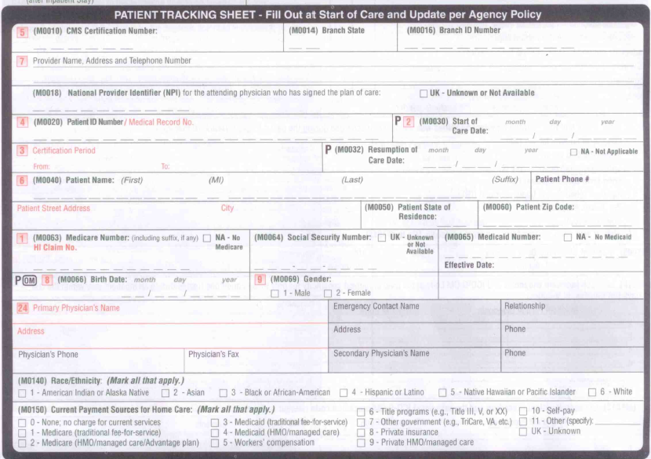
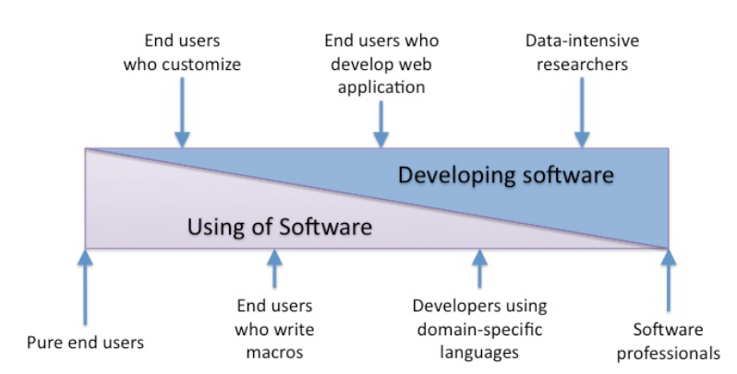
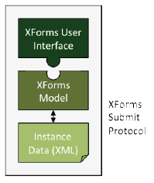
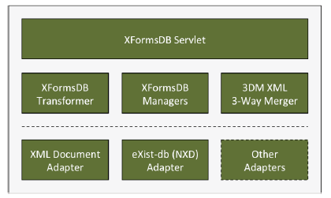
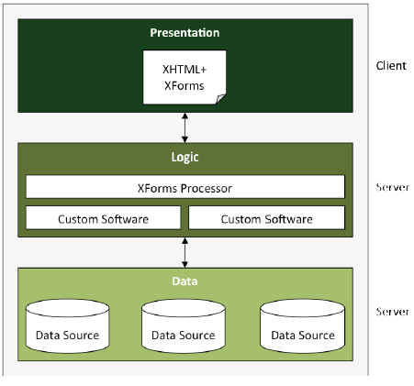
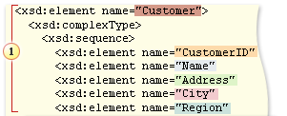
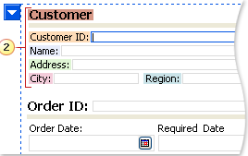
OASIS data collection using XForms
Kashyap Uppuluri, Merin Jose, Shruti Vangari under the guidance of Dr. En Cheng | Department of Computer Science | The University of Akron
Abstract
OASIS-C
Most Web applications are based on a conventional three-tier architecture
The presentation, application logic, and data management are developed and maintained in separate tiers.
Tier-expanding architectural approach that unifies the client-side (presentation tier) and server-side (logic and data tiers) programming under a single model
W3C-standardized client-side markup language, XForms, and its server-side extension
The Centers for Medicare and Medicaid Services (CMS)'s Outcome and Assessment Information Set (OASIS) is a group of data elements that represent core items of a comprehensive assessment for an adult home care patient and form the basis for measuring patient outcomes for purposes of outcome-based quality improvement.
Process
XformsDB
Home Health Agencies (HIA)
For reimbursement
The XFormsDB framework is an extensible Web application framework built upon declarative W3C standards.
It has four major advantages:
One programming language
One data model
It is based on W3C-standardized declarative markup
It has extensibility in all tiers
XForms addresses the most common problems found in HTML forms (e.g., dependency on imperative scripting languages, such as JavaScript) and eases dynamic Web form authoring by using declarative markup.
Collect dataset
OASIS-C
(CMS format)
Submit dataset
Project Stages
XForms
Stage1
Design XForms
Stage2
Data collection interface
Captures elements in the CMS format
XML vocabulary collection
Based on XML schema
It describes the structure of an XML document
XML Vocabulary
Works Cited
Markku Laine, Denis Shestakov, and Petri Vuorimaa. 2012. XFormsDB: an extensible web application framework built upon declarative W3C standards. SIGAPP Appl. Comput. Rev. 12, 3 (September 2012), 37-50. DOI=10.1145/2387358.2387361 http://doi.acm.org/10.1145/2387358.2387361
Materials from Dr. En Cheng and Cleveland Clinic – OASIS-C-SOC-ROC-MedPassForm
World Wide Web Consortium W3C – www.w3.org
Wikipedia, www.wikipedia.org

