Slide 1
Medical Imaging & Visualization
A Presentation by Shruti Vangari Under the guidance of Dr. Xiao

Slide 2
Outline of this project
Aim: To help doctors diagnose cancer faster
Data used : Collection of brain samples of patients detected with cancer
Idea : Filtering of edges of these medical images can help fasten the process of detecting tumor
Algorithm : Canny Edge Detection

Slide 3
Terminology
Medical Imaging:
Process to create images of the human body for clinical purposes
Visualization:
Representing information as Computer Graphics
VTK(Visualization toolkit) and ITK(Insight Segmentation and Registration Toolkit) :
Computer graphics, image processing & visualization

Slide 4
Medical Terminology
Nuclear Medicine (NM):
Application of radioactive elements – radiopharmaceuticals in the diagnosis and treatment of disease
Medical Resonance Imaging (MR):
Medical technique used in radiology to visualize internal structures of the body

Slide 5
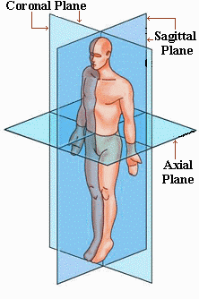
Medical Topology

Slide 6
Steps followed – Step 1
Step 1 – Collect Samples
MR and NM samples of the following time periods:
Baseline
Baseline + 2 months
Baseline + 4 months
Baseline + 7 months
Baseline + 10 months
Baseline + 12 months
Baseline + 15 months
Baseline + 17 months
Baseline + 21 months
Baseline + 25 months

Slide 7
Steps followed – Step 2
Step 2 – Setup the system and software
Download Cmake
Download VTK
Download VTK data
Download ITK Insight Applications
Download ITK Insight Toolkit
Build all the software as per the steps
Write a sample program to build the binaries

Slide 8
Steps Followed – Step 3
Step 3 - Canny Edge detection Algorithm
Gaussian filter – to smoothen image & reduce noise
Gradient Magnitudes – Gradient vector of an image
Non-Max suppression – Sets to 0 if pixel is not a peak
Canny Output Edges – Got after thresholding and linking the edges

Slide 9
Steps followed – Step 4
Step 4 – Canny Edge Detection in VTK
"vtkSmartPointer.h"
"vtkDICOMImageReader.h"
"vtkImageGaussianSmooth.h"
"vtkImageActor.h"
"vtkRenderer.h"
"vtkRenderWindow.h"
"vtkRenderWindowInteractor.h"
"vtkImageGradient.h"
"vtkImageMagnitude.h" vtkImageNonMaximumSuppression.h"
"vtkImageConstantPad.h"
"vtkImageToStructuredPoints.h"
"vtkLinkEdgels.h"
"vtkThreshold.h"
"vtkGeometryFilter.h"
"vtkSubPixelPositionEdgels.h"
"vtkStripper.h"
"vtkPolyDataMapper.h"
"vtkJPEGReader.h"
"vtkTextProperty.h"
"vtkTextActor.h"

Slide 10
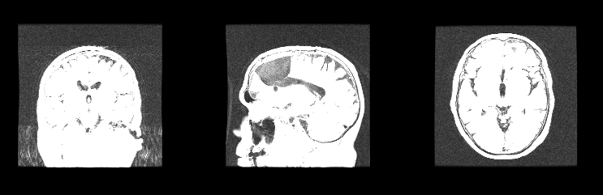
Input Data Used
MR Data
Coronal
Saggital
Axial

Slide 11
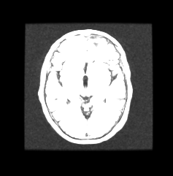
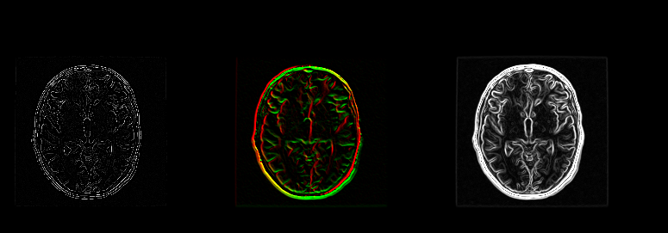
Canny Edge Detection - Output
Gaussian Smoothed
Gradient Magnitudes
Canny Edges
Non-Max Suppression

Slide 12
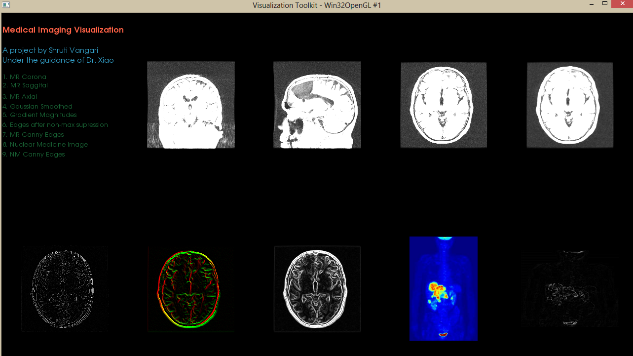
Results - Final Output

Slide 13
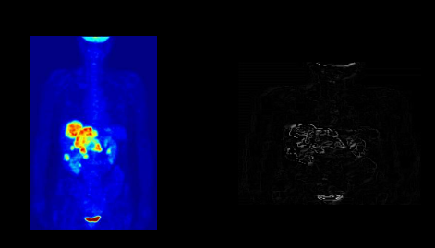
Other image filtering - NM
NM Data
Input NM Data
Canny Edges

Slide 14
Conclusion
The Canny Edge Detection algorithm uses a multi-stage algorithm to detect edges in images.
It finds “optimal” edges implying
Good Detection
Good Localization
Minimal Response
Hence, one gets accurate results. The same was proved in his paper as well – cited in the references

Slide 15
Future Work
To use ITK
Use the concept of FUSION – MR + NM
Detect edges for the fused image – faster and more accurate results
To find edges for all the data collected : Baseline to Baseline + 25 months.

Slide 16
References
Visualization slides prepared by Dr. Xiao http://cs.uakron.edu/~xiao/
Wikipedia, the free encyclopedia http://www.wikipedia.org/
VTK Kitware http://www.vtk.org/
ITK Kitware http://www.itk.org/
Cmake Kitware http://www.cmake.org/
Cancer data samples collected from https://public.cancerimagingarchive.net/ncia/home.jsf
Canny Edge Detection http://www.cse.iitd.ernet.in/~pkalra/csl783/canny.pdf
Image Processing Algorithms
J Canny. 1986. A Computational Approach to Edge Detection. IEEE Trans. Pattern Anal. Mach. Intell. 8, 6 (June 1986), 679-698. DOI=10.1109/TPAMI.1986.4767851 http://dx.doi.org/10.1109/TPAMI.1986.4767851

