Slide 1
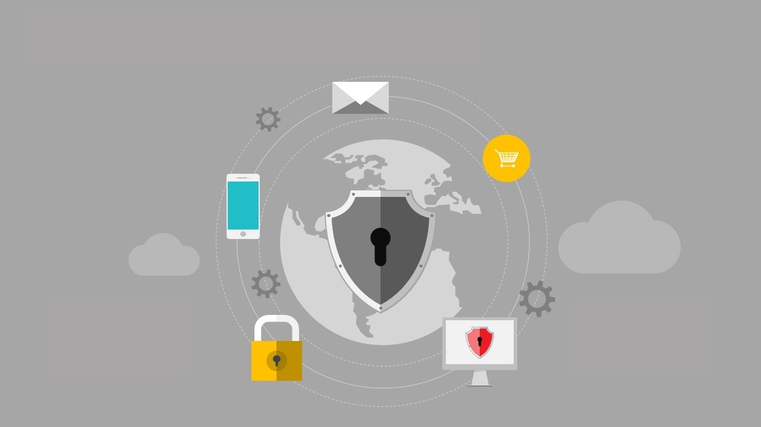
Ransomware - A billion dollar virus
Presented By:-
Shruti Varade
Pritam Padhye
For
Computing for sustainable Global Development
IEEE Conference ID - 42835

Slide 2
Agenda:
What is Ransomware
Introduction
History
Working
Solution
Future of ransomware
References

Slide 3
What is Ransomware:
‘Ransomware’ is a type of malware that attempts to extort money from a computer user by infecting and taking control of victims machine, or the files or documents stored on it
Typically, the ransomware will either ‘lock’ the computer to prevent normal usage, or encrypt the documentation and files on it to prevent access to saved data

Slide 4
Introduction:
Ransomware is actually a malware that infects the victim’s system to make it either difficult to use or makes it unusable.
There are two broad types of Ransomware they are as follows:-
Encryption Ransomware .
Locky type of Ransomware.

Slide 5
Types of Ransomware
Encryption: The data is encrypted using a military grade encryption or a 128 bit standard encryption
Locky type: This type of ransomware where the screen is covered with a ransom message to pay some amount to the hacker to unlock the system.

Slide 6
History:
1989 AIDS trojan
2006 Archievus
2011 The Unnamed Trojan
2012 Reveton
2013 Crypto locker
2014 Crytodefence
2014 Sypeng and Kolar
2015 Lockerpin
2016 Locky
2016 Petya
2017 Wannacry

Slide 7
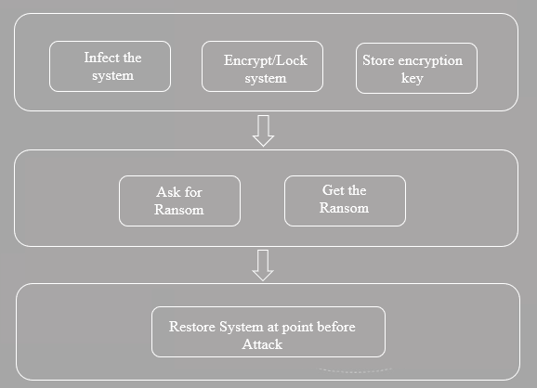
Working:

Slide 8
Impact Analysis:
Π = ∑_{i}^{N} (p_{i} – c) li – F
Where N is the number of people attacked
p_{i} is the ransom asked of a person i
c is the cost of dealing with any ransom money
l_{i} is an indicator variable that takes value 1 if pi<= vi and 0 otherwise
F is the fixed cost of operating the malware.

Slide 9
Preventives:
Password selection criteria
DMZ hardening
Logger software.
Regular patching
Avoid social engineering as long as possible
Two factor authentications

Slide 10
Proposed Solution:
Get a live CD of Kali/Ubuntu Linux and go for using a live CD.
Boot into the Linux operating system using the live CD.
After booting go to application and install a Linux antivirus like Clam TK or any other Linux antivirus.
Run a full scan of the disk and select the drive victim want to scan victim will be able to find the malicious code and can be removed with an option of removal or quarantine.
Insuring the removal of malicious file victim can remove the CD and normal boot the computer.
The ransomware will be absent now.

Slide 11
Future of Ransomware
Social Blackmail.
Household to ransom.
Transport Hacks.
Breaking Factory lines.
Digital Lifestyle.

Slide 12
References:
Savita Mohurle, Manisha Patil volume 8, No. 5, May-June 2017 International journal of advanced research in computer science, A study of Wannacry Threat: Ransomware Attack 2017.
S. mahmudha Fasheen, P. Kanimozhi, B. Akora Murthy, Volume 5, issue 1, IJDER, Detection and avoidance of Ransomware.
www.slideshare.net

Slide 13
Thank You

