Slide 1
Iot based hazardous gas monitoring system
Presentation on:

Slide 2
Group no. 13
Guided by:
Prof. Kamlesh Chandravanshi
Team Members:
1. Prajwal Rajput
Roll no. 78
Enrollment no. 0103IT181079
2. Shruti Verma
Roll no. 106
Enrollment no. 0103IT181107

Slide 3
Presentation outline:
Introduction
Objectives
Technology Platform Overview
Requirement Specification
Methodology
Working
Result
Snapshots
Conclusion

Slide 4
Introduction
The technology is growing day by day, with this rise in technology we have not succeeded to take care of our environment in which we live, Thus we have polluted the surrounding. Toxic air cannot be detected as it can be colourless, odourless and tasteless. Hence there is an increasing demand for the environmental pollution control and monitoring systems. In the view of the ever-rising pollution sources with hazardous chemicals, these systems should have the provisions to detect the sources quickly. Hazardous gases are one that causes health problems, but are also used in industries in large quantities.
These gases have to be monitored such that rise in the normal level of them could be detected and suitable safety measures can be taken. But the present systems available are not so handy, are expensive and hard to implement. So a IoT based system which is handy and portable designed using NodeMCU Microcontroller with a UI as Blynk Application for the purpose of detection of toxic gas leakage and for alerting which in turn neglects the dangers that have adverse effects on human lives.

Slide 5
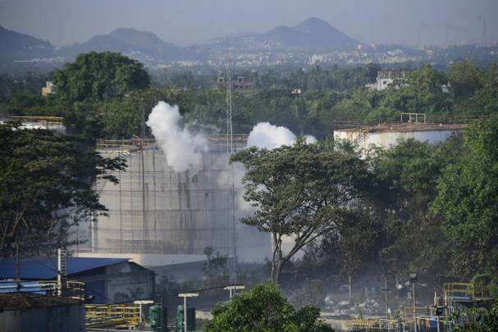
Recent industrial Accident
At Vishakhapatnam(A.P)
on 7 May 2020
Pic.1 : Smoke is seen at LG Polymers plant in Visakhapatnam. People in the Gopalapatnam area, where the chemical plant is located, complained of irritation in eyes, breathlessness, nausea, and rashes on their bodies. As many as 25 people are critical and close to 1000 people have been evacuated.

Slide 6



Pic. 2 :This incident evoked memories of Bhopal gas tragedy in 1984 when a gas leak at a factory of US chemical firm Union Carbide killed thousands. In this picture, dead cattle affected by a gas leak at the LG Polymers Plant is seen in Visakhapatnam.

Slide 7

Pic. 3: People affected by the gas leak at the LG Polymers Plant are transported in a ambulance in Visakhapatnam. The leak is suspected to have been from large tanks left unattended because of the nationwide lockdown to fight COVID-19, (as per news reports).

Slide 8
OBJECTIVE
Safety place a major role in today’s world and it is necessary that good safety systems are to be implemented in places of education and work. This work modifies the existing safety model installed in industries and this system also be used in homes and offices. The main objective of the work is designing handy and portable toxic gas monitoring system, which shows live gas level and alerting message if gas leakage detects. The hazardous gases like LPG, methane and carbon monoxide should be sensed and displayed each and every second on Blynk server.

Slide 9
Technology platform
Internet of Things (IoT): The Internet of Things(IoT) refers to a system of interrelated, internet – connected objects that are able to collect and transfer data over a wireless network without human intervention .
Back End : C/C++ for Arduino IDE
User Interface : Blynk Application
Communication Medium : Wi-Fi

Slide 10
Requirement SPECIFICATION
HARDWARE
NodeMCU
MQ2 Sensor
Buzzer
LED Green/Red
Resistor 220 ohm
Breadboard
Jumper Wires
SOFTWARE
Arduino IDE
Blynk Application

Slide 11
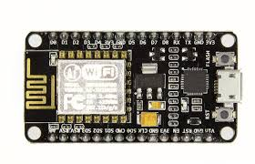
Nodemcu
NodeMCU is a low-cost open source IOT platform. It initially included firmware which runs on ESP8266 Wi-Fi System-on-a-chip (SOC). The ESP8266 can be programmed using the Arduino IDE programming environment.
Figure 1: NodeMCU

Slide 12
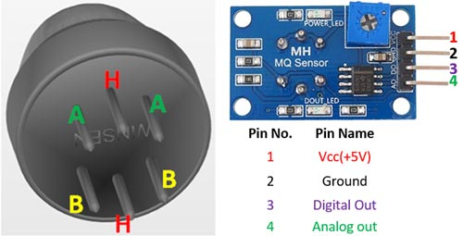
Mq2 Sensor
MQ2 gas sensor is an electronic sensor used for sensing the concentration of gases in the air such as LPG, propane, methane, hydrogen, alcohol, smoke and carbon monoxide. It contains a sensing material whose resistance changes when it comes in contact with the gas. This change in the value of resistance is used for the detection of gas. MQ2 is a metal oxide Semiconductor type gas sensor. This sensor works on 5V DC voltage. It can detect gases in the concentration of range 200 to 10000ppm.
Figure 2:MQ2 Gas Sensor

Slide 13
Arduino IDE
The Arduino IDE is a cross-platform application (for Windows, macOS, Linux) that is written in the programming language Java, C, C++. It is used to write and upload programs to Arduino compatible boards, but also, with the help of 3rd party cores, other vendor development boards. It also supports the languages C and C++ using special rules of code structuring.
The Arduino IDE contains a text editor for writing code, a message area, a text console, a toolbar with buttons for common functions and a series of menus. Programs written using Arduino Software are called sketches.

Slide 14
Blynk Application
Blynk was designed for the Internet of Things. It can control hardware remotely, it can display sensor data, it can store data, visualize it and do many other cool things.
There are three major components in the platform:
Blynk App - allows to create amazing interfaces for projects using various widgets we provide.
Blynk Server - responsible for all the communications between the smartphone and hardware. You can use our Blynk Cloud or run your private Blynk server locally. It’s open-source, could easily handle thousands of devices.
Blynk Libraries - for all the popular hardware platforms - enable communication with the server and process all the incoming and outcoming commands.

Slide 15
Blynk Setup
Install Blynk application from play store or iOS app store.
Open Blynk App and tap on New Project
Enter a name of the project, Choose device as NodeMCU and tap on Create.
An Auth Token will be sent to registered email address. Tap on OK
Now tap on the highlighted icon to add widgets
Scroll down and select Gauge
Scroll down and select Notification widget
Tap on Gauge and configure it with below parameters.
Finally Blynk Project is ready. Press the triangular play button to start.
Once project is ready and the hardware is connected with Blynk then it will show the gas level.

Slide 16
Methodology
The functionality of system is divided into three main steps.
Step 1- The gas leakage is detected by the gas sensor. This detects the gas leakage and gives the signal to the microcontroller.
Step 2- In second step the microcontroller receives the signal, which sends by gas sensor.
Step 3- It sends activation signal to other external devices.

Slide 17
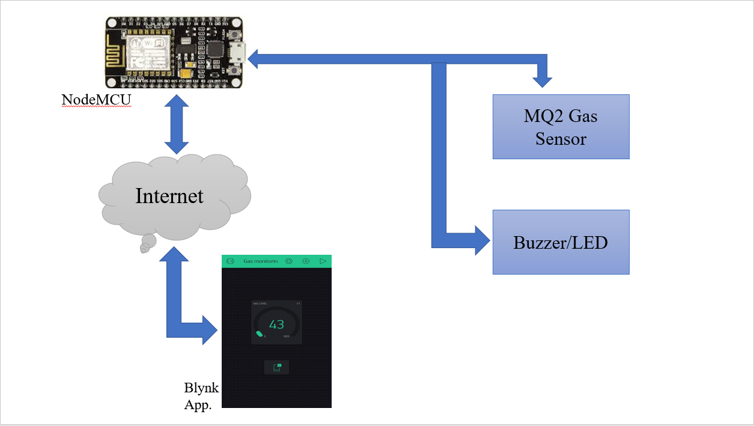
Figure 3: Working chart

Slide 18
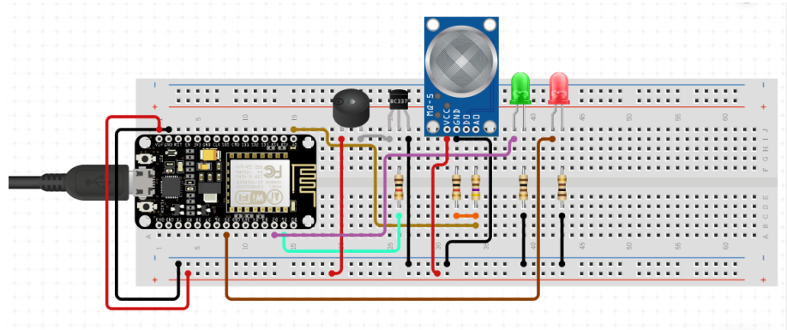
Circuit Design
Fig. 4: Circuit diagram of hazardous gas monitoring system

Slide 19
Connections
NodeMCU Vin to Bus POS.
NodeMCU GND to Bus GND.
VCC of MQ-5 to Bus POS.
GND of MQ-5 to Bus GND.
A0 of NodeMCU to A0 of MQ-5 Sensor.
Buzzer POS to Bus POS.
Buzzer negative to bus ground .
Green LED Vin to NodeMCU D2.
Red LED Vin to NodeMCU D5.
Green LED GND to Bus GND.
Red LED GND to Bus GND.

Slide 20
working
Sensor senses the gas and gives data to microcontroller NodeMCU. In this system NodeMCU works as both Microcontroller and Wi-Fi module, NodeMCU takes data from Sensor and as per coding give data to Blynk Application which shows live gas level on portable device and if gas leakage occurs our green LED glows, Buzzer gives beep sound and alerting notification pop-up’s on Mobile phone.

Slide 21
result
The RED light will be ON indicating no gas leakage detected. The buzzer will also be is OFF state. In Case any gas detected and the gas level increases beyond 200, then green light and Buzzer will turn ON indicating gas leakage. We will also get notified by Blynk app as an alert.

Slide 22
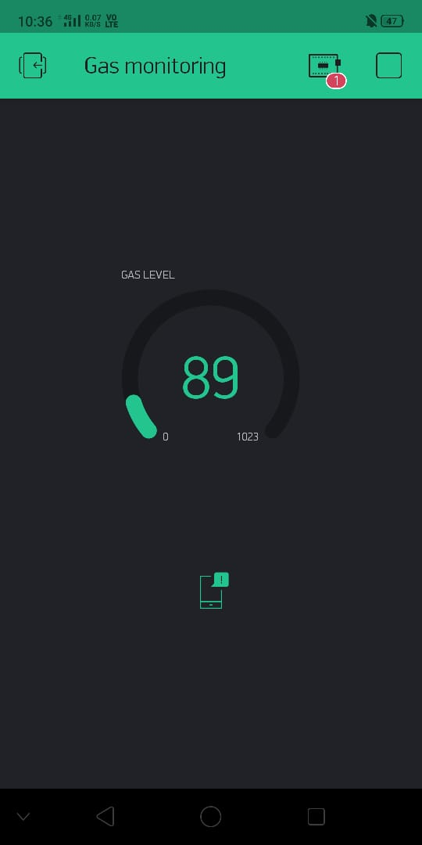
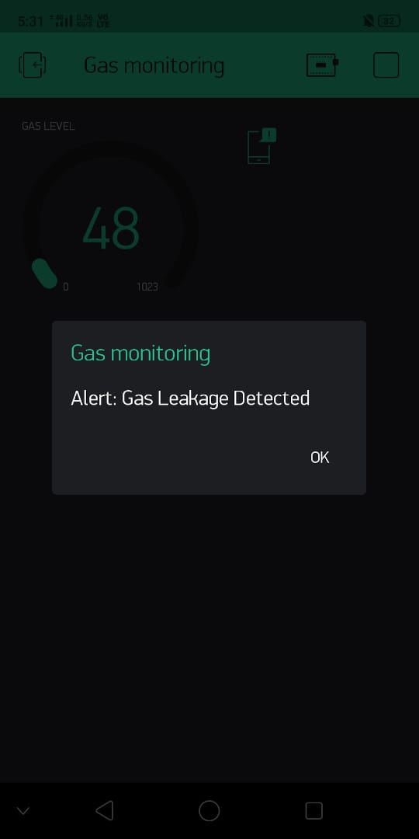
Snapshot
Gas level in Blynk App.
Gas Alert Notification

Slide 23
Conclusion
In this project, the idea proposed would be another step towards automation. This system would considerably reduce human intervention in the monitoring of the toxic gases and hence will save much time. It will also ensure human safety by preventing accidents due to gas leakage through portable device when there is gas leakage. This system can be scaled for use in industries where heavy pipelines and cylinders are used. The proposed system when successfully implemented can also be used in mines where gas sensors will detect leakage of toxic gases and can send a signal for the emergency evacuation of workers.
In this system we have describe a new approach for gas leakage detection system at a low concentration. The leakage is detected with the help of MQ-2 gas sensors. Sensor sends a signal to microcontroller. In the next step microcontroller sends an active signal to other externally connected devices. A quick response rate is provided by this system. With the help of this system the critical situations can be solved quickly over the manual methods which require large amount of time.

Slide 24
THANKYOU

